Slide 1



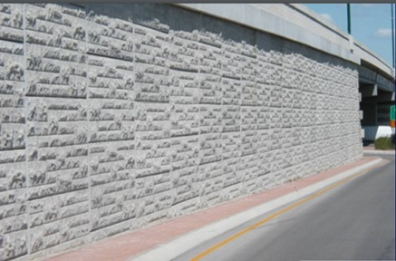
Maintenance Guidelines for MSE Walls – TRC2104
Michelle L. Barry, PhD, PE
Associate Professor, Civil Engineering
mlbernha@uark.edu
Richard A. Coffman, PhD, PE, PLS
Associate Professor, Civil Engineering
rick@uark.edu
Ruimin Feng, PhD
Postdoctoral Researcher, Civil Engineering
rf015@uark.edu

Slide 2

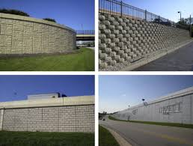
Mechanically Sabilized Earth (MSE)
Reduces Use of Heavy Equipment
Simple & Fast Construction
Various Shapes and Orientations
Reduces Land Required
Less Site Preparation Required
Can Build on Poor Soils

Slide 3
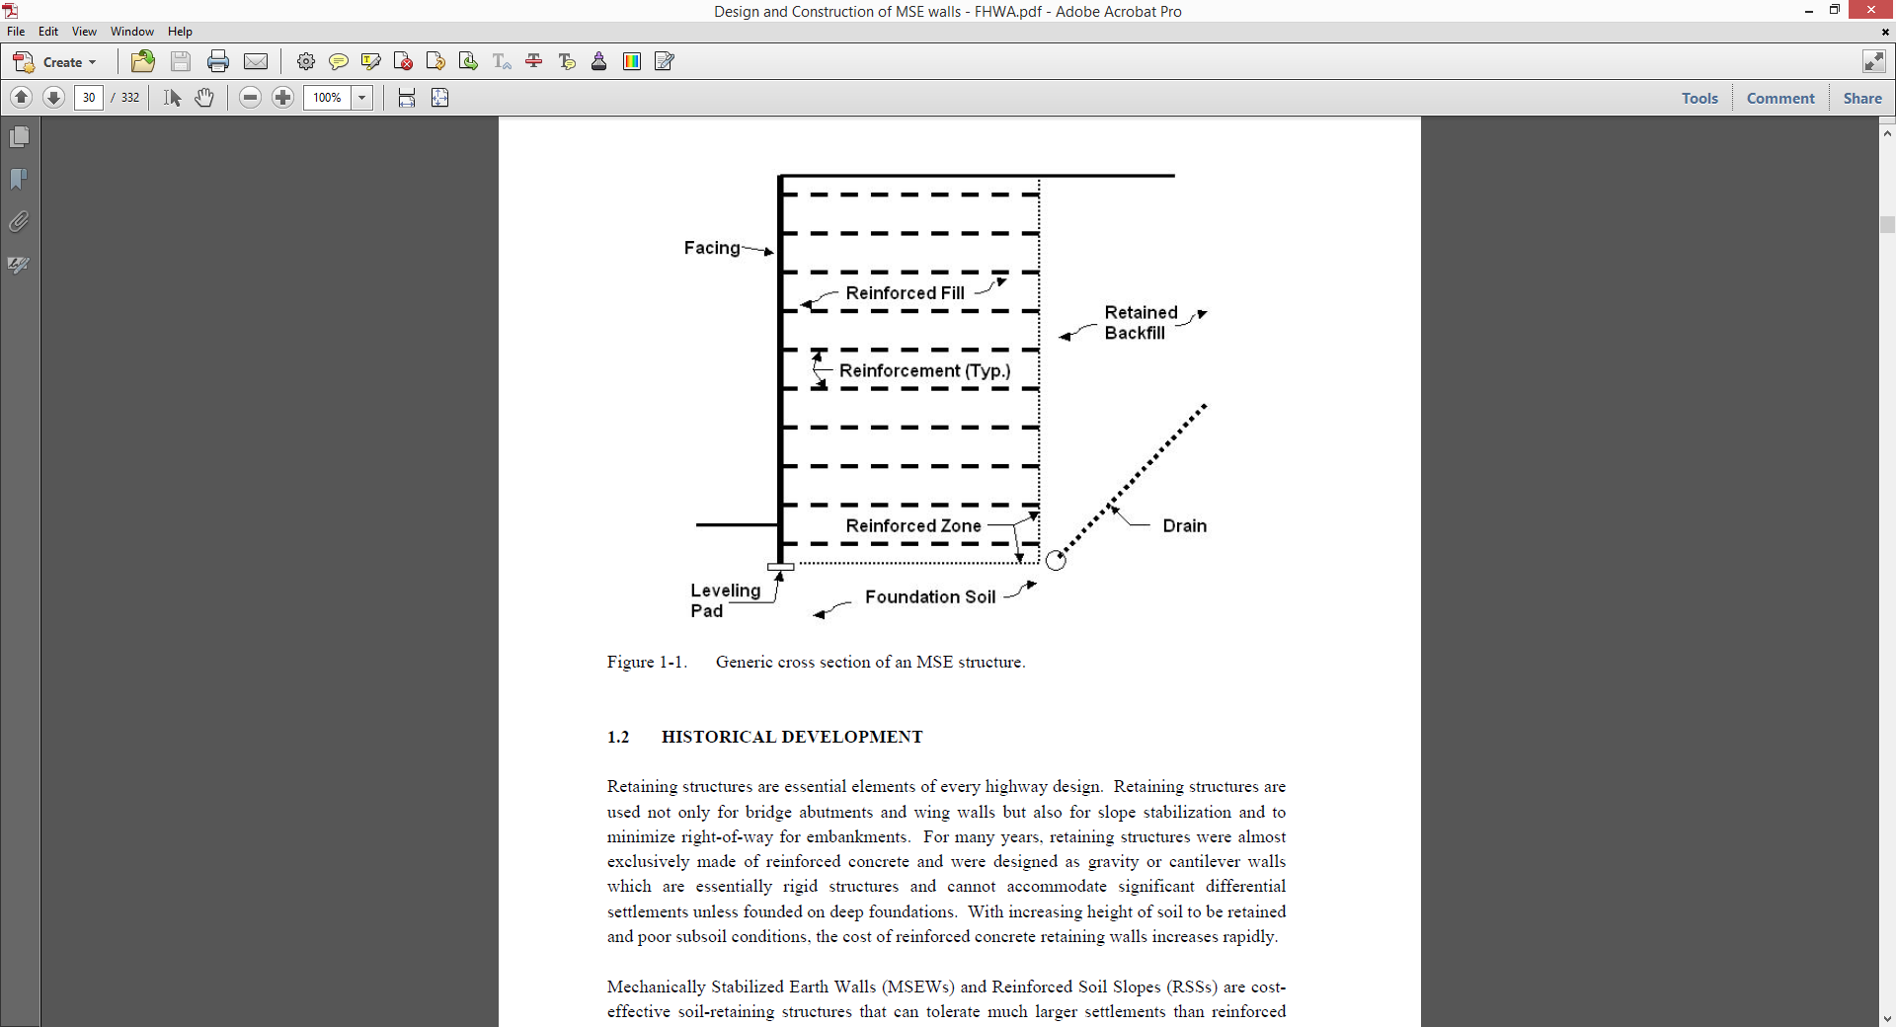
MSE Wall Systems
Item | Advantages
Construction | Simple and rapid procedures No special skills or large equipment required Less site preparation required
Design | Reinforcement improves strength of the soil Very steep slopes and vertical walls allowed No special foundation typically needed Technically feasible to heights over 100 ft
Settlement | Can tolerate much larger settlements associated with poor subsurface soils
Land Use | Less ROW required typically Less space in front of wall required during construction
Cost | Unit cost decreases as height increases Pre-fab components and rapid construction result in large savings over traditional systems
Appearance | Panel facing allows for custom aesthetics

Slide 4
MSE Wall Systems
System | Reinforcement Detail | Face Detail (typical)
*Reinforced Earth® (Reinforced Earth Company) | Ribbed galvanized steel strips, 0.157 in. thick, 2 in. wide, or galvanized steel ladder strips, W10 wire, two longitudinal wires and cross bars spaced at 6 in. | Cruciform and square shaped precast concrete nominally 5 ft x 5 ft x 5.0 to 5.5 in. thick. Also rectangular shaped precast concrete nominally 5 ft x 10 ft x 5.5 in. thick. Variable height panels used at top and bottom of wall.
*Reinforced Earth® (Reinforced Earth Company) | Rectangular grid of W11, W15 or W20 galvanized steel wire, 24 x 6 in. grid. 2, 4, 5 or 6 longitudinal bars. Stainless steel mesh used in marine and corrosive environ. | Hexagonal and square precast concrete 5 ft x 5 ft x 5.5 in. thick. Also rectangular shaped precast concrete 5 ft x 10 ft x 5.5 in. thick. Variable height panels used at top and bottom of wall.
*ARES (Tensar Inter. Corporation) | High Density Polyethylene (HDPE) Geogrid | Precast concrete panel; rectangular 9 ft wide, 5 ft high, 5.5 in. thick.
Mechanically Stabilized Embankment (California DOT) | Rectangular grid of W11, W15, and W20 galvanized welded wire mats, 6 longitudinal wires with variable transverse spacing. | Precast concrete; 5 ft square, 6 in. thick.
*Welded Wire Wall (Hilfinker Retaining Walls) | Welded steel wire mesh, galvanized or non-galvanized. Mesh reinforcements vary in spacing and gauges to meet project design specifications. | Welded steel wire mesh, 2’ tall x 8’ wide typical. Backing mat, hardware cloth or filter fabric depending on project. (With geotextile or shotcrete, if desired).
SYSTEM
Reinforcement Type
Stress Transfer
Facing Type
Select Fill
Site Drainage

Slide 5
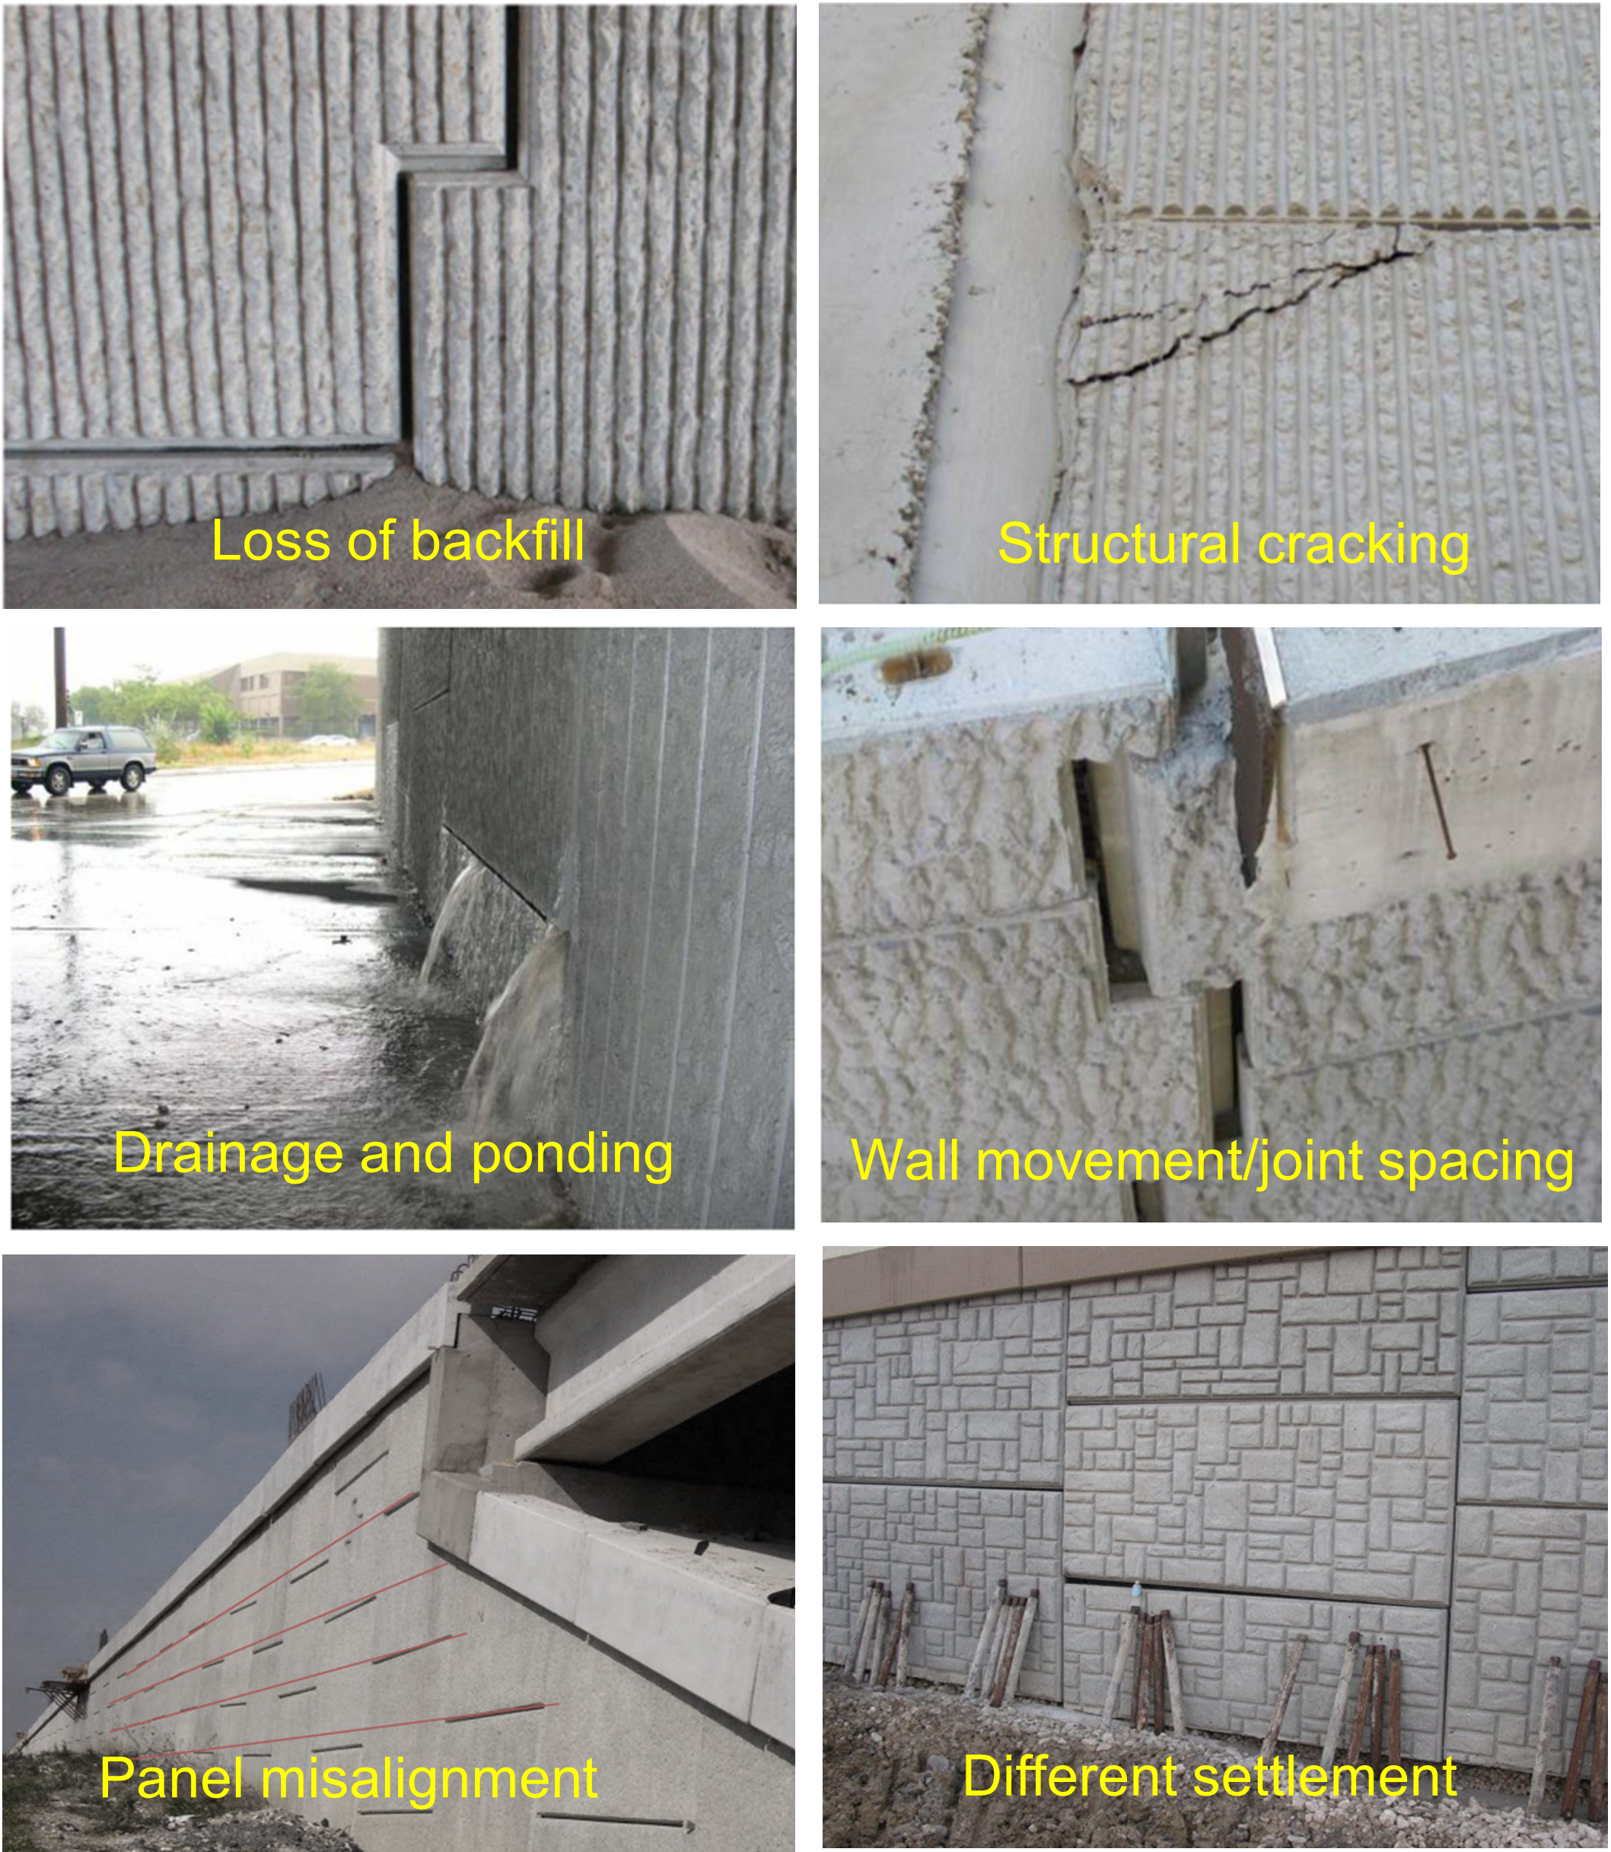
Disadvantages of MSE walls
Numerous system designs, reinforcement types, etc.
Typical Maintenance Concerns
Disconnect between design and construction practices and specifications
Poor performance can lead to maintenance headaches
Limited maintenance guidance
Notes:
Numerous designs - can make it difficult to categorize for post-construction monitoring and maintenance

Slide 6
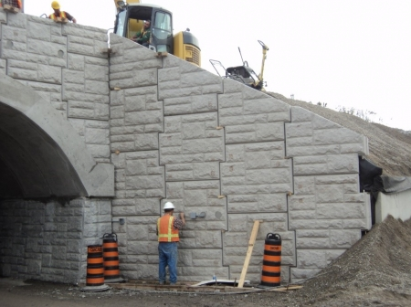
Critical Issue
There is little to no guidance regarding post-construction monitoring and appropriate repairs for given distress signs or performance metrics.
Only 2 of 33 states reported having MSE wall maintenance handbooks
These handbooks had very little information on actual post-construction practices
Very little guidance on repairing versus rebuilding
Notes:
When surveyed, 2 of 33 states had MSE wall handbooks
When further investigated, these handbooks were found to primarily focus on the construction phases and had very little information regarding post-construction monitoring and distress or warning signs

Slide 7
Research Goals & Objectives
Determine Best Management Practices (BMP) for MSE walls
Develop a maintenance inspector’s guidebook to provide assistance to address potential signs of distress
Objectives:
Expand an ArcGIS database to include an inventory of all MSE walls maintained by ARDOT
Perform an initial inspection of candidate sites chosen by ARDOT
Determine BMP and develop MSE maintenance guidebook

Slide 8
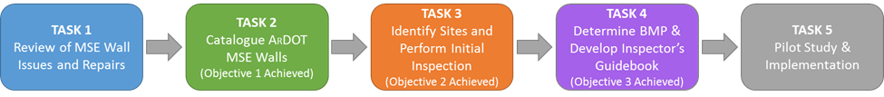
Work Plan
Literature Review
Nationwide Survey
Manufacturer Input
Create parameter list/database
Identify MSE walls in Arkansas
Catalogue MSE walls and any known issues
Survey districts to identify MSE walls with issues
Visit sites and perform initial inspection
Develop inspection process and identify needed equipment
Determine BMP for inspection and repair
Identify equipment/tools needed and obtain rating pictures
Develop Inspector’s Guidebook/Manual
Perform pilot study using developed guidebook
Make changes as determined in pilot study
Facilitate implementation and training

Slide 9
Nationwide MSE Wall Survey
Survey sent out to DOT contacts at all 50 states and D.C.
  47 responses were received, 44 complete responses
Survey comprised of 14 total questions (23 sub-questions)
covering 3 categories
  General system information and usage
  MSE issues encountered
  Inspection, maintenance, repair plans in place
The survey results and literature review were then discussed with 3 MSE wall manufacturers and industry representatives.

Slide 10
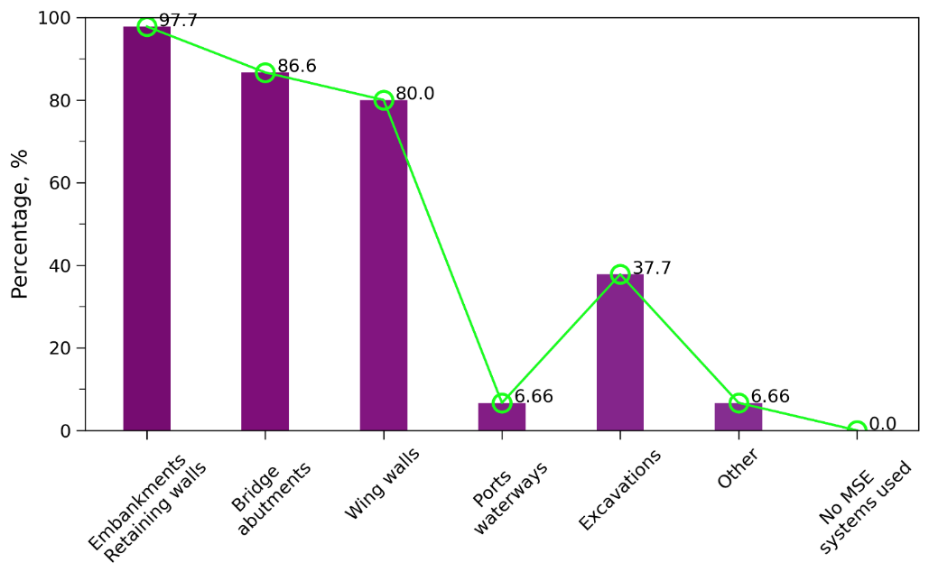
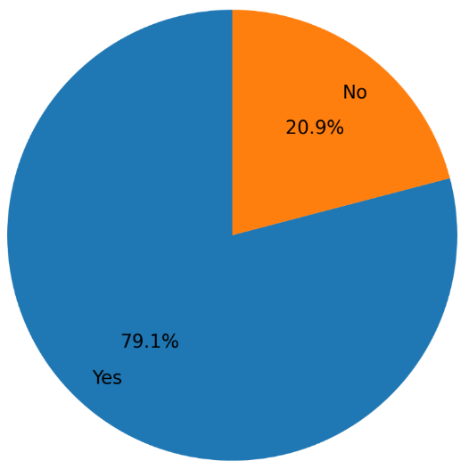
Nationwide MSE Wall Survey
General system and reinforcement type
2. Do you have a list of approved MSE manufacturers/products?
3. Do you know which specific systems/products have been constructed?
1. Which of the following types of structures have MSE systems been used for in your state? Please select all that apply.

Slide 11
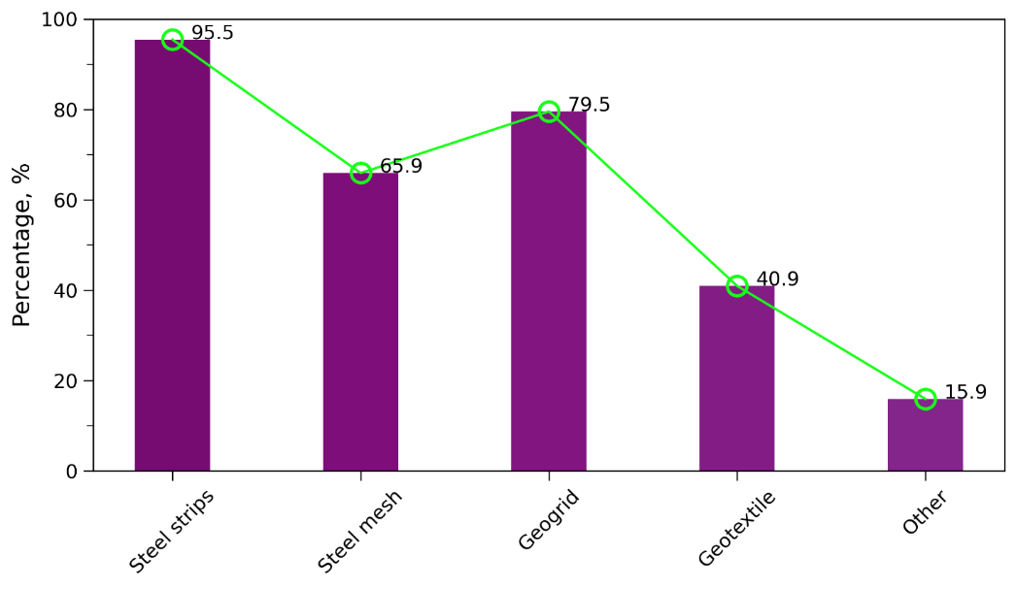
Nationwide MSE Wall Survey
General system and reinforcement type
State ID | Type of Coating
SD | Epoxy
IL | Aluminized
MO | Epoxy
WI | Aluminized Type 2 (only a few projects)
5. If steel reinforcement was used, have there been any other types of coatings used other than galvanization?
4. What types of soil reinforcement have been used in your state?

Slide 12
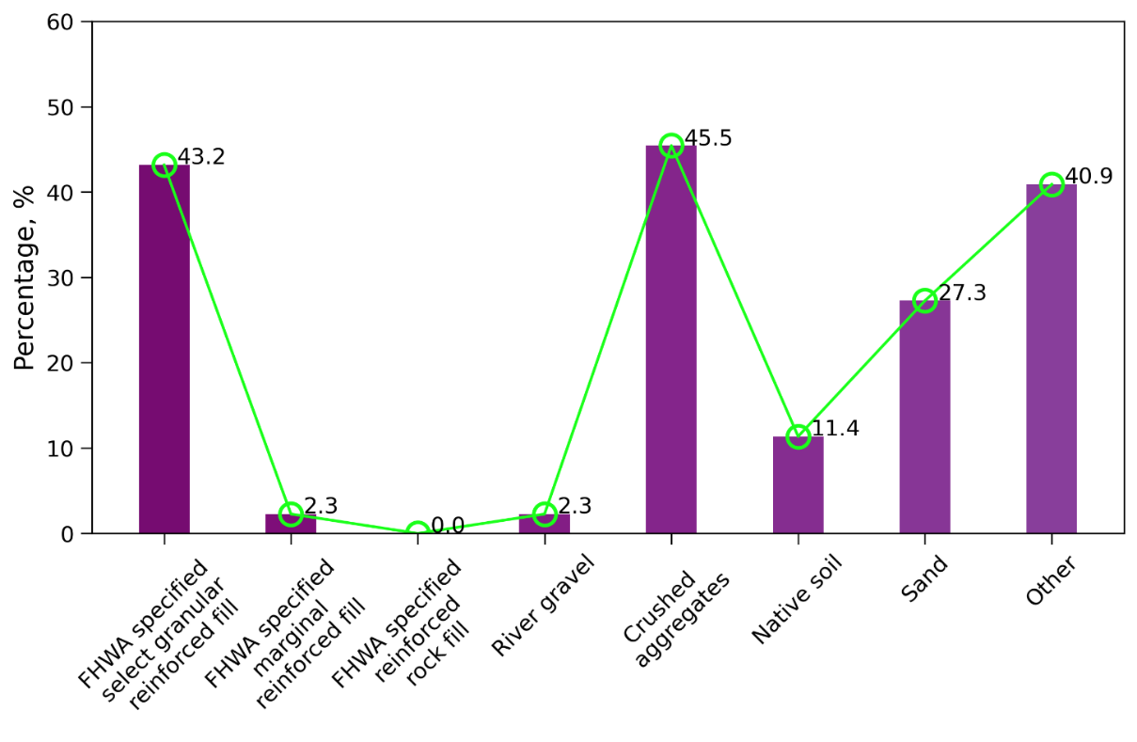
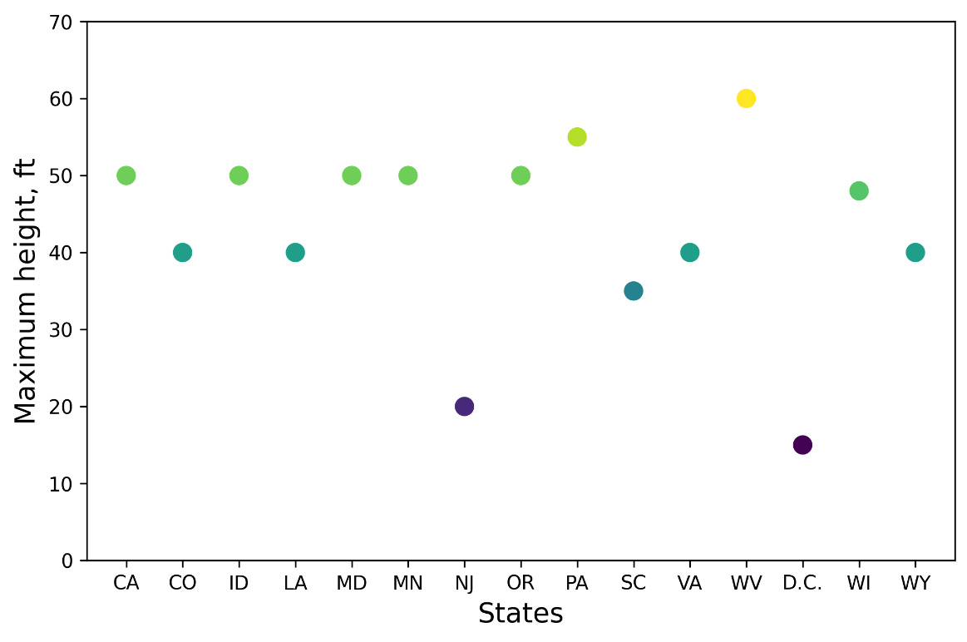
Nationwide MSE Wall Survey
Backfill type and design height allowed
6. What type of backfill materials have been used in your state? Please select all that apply and/or list the specifications that are used.
7. What is the maximum height (in ft) allowed for MSE walls in your state?

Slide 13
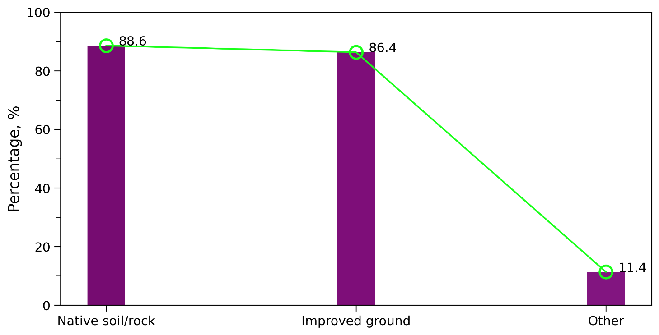
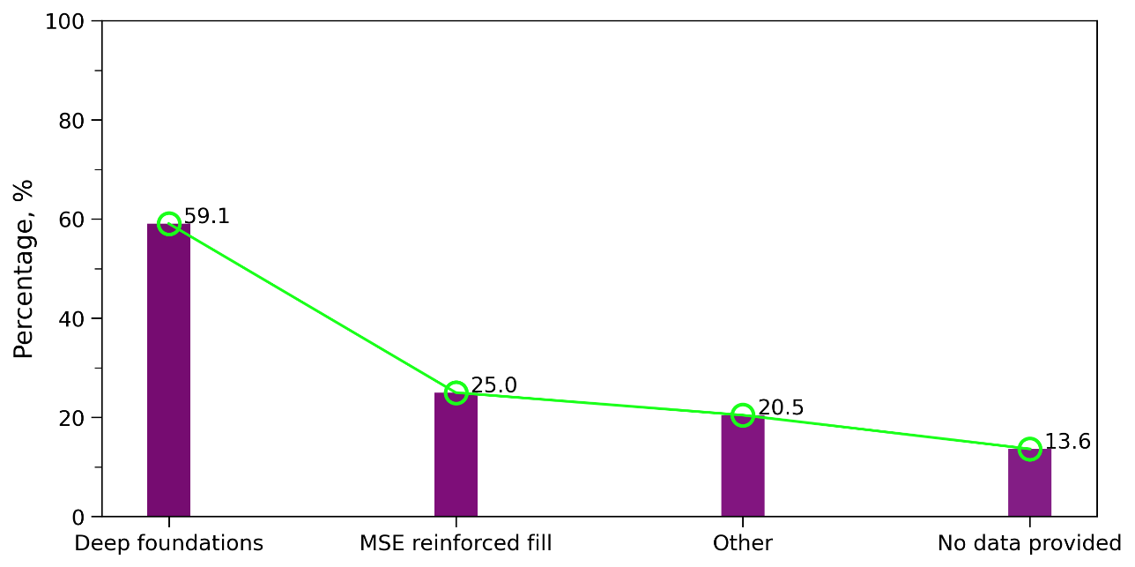
Nationwide MSE Wall Survey
Foundation type and bearing type
8. MSE walls are allowed to be built on which of the following in your state?
9. If MSE walls are used as bridge abutments, the bridge footing is bearing on which of the following?

Slide 14
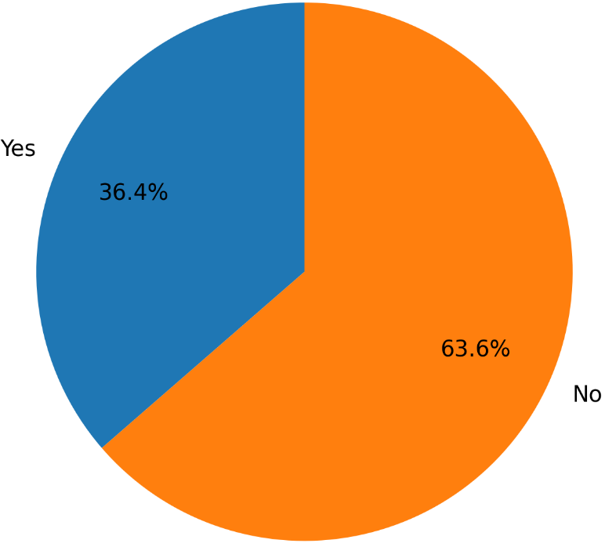
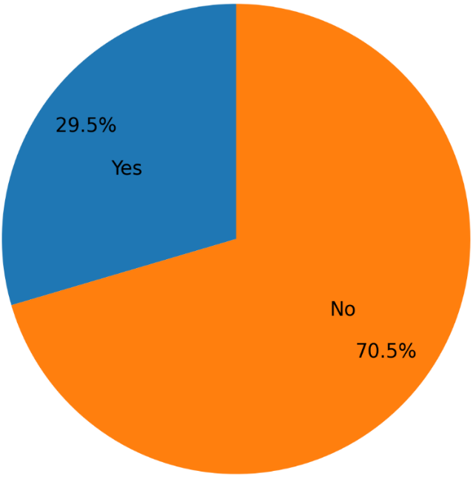
Nationwide MSE Wall Survey
Inspection and maintenance issues
11. Have there been any MSE wall failures in your state? Failures are defined here as issues occurring in the wall that cannot be repaired and require the wall to be reconstructed.
13. Is there a periodic inspection or maintenance plan and/or inventory in place for MSE walls in your state?

Slide 15
Nationwide MSE Wall Survey
Types and the number of MSE wall failures
 | States | CA | CO | FL | GA | HI | ID | IN | LA | MD | NY | PA | TX | UT | VA | WA | WI
Failure type
Vertical deviation on facing panels |  |  |  |  |  |  |  | √ | √ |  |  | √ | √ |  |  |  | √
Cracking on facing panels |  |  |  |  |  |  |  |  |  |  |  |  |  |  |  | √
Settlement of backfill |  |  | √ |  | √ |  |  |  |  |  |  |  | √ |  | √ | √ | √
Hit by vehicle |  |  |  |  |  |  |  |  |  |  |  |  | √ |  |  |  | √
Loss of backfill |  |  | √ | √ | √ |  |  |  | √ |  |  |  | √ | √ |  | √ | √
Problematic drainage |  |  | √ |  | √ |  |  |  | √ | √ |  |  | √ |  |  | √
Other (specify) |  | √ |  | √ | √ | √ | √ |  | √ | √ | √ | √ |  |  | √
How many failures |  | 1 | 2-3 | 1 | <10 | 1 | N/A | 1 | 10 | 1 | 2 | 1 | Roughly 5 | 1 | N/A | N/A | √

Slide 16
Nationwide MSE Wall Survey
States with MSE Inspector Handbooks
States | Link or sources
FL | https://www.fdot.gov/docs/default-source/construction/CONSTADM/Guidelist/InspectGuidelist/FY1213/MSE-Wall-Inspectors-Handbook.pdf
OH | http://www.dot.state.oh.us/Divisions/Engineering/Structures/bridge%20operations%20and%20maintenance/Pages/default.aspx
NY | See previous question/link for NYSDOT GEM-16
PA | Publication 238 addresses MSE wall inspection. See Chapter 2. https://www.dot.state.pa.us/public/PubsForms/Publications/PUB%20238.pdf
WI | Wisconsin Structures Inspection Manual: https://wisconsindot.gov/dtsdManuals/strct/inspection/insp-fm-pt4ch4.pdf Updates to inspection and maintenance guidance is currently ongoing.

Slide 17
Nationwide MSE Wall Survey
States with MSE Inspector Handbooks
States | a. How often | b. rating system | c. link or reference
AK | Not set interval
CO | 5
DE | Preparer said: “don’t recall”
IN | Not set interval | √
KS | Not set interval
ME | Inspected at the frequency of bridge inspection | √ | √
NE | 2 | √ | √
NY | 5 | √ | √
OH | 10
PA | 5 years routine 10/15-year in-depth inspections | √ | √
VT | 2
MO | unknown – typically tracked with bridges where applicable
WI | 6 | √ | √

Slide 18
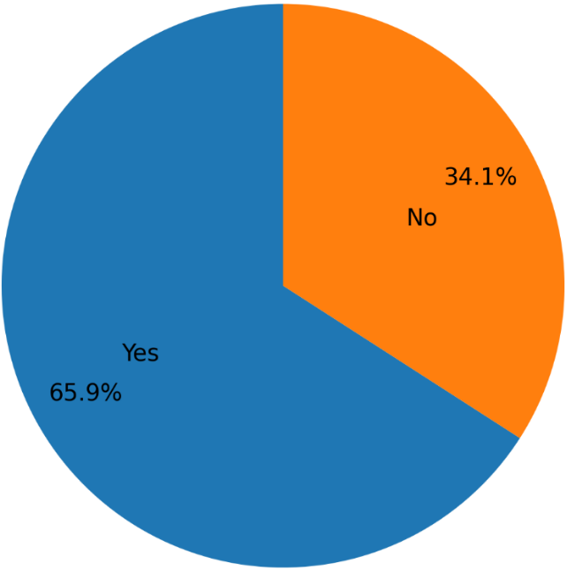
Nationwide MSE Wall Survey
Maintenance issues with MSE walls
States | Question a: how many walls have experienced issues? | Question b: are these primarily reoccurring or new issues?
AR | 10 | Vehicle strike
CA | Half dozen or so | One time issue
FL | Unknown
GA | small percentage, no records available. | new issues
ID | A few. No specific number available. | Occasional, due to vehicle impacts and construction defects.
IL | At least 2 state and 1 local agency walls | These are rare occurrences
IN | more than 30 walls | reoccurring
IA | Not very many | Typically, one off instances
KS | Several
LA | 20 percent-50 percent | both
… | … | …
14. Have there been any maintenance issues with MSE walls in your state? Maintenance issues are defined here as events that do not result in replacement or reconstruction of the wall, but require repair. (26 responded with more details)

Slide 19
Nationwide MSE Wall Survey
Maintenance repair activities
States | Vertical Deviation of the Facing Panels
GA | This has typically only been observed during the wall construction. Contractor must remove and replace to meet tolerances.
IN | Repair
KS | Monitor, possibly compaction grout if settlement is the issue
LA | none (that we know of, note that some maintenance is performed by district forces prior to geotech designers being notified)
MS | √
MT | some minor surficial movement, also drainage related
NE | Monitor
OH | Unknown
OR | During construction out of tolerance dimensions are assessed on a case by case basis. I am not aware of maintenance efforts on existing walls for this.
OK | Have not repaired
WI | -Monitor -Reset panels (limits vary on when to reset panels)

Slide 20
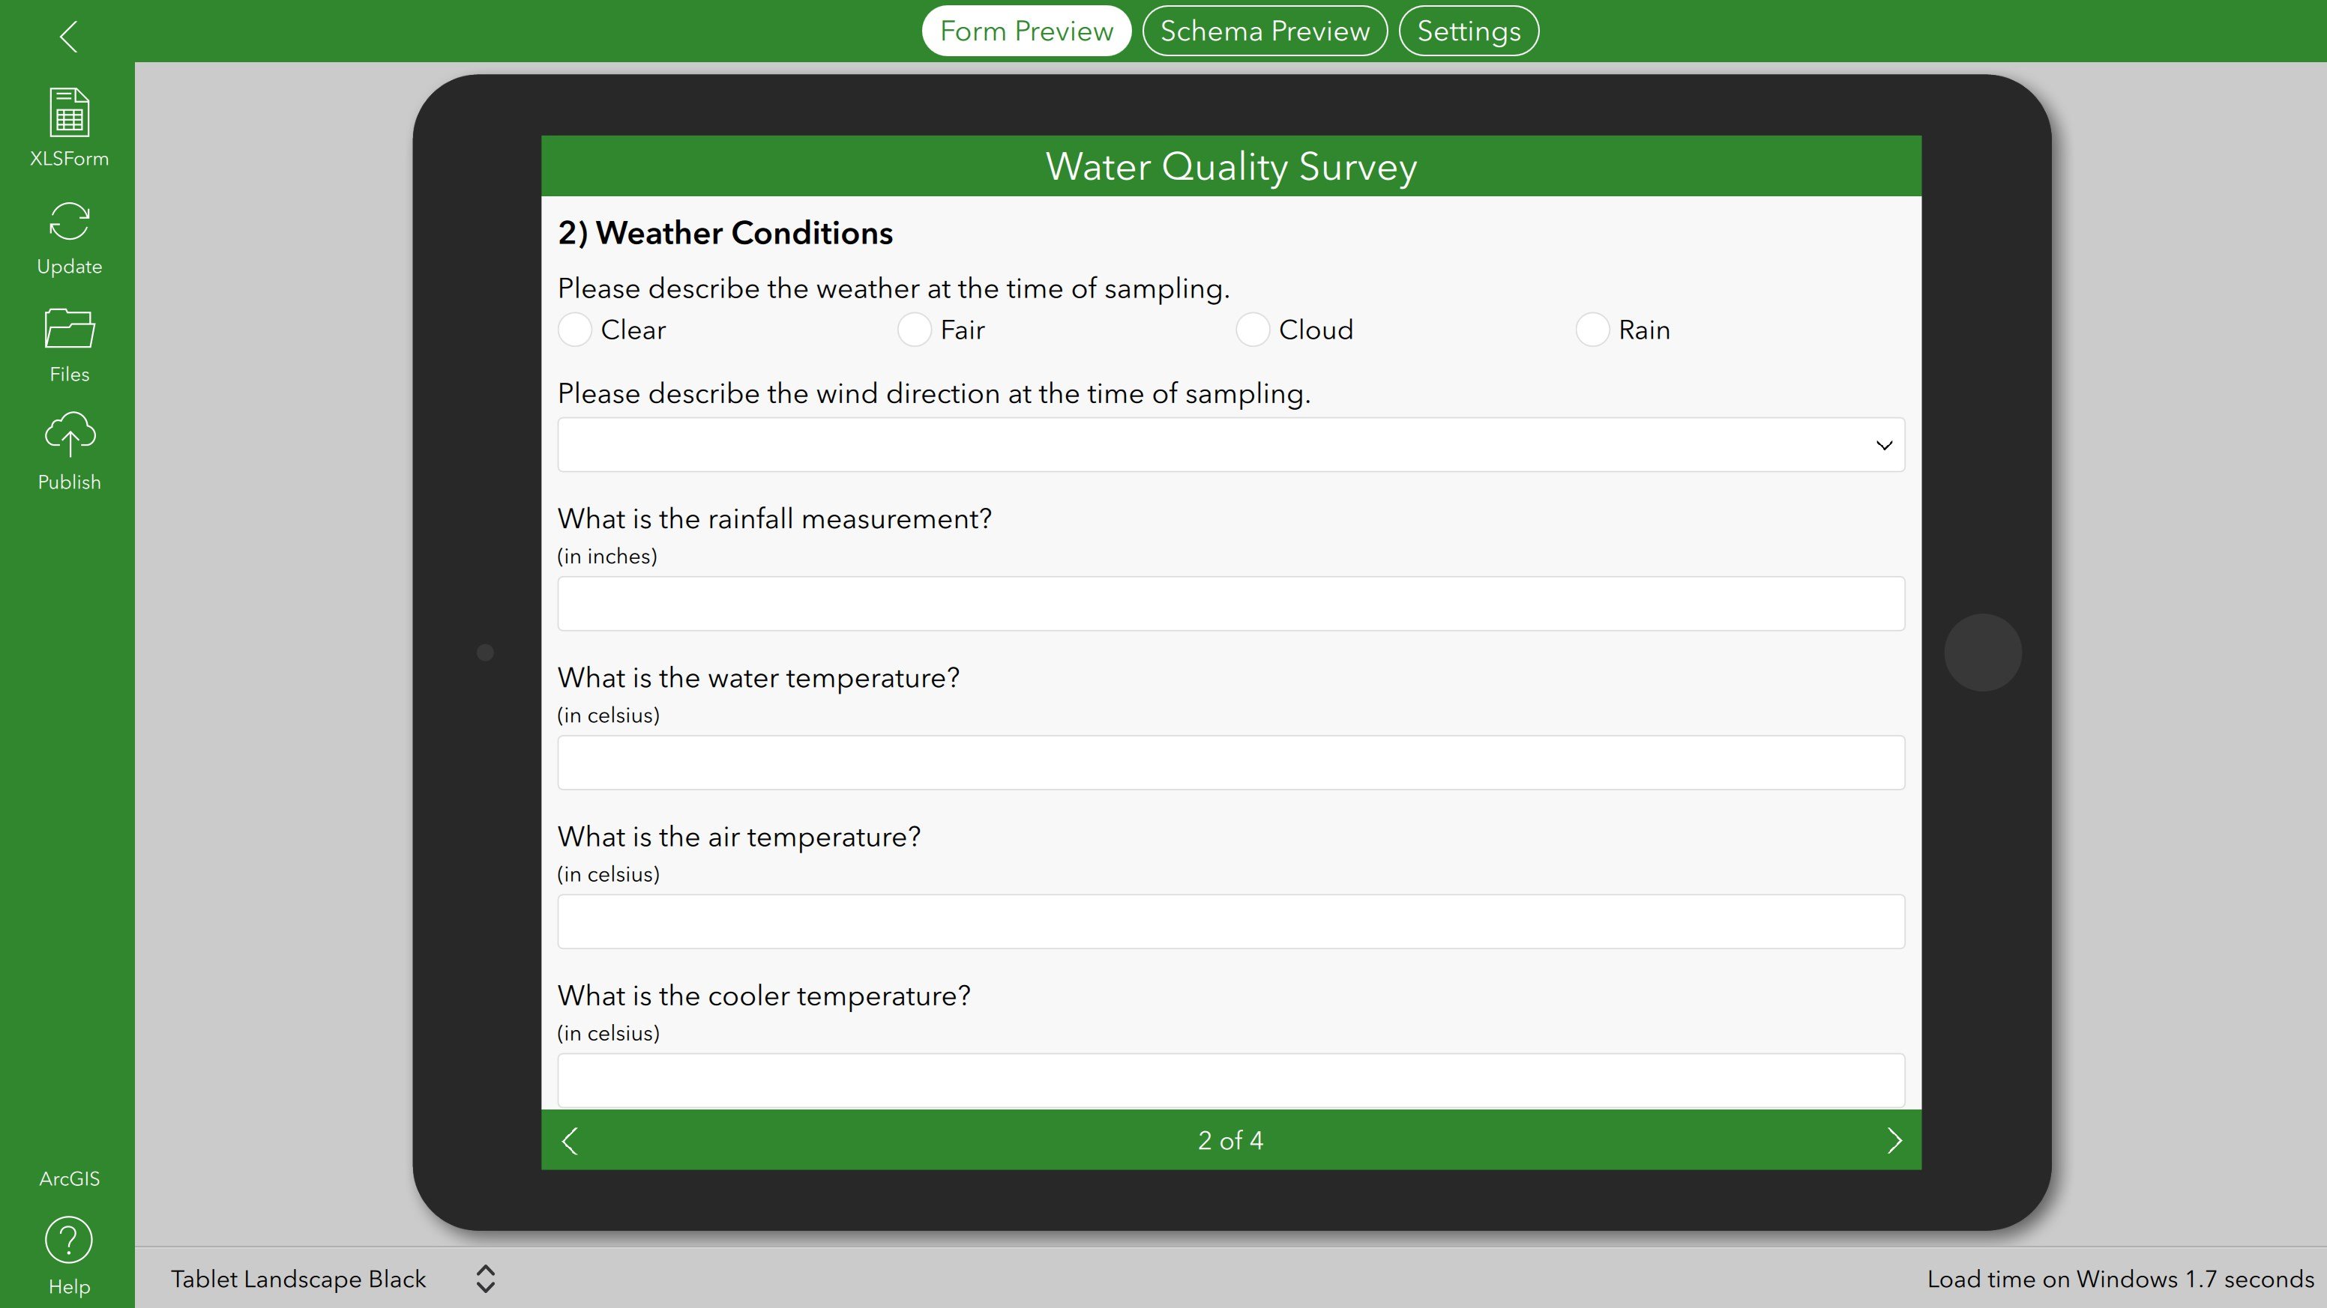
ARDOT GIS Database
Parameters in database:
  Location, identifier (bridge or wall ID), type and year of build
  System and details (Soil reinforcement type, panel type, etc.)
  Backfill material
  Facing panel
  Foundation
  Dimension/height of the wall
  Sign of distress
  Performance of any structure supported by the reinforced soil
  Inspection history/Maintenance history
  Maintenance issue(s) encountered
Catalogue MSE walls in Arkansas and provide up to date information for maintenance personnel

Slide 21
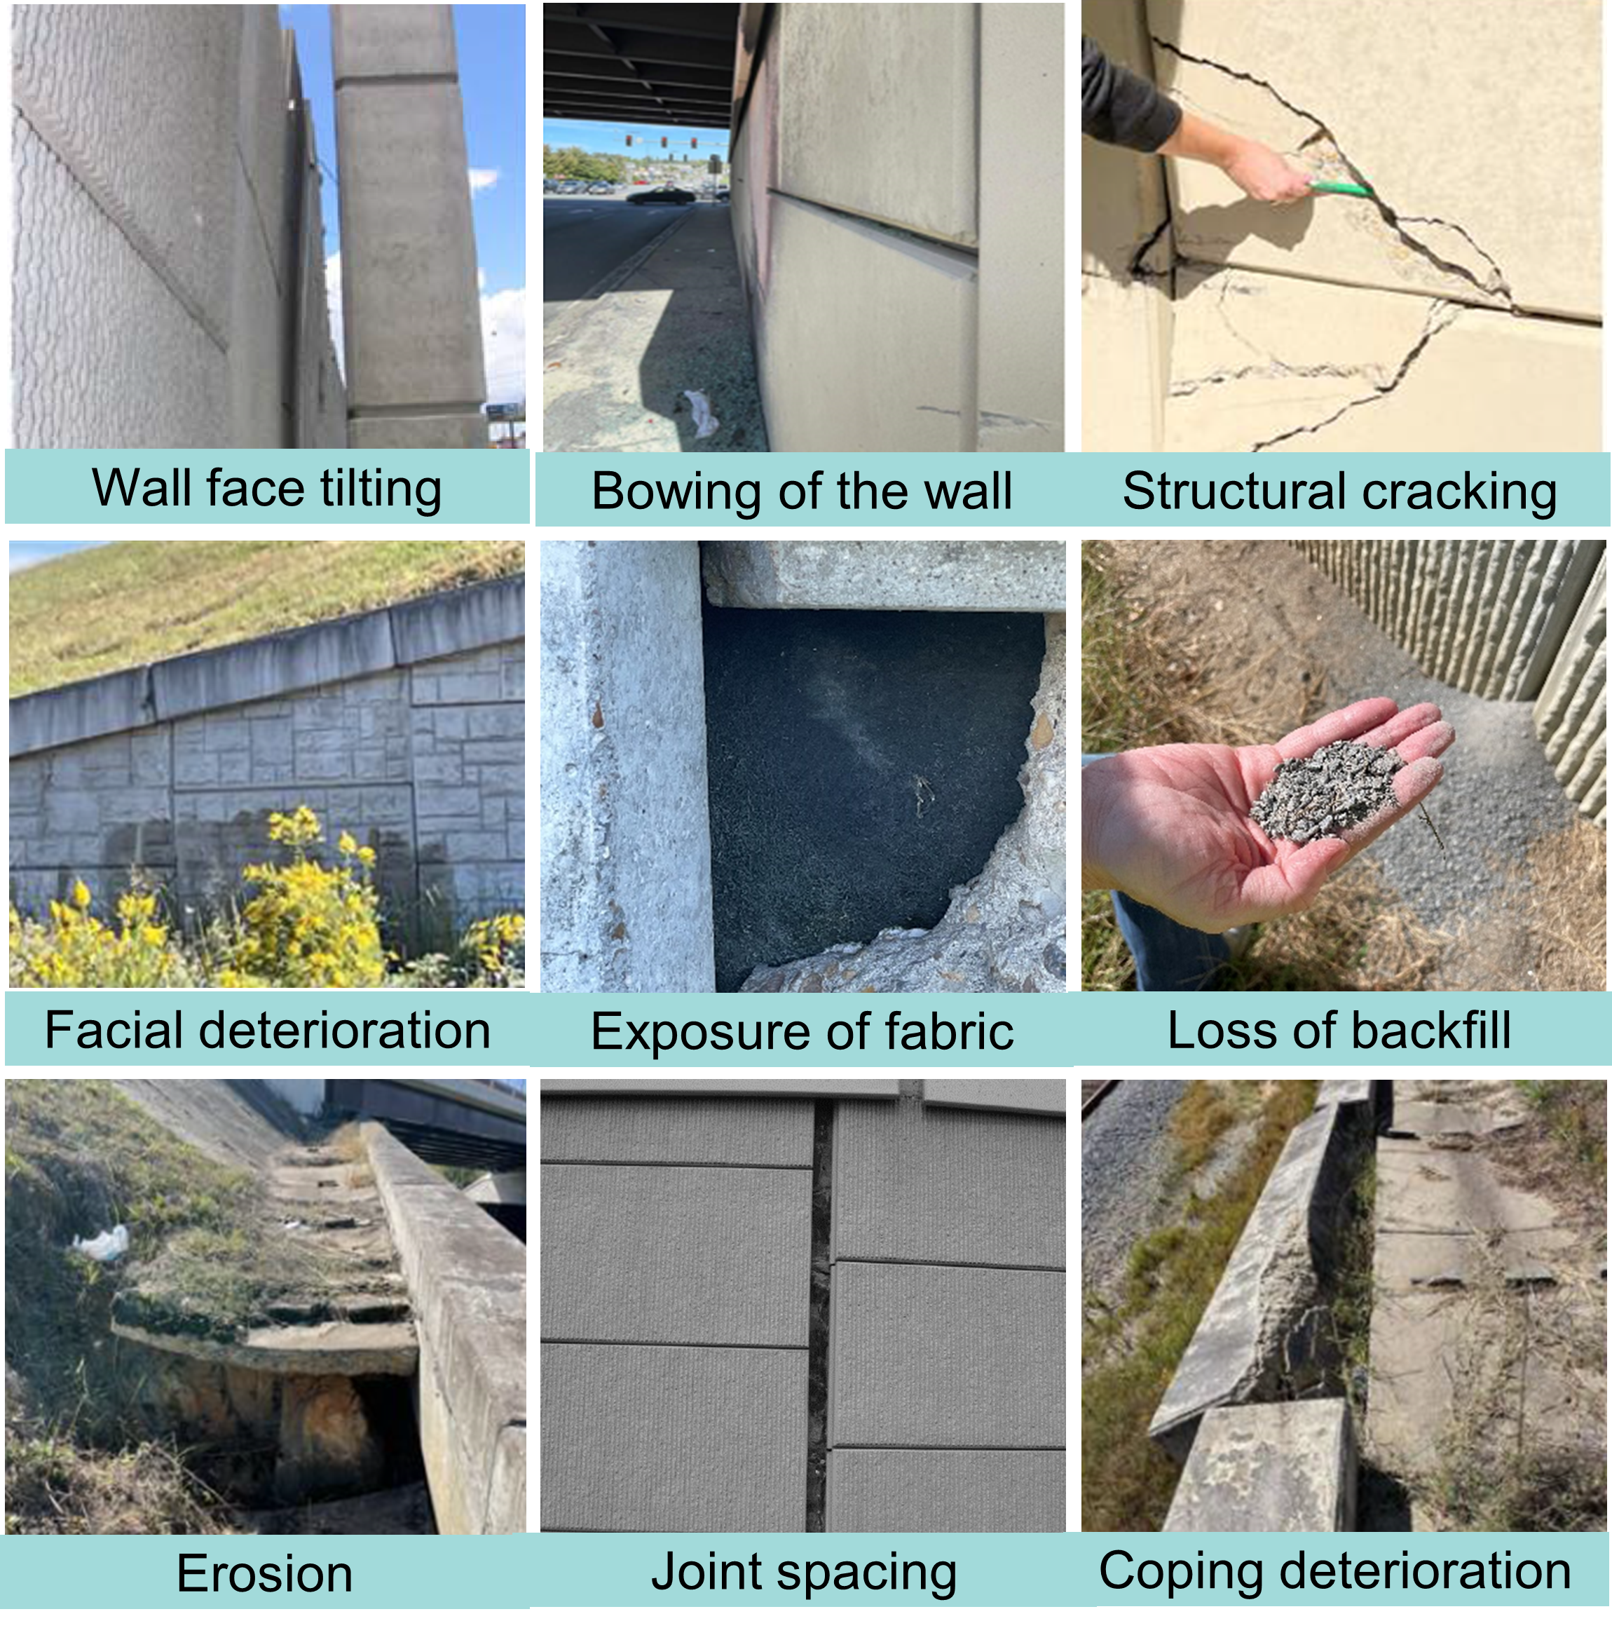
Initial Field Inspection
Example signs of distress in MSE walls in Arkansas

Slide 22



MSE Manufacturer Guidance
Maintenance issues and suggested repairs were discussed to help develop the best practices for the inspection process and associated guidebook
  Importance of initial “as built” measurements and information
  Tools and best measurement practices for the various issues
  How to determine cosmetic damage versus something more serious
  What severity ratings can accurately capture the various issues
  Importance of rate of change versus absolute measurement in some cases
  How to identify the root of the cause versus the symptoms
  When to get an engineer or manufacturer involved

Slide 23
MSE Inspector’s Guidebook/Manual
  Guidebook follows along with the ARDOT bridge inspection manual
    Similar layout and flow (includes glossary and list of equipment)
    Similar rating system (0-9 with 9 being no issues/changes)
  Contains pictures and measurement descriptions where possible to help differentiate a severity rating
  Walks inspector through each item for each section of the MSE wall
  Each of the documented measurements, ratings, and notes can be implemented in the ArcGIS Survey123 system
  Evaluates the overall condition of the wall and the percentage damaged
  Specifies when a particular issue may require an engineer or manufacturer to be contacted

Slide 24
Deliverables & Implementation
Database of all existing MSE walls managed by ARDOT
Categorized according to system/type, design, materials, performance and maintenance history
Inspection & Maintenance Guidebook detailing signs of distress, rating criteria, and corresponding maintenance practice and/or repairs
On-site training on use of database and handbook
Reduce confusion related to maintenance practices
Improve safety
Save time and money
Notes:
Database based on design/as-built drawings and field reports, MSE walls categorize
Catalogue possible distress signs and performance metrics
Existing metrics from construction inspector handbooks will also be considered
Special attention will be placed on wall types used in AR and distress signs observed for these walls
Possible links between distress signs observed and construction flaws will also be examinedd by system/type, design specifics, materials, performance and maintenance history

Slide 25

ACKNOWLEDGMENTS
TRC2104 Subcommittee
Kim Romano
Manuel Regalado
Raymond Leung
Rochelle Blue
Daniel DeVore
Paul Tinsley
John Borgeson
David Hutchinson
Willie Liew
Robert Johnson
Robert Gladstone
Michelle L. Barry, PhD, PE
Associate Professor, Civil Engineering
mlbernha@uark.edu
Richard A. Coffman, PhD, PE, PLS
Associate Professor, Civil Engineering
rick@uark.edu
Ruimin Feng, PhD
Postdoctoral Researcher, Civil Engineering
rf015@uark.edu

