Slide 1

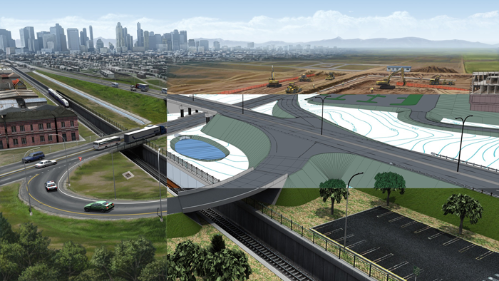
Digital Delivery QC – A New Way
“How I stopped worrying and learned to trust the model.”
ARDOT TRC 2024
Josh Kleitsch, PE
Digital Engineering & Project Delivery, Transportation – Olsson
jkleitsch@olsson.com

Slide 2

About Me
Digital Engineering Technology SME
  Fluent in OpenRoads Designer and Civil 3D
  Passionate about connecting people with the technology and process they need to work
  We’re not locked in here with AI…AI is locked in here with us.
Transportation Engineer
  Digital Delivery Technical Expert for the Transportation Market at Olsson
  Based in Denver, CO
  Experienced on Infrastructure projects from multi-disciplinary Digital Design Manager on a major airport Design-Build, down to lead designer on local sidewalks projects for “Safe Routes to School.”

Slide 3

Objectives
Review high-level project delivery concepts.
  Where is the industry headed in 2024?
Discuss known gaps in skills, tools, workflows.
Present a solution and new thought process.

Slide 4
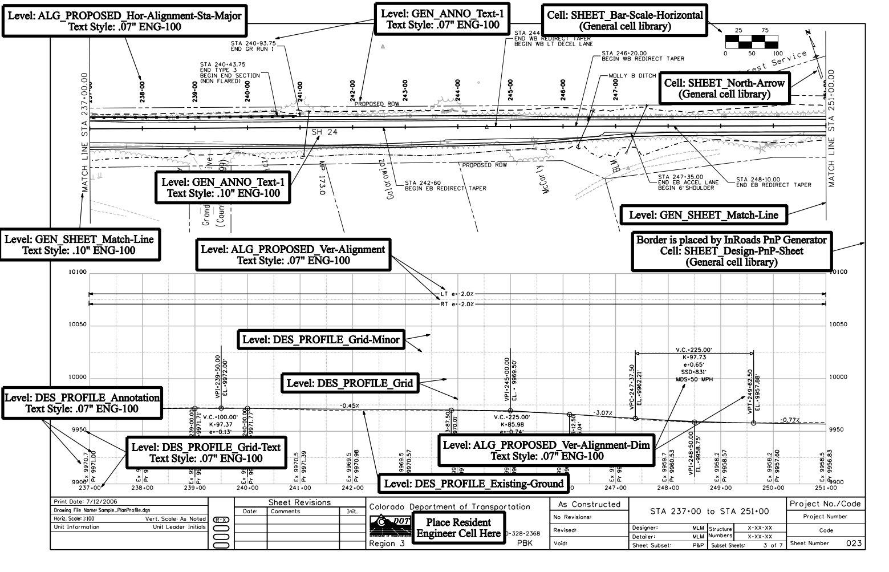
Project Delivery – Past, Present, Future
MicroStation 2.0 in 1987
  Began using CAD to create plans.
InRoads in 1990
  CAD is used to model 3D elements and aid in plan production.
Geopak in 2001
  Models are becoming more commonplace across Transportation engineering.
OpenRoads Designer in 2017
  First program made with model delivery as primary purpose.

Slide 5
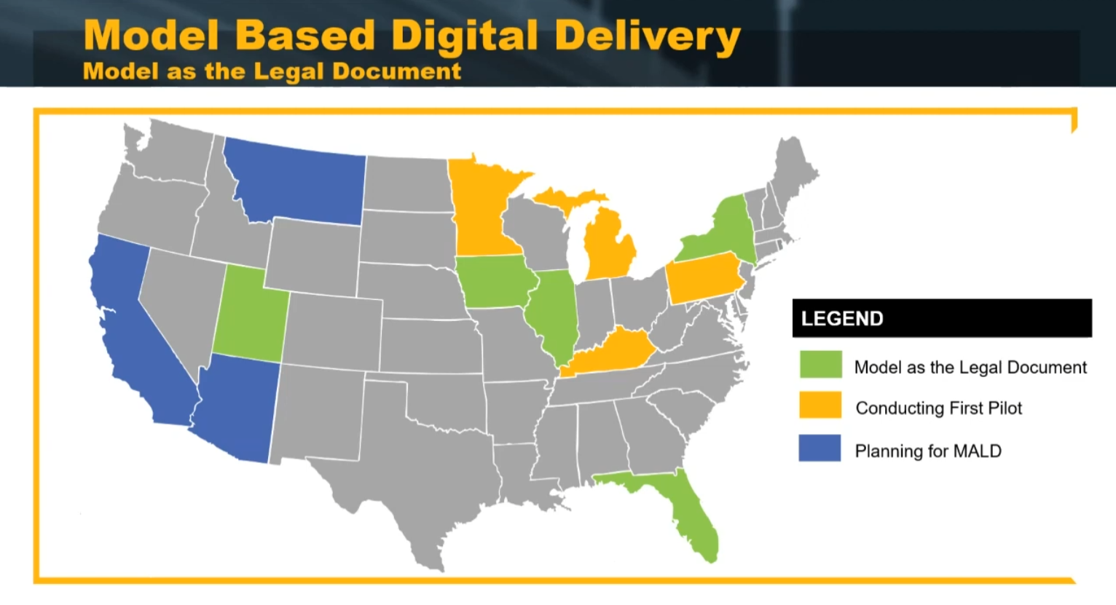
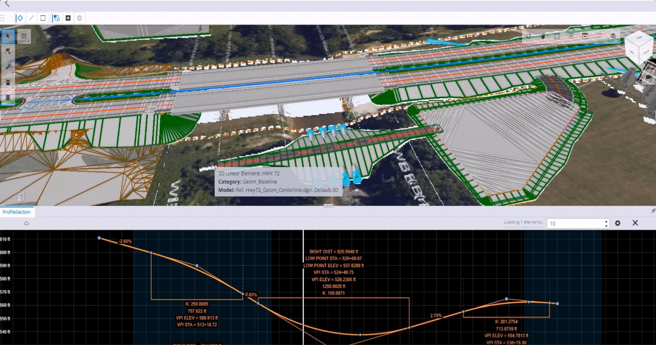
Model as Legal Document (AKA: the Holy Grail)
The 3D model files are the legal deliverable.
  Plans "for Information Only"
  May still use shop drawings as needed.
ProjectWise Civil Validation Tools.
  Demo: https://youtu.be/anJRb_4pJfU
  Web-based review of design models.

Slide 6
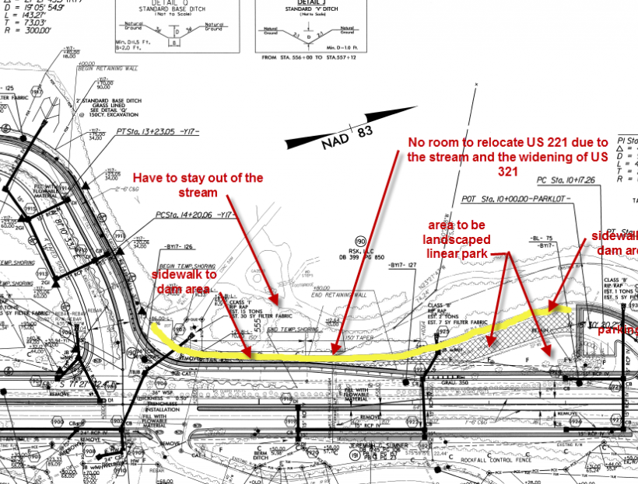
PROBLEM: We're not there yet!
We don't have the Best Practices and Workflows.
Quality Control has always been a manual process.
Our people don't know the software.
The software is not configured right/we don't have the resources to make it all work.
It's too expensive!

Slide 7
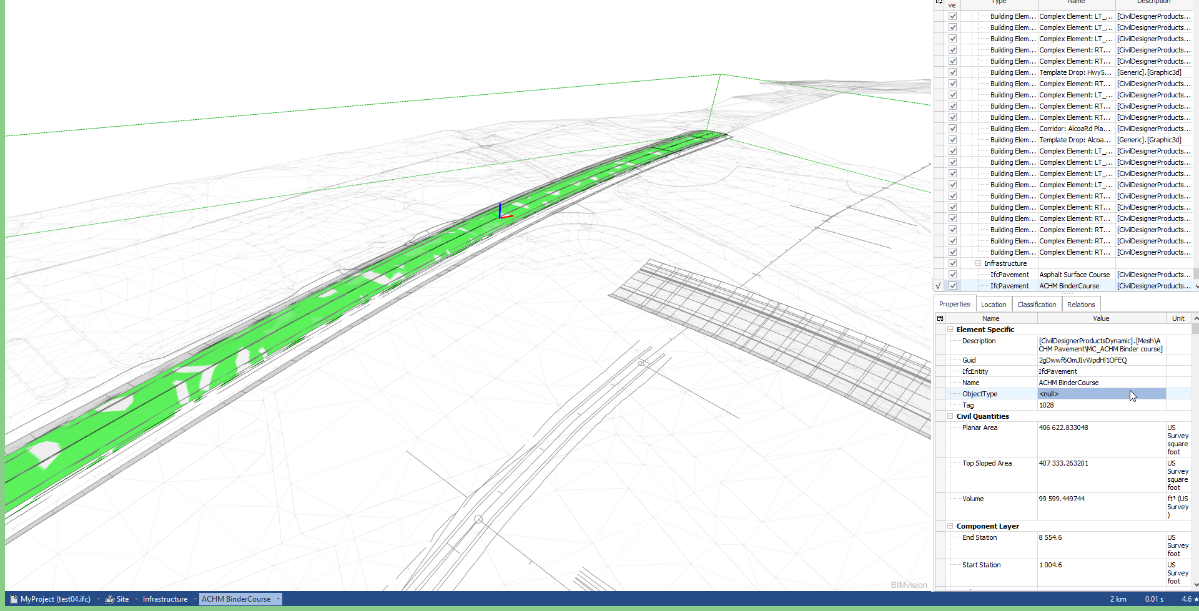
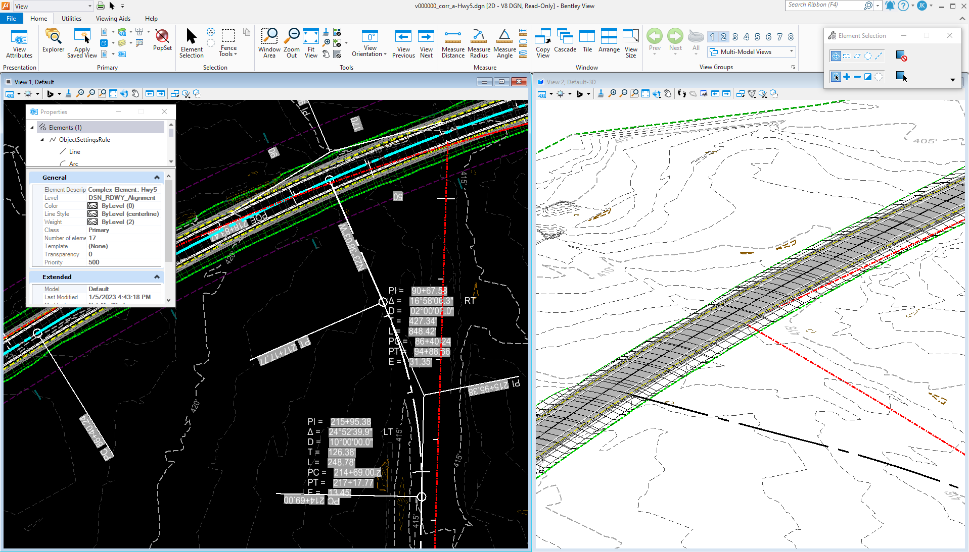
SOLUTION: Use free "viewer" software to bridge the gap
Bentley View
  Opens the dgn natively.
  Shows exactly what the designer sees.
  Full measurement tools, including quantities.
BIMvision​
  Opens IFC files (more on those later).​
  Not as detailed, but simpler to learn.​
  Great for coordination and model completeness checks.

Slide 8
Two Approaches
Internal Technical Review
External Stakeholder engagement
Bentley View
Install and open dgn's natively, minimal learning curve for experienced users.
Complicated interface and doesn't tell you if the model is fully "translatable" from one discipline to the next.
BIMvision
Free install but requires IFC files. (what is IFC??)
This is not automatically included but is easy to add.
Two variables and an Excel file added to WorkSpace.

Slide 9
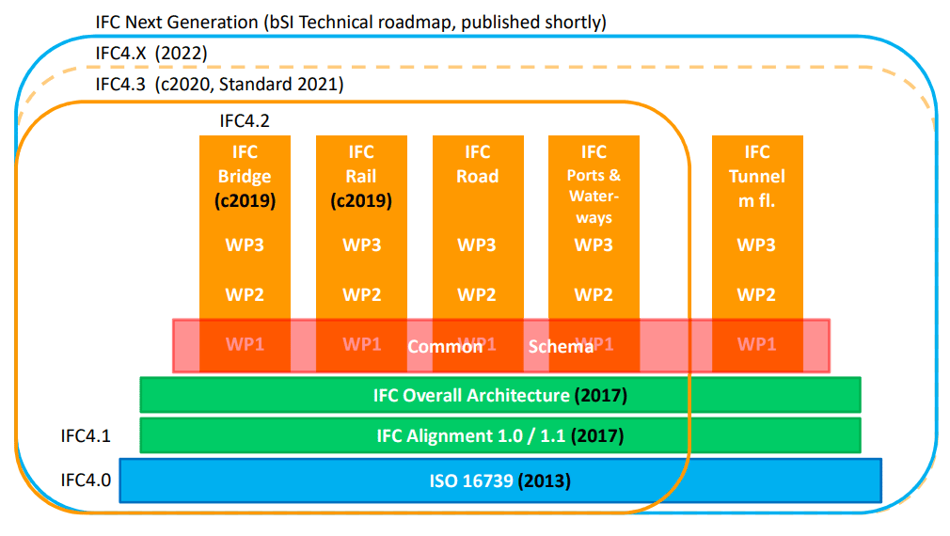



What about File Types?
Most are Proprietary
  dgn, dwg, xml, dtm, xin, ucf, pcf, oh my!
An Open Source Option: IFC
  Industry Foundation Classes (IFC): Created for BIM, now includes Roadway, Bridge, Rail, etc.
  Improving all the time.
What about Standards?
  buildingSMART International works with the TRB, HEEP, DOT's, FHWA.
  Open Data Standards for our designs.
  More secure and extensible than proprietary formats.

Slide 10
Setting up OpenRoads for IFC – ORD 2023
Configure Item Types on the WorkSpace level.
Add the IFC Classifications Excel file to folder identified in variable, build picklist, create library.
Add the IFC Item Type to the Feature definition.
When the designer builds a corridor, the IFC data is embedded in the model objects.
Export IFC 4x3
Open .ifc file and check that your model is correct.
For ARDOT:
New Variable: ITEMTYPE_LOOKUP
$(CIVIL_ORGANIZATION_STANDARDS)ASSET MANAGER\IFC_CLASSES_TYPES.XSLX
Excel file comes from the Bentley ORD 2023 WorkSpace on your C: drive.
Gives ORD the data it needs to correctly attribute the model elements.

Slide 11
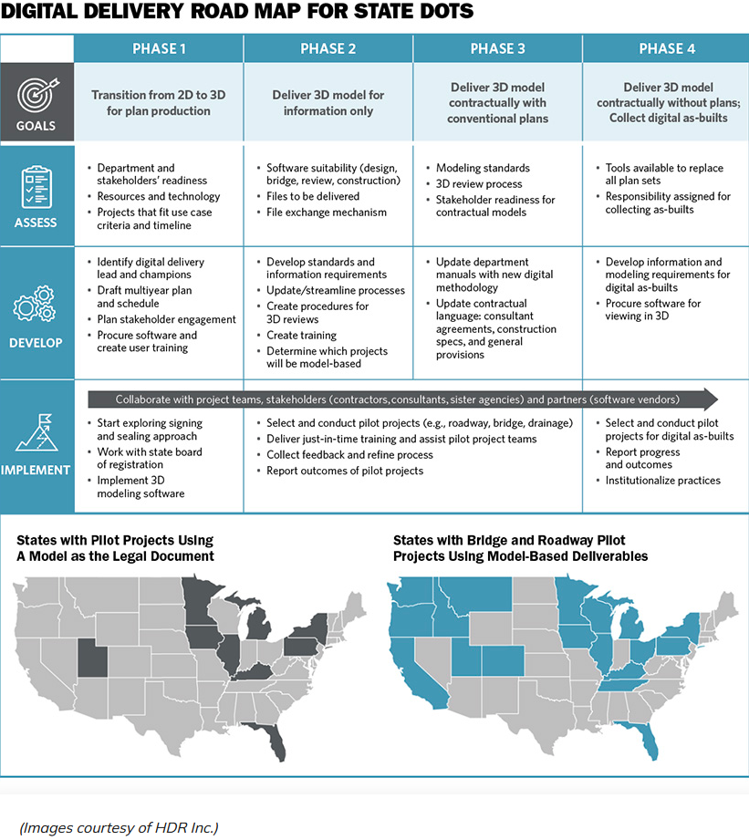
Takeaways
Transportation is moving away from plans.
  Not obvious how to make that transition.
Model as Legal Doc is ambitious, but we can get there.
IFC files can be part of the solution.
  Free viewers that can open complex models.
  Lower technical requirements
  Lots of data in the models.
  Incredible interoperability, no data loss.

Slide 12
References and Resources
Bentley
IFC
Configuring Feature Definitions and Item Types: https://learn.bentley.com/app/VideoPlayer/LinkToIndividualCourse?LearningPathID=110831&CourseId=135502&MediaID=5023267
Bentley View: https://www.bentley.com/software/bentley-view/
ORD IFC: https://youtu.be/7R6tyVcKBcg?si=ce-wfSxeyWutdIMJ
BIMvision: https://bimvision.eu/
BuildingSMART USA: https://www.buildingsmartusa.org/us-activities/chapter-committees/roads-bridges-committee/
IFC for Roads and Bridges: https://www.fhwa.dot.gov/bridge/bim/
HEEP: https://www.heep.org/bimis

