Slide 1
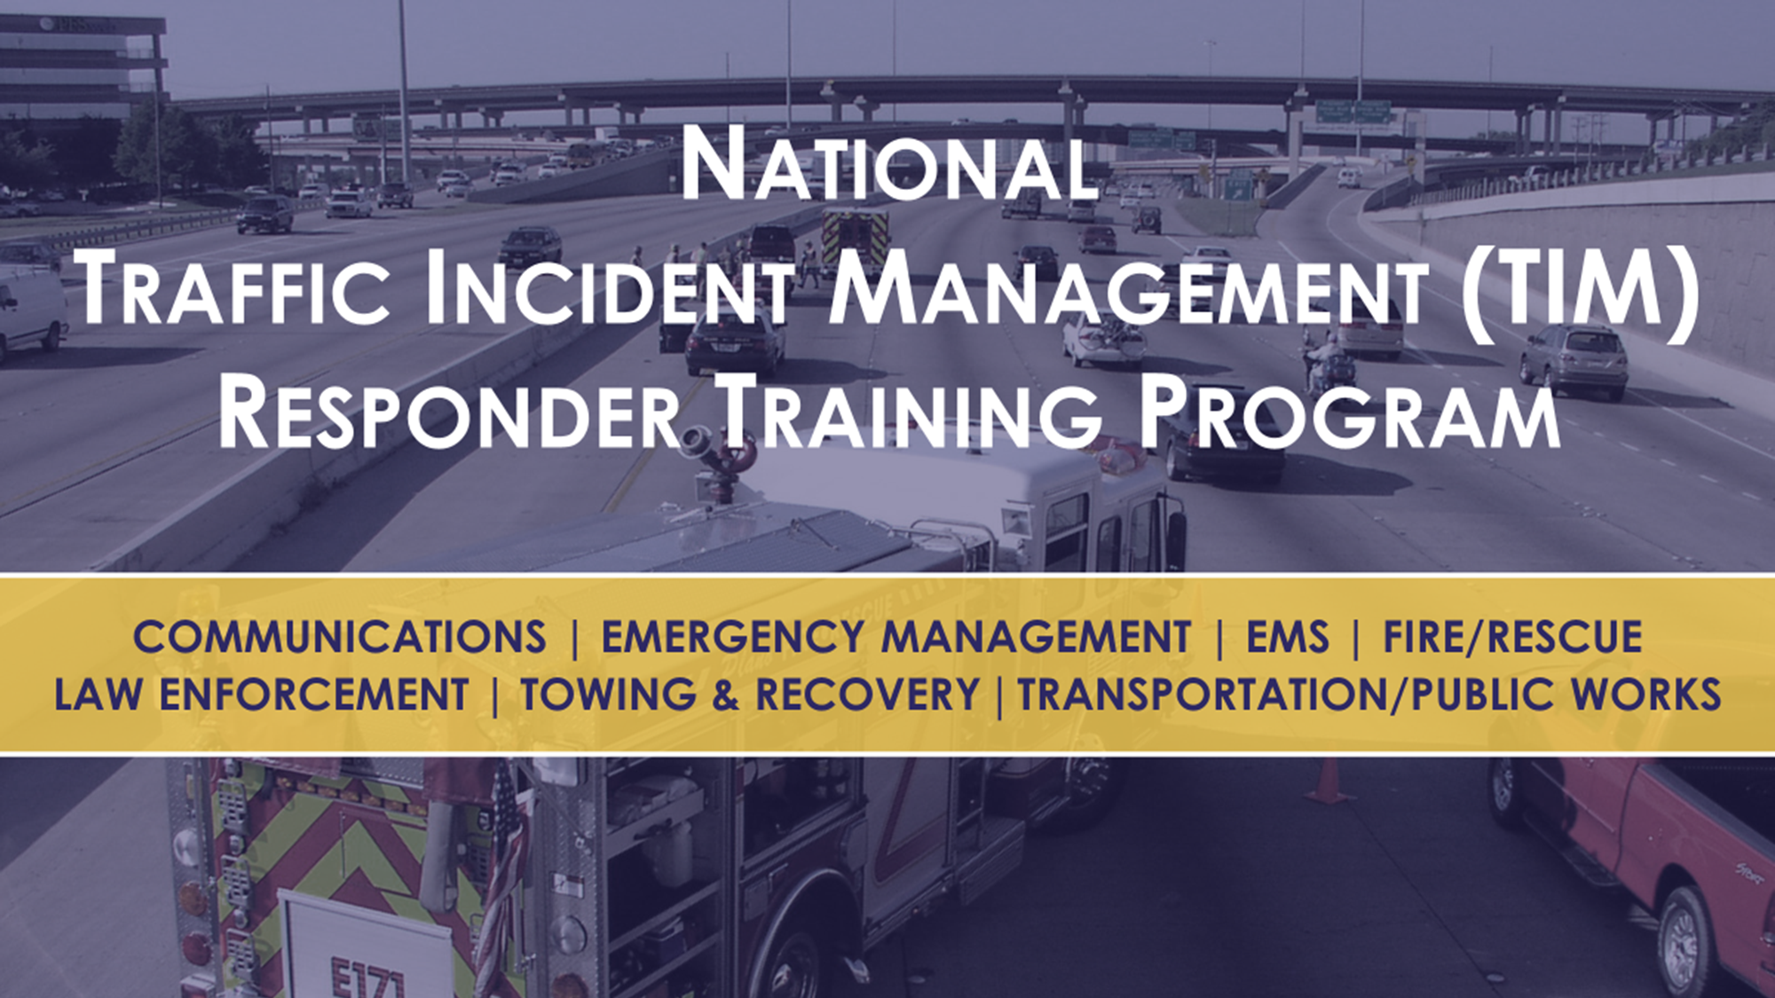


LT Brad Perkins
Arkansas Highway Police

Slide 2
Second Strategic
Highway Research Program
The National TIM Responder Training Program was developed under the second Strategic Highway Research Program (SHRP2)
The training was developed and pilot tested by responders, for responders
Once finalized, the Federal Highway Administration (FHWA) began rolling out the training nationwide in August 2012
3

Slide 3
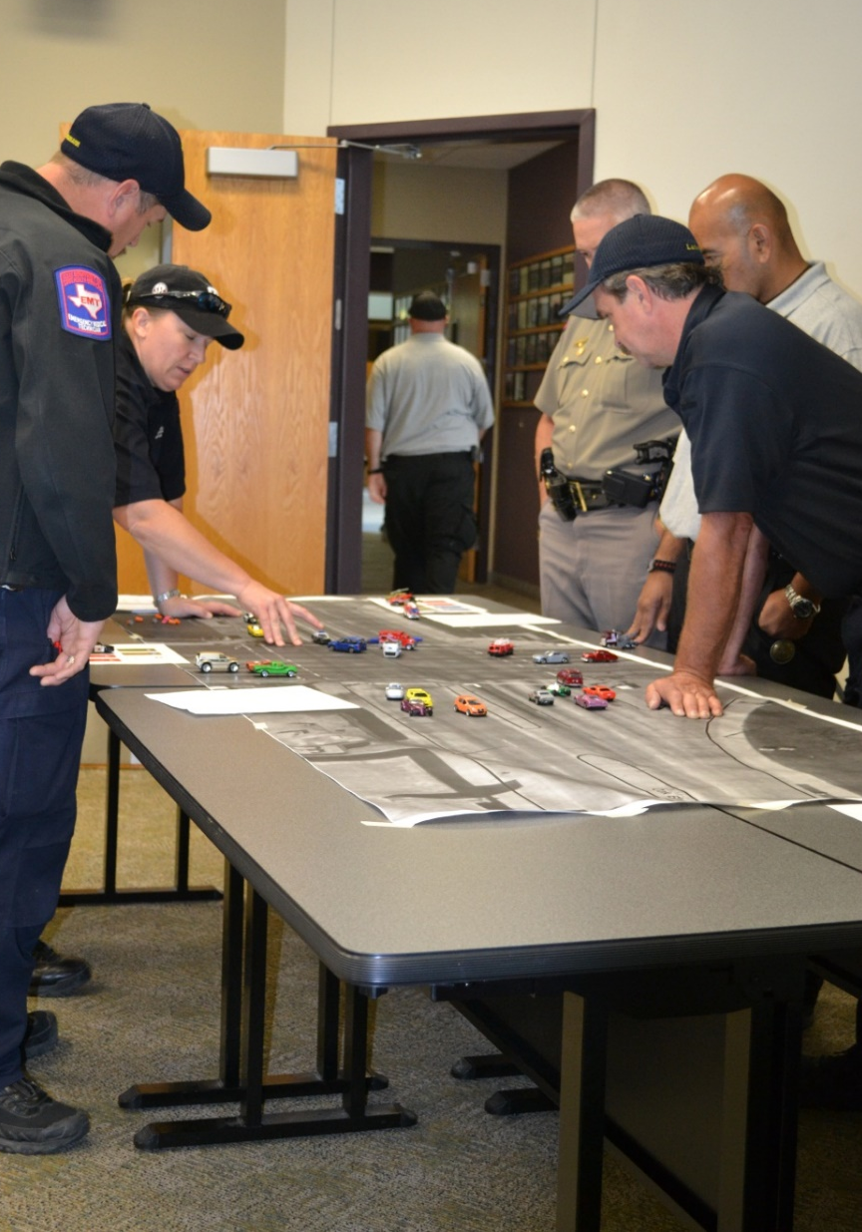
National TIM Responder Training
Designed to establish the foundation for and promote consistent training of all responders to achieve the three objectives of the TIM National Unified Goal (NUG):
  Responder Safety
  Safe, Quick Clearance
  Prompt, Reliable, Interoperable Communications
4

Slide 4
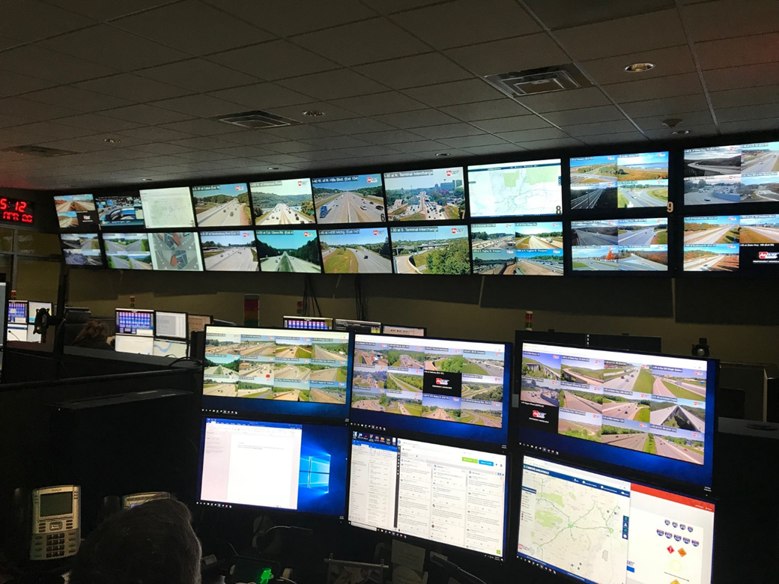
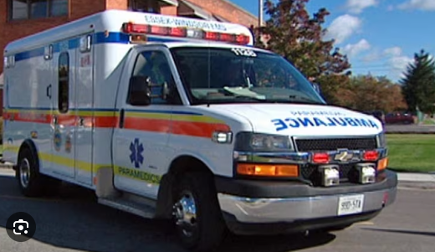
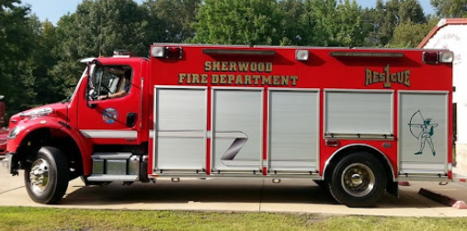
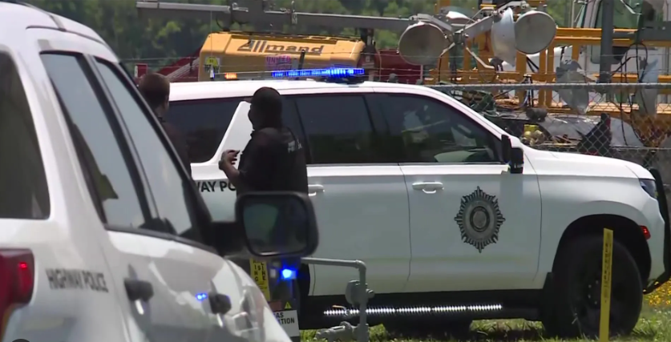
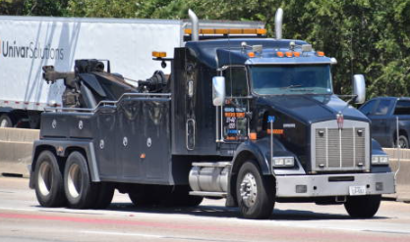
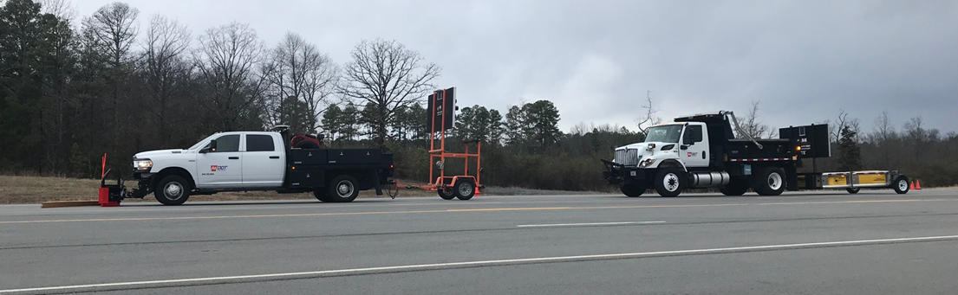
Responder Disciplines
Communications
Emergency Management
Emergency Medical Services (EMS)
Fire/Rescue (F/R)
Law Enforcement (LE)
Towing and Recovery (T&R)
Transportation/Public Works (DOT)
Others
3

Slide 5
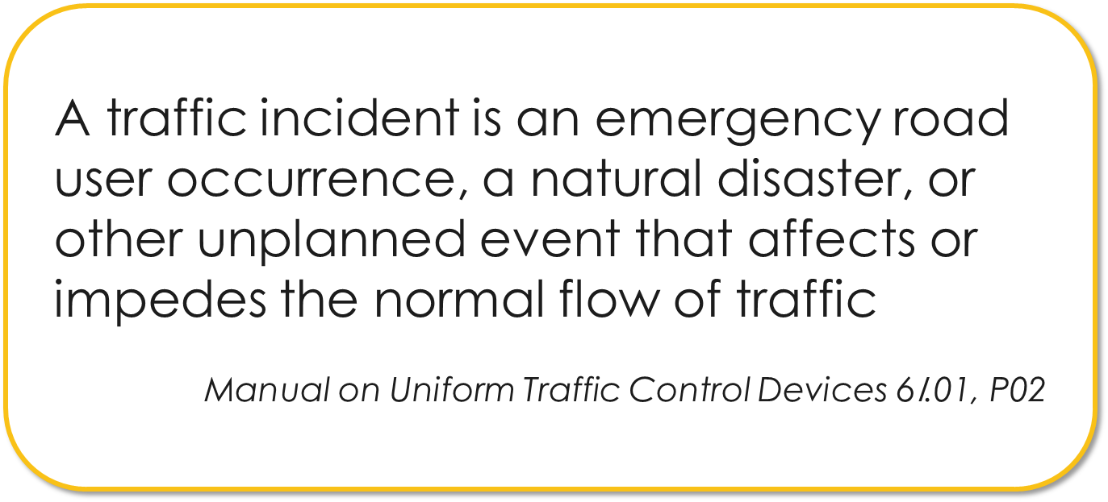
What Is A Traffic Incident?
3

Slide 6
Arkansas Crash Report 2021
85,442 Total Crashes Reported
621 Fatal Crashes Resulting in 683 Fatalities
9,524 Involved CMVs / 3,864 Large CMVs (26,000 lbs or larger)
1,222 Secondary Crashes Reported
Work Zone Crashes
2,654 Total / 146 were secondary accidents
18 Work zone Fatal Crashes Resulting in 20 Fatalities
3

Slide 7
Law Enforcement & Responders Killed In 2021
Law Enforcement & Responders killed in the United State responding to or at incident/accident scenes in 2021
9 Fire & Rescue Personnel
20 Law Enforcement Officers
2 DOT
60 Tow & Recovery
3

Slide 8
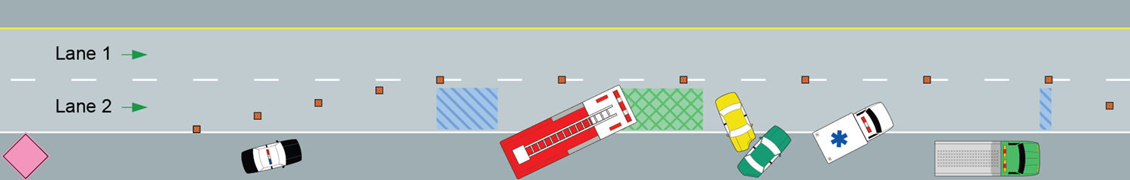
Traffic Incident Management Area Components
For Safe Scenes
Buffer
Space
Incident Space
Advance Warning Area
Transition Area
Activity Area
Termination Area
3

Slide 9
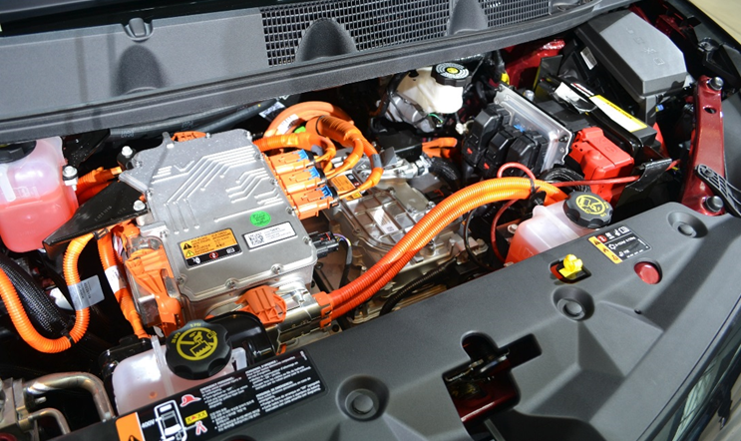
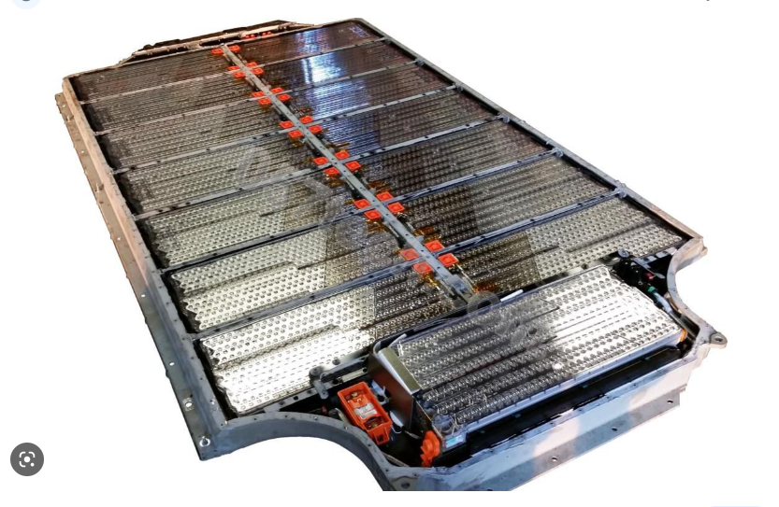
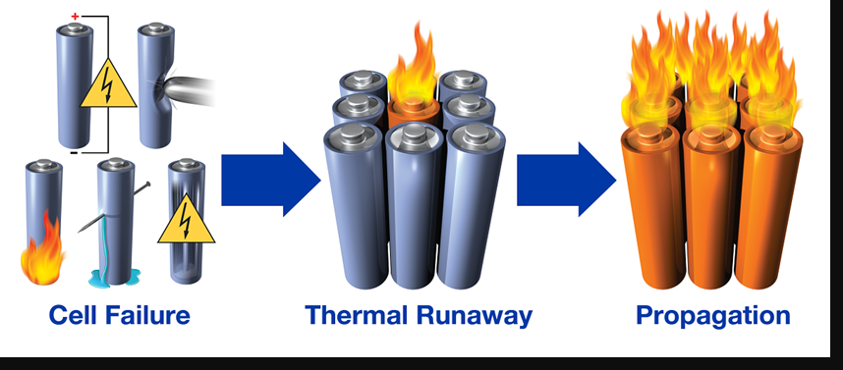
Crashes Involving Electric and
Hybrid-Electric Vehicles (EVs and HEVs)
Electric Vehicle Fires Can Take Up To 8,000 Gallons Or More Of Water To Extinguish. It Is Not Recommended To Use Foam
It May Take 2 Hour Or Longer To Burn Out
3

Slide 10
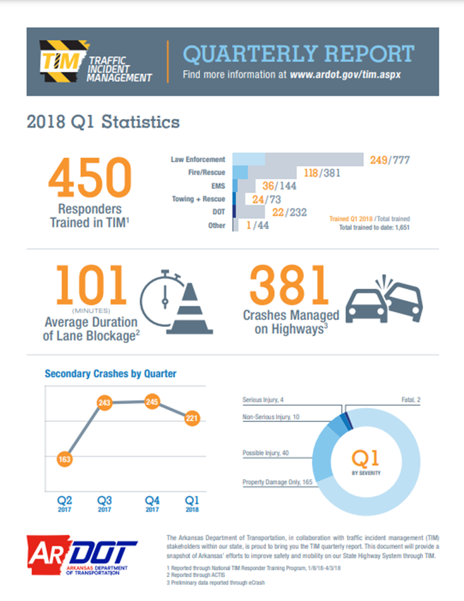
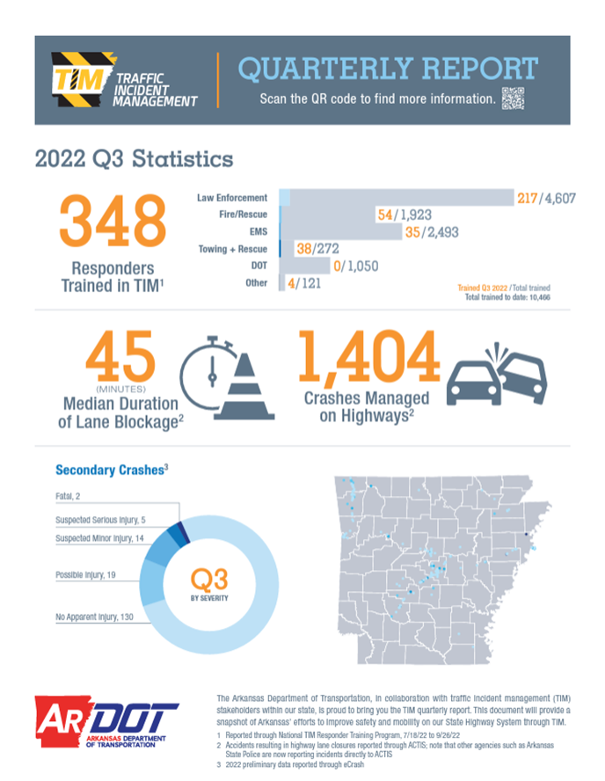
How Traffic Incident Management Has Improved
3

Slide 11
Responders Trained In Arkansas
Responders Trained In Arkansas Since 2015
On-Line 10,960 In-Class 1,879
DOT 649 426
MEMs 2,804 27
Fire 1,626 850
LE 5,722 329
Tow 151 193
Other 108 54
3

Slide 12
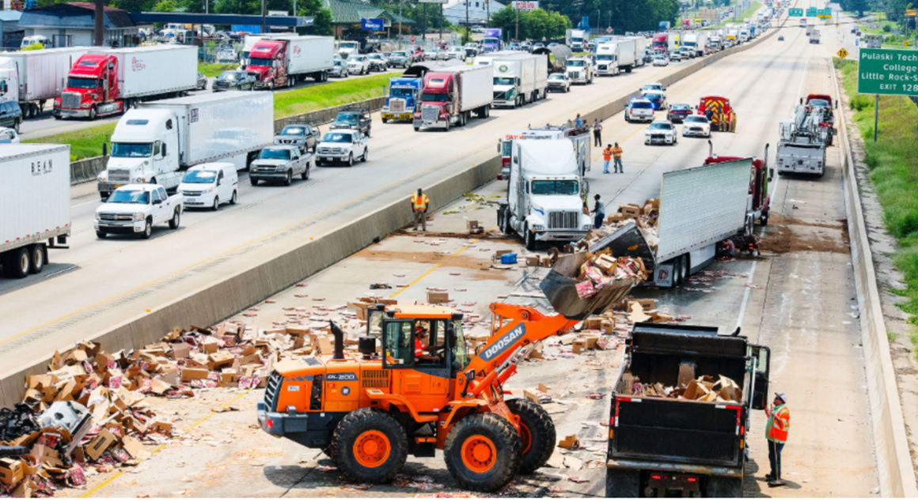

Working Together
Assisting With
Cargo Removal
3

Slide 13
Questions
?
3

Slide 14
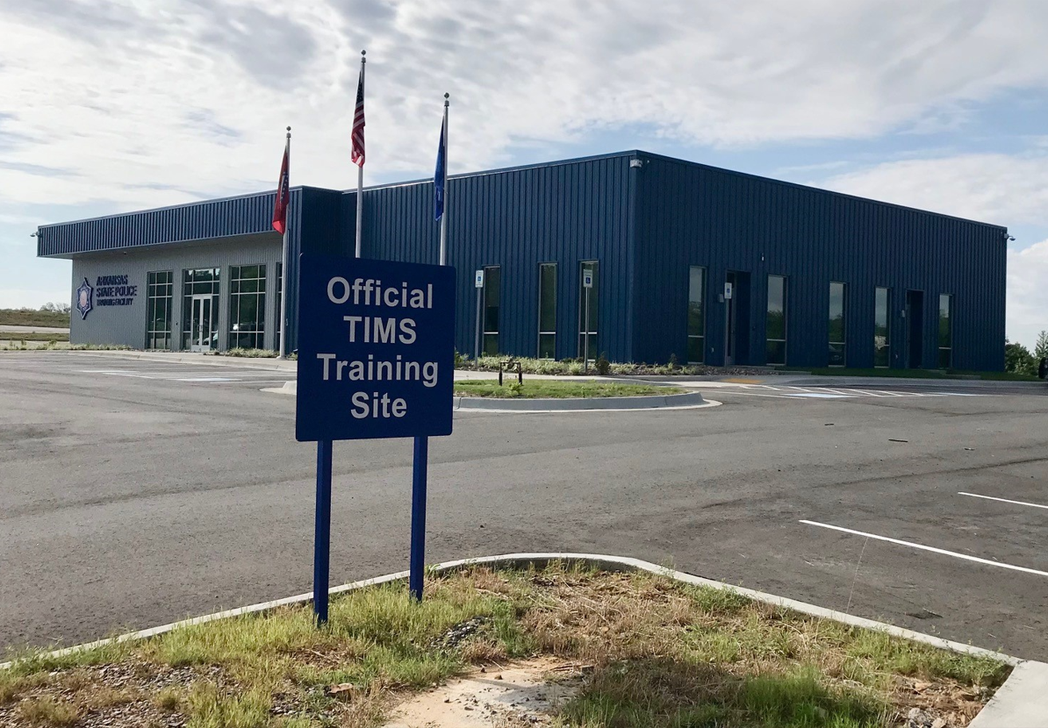
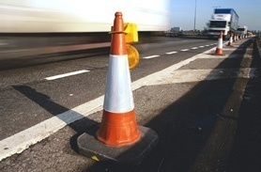

ARKANSAS
TRAFFIC INCIDENT MANAGEMENT
ADVANCED
TRAINING FACILITY
LT Brad Perkins
Arkansas Highway Police
Notes:
Good Afternoon – Thank you for inviting me to join you today.
I’m Lieutenant Brad Perkins, with the Arkansas Highway Police.
Today I’d like to discuss our new TIM Training Facility.

Slide 15
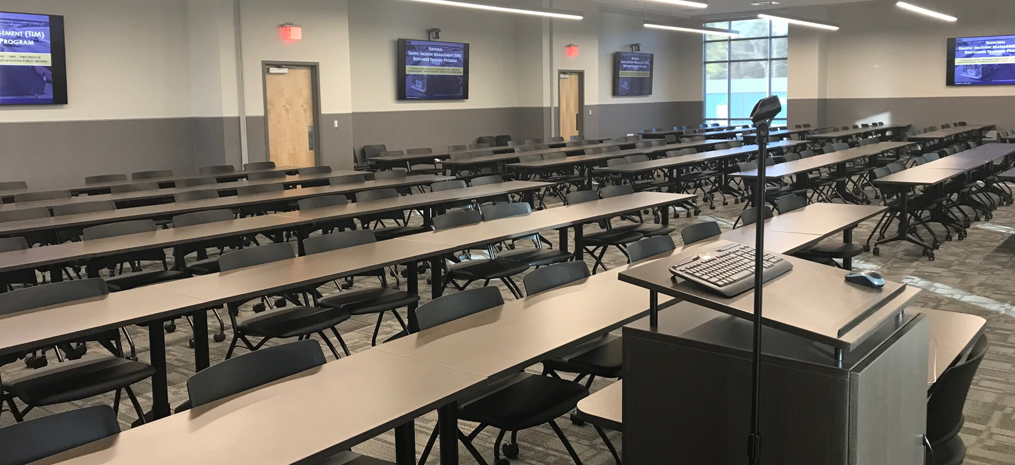
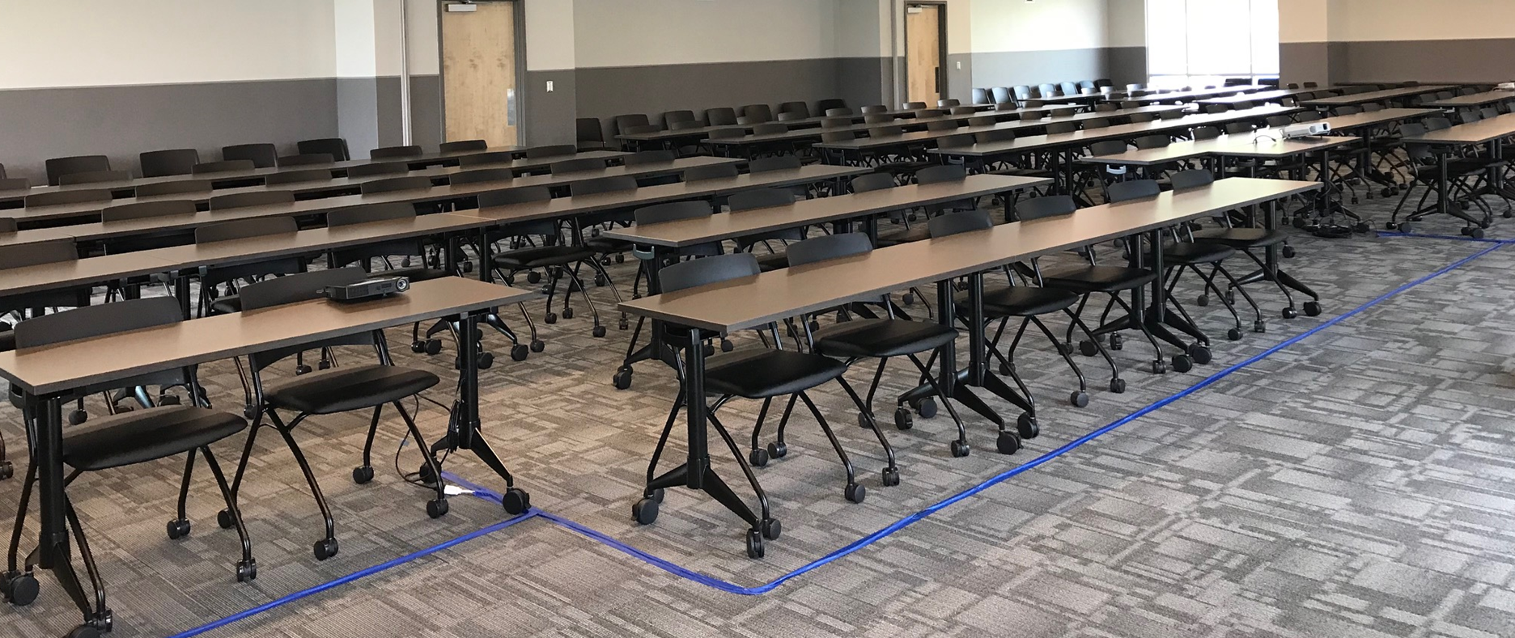
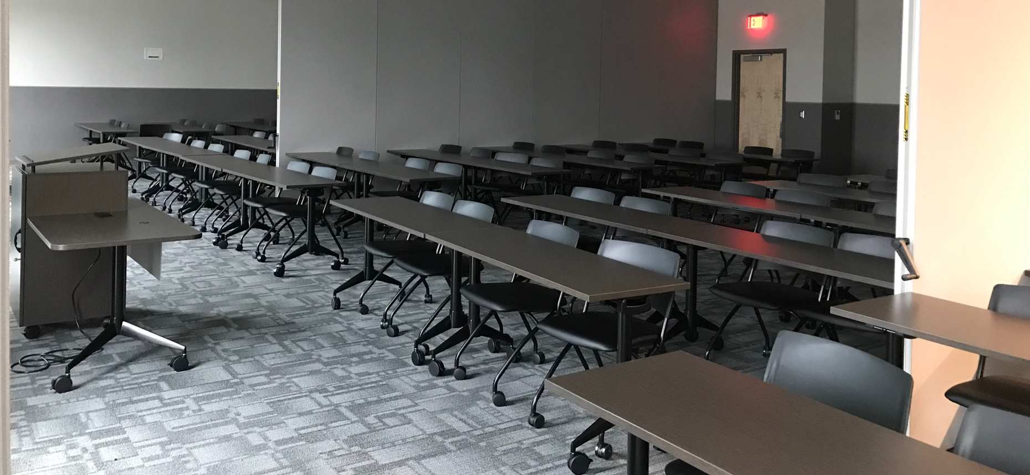
THE TRAINNG FACILITY
CLASSROOM(S)
Can Be Used As One Large Room To Accommodate 146 Attendees
Can Be Divided Into One large Room to Accommodate 98 Attendees and One Small Room For 49 Attendees
Or Can Be Divided Into Three Small Classrooms That Will Accommodate 49 Attendees Each
There are 8 86inch Smart TVs For Easy Visibility From Any Location In the Classroom.
Each Classroom Section Has Video Camera For Remote Viewers
Notes:
The training classroom can accommodate up to 146 attendees or the classroom can be divided into separate rooms
Each classroom area has video cameras for use when teaching to remote locations

Slide 16
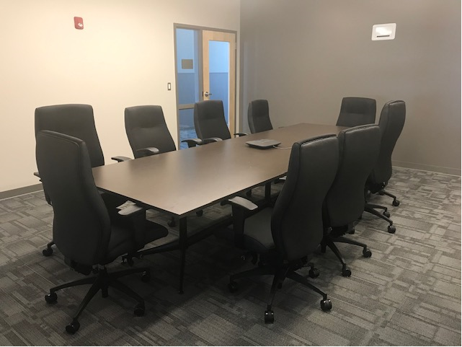
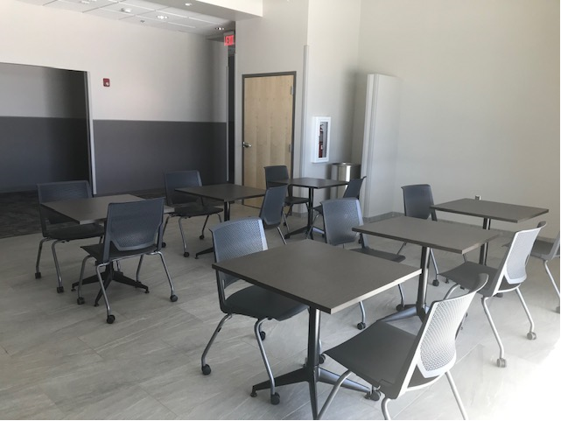
THE TRAINNG FACILITY
Break Room
Conference Room

Slide 17
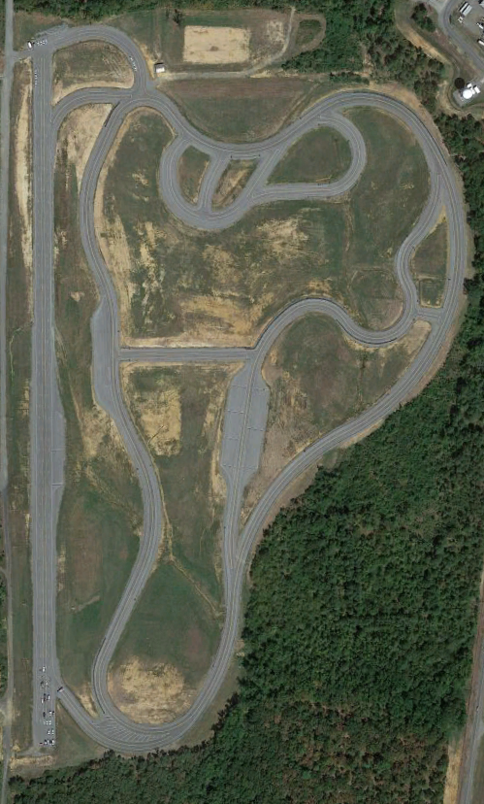
THE TRACK
2 ½ Miles Of Paved Roadway
Notes:
2 ½ miles of paved roadway surface which includes many turns small grade hills that obscures the forward view, guard rails and intersections

Slide 18
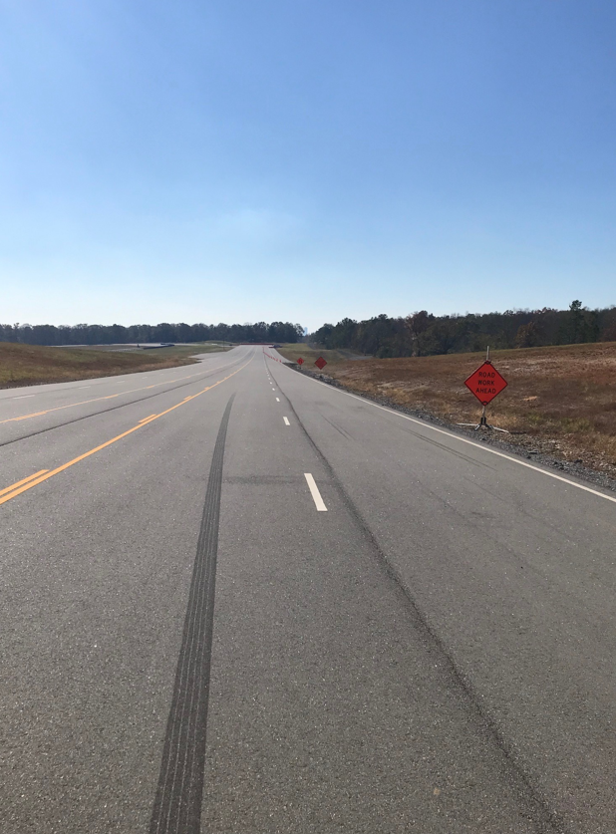
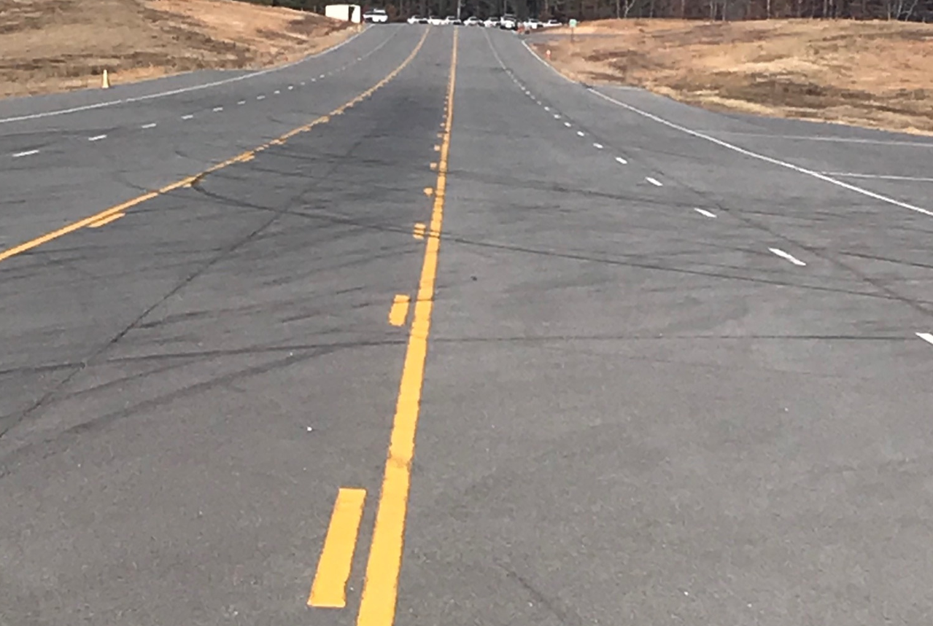
THE TRACK
½ Mile Of Full-Size Interstate Roadway Or Four Lane With Middle Turn Lane
Notes:
The track also has ½ miles of roadway made to the specifications of an interstate roadway or 4 lane with center turn lane.

Slide 19
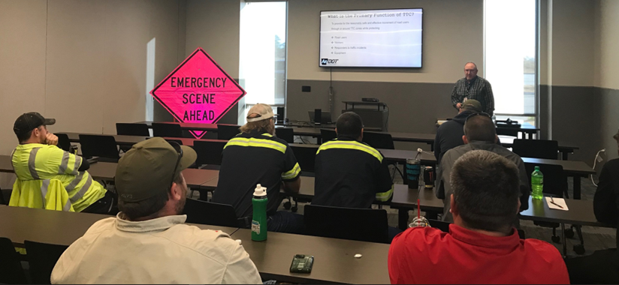
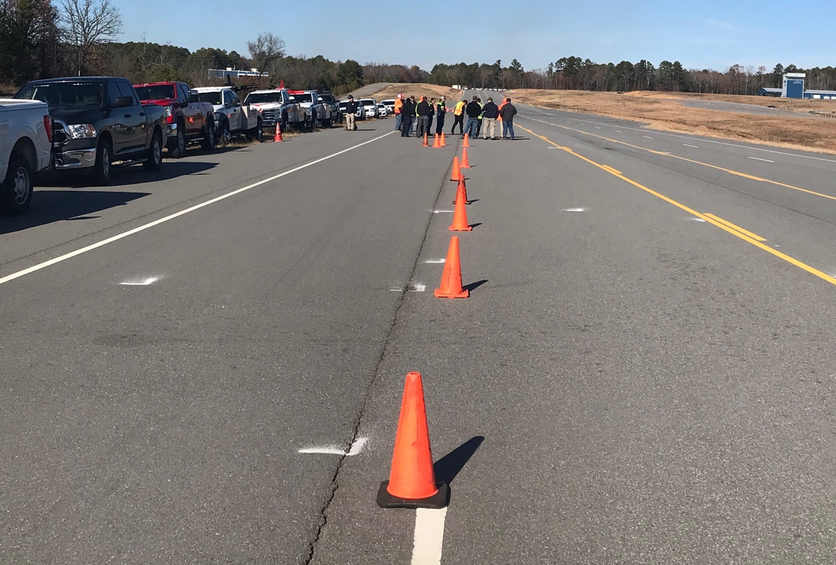
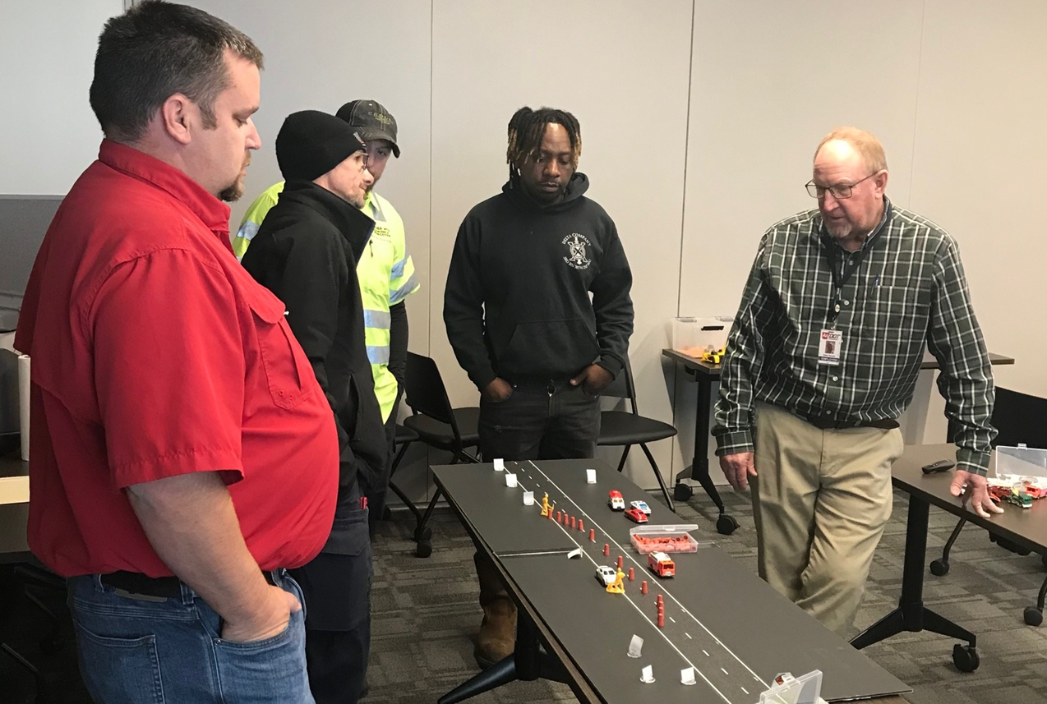
RECENT TRAINING
How To Safely Set Up A Proper Lane Closure
Notes:
ARDOT Training Instructors assisted in teaching responders how to safely set up a proper lane closure
Utilized classroom time to explain the details and the part of the MUTCD that pertains to temporary lane closures
Attendees then went to the “Interstate” part of the track to set up a proper lane closure

Slide 20
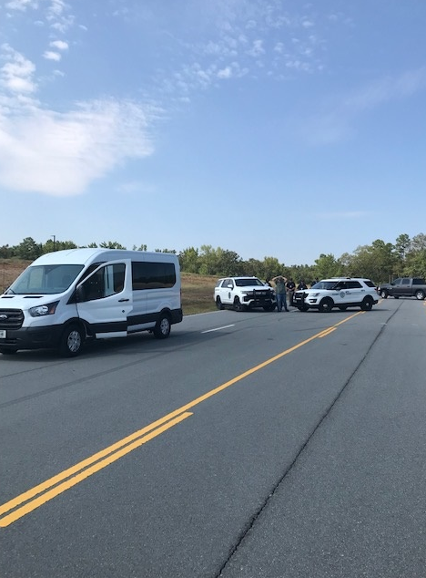
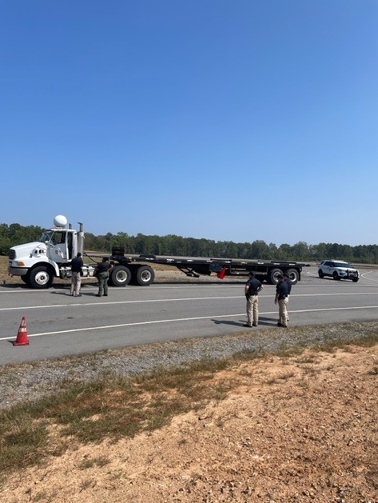

ADVANCED TRAINING - SAFE CONTROLLED ENVIRONMENT
Safe Location For Realistic Traffic Stop Training
Notes:
Realistic traffic stop training

Slide 21

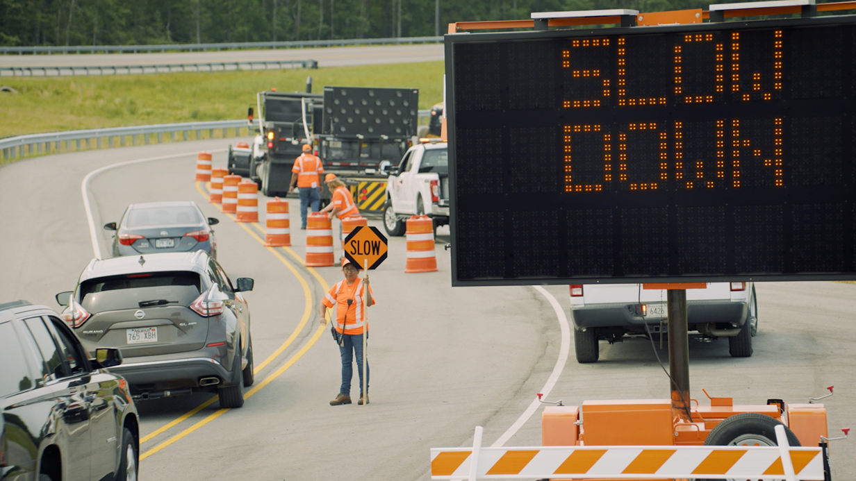

RESPONDER SAFETY
Slow Down, Phone Down: a statewide work zone safety campaign
Arkansas Highway Police and Arkansas State Police cracking down on distracted and reckless driving
Education and awareness around work zone laws
Notes:
Track was used to film the TV adds
Three ads in total were filmed
Additional Slow Down Phone Down commercials were filmed on Jan 10 &11 of this year
.

Slide 22
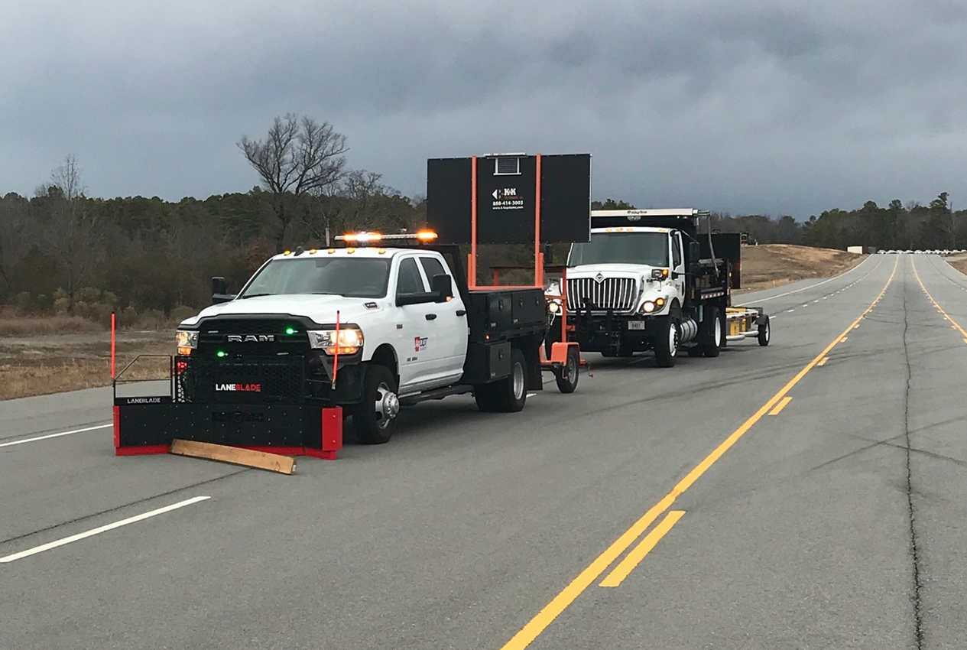

Lane Blade Debris Removal Training
Train operators how to properly deploy the Lane Blade Debris Removal tools at speed in a safe controlled environment

Slide 23
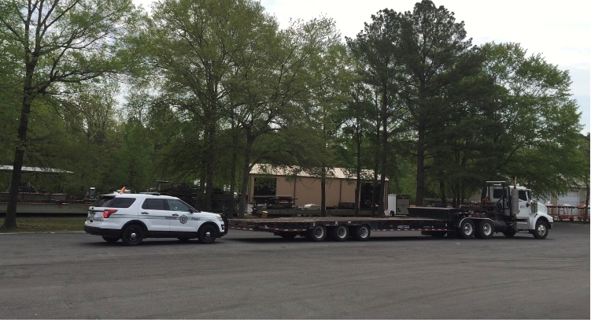
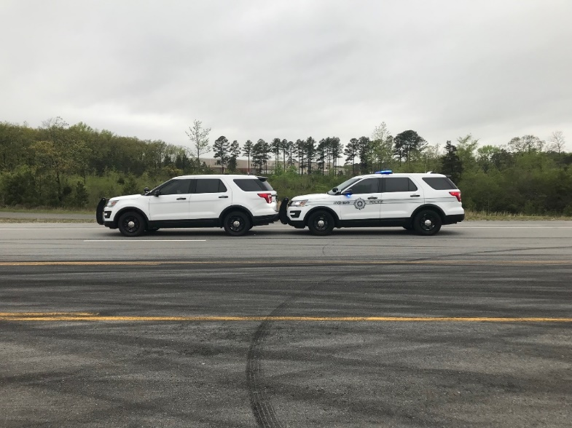
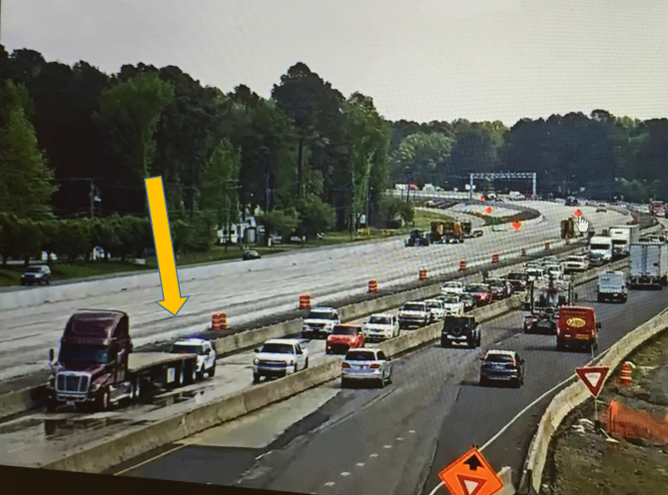
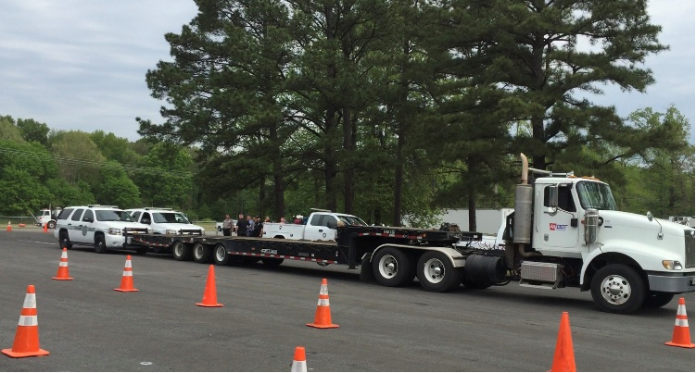
Push Bumper Training
Notes:
Here we teach responders, mostly for the LE, how to use the push bumpers
How to safely push passenger vehicles
Methods to push large CMVs

Slide 24
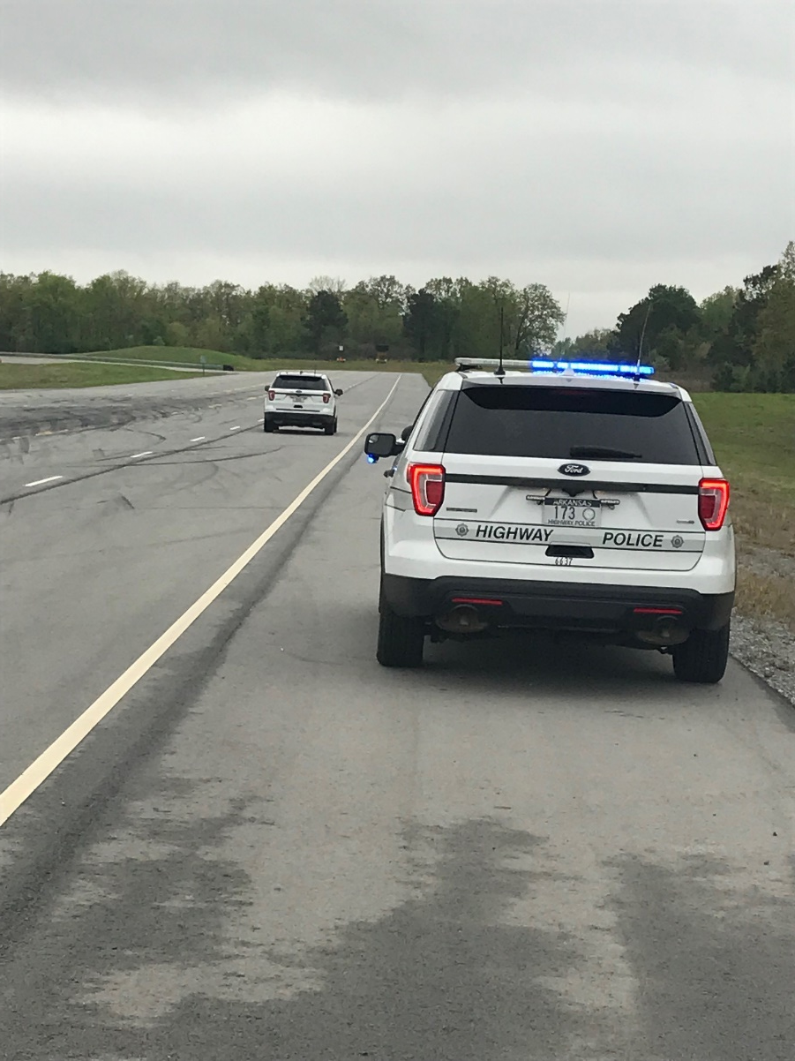
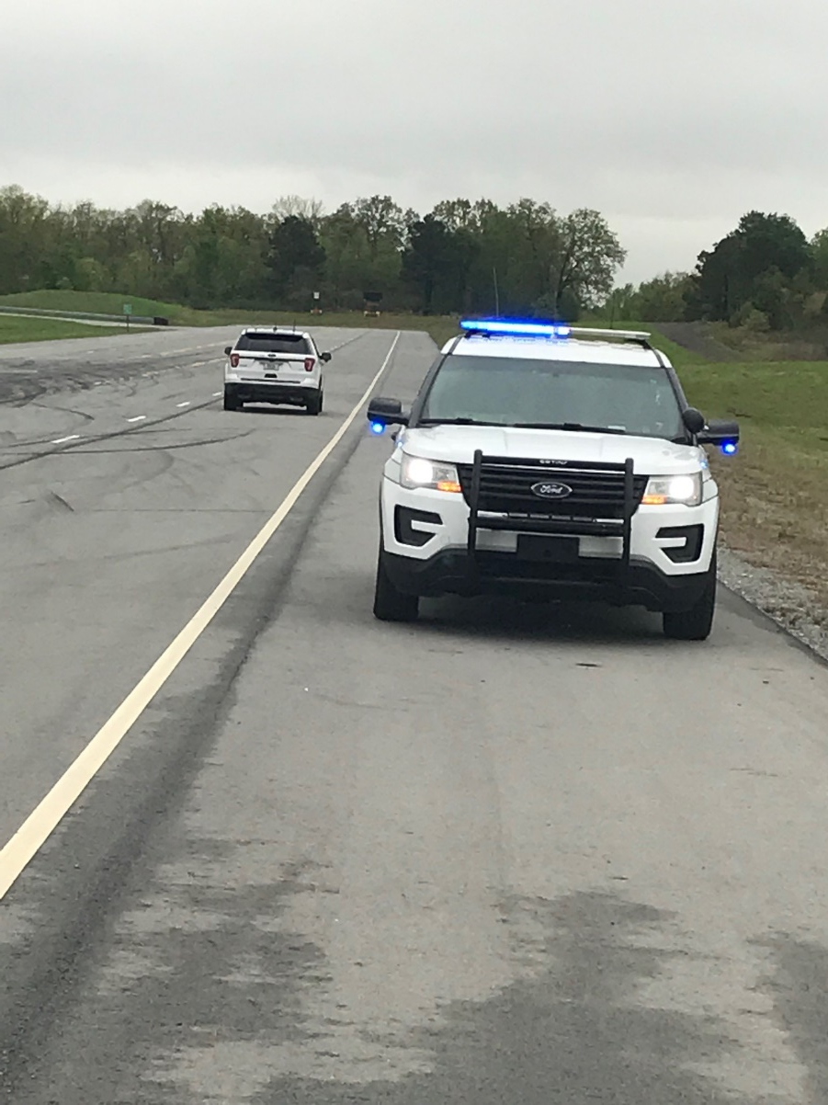
Safe Location for Back of Queue Training
Notes:
Teaching safe methods of protecting the queue and how to move safely as a queue increases or decreases in length

Slide 25
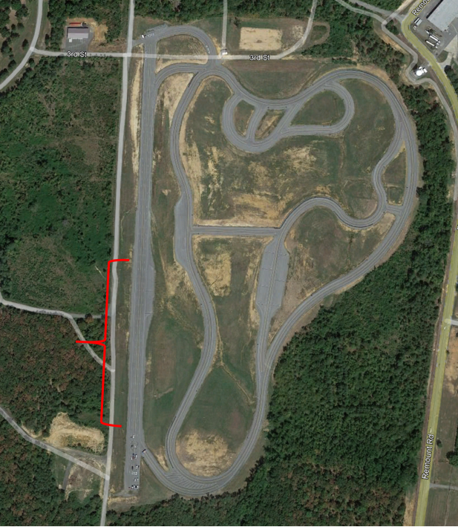
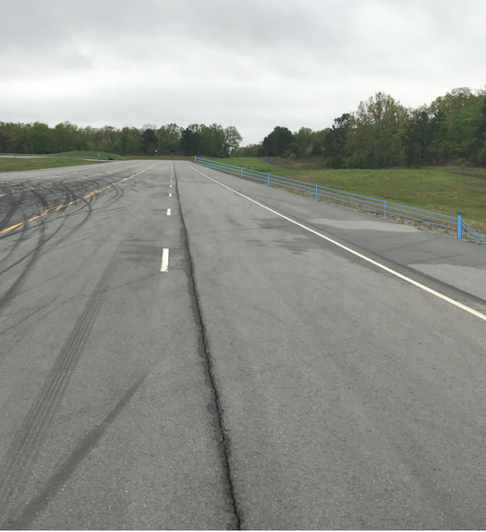
Cable Barrier Training
Potential Location for Cable Barrier Training
Proposed Cable barrier
Notes:
Future installations to teach responders how to safely manipulate the cable barriers

Slide 26
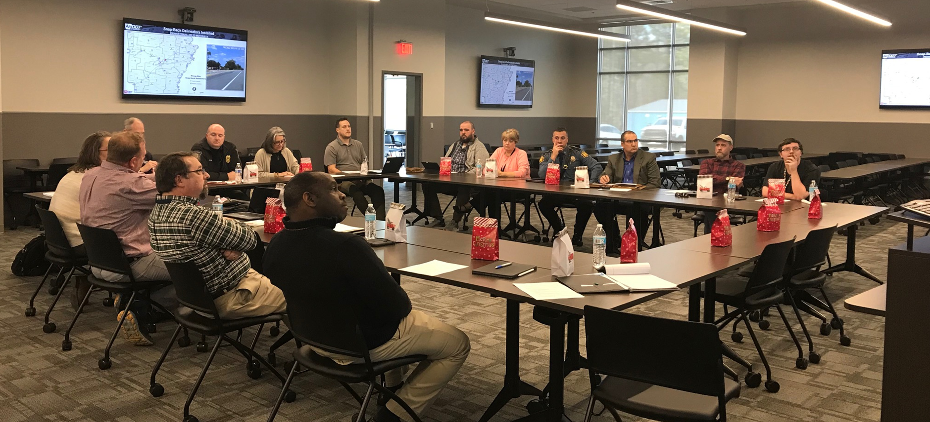
ARKANSAS TIM WORKING COMMITTEE
Arkansas TIM Working Committee Meeting
Notes:
Arkansas TIM Working Committee Meetings will be held at the TIM Training Facility

Slide 27
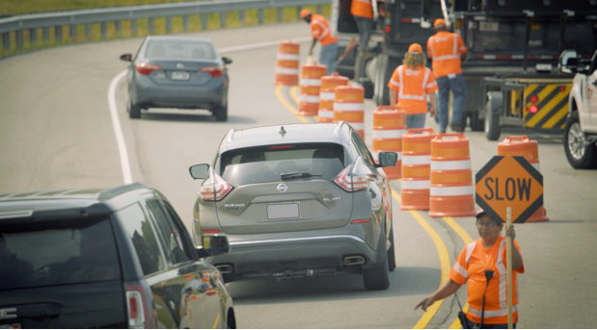

ARKANSAS
TRAFFIC INCIDENT MANAGEMENT
ADVANCED
TRAINING FACILITY
LT Brad Perkins
Arkansas Highway Police
brad.perkins@ardot.gov

