Slide 1


TRC2101: Update of the ARDOT Workforce Forecasting System
Suman Mitra, PhD
Adedolapo Ogunbire
2024 TRC Conference, Hot Spring
05/22/2024

Slide 2
Content Outline
Background
Existing Forecasting Software
Past Works
Data
Forecasting Models
Distribution Models
Software Architecture
Automation
Software Interface
Progress

Slide 3




Background
Less staff are required to manage increasing highway mileage
Need for proper future planning to save cost from emergency hiring
Quality is preserved with adequate workforce overseeing projects across RE offices
Talents are being attracted into other industries

Slide 4




Existing Forecasting System
Outdated system first introduced in 1970s
Forecasts are inaccurate and unreliable
Formulas need constant update and are out of date
Not well integrated with today’s tool, technology, and workflow

Slide 5
State-of-the-practice
E-WoW System for forecasting using data from multiple State Transportation Agencies (STAs) and simple cost ratio based on quartiles
TxDOT forecasts based on simple linear regression
SCDOT adopts simple linear regression using cost and person-hours by project categories

Slide 6
State-of-the-Art Techniques
Machine learning Models
Simple and multiple linear regression models
Econometrics timeseries and neural network based such as recurrent neural networks
System Dynamic approach using stock and flow modeling

Slide 7
Data
Data received was for the period of 2012 – 2021
Over a million record for employee hours and more than 3000 project information
Employee data includes key details such as hours, project ids, job title descriptions
Project data includes important variables: project type, ids, cost, status, begin and end dates

Slide 8
Data
Predictor Data for Workforce Estimation
Project Type
Cost
Total Person-hours
Let Year

Slide 9
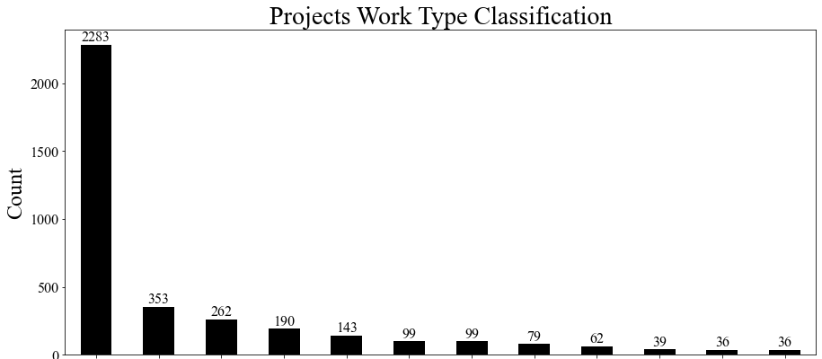
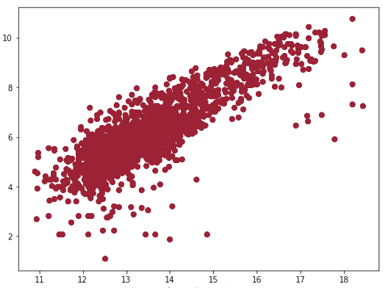
Data
Log (Person-hours)
Base
Log (Cost)
Resurfacing
Resurf. & Shou.
Struct. & App.
Sealing
Passing Lanes
Reconstruction
New Location
Major Widening
Rehabilitation
Base & Surf.
Safety & Traf. Eng.

Slide 10
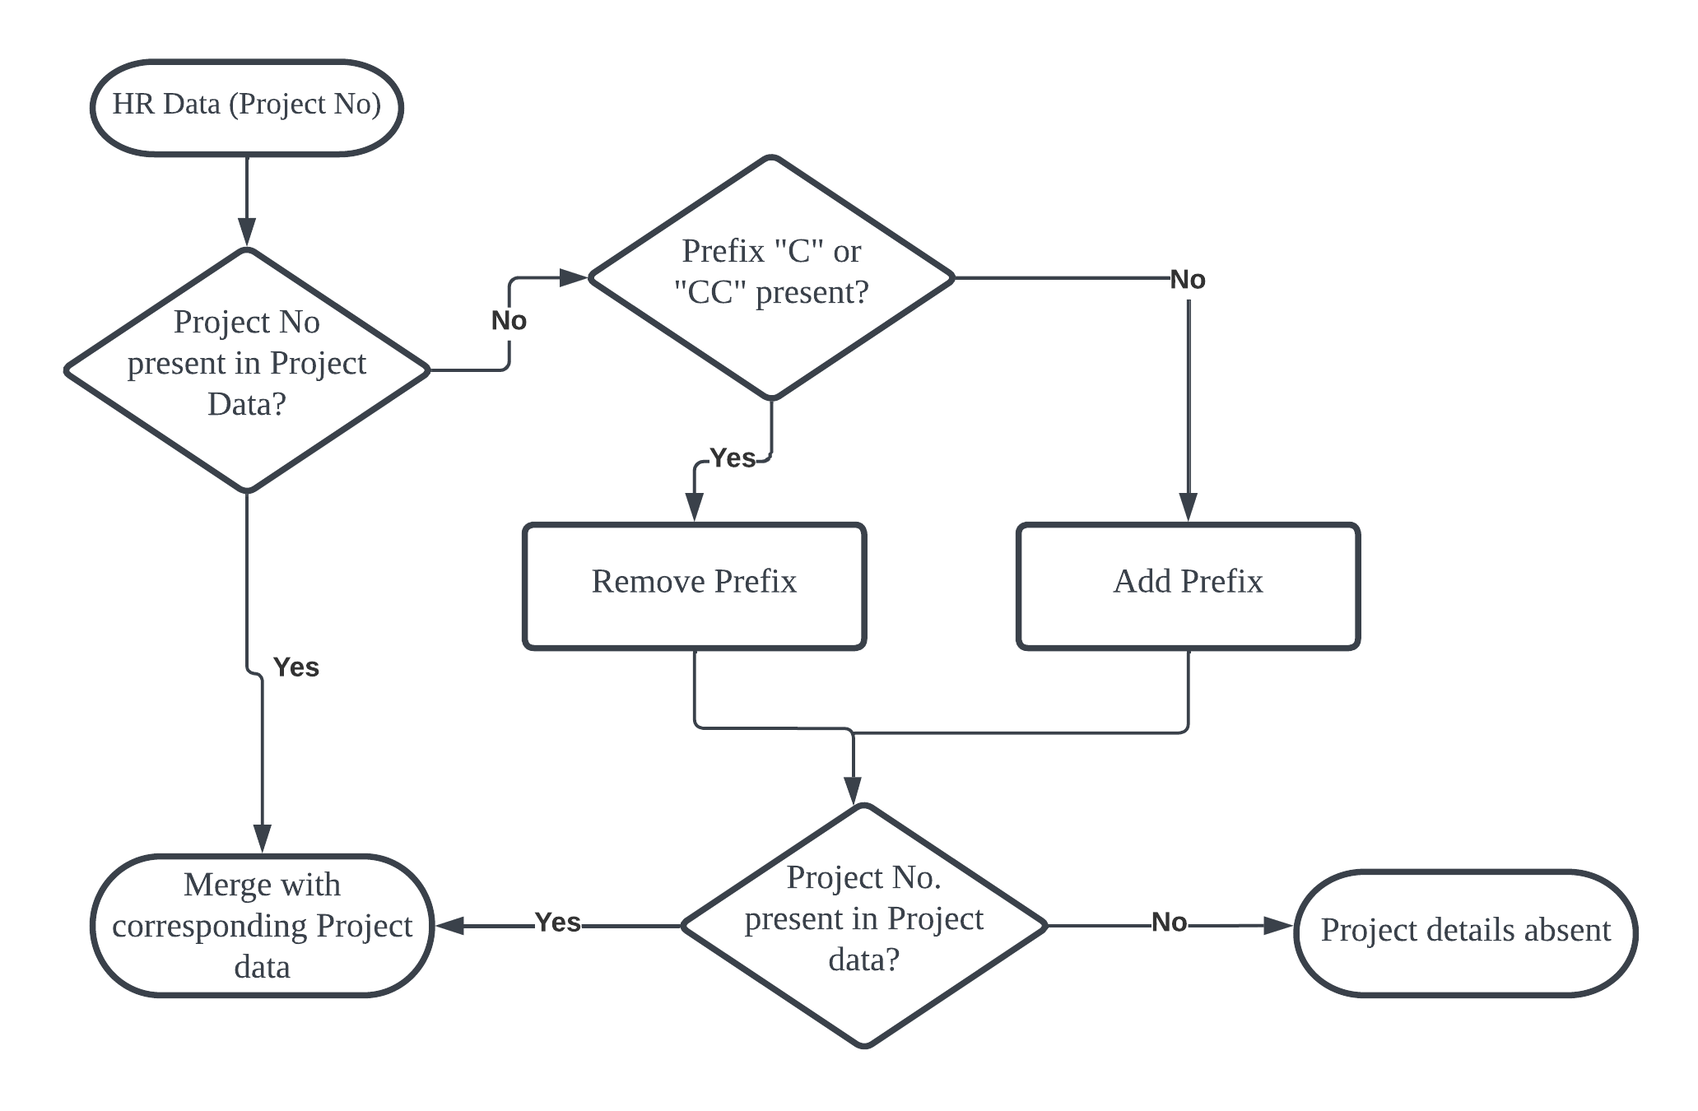
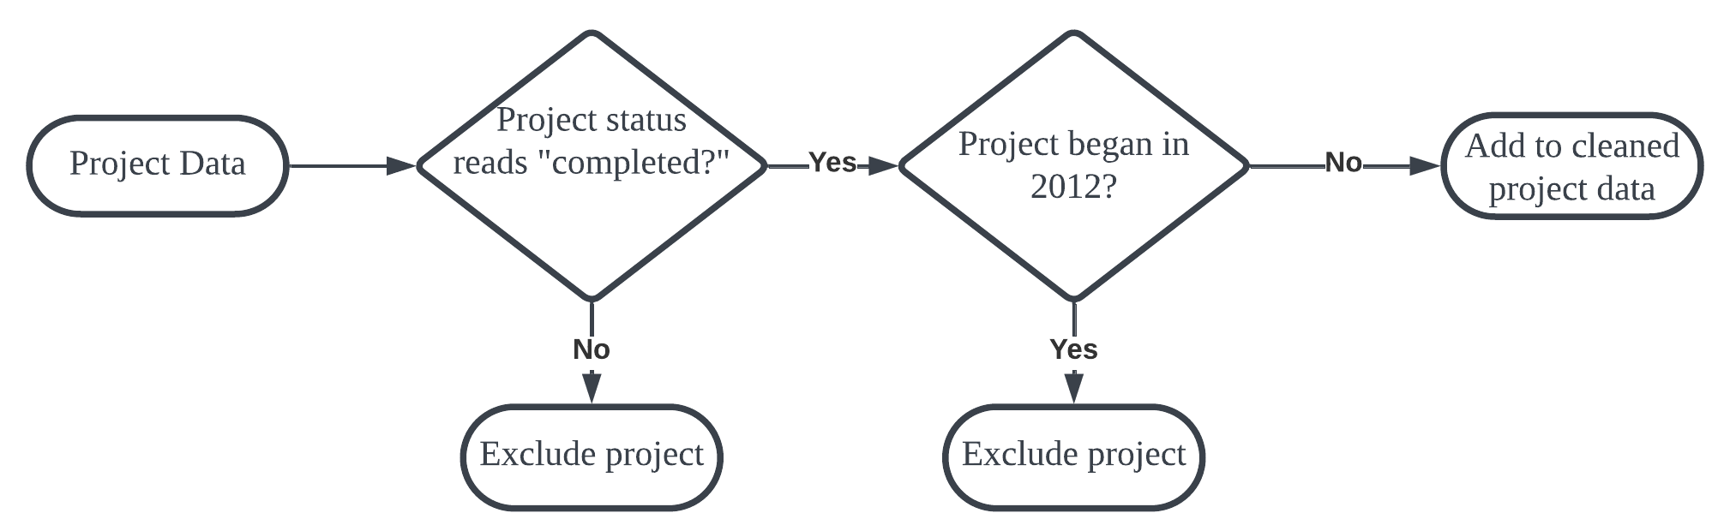
Preprocessing
Simplified charts showing the data cleaning process
Project data cleaning
Merging and cleaning data

Slide 11
Forecasting
Multiple linear regression models employed for total person-hours forecast
Need for grouping of multiple project types that have insufficient number of projects
Group 01 (39) | Group 02 (36) | Group 03 (53)
Base Stabilization (12) | Buildings (6) | Emergency (3)
Base & Drainage (2) | Minor Widening (3) | Interchange (9)
Grading, Drainage & Base (1) | Surfacing (7) | Passing Lanes (12)
Grading & Structures (2) | Roadside Appurtenances (6) | RR Crossing (2)
Base (7) | Sealing (5) | Rehabilitation (11)
Base & Surfacing (15) | Miscellaneous (9) | New Location (11)
 |  | Bridge Rehabilitation (5)

Slide 12
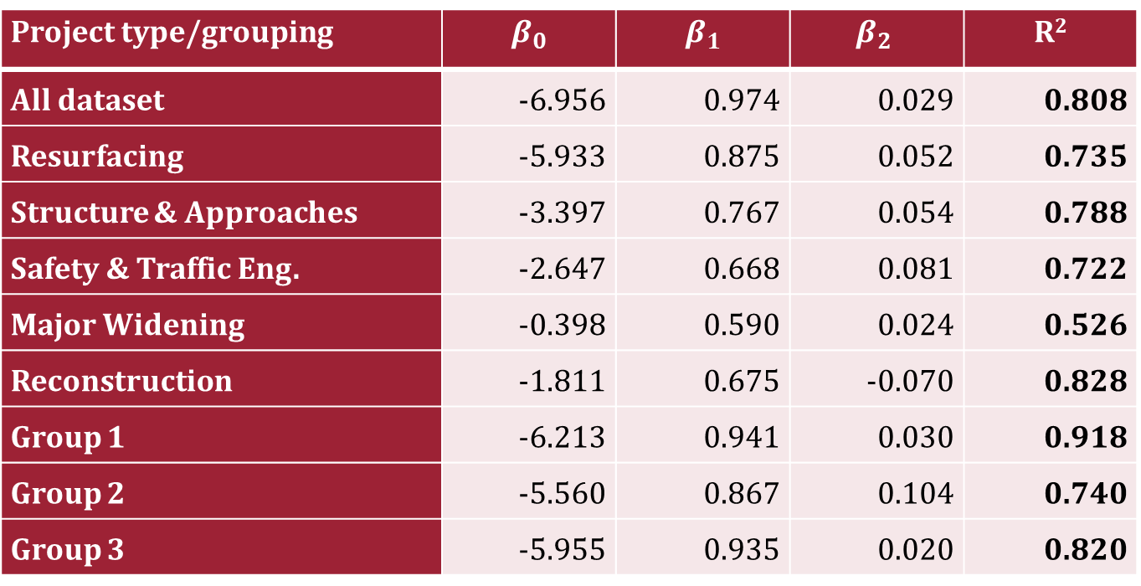
Forecasting Model
$$Log \left(person_hour\right)= β_{0}+β_{1}×\log\left(adjusted cost\right)+ β_{2}×\left(year_difference\right)$$
Project type/grouping | $$β_{0}$$ | $$β_{1}$$ | $$β_{2}$$ | R²
All dataset | -6.956 | 0.974 | 0.029 | 0.808
Resurfacing | -5.933 | 0.875 | 0.052 | 0.735
Structure & Approaches | -3.397 | 0.767 | 0.054 | 0.788
Safety & Traffic Eng. | -2.647 | 0.668 | 0.081 | 0.722
Major Widening | -0.398 | 0.590 | 0.024 | 0.526
Reconstruction | -1.811 | 0.675 | -0.070 | 0.828
Group 1 | -6.213 | 0.941 | 0.030 | 0.918
Group 2 | -5.560 | 0.867 | 0.104 | 0.740
Group 3 | -5.955 | 0.935 | 0.020 | 0.820

Slide 13
Distribution Models
Uses historical distribution as reflected by past projects
Cost quartiles employed for job title distributions
Timeline distribution employed historical trend and person-hour distributions
Varying duration of similar project types warranted the need to normalize distribution over varying lengths

Slide 14
Job Title Distribution
Similar project types across various cost quartiles have similar distribution of inspectors types for their projects
Constr. Inspector
Quartile 1
Engineer
Constr. Inspector
Project type
Quartile 2
Construction Aide
Engineer
Quartile 3
Advanced Engineer
Construction Aide
Quartile 4
Advanced Engineer

Slide 15
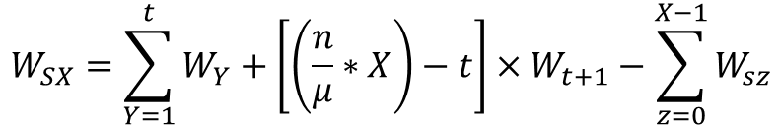
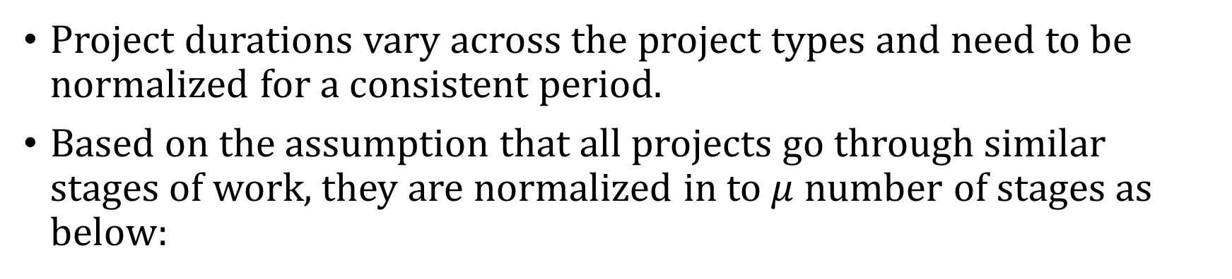
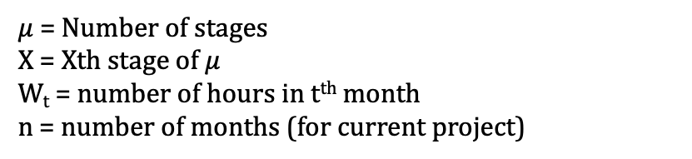

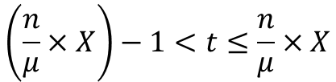
Time Distribution Model
Project durations vary across the project types and need to be normalized for a consistent period.
Based on the assumption that all projects go through similar stages of work, they are normalized in to $μ$ number of stages as below:
$$W_{SX}=\sum_{Y=1}^{t}{W_{Y}}+\left[\left(\frac{n}{μ}∗X\right)−t\right]×W_{t+1}−\sum_{z=0}^{X−1}{W_{sz}}$$
$$\left(\frac{n}{μ}×X\right)−1<t≤\frac{n}{μ}×X$$
$$t∈ \left\{Z^{+}∪0\right\}$$
$μ$ = Number of stages
X = Xth stage of $μ$
W_{t} = number of hours in t^{th} month
n = number of months (for current project)
W_{S0} = 0
A.P.C. Chan et al. (2005)

Slide 16
Software Tool
Forecasting tool was built into a webapp
The webapp could be accessed from any modern web browser
Tool installed in ARDOT’s server with security authentication requirement for end users

Slide 17



Software Tool
Forecasting tool was built into a webapp
The webapp could be accessed from any modern web browser
Tool installed in ARDOT’s server with security authentication requirement for end users

Slide 18
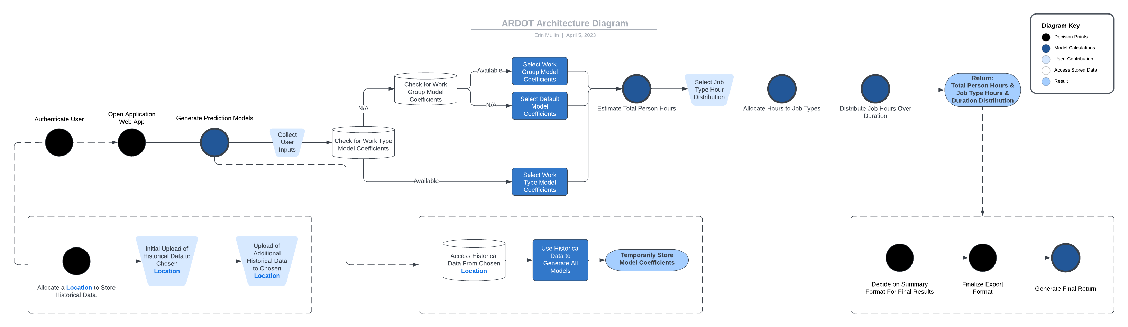
Software Architecture
Software architecture diagram for forecasting tool

Slide 19
Software Architecture
Initializing the tool

Slide 20
Software Architecture
Selecting appropriate model for estimate

Slide 21
Software Architecture
Distribution models for job type and timeline

Slide 22
Automation
Seamless integration into ARDOT’s existing databases
Automatic update of model coefficients using most recent data
Project details from ARDOTs’ Database
Automated Model Coeff. Updates

Slide 23
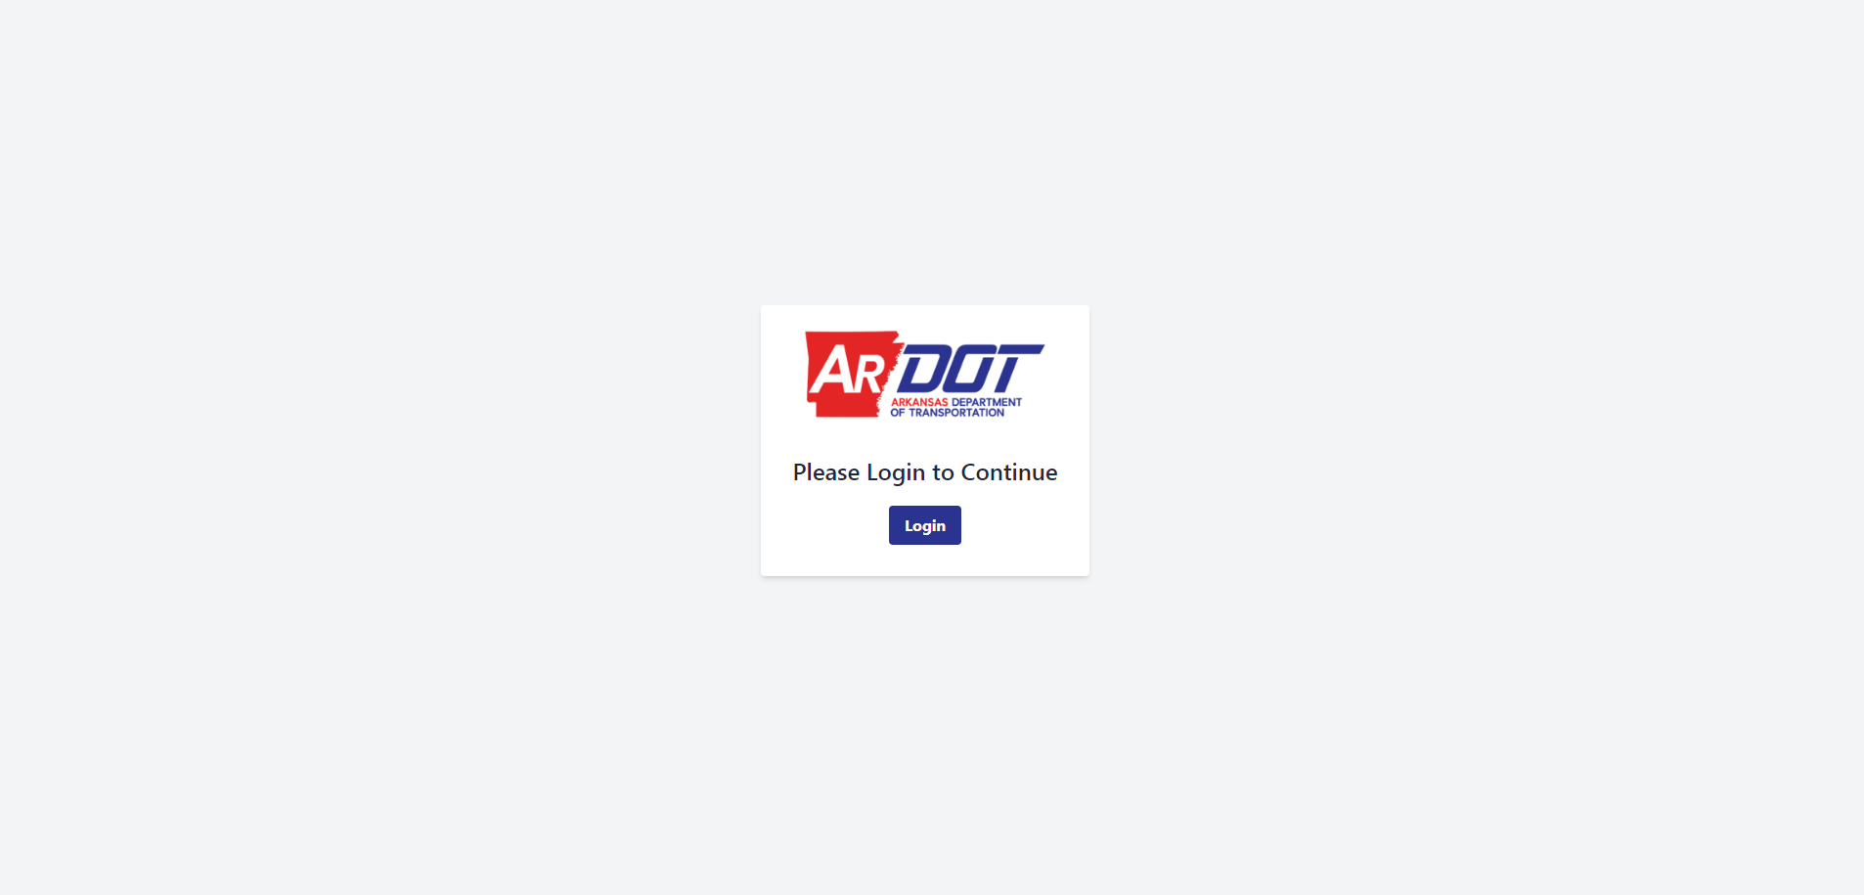
User Interface
Visualization of the user interface
Microsoft user authentication
Login interface

Slide 24
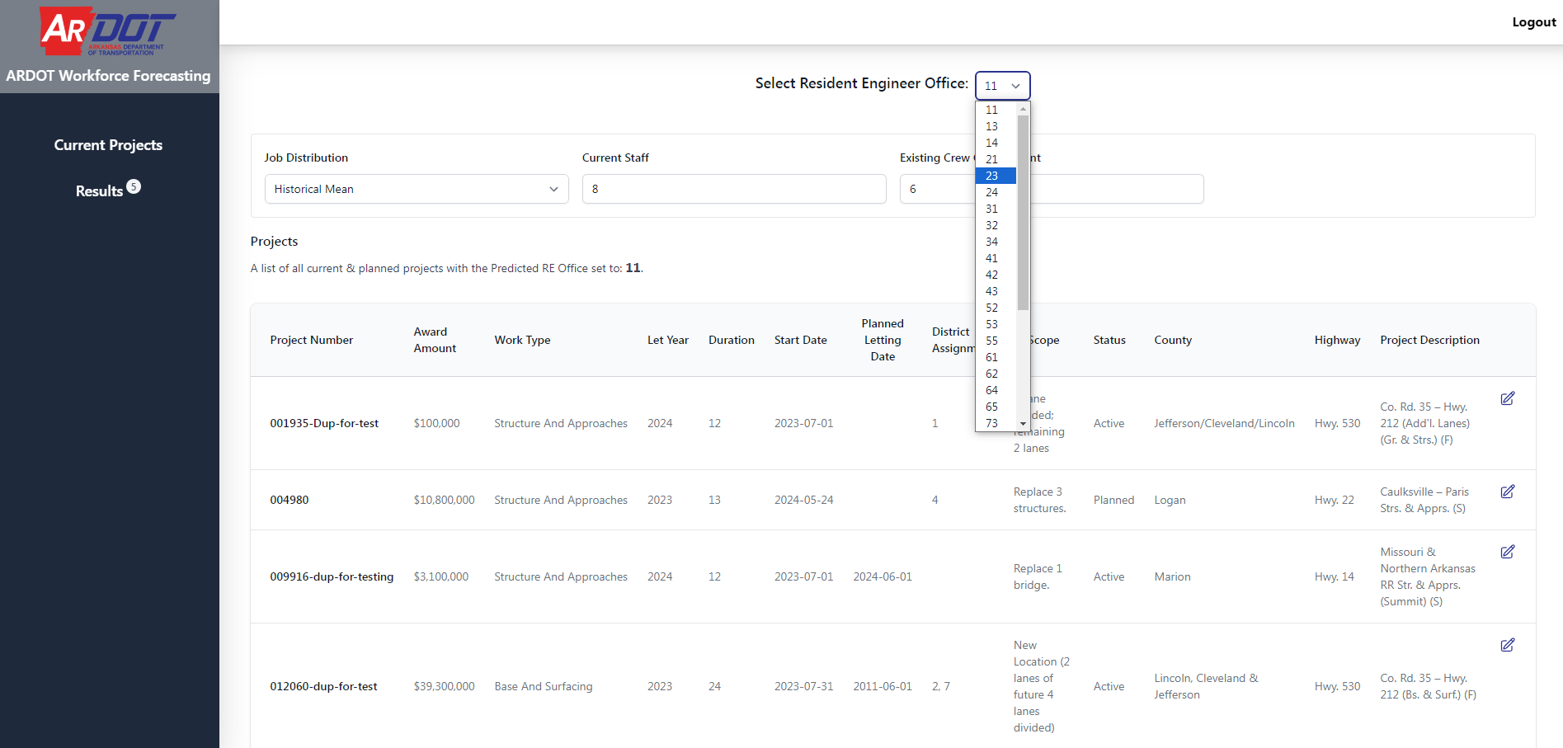
User Interface
Project Listings for RE offices

Slide 25
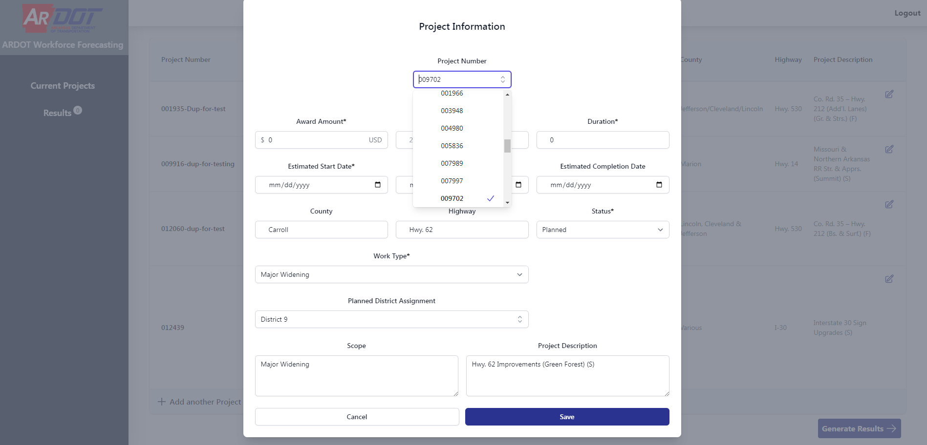
User Interface
Adding new project for RE office from database

Slide 26
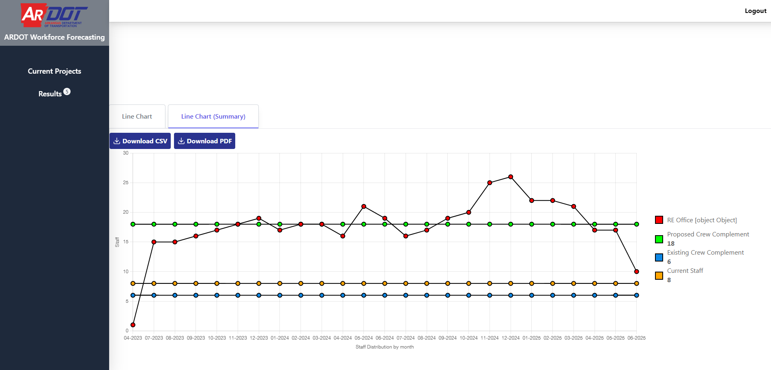
User Interface
Visualizing results for RE office

Slide 27
Progress
Adapting the current tool to match ARDOTs’ project database
Bug fixes and modifications to improve user experience
Technical documentation and development of user guide

Slide 28
Acknowledgements
Cast partners: Clayton Sexton and Erin Mullin
ARDOT subcommittee
Dr. Sarah Hernandez

Slide 29
Progress
Thank You
Q & A
Email: skmitra@uark.edu

