Slide 1
2024 Solar Eclipse
Traffic Management Plan
ARDOT Transportation Research Conference
May 22, 2024
Nicci Tiner, PE, PTOE

Slide 2
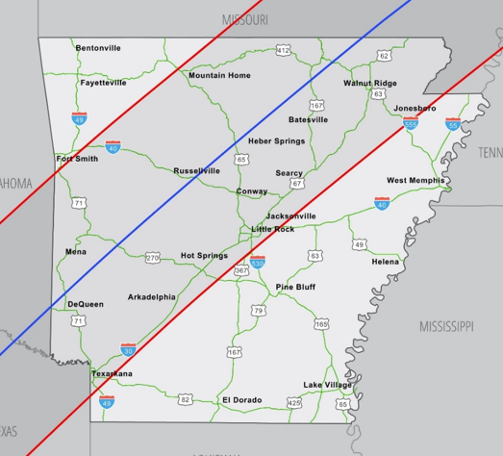
Introduction
On April 8, 2024, the Moon passed between the Sun and the Earth, creating a 117.9-mile-wide shadow.
In preparation for this event, Garver prepared a Traffic Management Plan for ARDOT.

Slide 3
Data Compilation & Traffic Forecasting

Slide 4
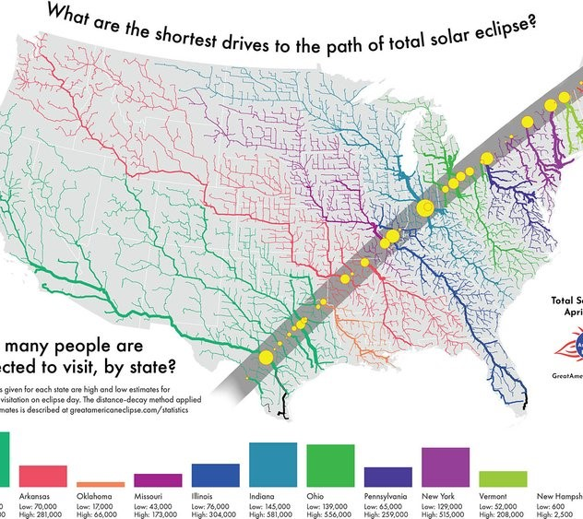
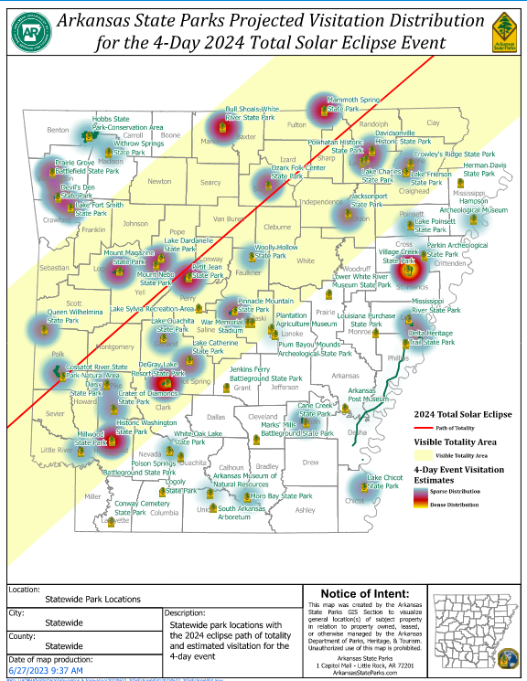
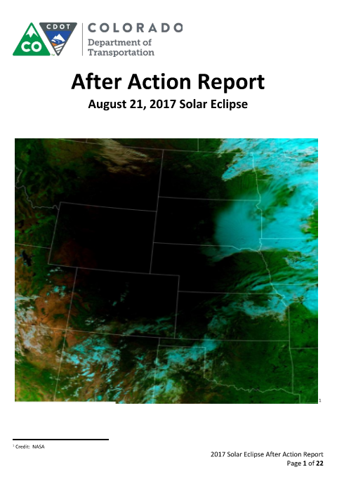
Data Compilation
Information from the Arkansas State Parks
Booking data for hotels, campgrounds, and RV parks
After-Action Plans from the 2017 Eclipse
Miscellaneous websites

Slide 5
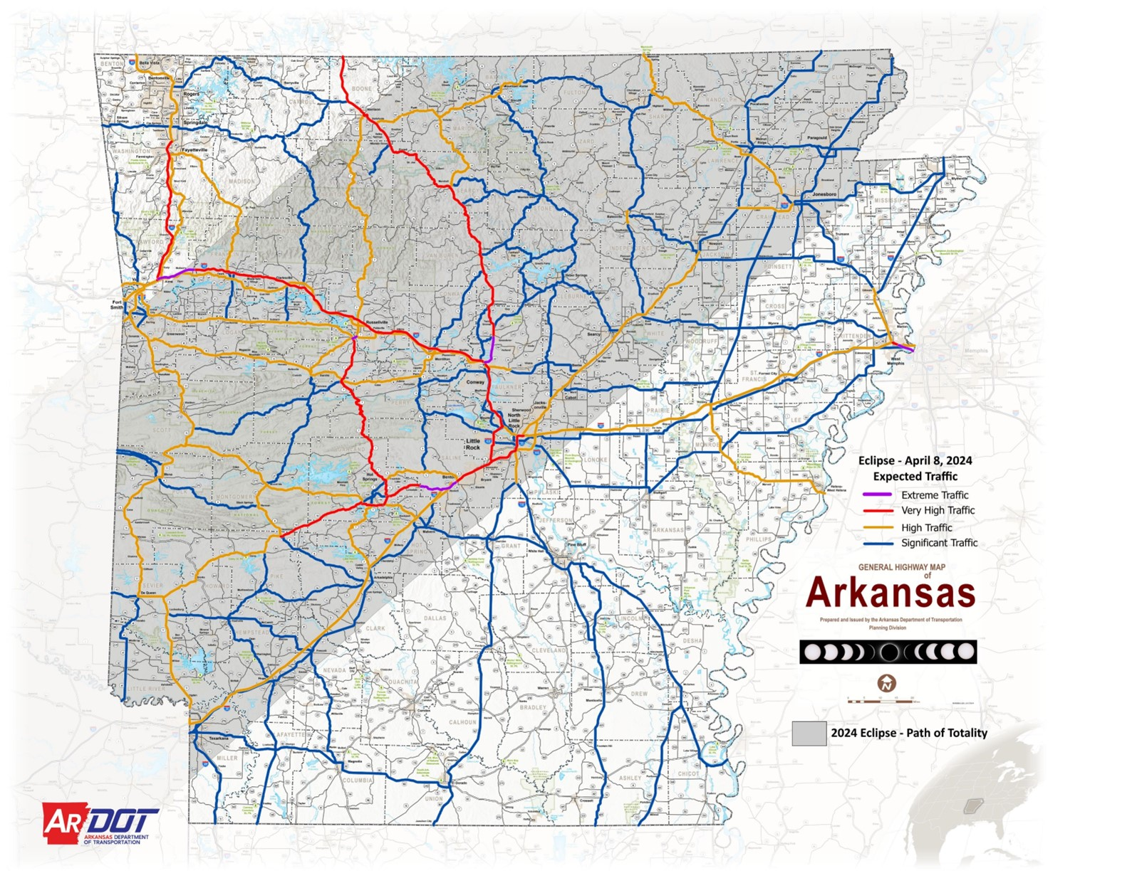
Traffic Forecasting
Up to 1.5 million visitors expected to visit and 500,000 Arkansans travelling also.
Assumed 2.86 passengers per vehicle
Reviewed the 2017 Eclipse to develop travel patterns
  30% arrive day of the event
  80% leave immediately afterwards

Slide 6

Travel Demand Modelling
Alliance Transportation Group (ATG) partnered with us on this project.
Using the available information, ATG modified the Statewide Travel Demand Model (TDM).
Based on the TDM results, the Team (ARDOT, ATG, and Garver) identified hot spots and corridors needing mitigation.

Slide 7
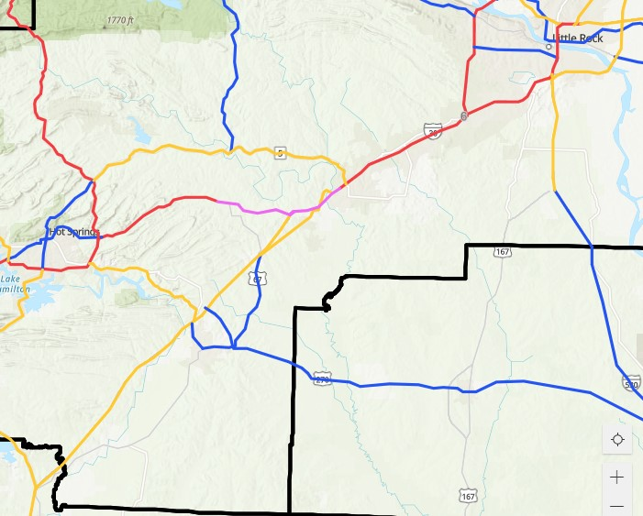
Travel Demand Model Results
Extreme (Purple) = bottleneck points
Very high (Red) = well above capacity
High (Orange) = above capacity
Significant (Blue) = approach or modestly exceed capacity

Slide 8
Traffic Demand Reduction Strategies

Slide 9
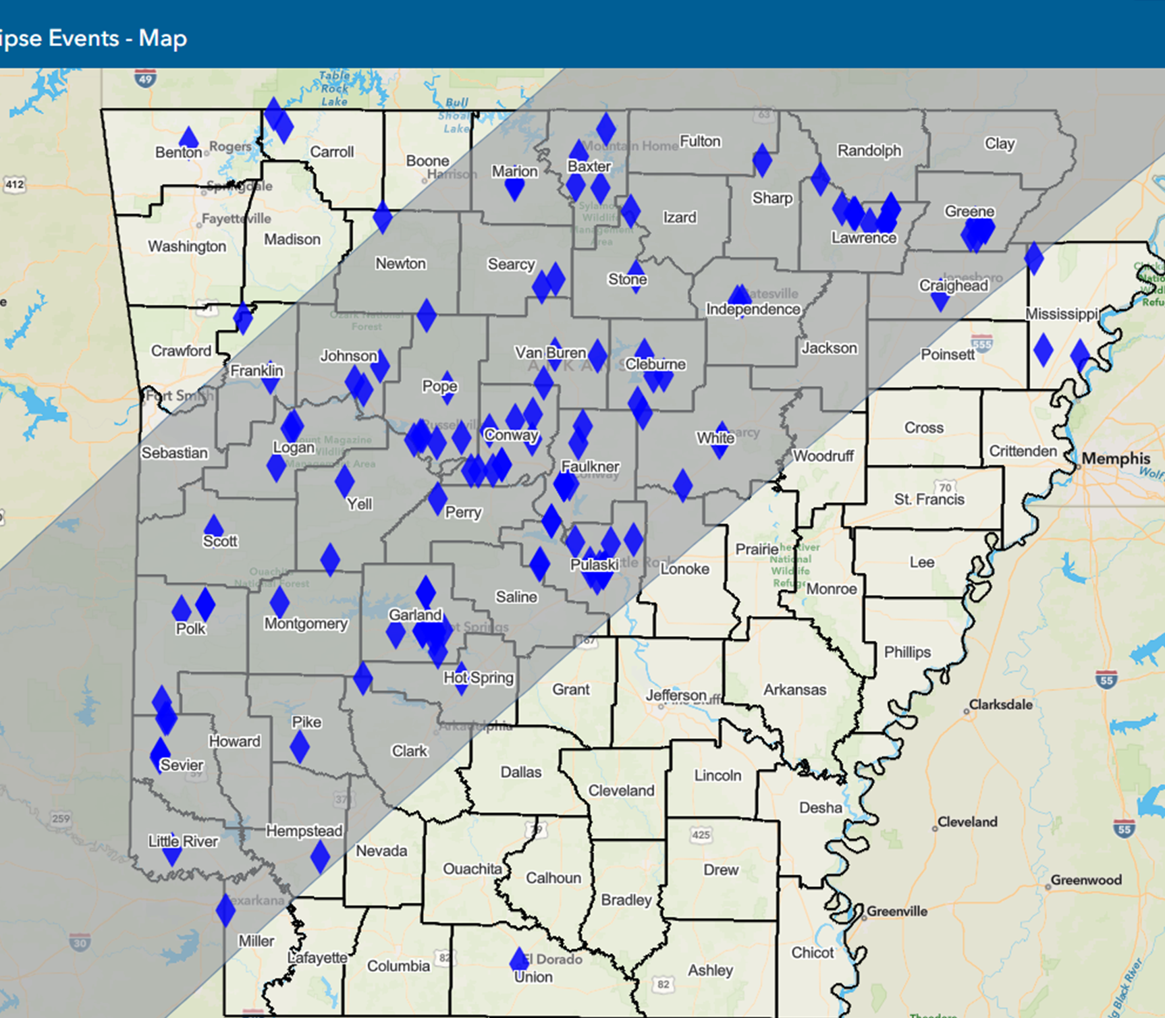
Traffic Demand Reduction Strategies
Stay a While
  Festivals and activities across the state promoted tourist to stay afterwards

Slide 10
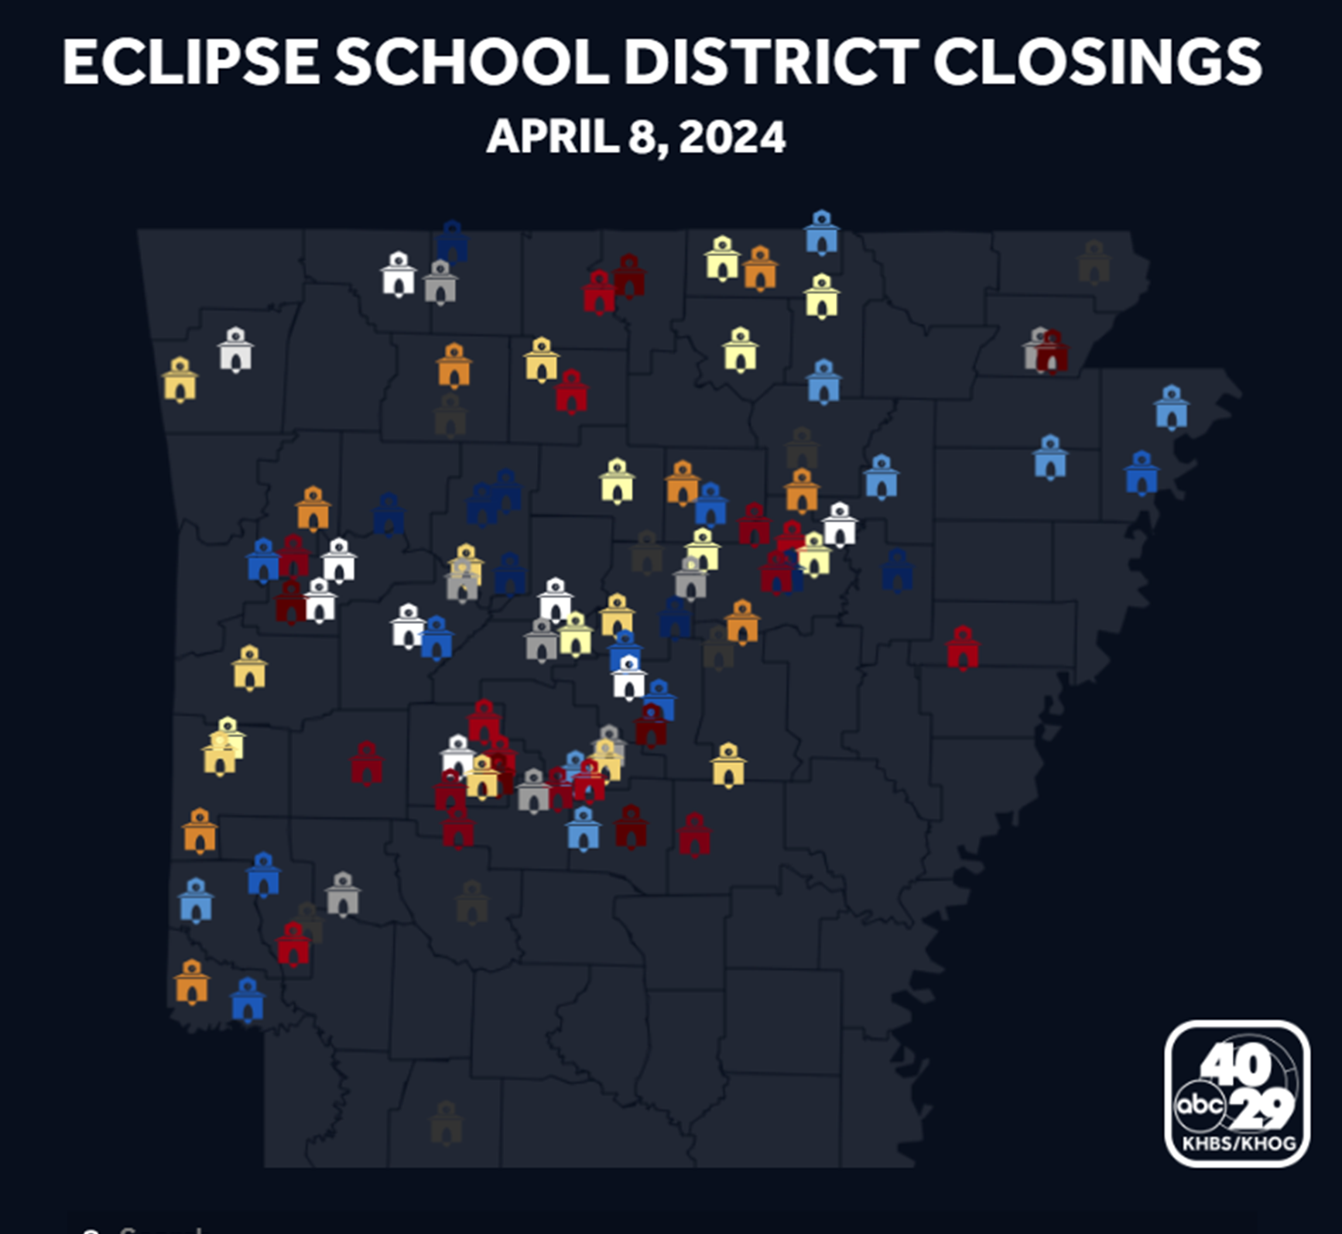
Traffic Demand Reduction Strategies
Stay a While
  Festivals and activities across the state promoted tourist to stay afterwards
School Closings
  Over 100 school districts were closed

Slide 11
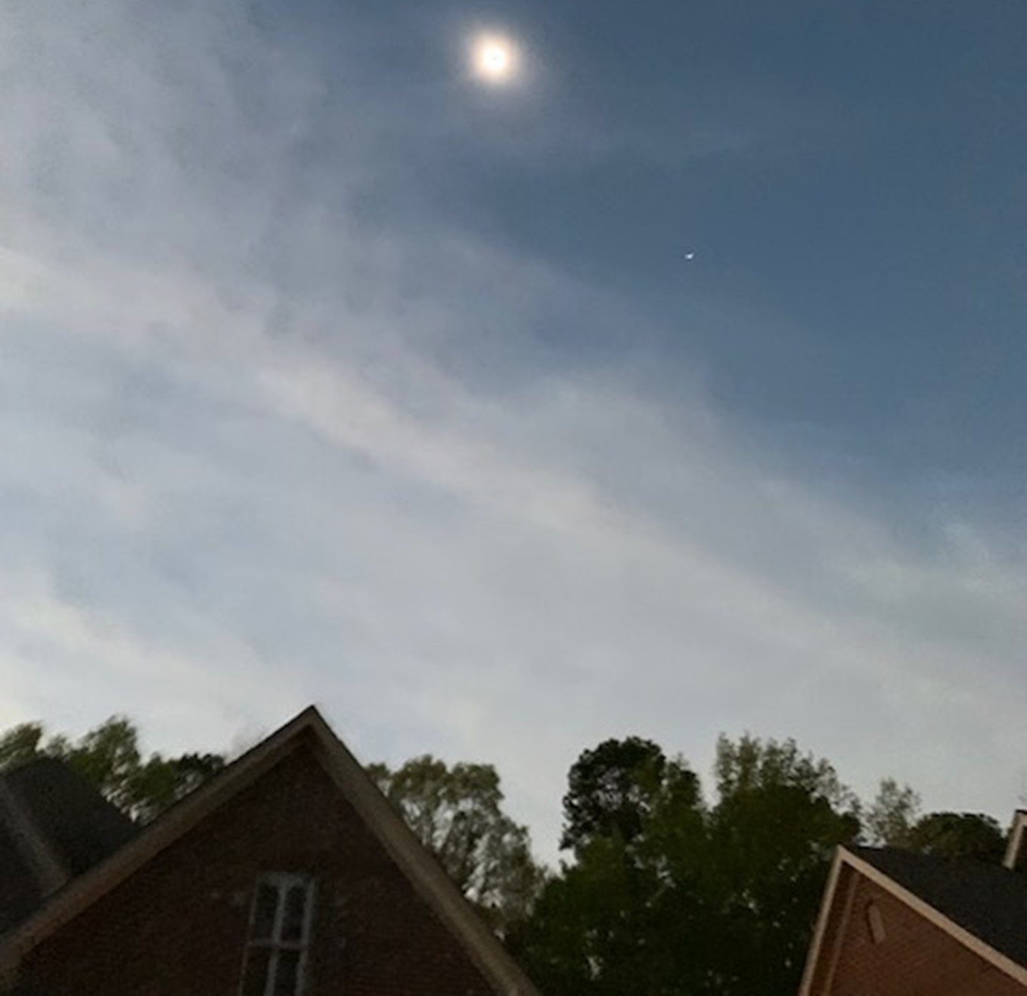
Traffic Demand Reduction Strategies
Stay a While
  Festivals and activities across the state promoted tourist to stay afterwards
School Closings
  Over 100 school districts were closed
Work from Home
  Many employees worked from home

Slide 12
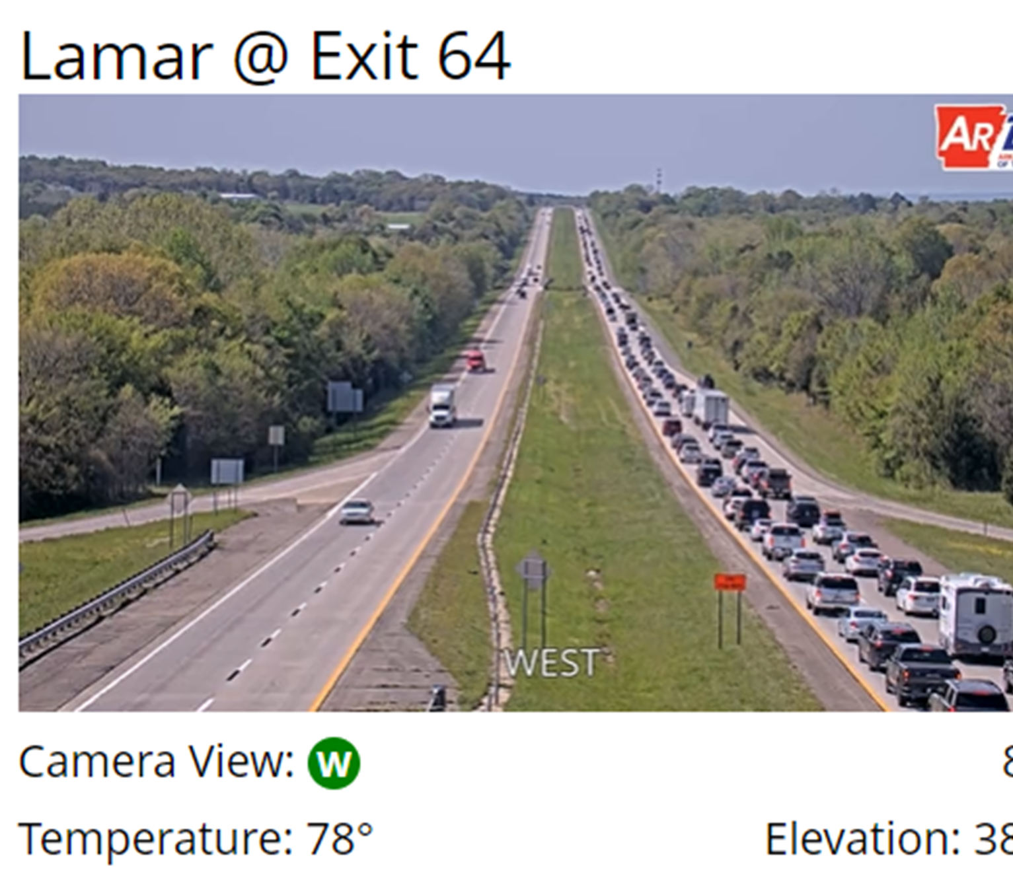
Traffic Demand Reduction Strategies
Oversized Loads
  ARDOT limited permits for oversized loads the day of the event
Truck Holiday
  Truckers were encouraged to adjust travel schedules
  Data shows that truck traffic was down approximately 50% on April 8, 2024
32% Trucks (Typ.)

Slide 13
Traffic Flow Enhancements

Slide 14
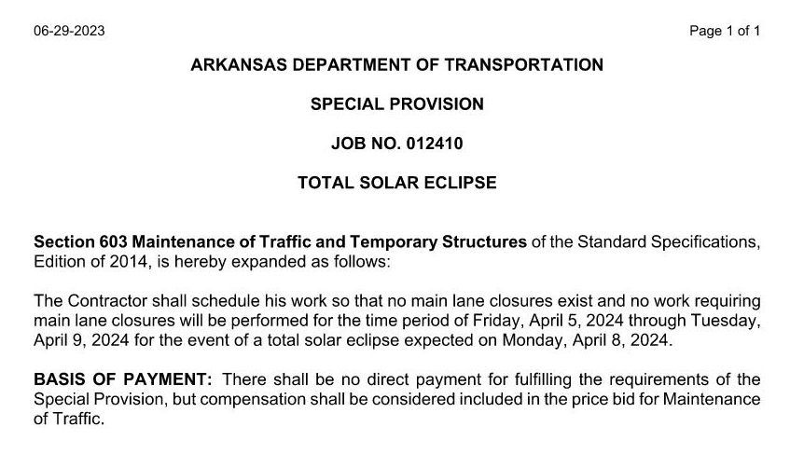
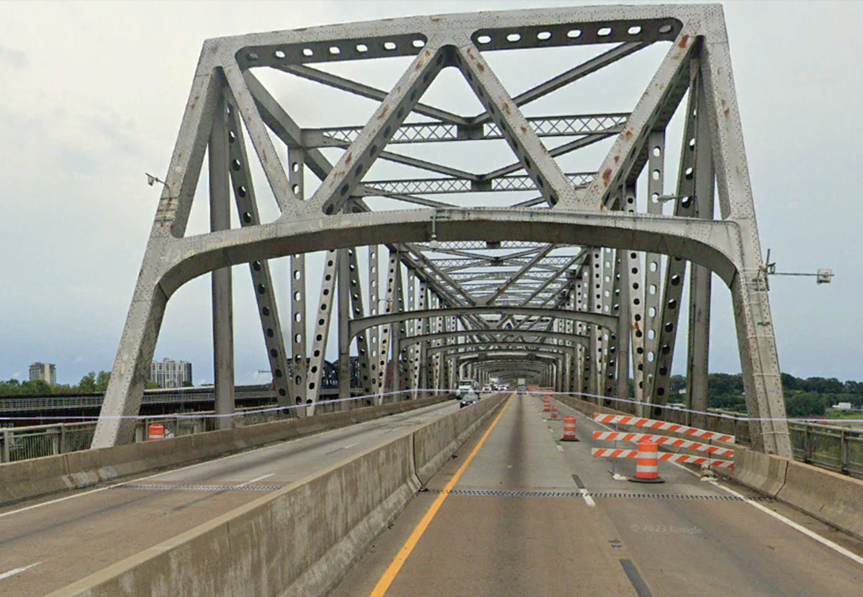
Reduce Construction Activity
Reduce construction activity and in particular lane closures
Special provision prohibited main lane closures from Friday, April 5 through Tuesday, April 9
Unfortunately, the lane closure on the I-55 River Bridge in Memphis was under TDOT jurisdiction. The EB lane closure was still in place.

Slide 15
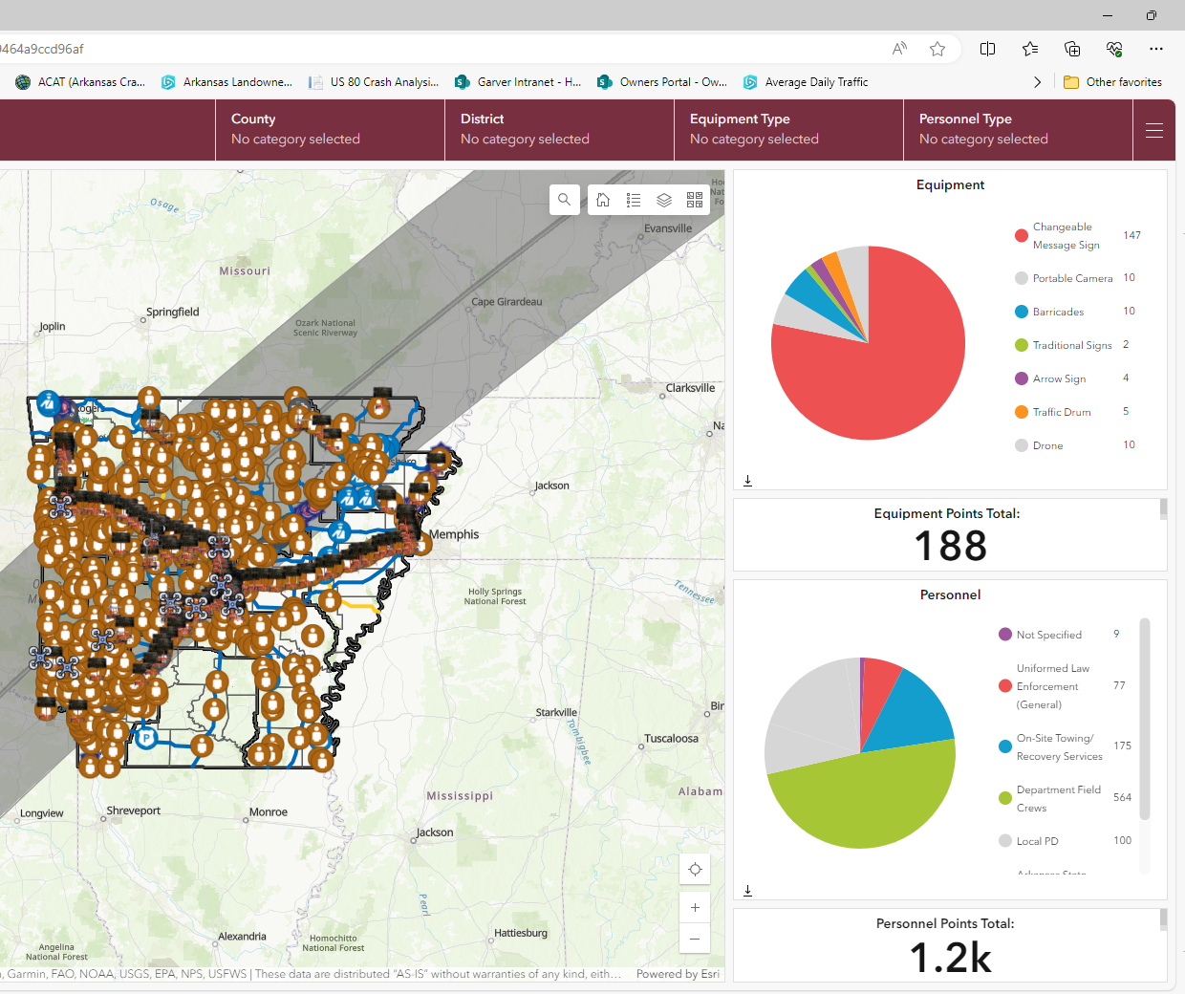
Response Positioning
Performed a systemwide review of bottleneck points
Prioritized routes
Created a dashboard
ARDOT District employees had editing access to this dashboard

Slide 16
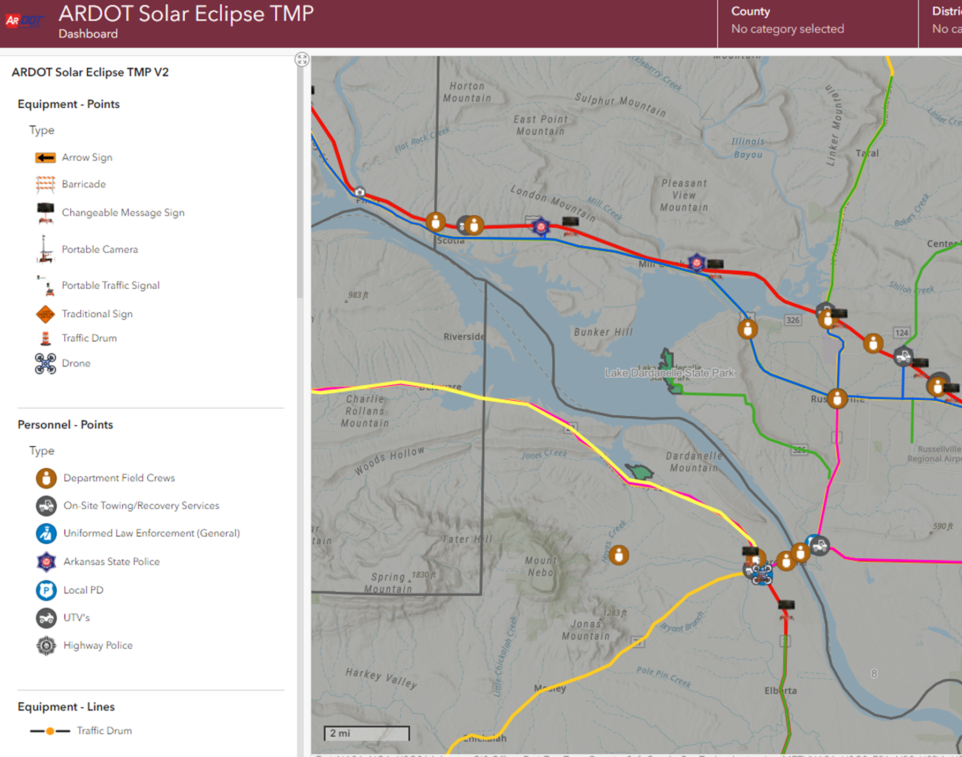
Response Positioning
Strategically station law enforcement, ARDOT field crews, and towing services at intersections where colored routes cross, and intersections leading to state parks

Slide 17
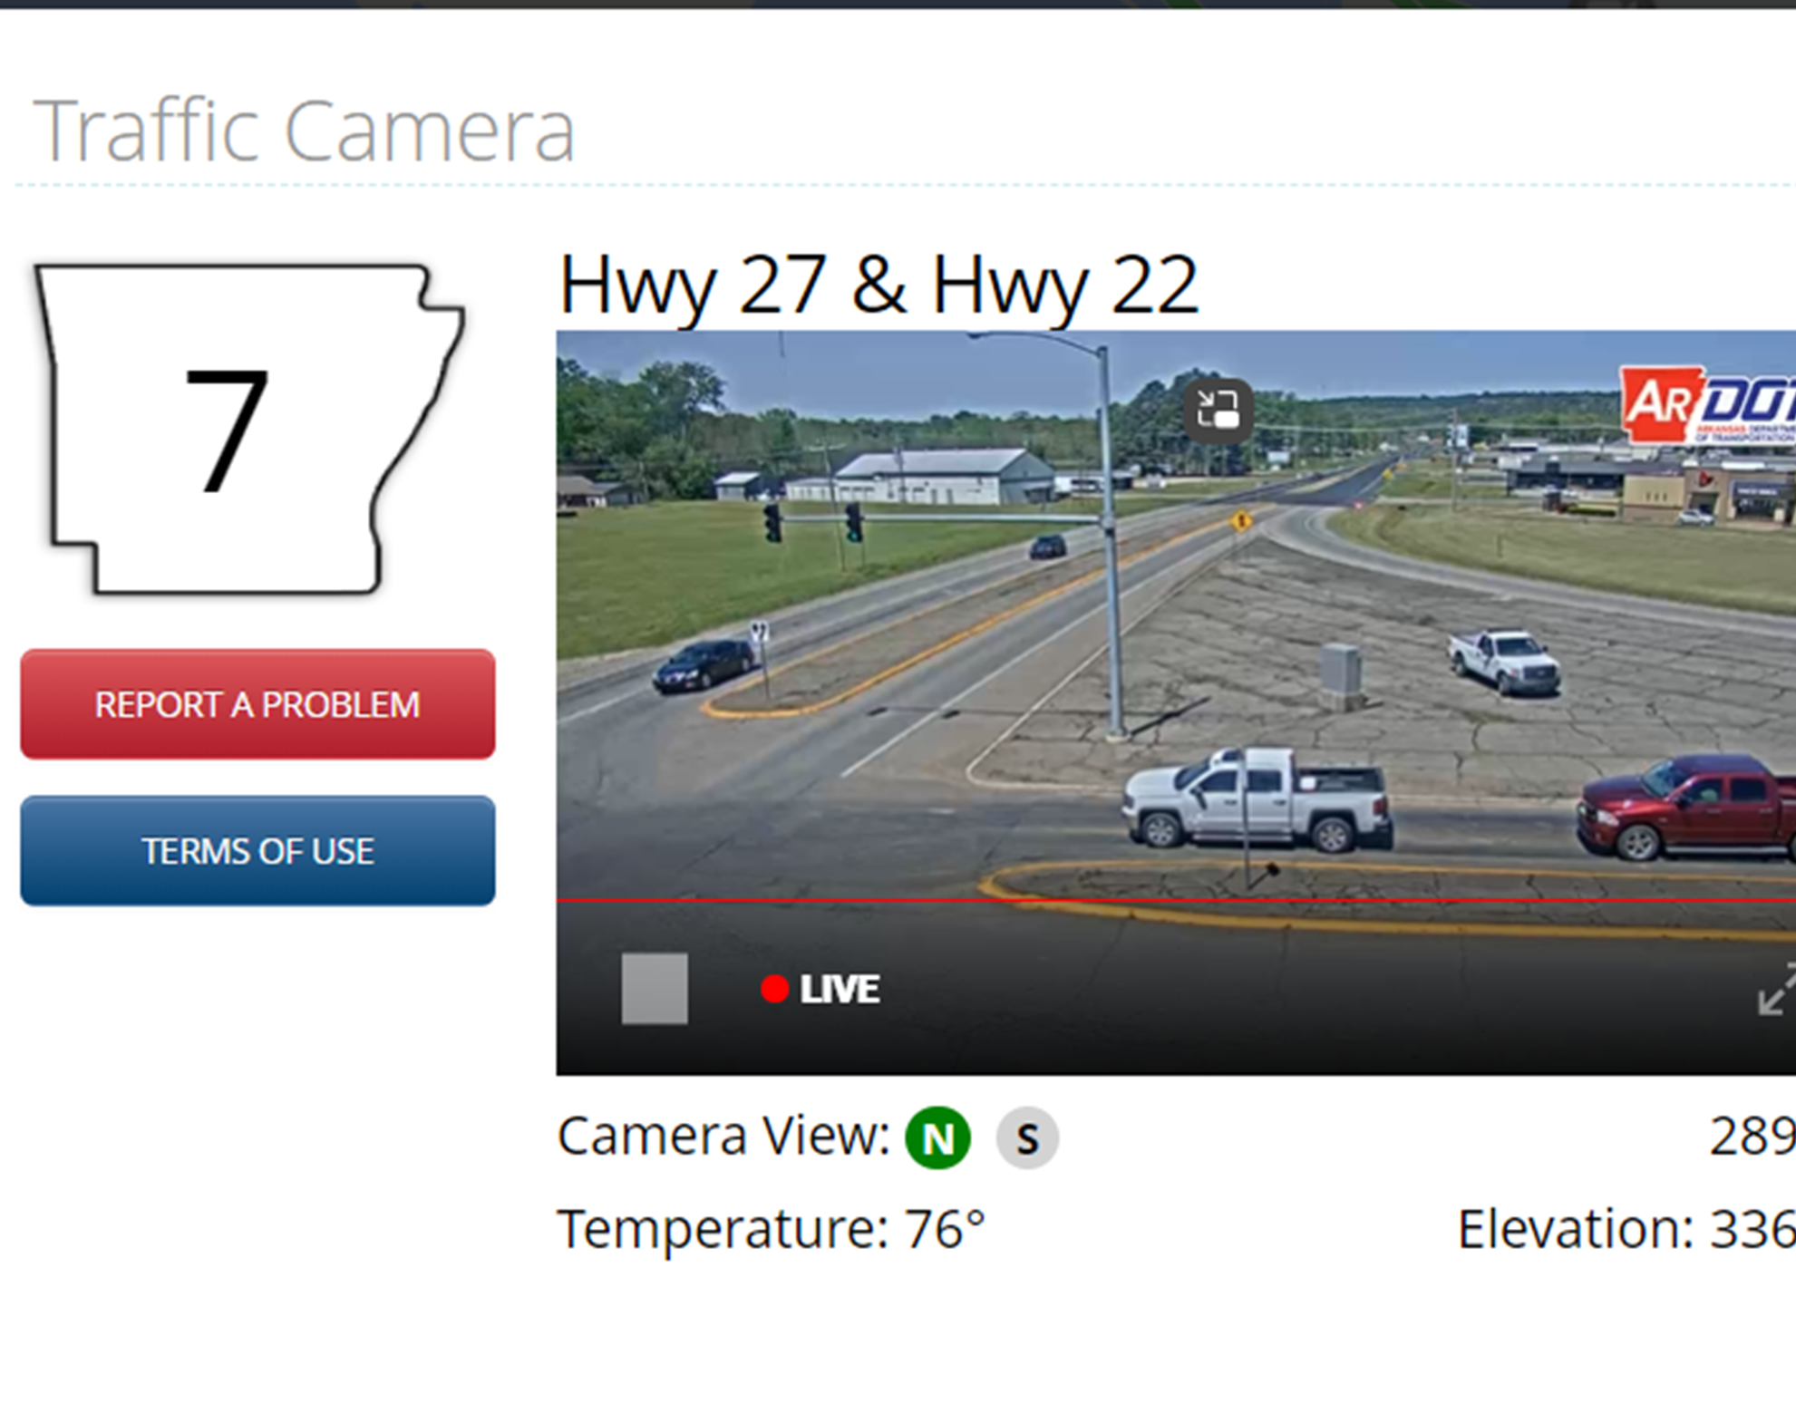
Response Positioning
Located at various locations such as interchanges, signalized intersections on the purple, red, and some orange routes

Slide 18
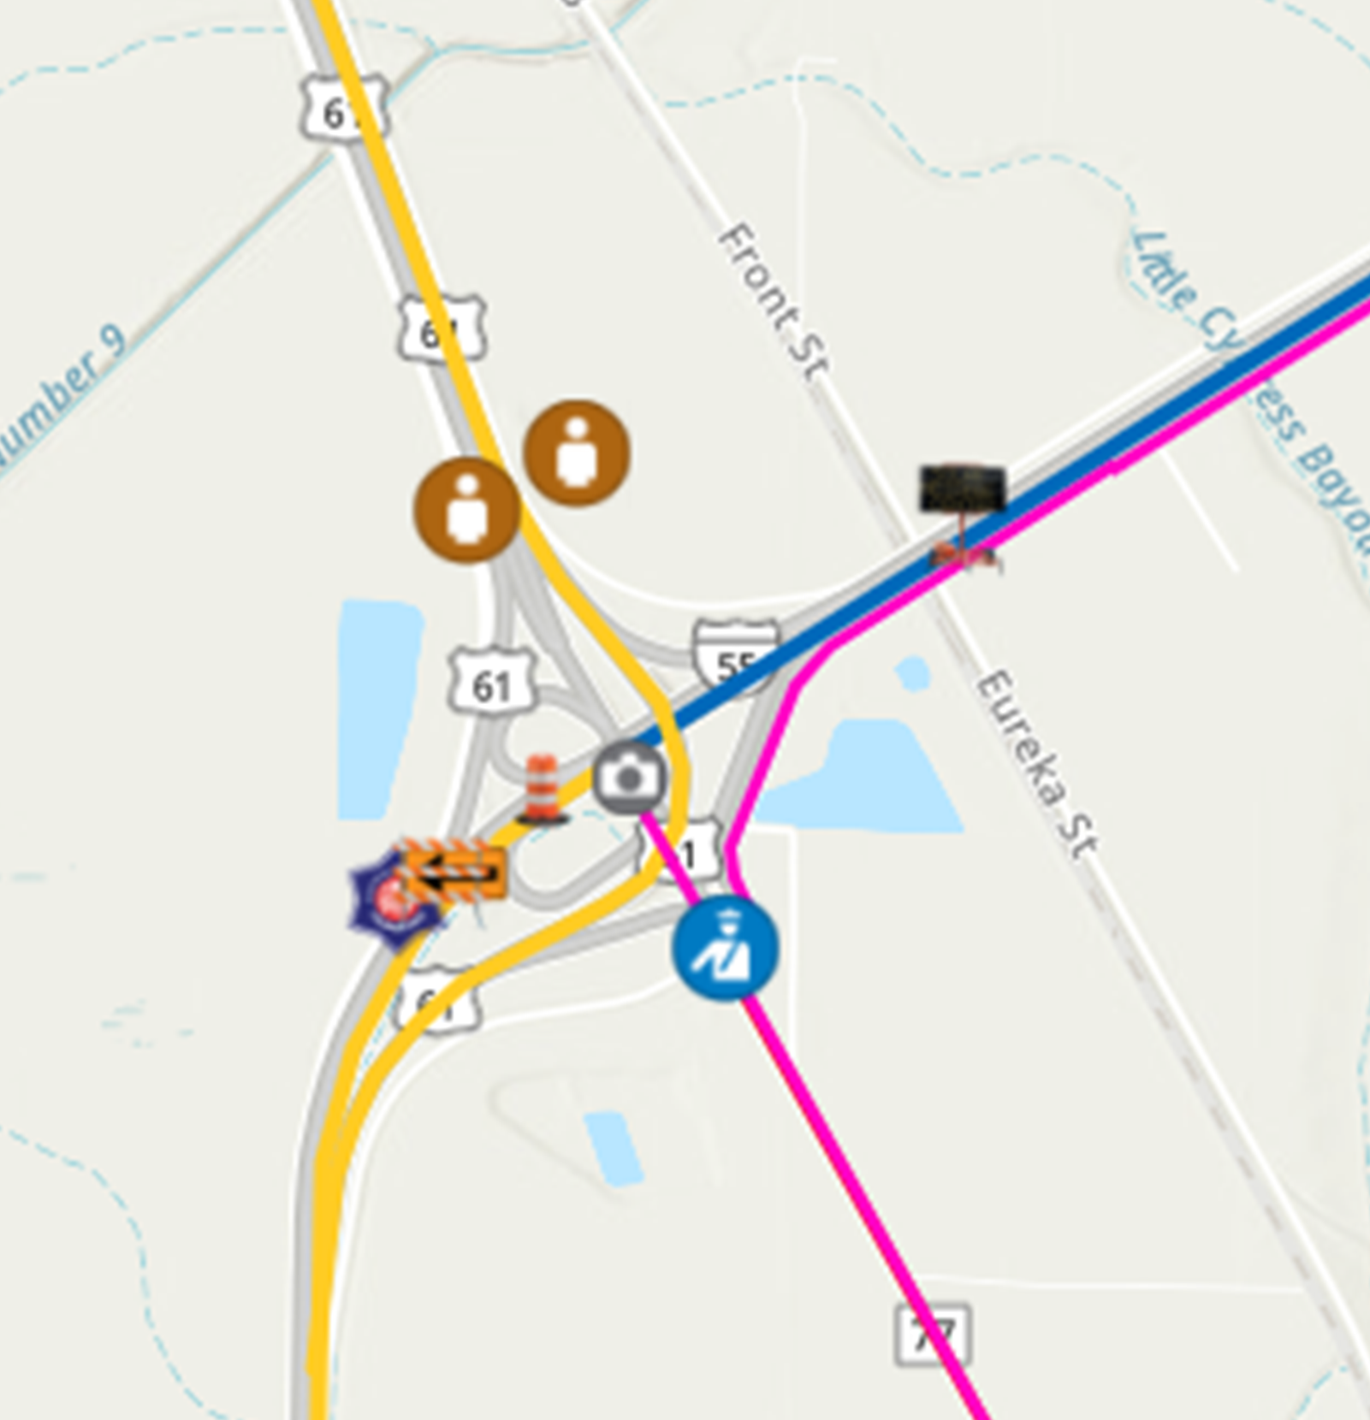
Spot Mitigation
I-55 at I-555
Prepared for potential lane closure on SB I-55 to allow SB I-555 entrance ramp to become free flowing
Outside lane becomes an exit only lane

Slide 19
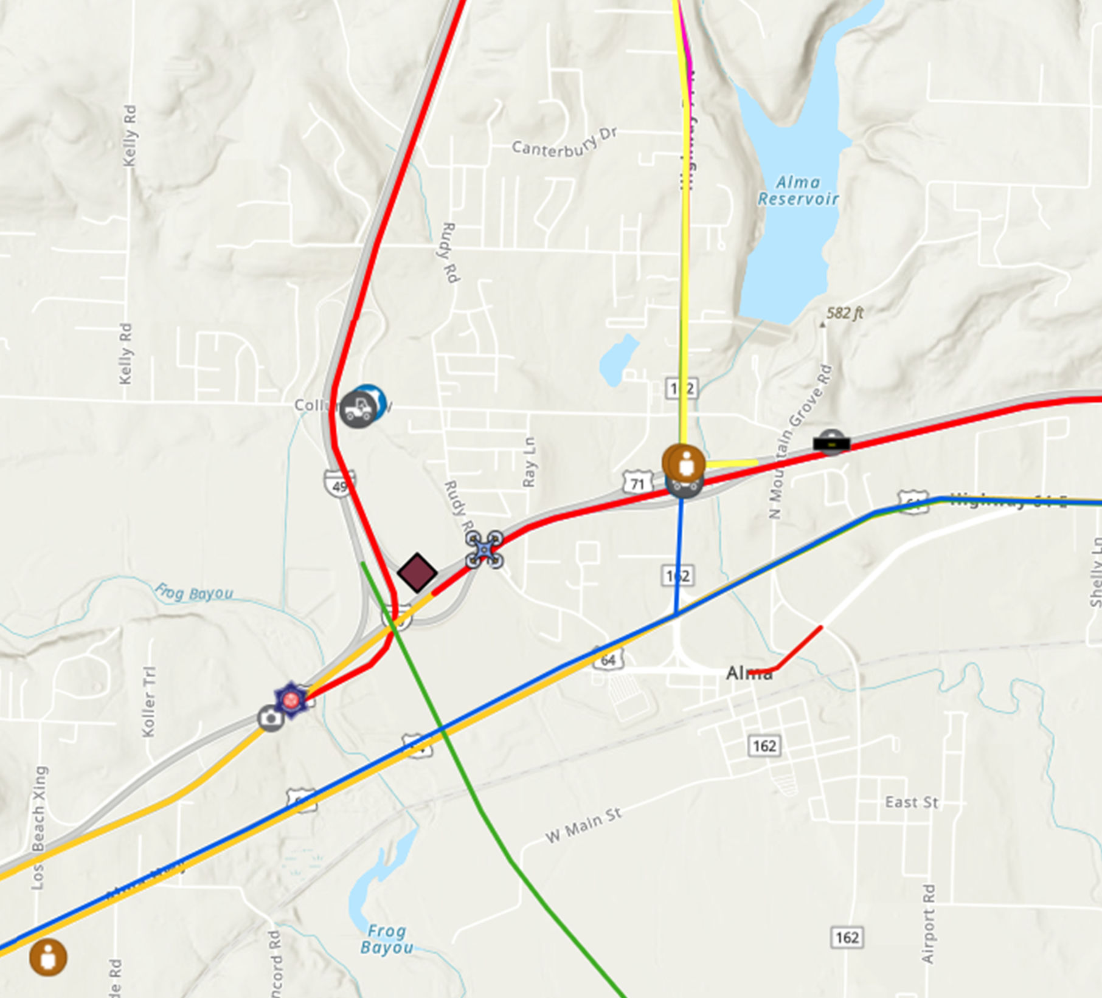
Spot Mitigation
I-40 at I-49
Advance signing prior to the Alma exit
Drone coverage
Tow trucks
ARDOT and police personel

Slide 20
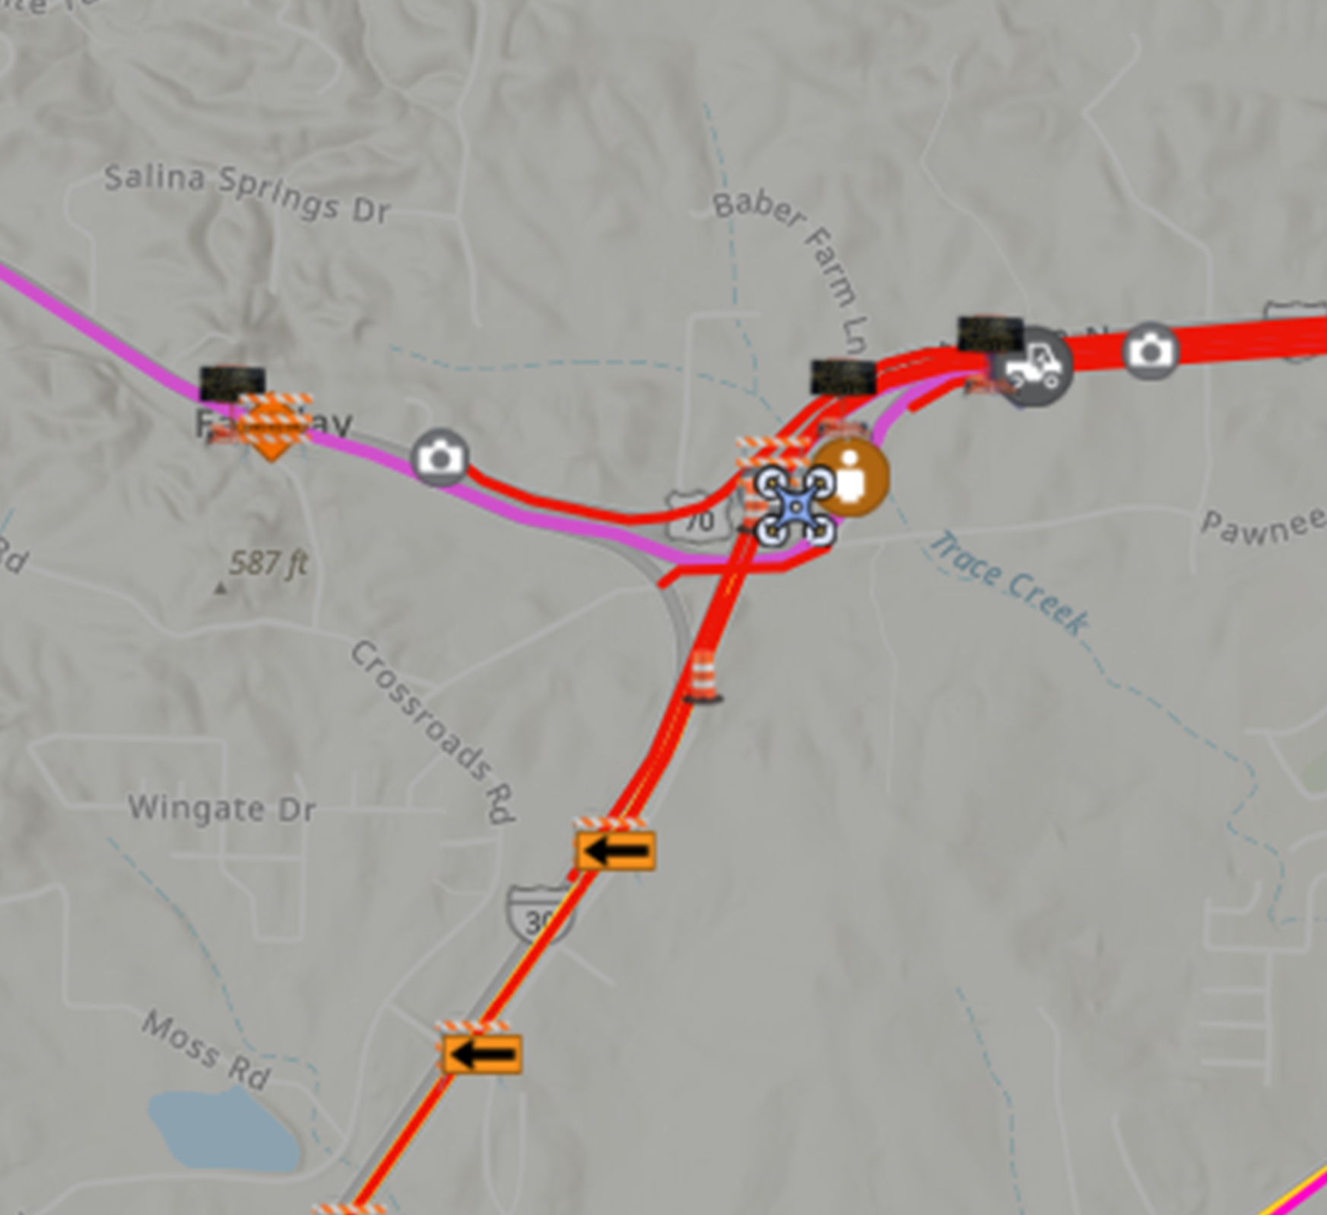
Spot Mitigation
I-30 at Hwy 70
Prepared for potential lane closure on NB I-30 to allow Hwy 70 entrance ramp to become free flowing.
Outside lane becomes an exit only lane

Slide 21
Eclipse Day – April 8, 2024

Slide 22
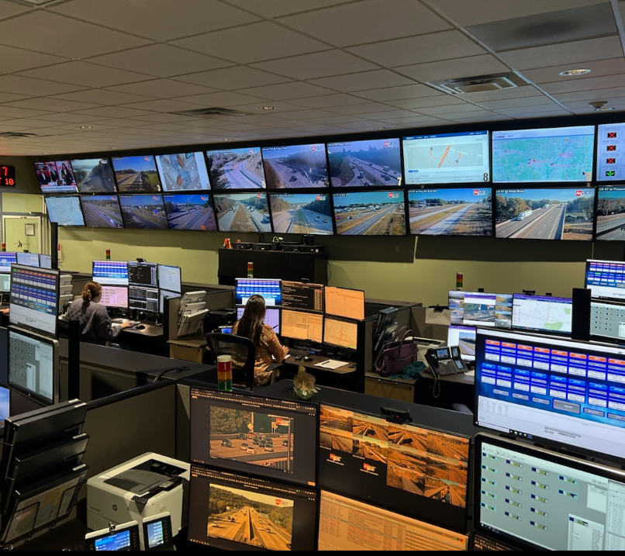
Traffic Management Center
TMC collected live information from:
  Cameras
  On-the-ground personnel
  Online sources
TMC disseminated information:
  Flagging crews
  Enforcement personnel
  Emergency responders

Slide 23
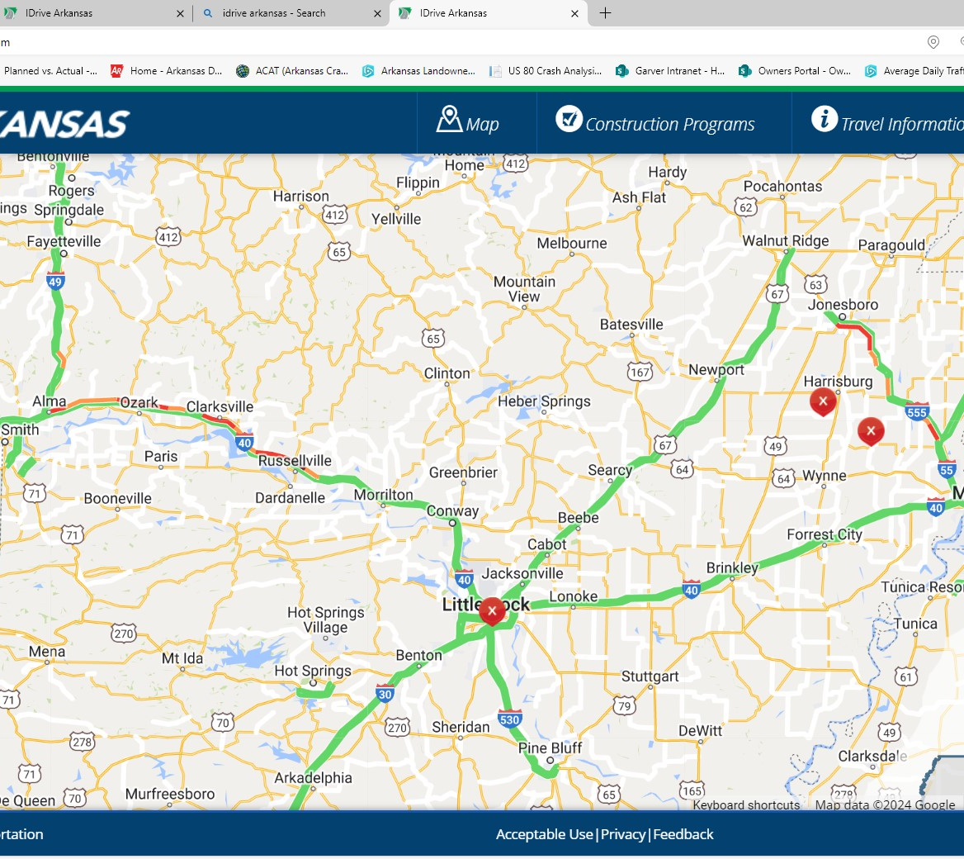
Hot Spots
Statewide
  Post eclipse traffic at approximately 3:15 PM

Slide 24
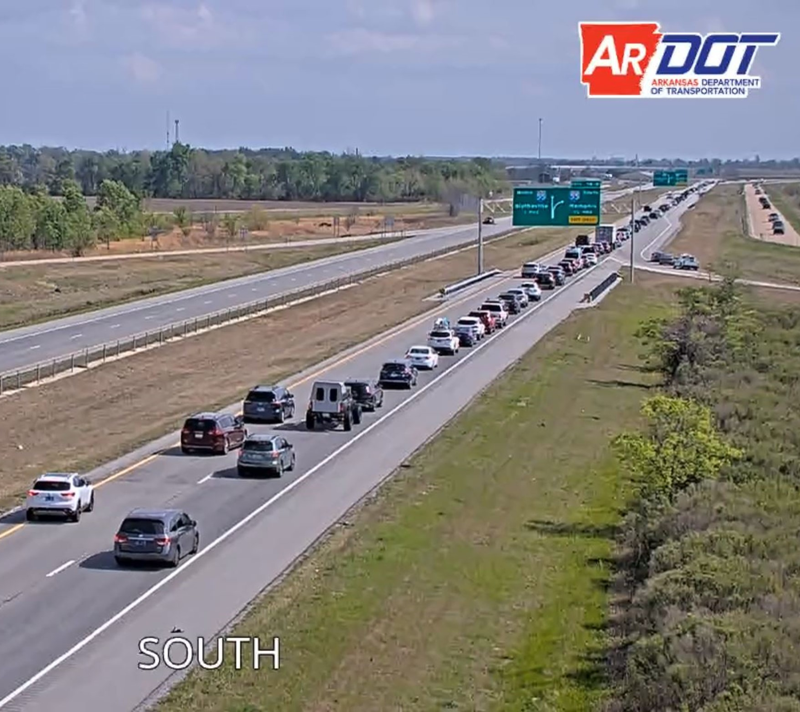
Hot Spots
I-555 prior to I-55
  Post eclipse traffic at approximately 3:30 PM
  Normal day traffic at this location is 14,000 vpd
  April 8, 2024, traffic was 28,500 vpd (more than double)

Slide 25
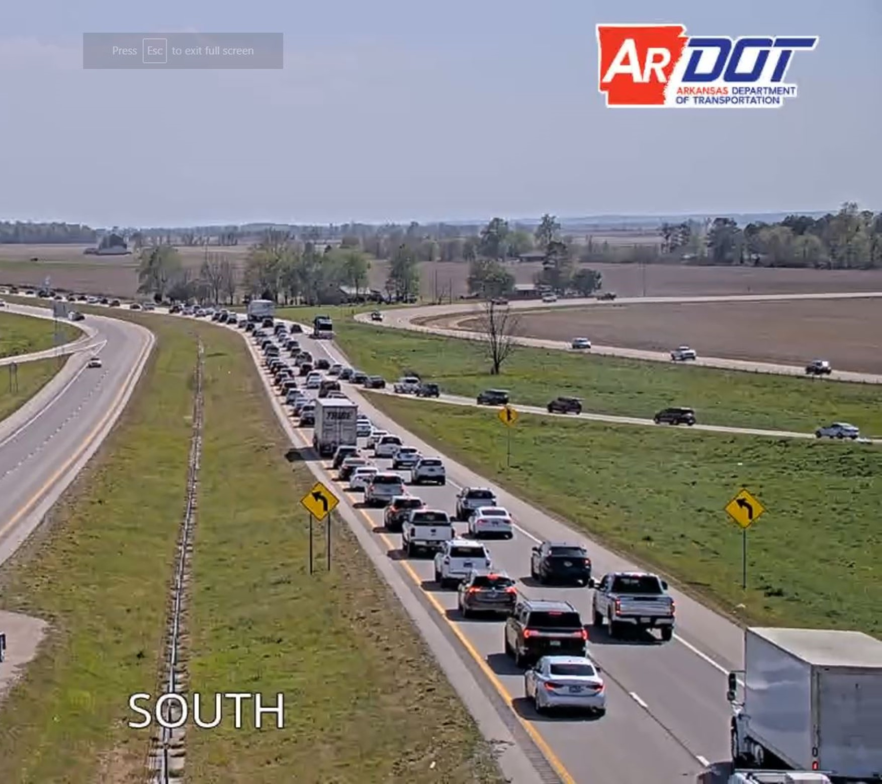
Hot Spots
I-555 at I-55
  Post eclipse traffic at approximately 3:25 PM
  Normal day traffic south of the entrance ramp is 31,000 vpd
  April 8, 2024, traffic was 40,500 vpd (30% increase)

Slide 26
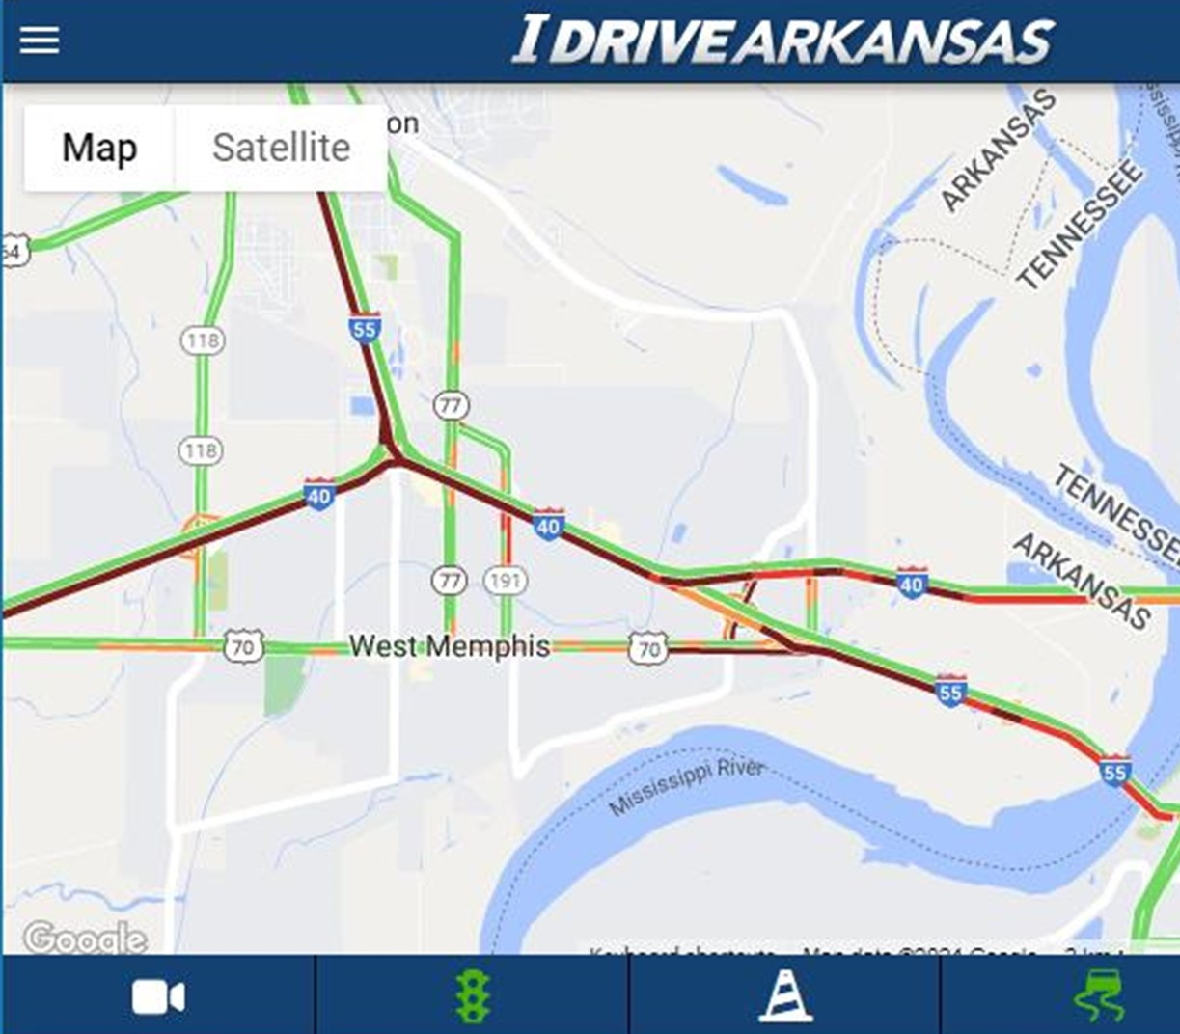
Hot Spots
I-40 at I-55
  Congestion began not long after the eclipse was over
  Primarily traffic coming from Jonesboro via I-55

Slide 27
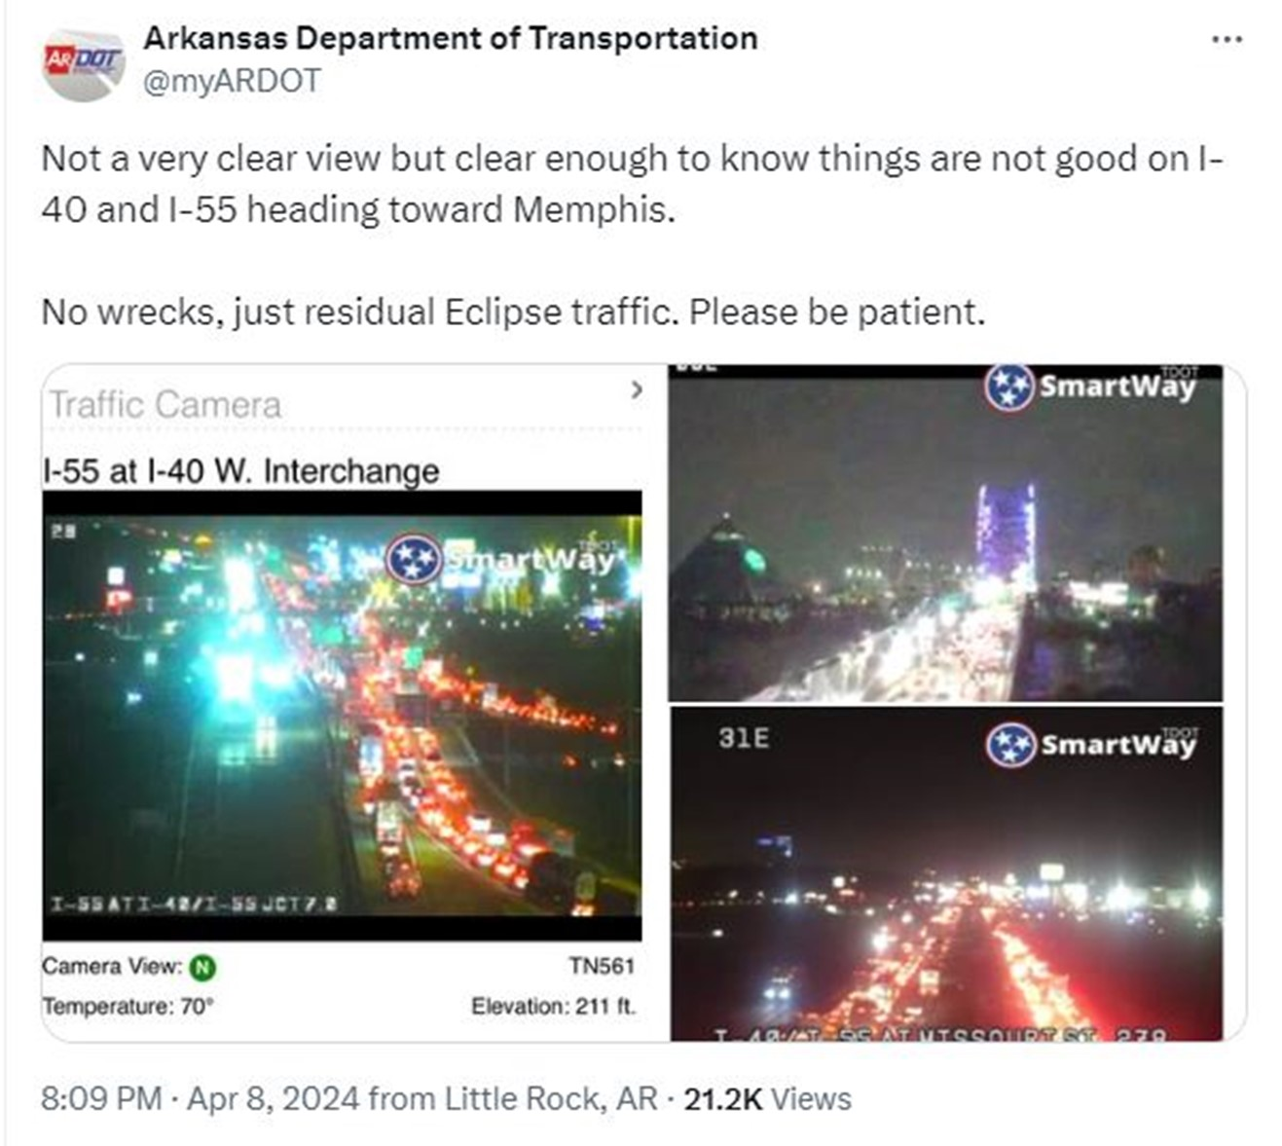
Hot Spots
I-40 at I-55
  The congestion continued through the evening
  The images are from around 8:10 PM on April 8, 2024

Slide 28
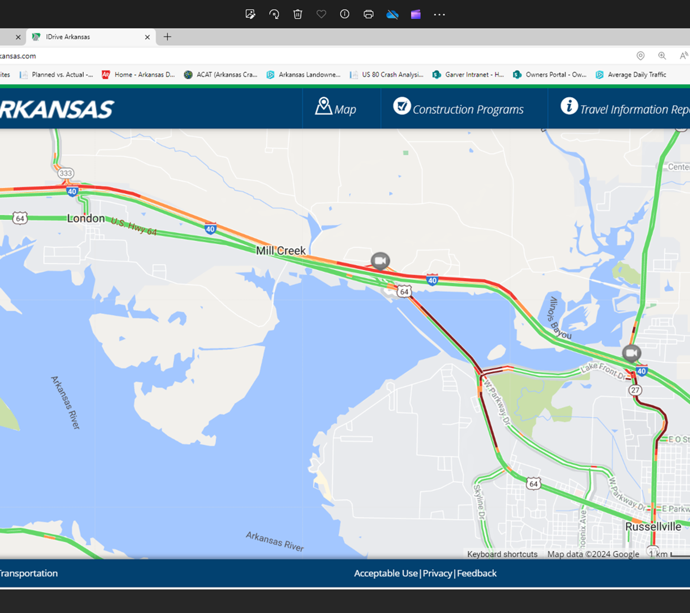
Hot Spots
I-40 near Russellville
  Post eclipse traffic at approximately 2:20 PM

Slide 29
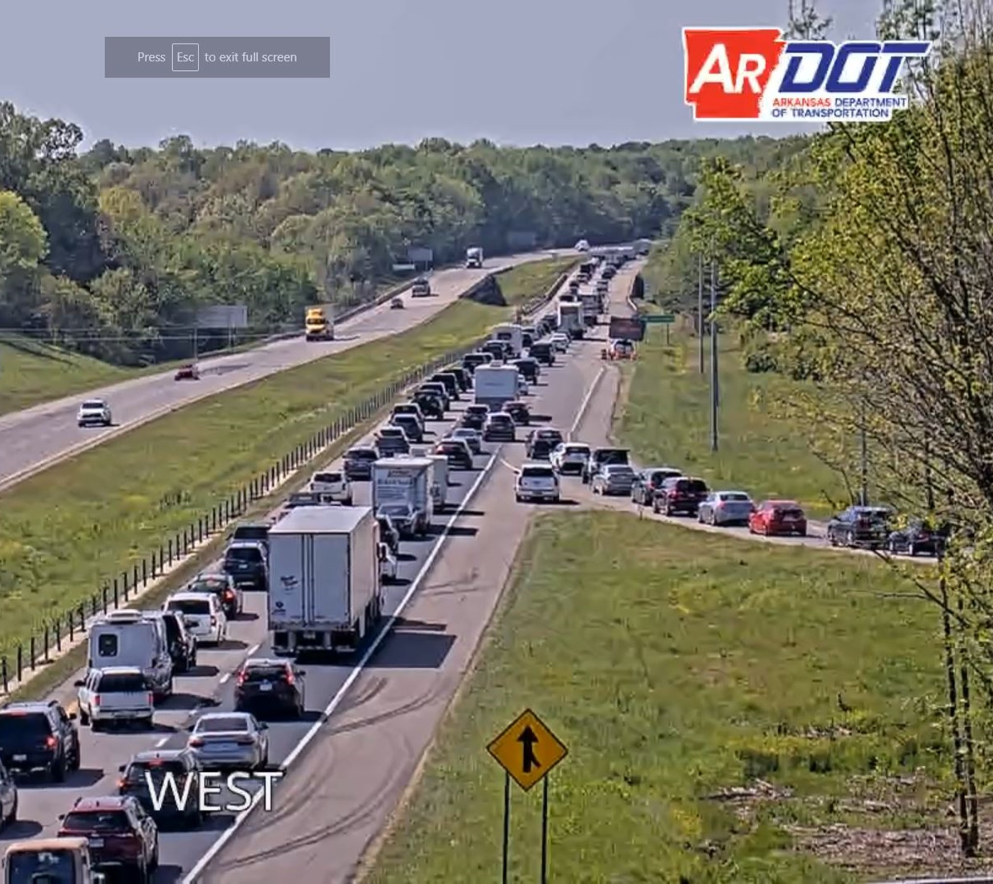
Hot Spots
I-40 near Russellville
  Post eclipse traffic at approximately 3:20 PM

Slide 30
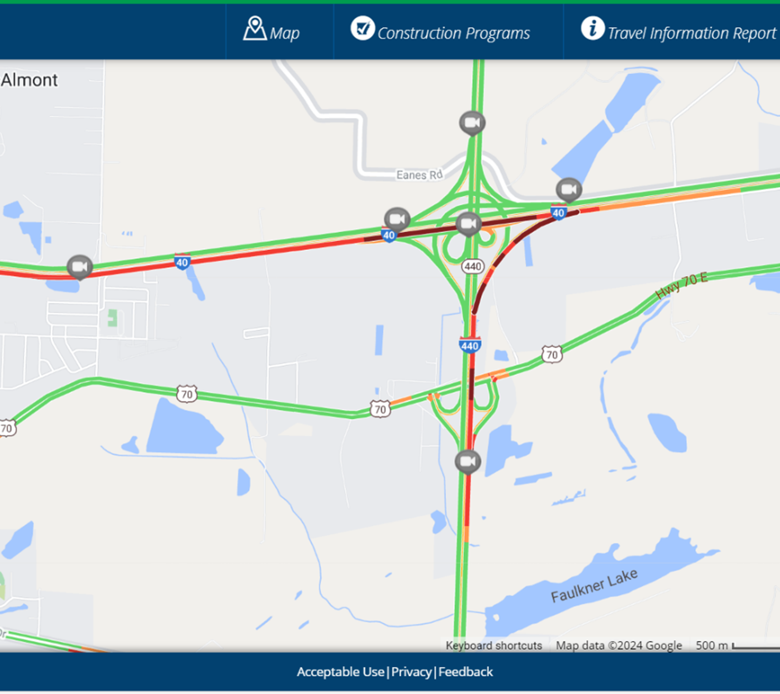
Hot Spots
I-40 at I-440
  Post eclipse traffic

Slide 31
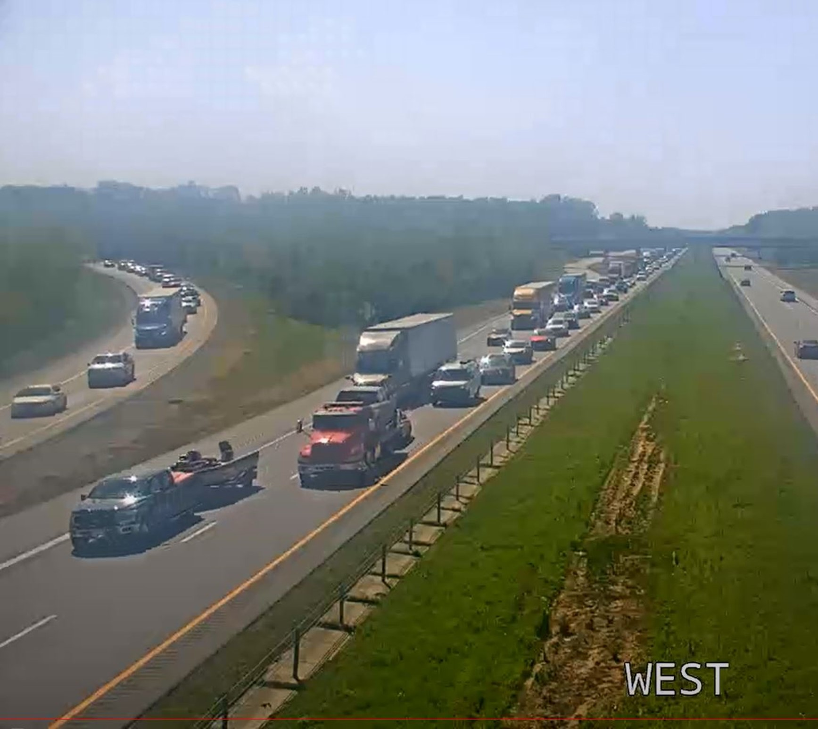
Hot Spots
I-40 at I-440
  Post eclipse traffic at approximately 3:25 PM

Slide 32
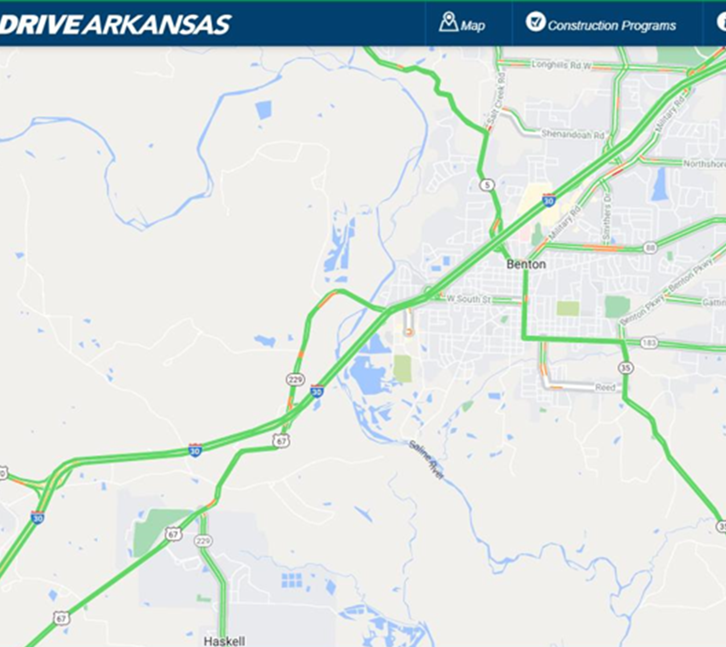
Not So Hot Spot
Hwy 70 at I-30
  Post Eclipse Traffic
  Normal day traffic on I-30 between Reynold’s Road and I-430 is 115,000 vpd and 19,000 vpd on Hwy 70
  April 8, 2024, traffic at that location was 76,000 vpd (35% decrease) on I-30 and 15,000 vpd (15% decrease) on Hwy 70

Slide 33
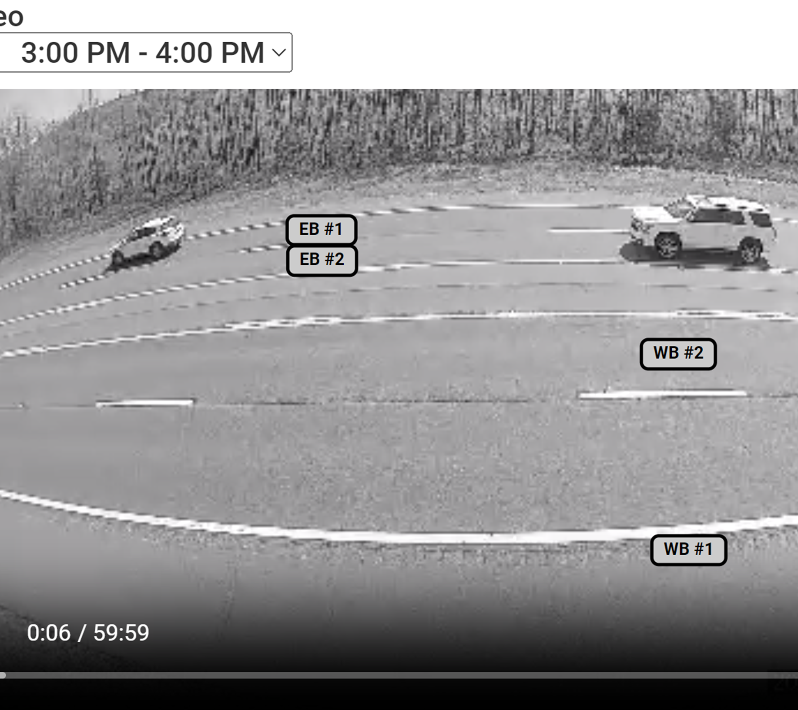
Not So Hot Spot
Hwy 70 at I-30
  Post eclipse traffic at approximately 3:00 PM

Slide 34
After-Action Plan

Slide 35
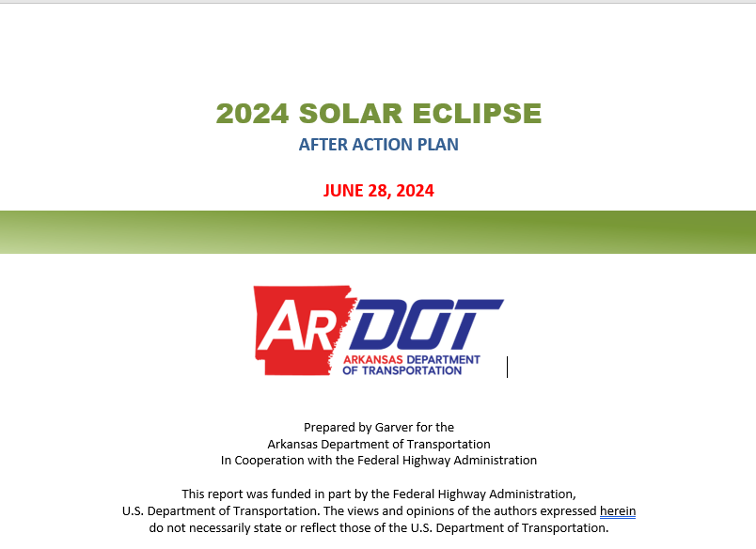
After-Action Plan
Currently working on the After-Action Plan

Slide 36
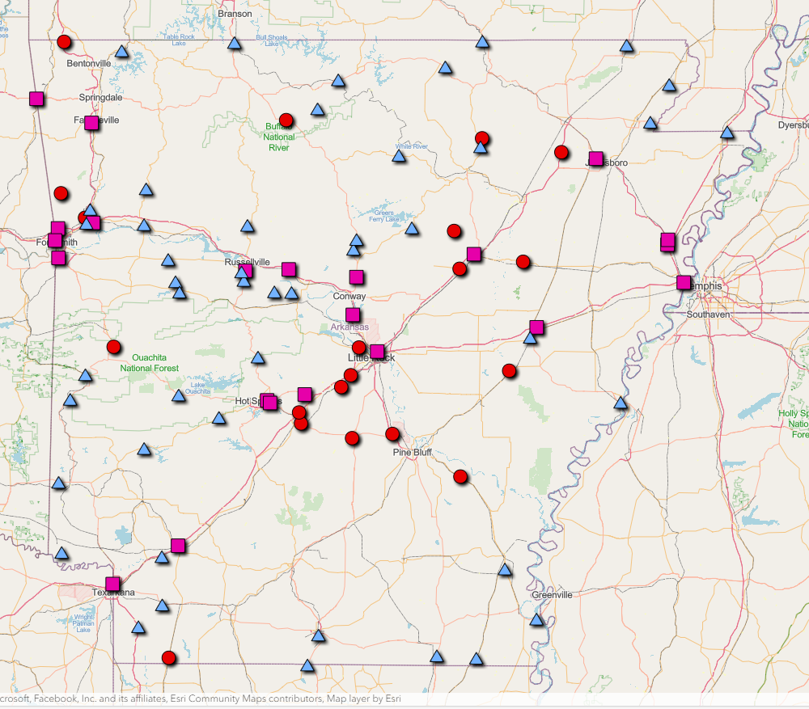
After-Action Plan
Data collection during the Eclipse
  20 ATR Stations Counts
  22 Miovision Counts
  46 Tube Counts

Slide 37
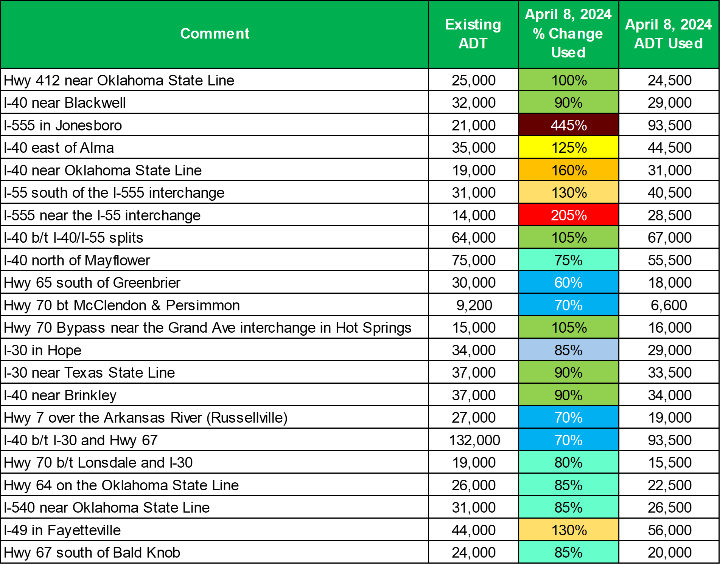
After-Action Plan
Tabulated the traffic data taken during the eclipse

Slide 38
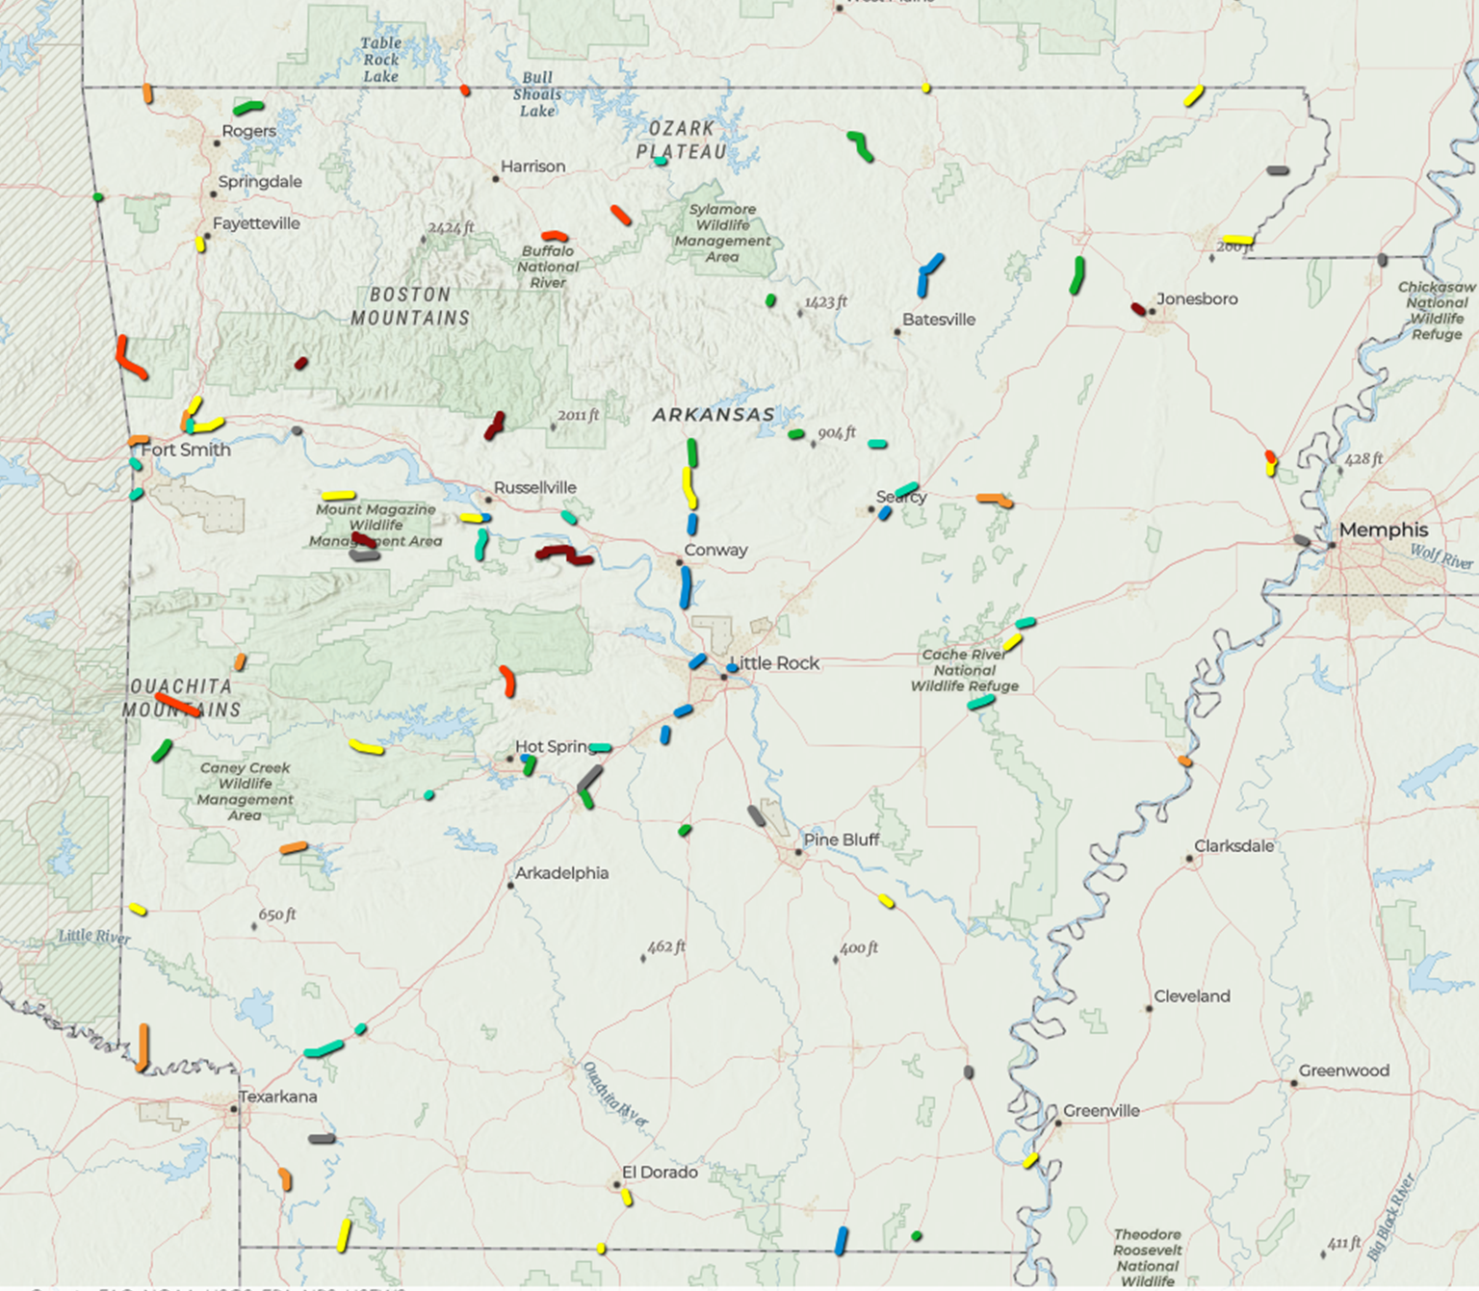
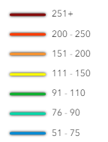
After-Action Plan
Plotted segments where data was collected

Slide 39
Questions

