Slide 1


Using Contractual BIM in your Structures Workflow, Design to Construction
Daniel Jensen, P.E.
Michael Baker International

Slide 2
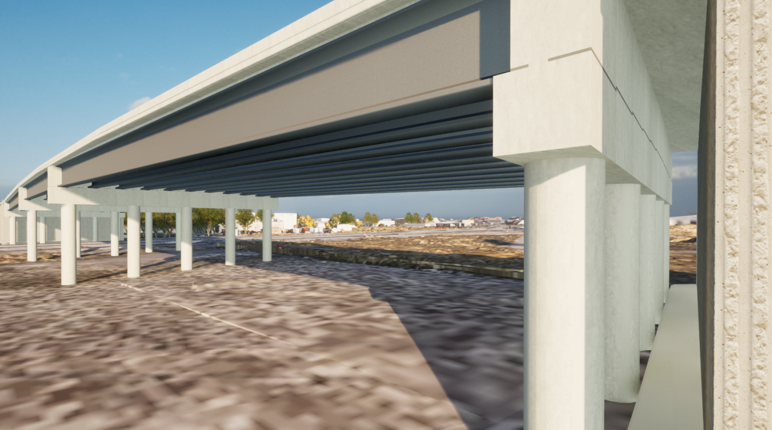
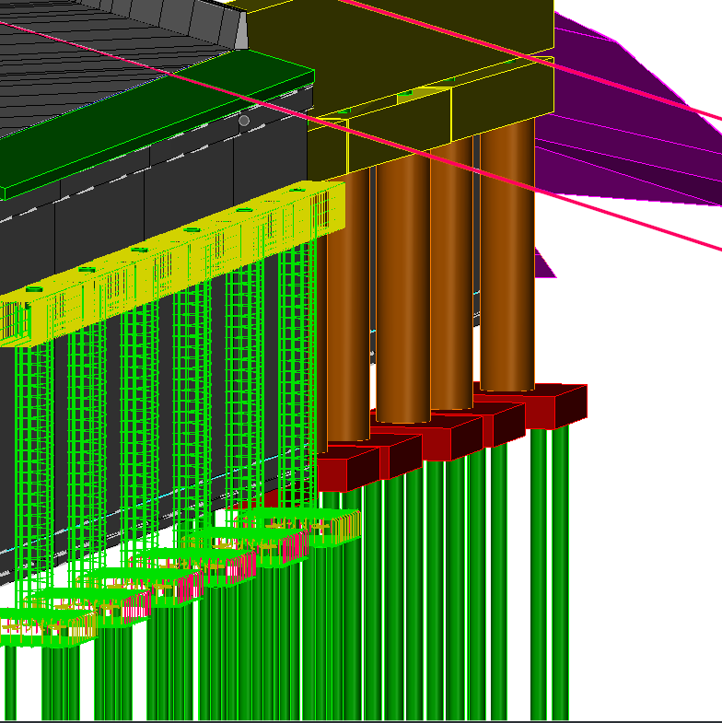
Utah Department of Transportation
  Bentley software
  4 projects w/ MALD
  Standards and manuals

Slide 3
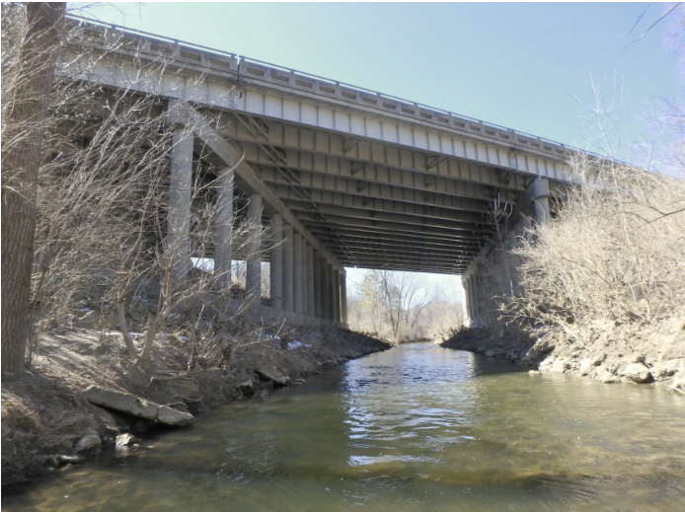
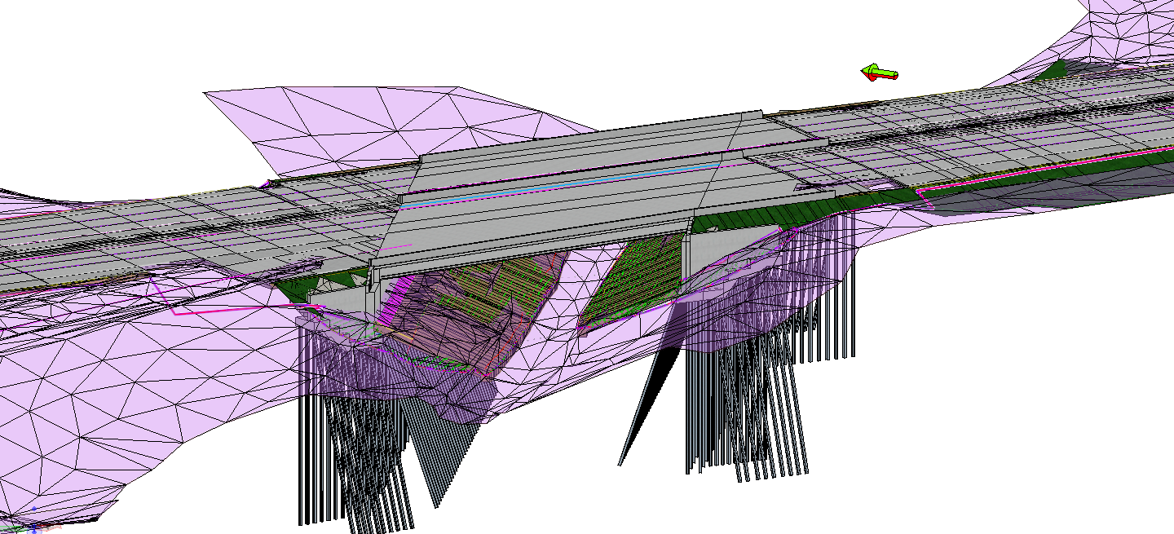
Michigan Department of Transportation
  Bentley software
  I-696 over Rouge River
  Current contract to build standards and manuals

Slide 4
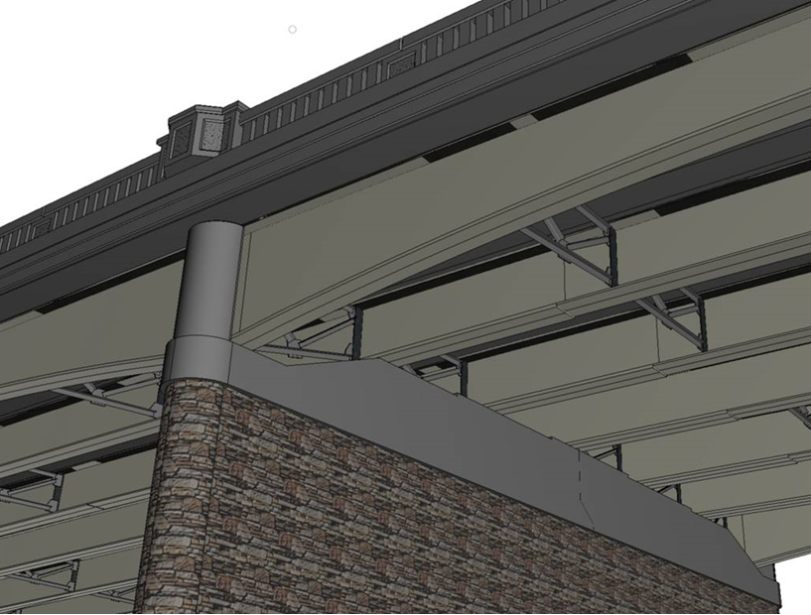
Pennsylvania Department of Transportation
  Bentley software
  Built out an extensive library
  Pilot project which will use .ifc files as the contractual document

Slide 5
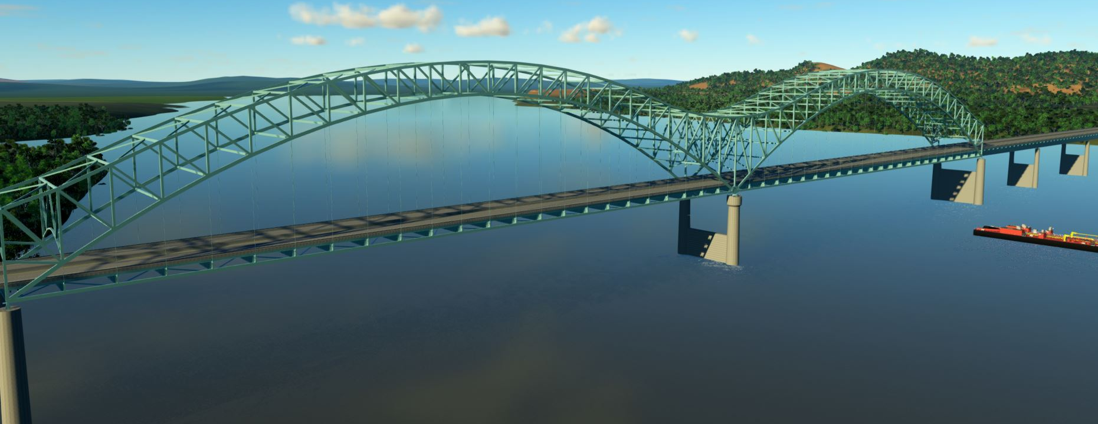

Hernando De Soto

Slide 6
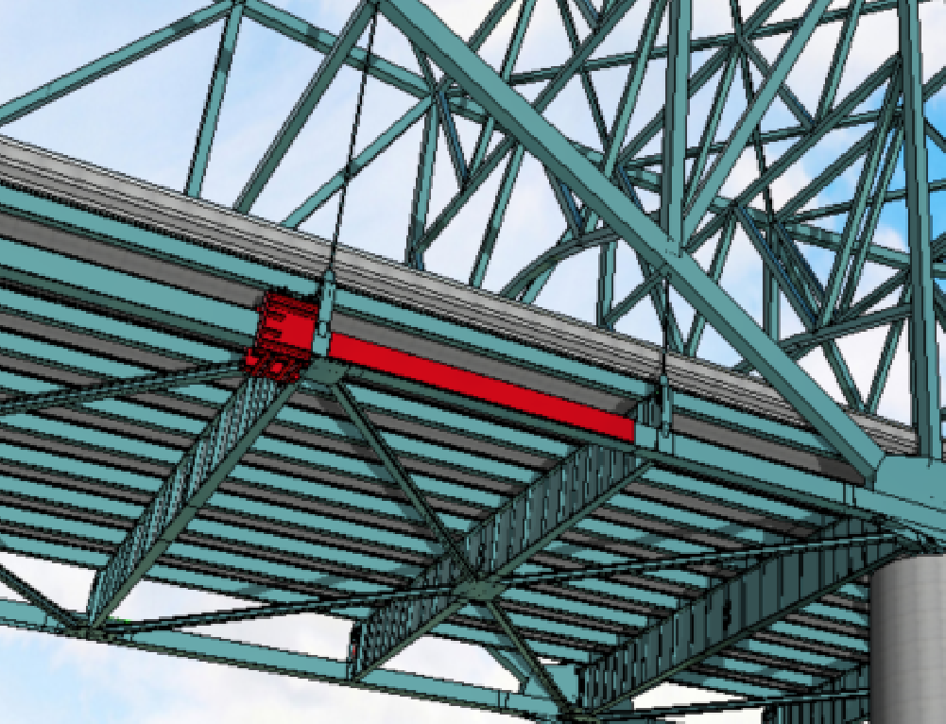
Modeled plate repair
T22
T23

Slide 7
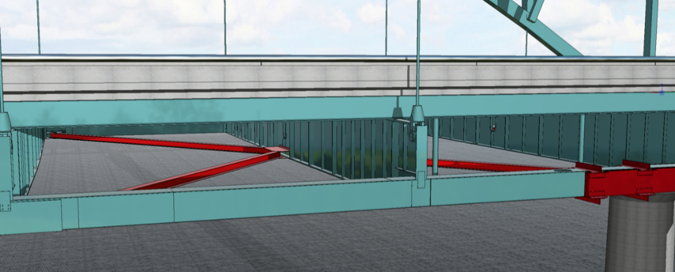
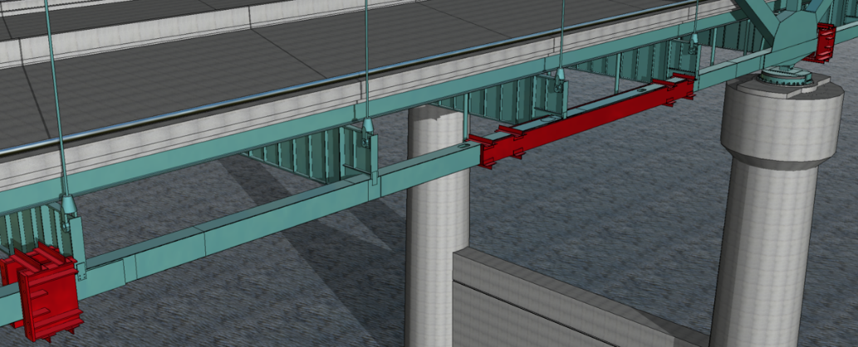
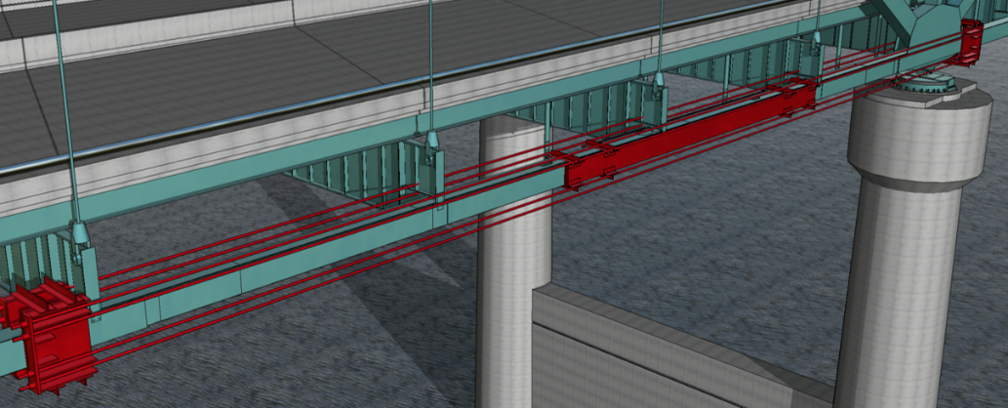
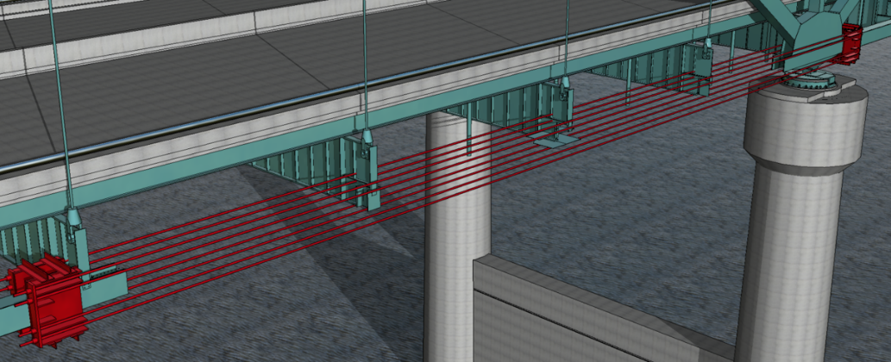
Modeled repair procedure

Slide 8

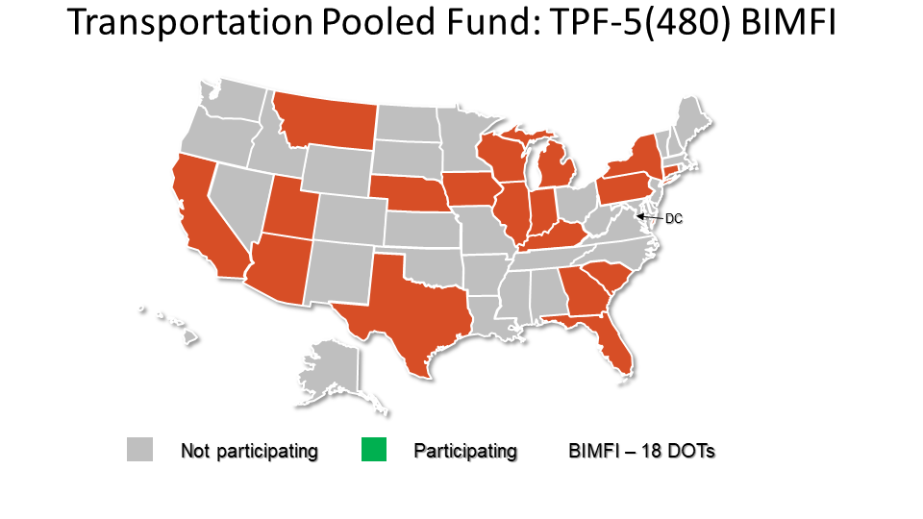
Other DOT’s
  New York
  Florida
  Montana
  Minnesota
Other National Efforts
  TPF BIM for Bridges
  TPF BIM for Infrastructure

Slide 9






Path to Digital Design and Delivery
Some of the solutions available today
  Bentley, Allplan, Autodesk, Trimble
Allplan Engineering (AE)
Steel Reinforcement
Sheet Creation and Management
Allplan Bridge (AB)
3D Structure Modeling
OpenBridge Modeler (OBM)
3D Structure Modeling
ProStructures (PS)
Steel Reinforcement

Slide 10
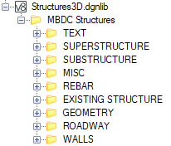
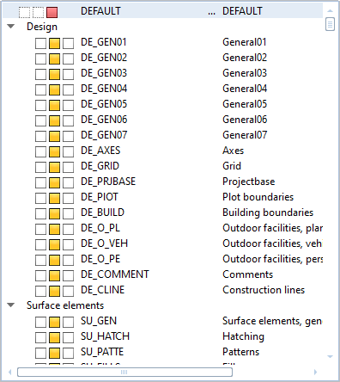
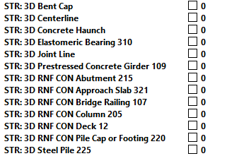
Workspace
Linestyles, Levels, Workspace
Levels and Linestyles can all be defined at the beginning of a project.
Workspace delivered through PW or locally.

Slide 11
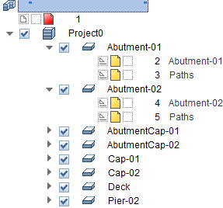
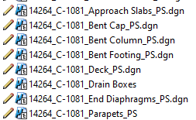
Working with Multiple Users
Utilizing various designers for multiple tasks
Only one designer can be used per bridge.
Multiple files for details

Slide 12
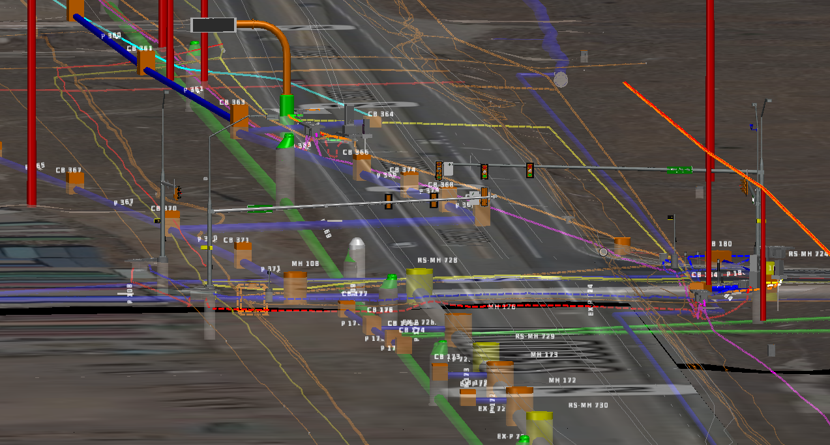
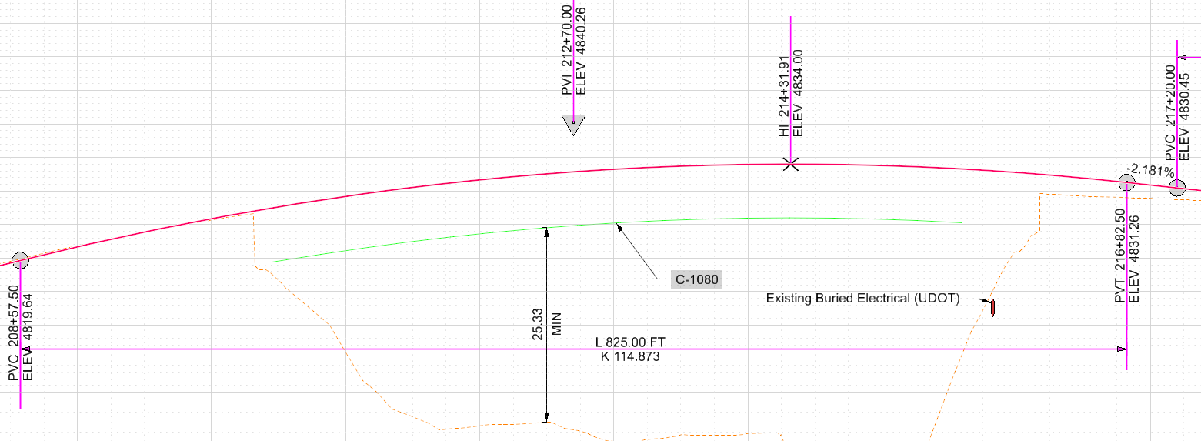
Starting a project with existing data
Alignments, Existing Topo, Drainage and Utility data
Referenced as .dgn file
Typically vertical and horizontal alignments can be created within program

Slide 13
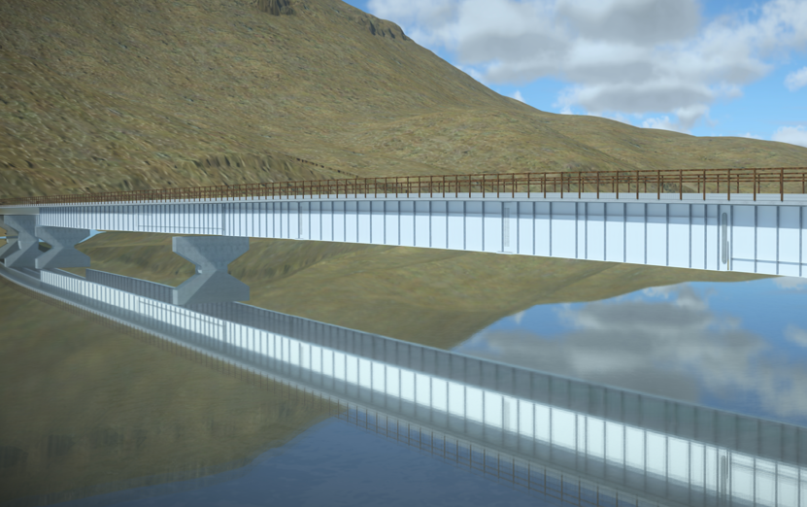
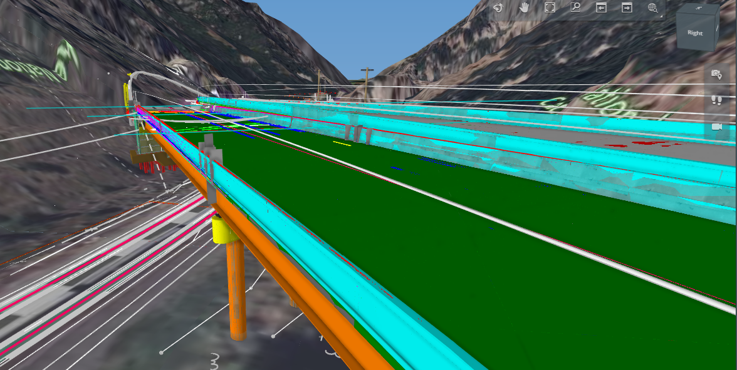
Creating your Base Model
Build geometry of bridge by 3D solid elements
Modify elements to ensure correct geometry as designed
Elements have no intelligence other than basic shape and size
Some elements can’t/shouldn’t be modeled.

Slide 14
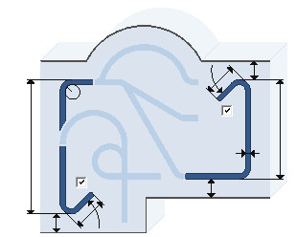
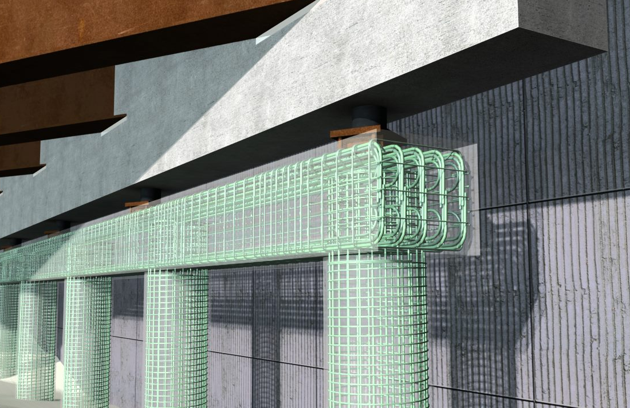
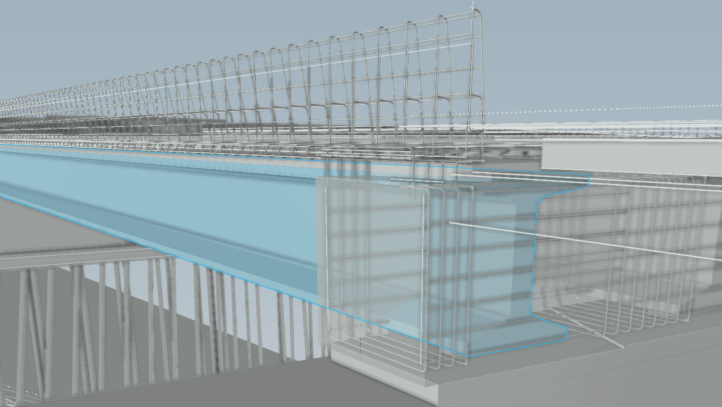
Reinforcement and Schedules
Reinforcement detailing within model.
Use Solids model as guidelines for reinforcement
Apply additional detailing such as welds and bolt patterns to detail model.

Slide 15

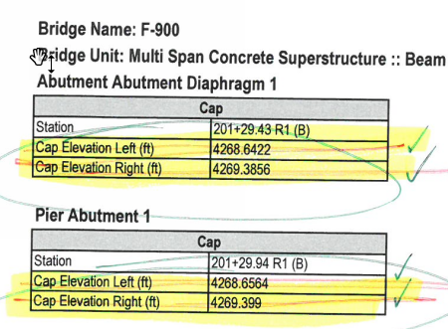
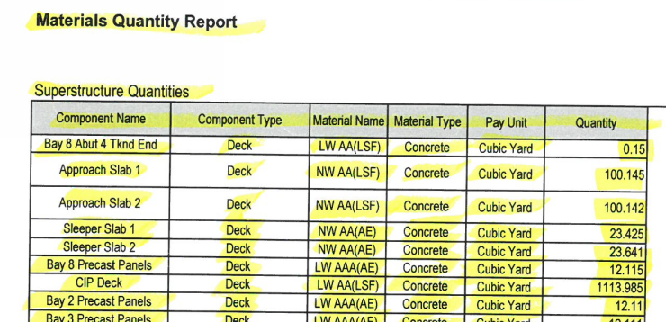
Automated reporting
Reports need to be created for geometry, quantities, etc.
Reports are predefined deck, beam, bearing, and pier reports as well as quantities.
Ability to QC

Slide 16



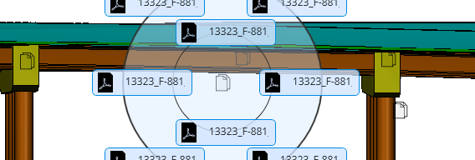
Attributing of Elements
Solids are nothing without data
Apply attributes and attachments to solids and detail model
Includes all information that would not be included in the basic geometry of the solids and detailing model.
Create and Attach any reports that are created from the solids and detail model
PDF
Reports (SP, etc.)
Excel
Tables (deck elevations, beam details, etc.
MicroStation
2D details

Slide 17
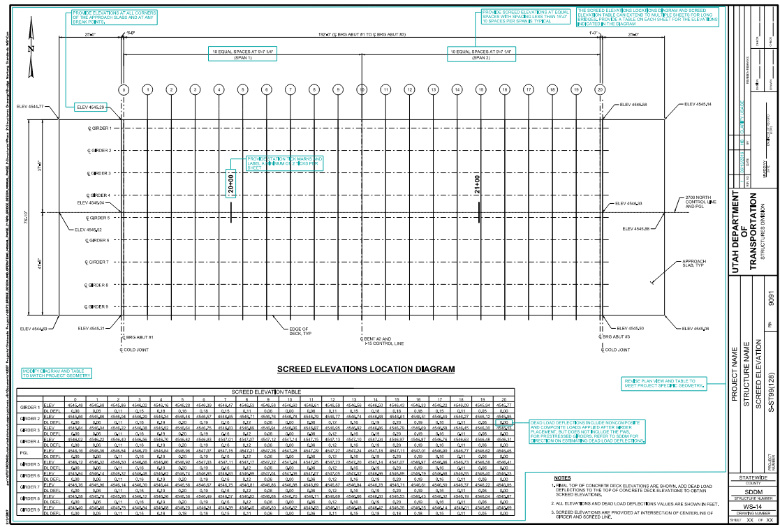
Detail/Sheet Creation
2D details are still needed in addition to 3D models.
Details from a 3D model can be projected to 2D sheets via plan, section and elevation views.

Slide 18
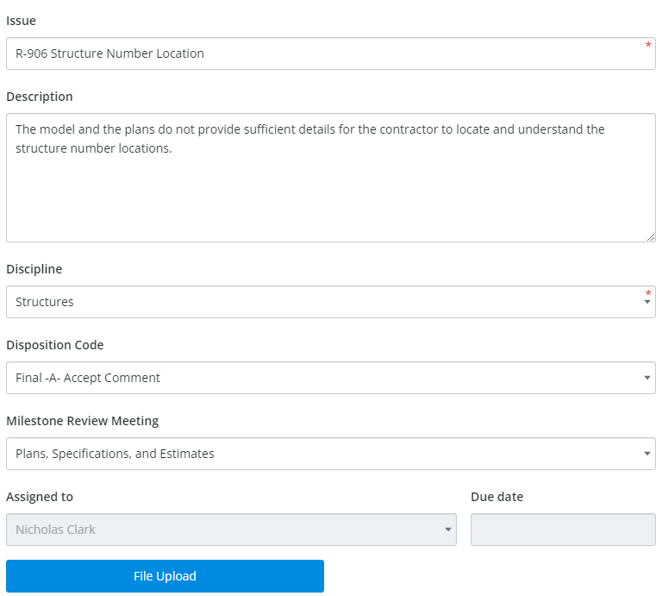
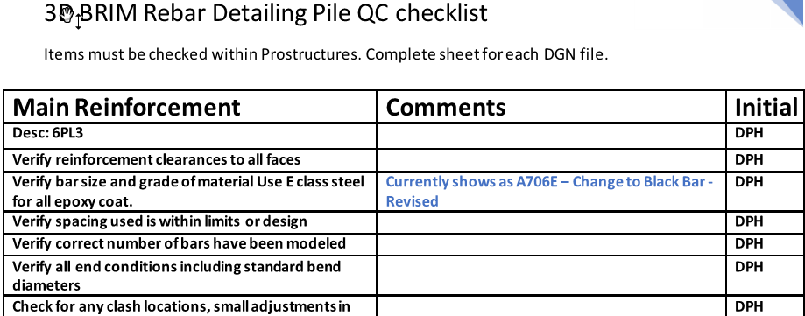
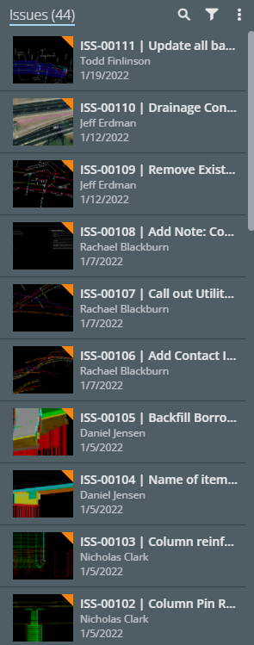
Model Review
Internal and External Review

Slide 19

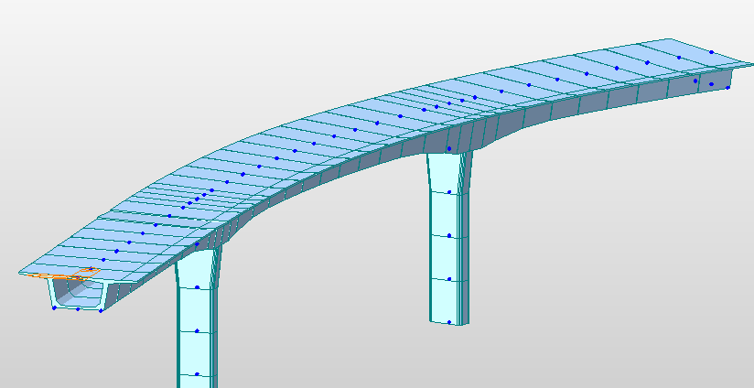
Analysis Interoperability
Internal and external interoperability
Direct link software
  Leap
  RMBridge
  Integrated spec checks
External link
  Output to various FEM software
  LUSAS, Midas, RMbridge

Slide 20
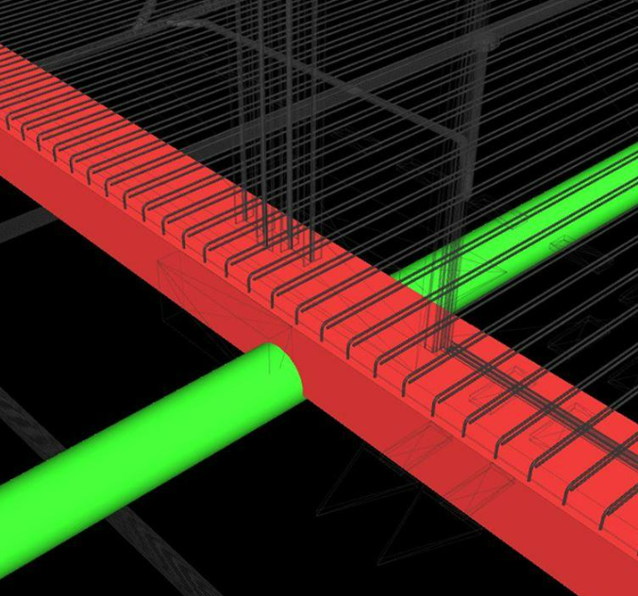
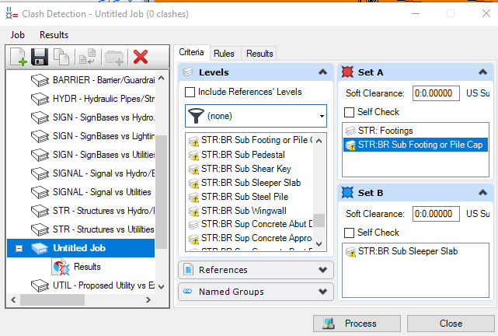
Clash Detection
Hard and soft clashes

Slide 21
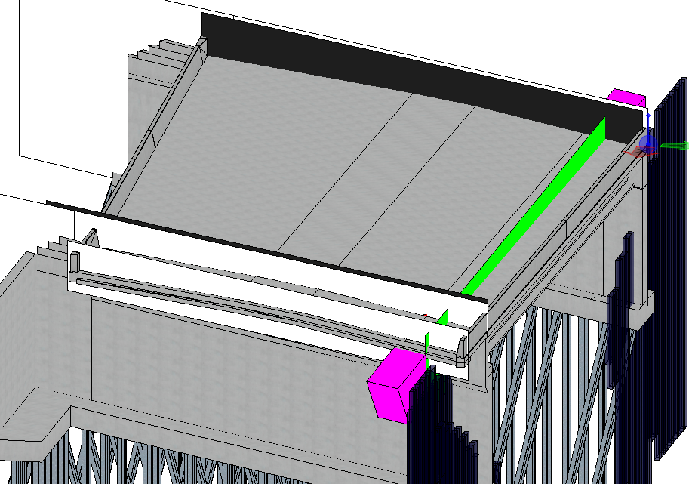
Construction Phasing 4D Modeling
Need to show phasing lines and construction sequencing
Various DOT’s require different phasing info in plans.
This could be more for the contractor and diagrams during design.

Slide 22
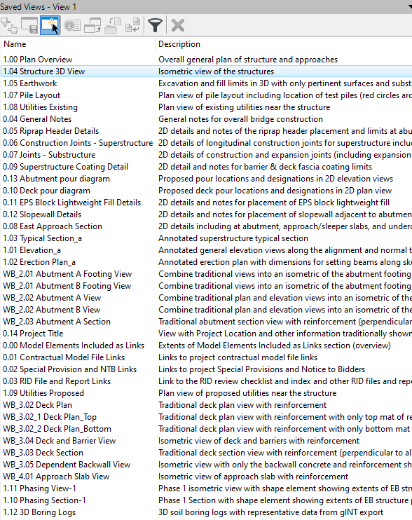
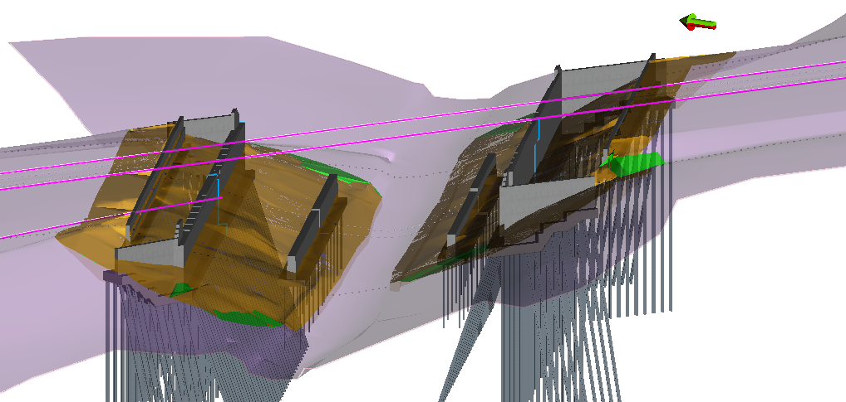
Saved Views
Allows designer to guide model user
Can be setup similar to planset

Slide 23


Software and Tools Structure
Software and Tools Structure
ProConcrete
Steel Reinforcement
Design & Quantities
OpenBridge Modeler
3D Structure Models
(Existing and Proposed)
OpenRoads Designer
3D Road Models
Survey and Earthwork Models
gINT Geotechnical Data
“Container” File
DGN (OpenRoads Designer or Bentley View)

Slide 24
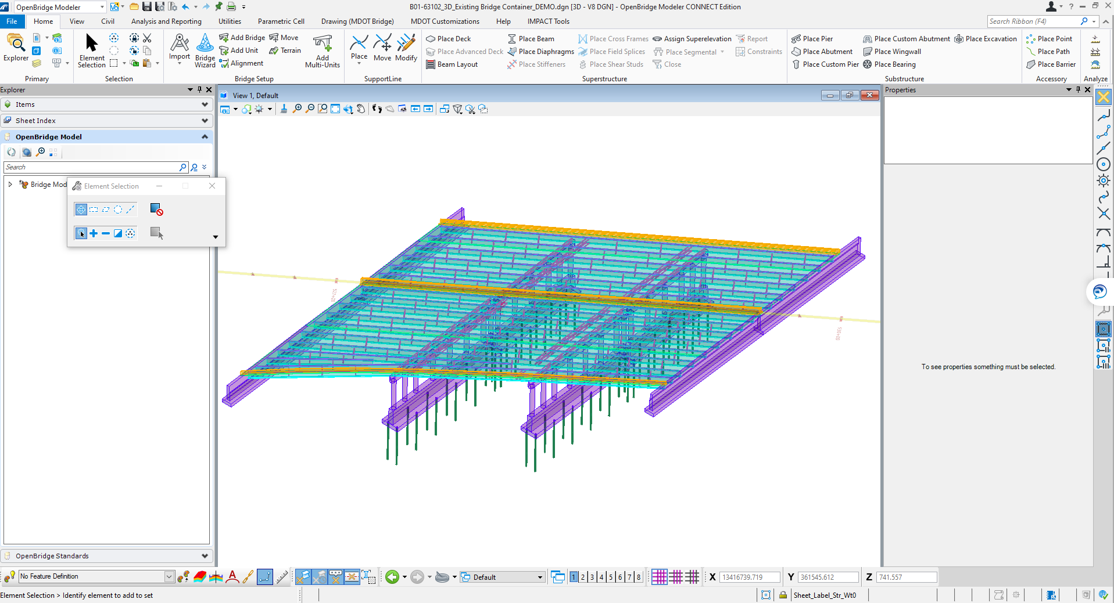
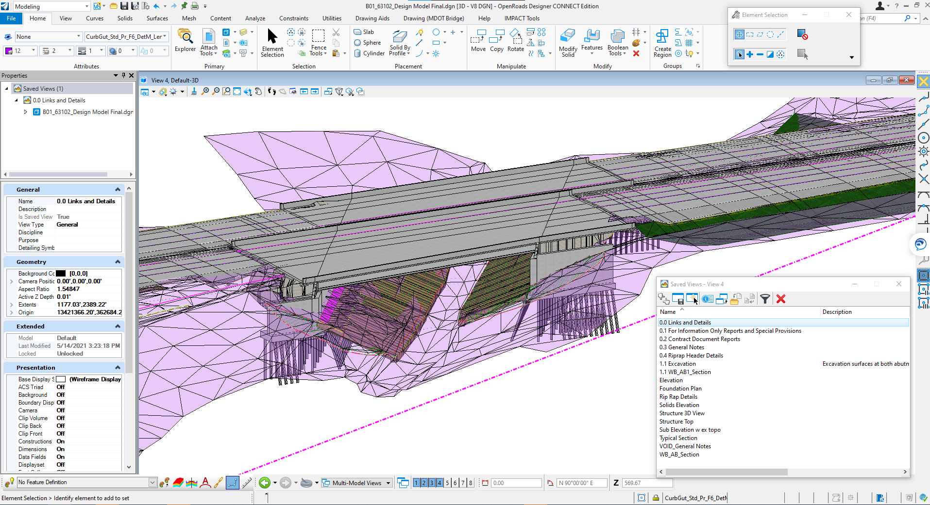
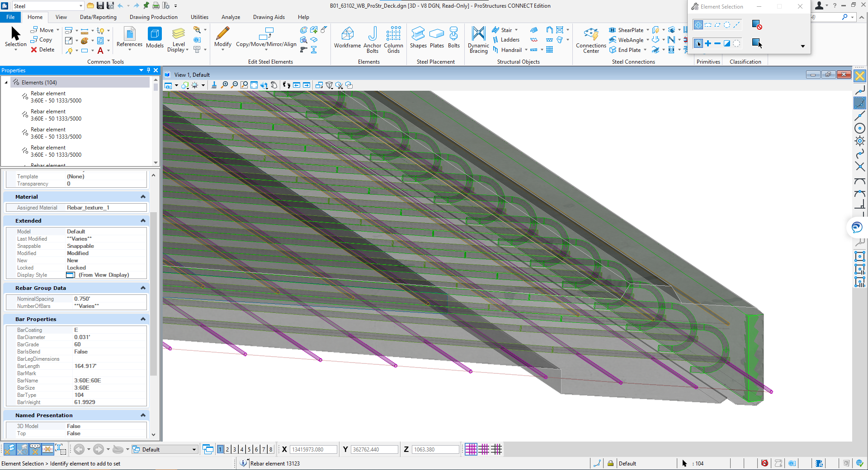

Federated Model
All Discipline Files
Reinforcement
Single Model Environment
Fill/Excavation Quantities
Existing Structure

Slide 25
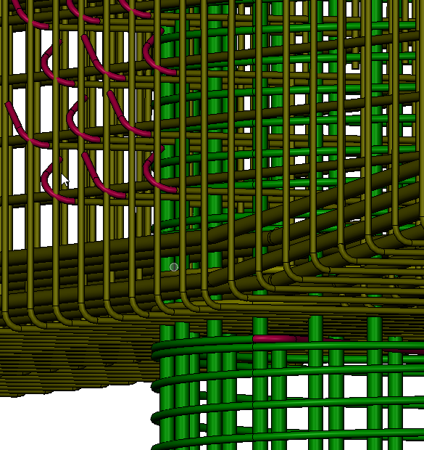

Export Formats
Ultimate goal is Universal file format
BuildingSmart .IFC file format
Modeling program should have integrated .ifc definitions.

Slide 26

Role Changes
PM
PM
Lead/QC Engineer
Designer/
Engineer
CADD/
Tech
CADD Designer
Lead/QC Engineer
Model Coordinator
Designer/
Engineer/
Modeler

Slide 27
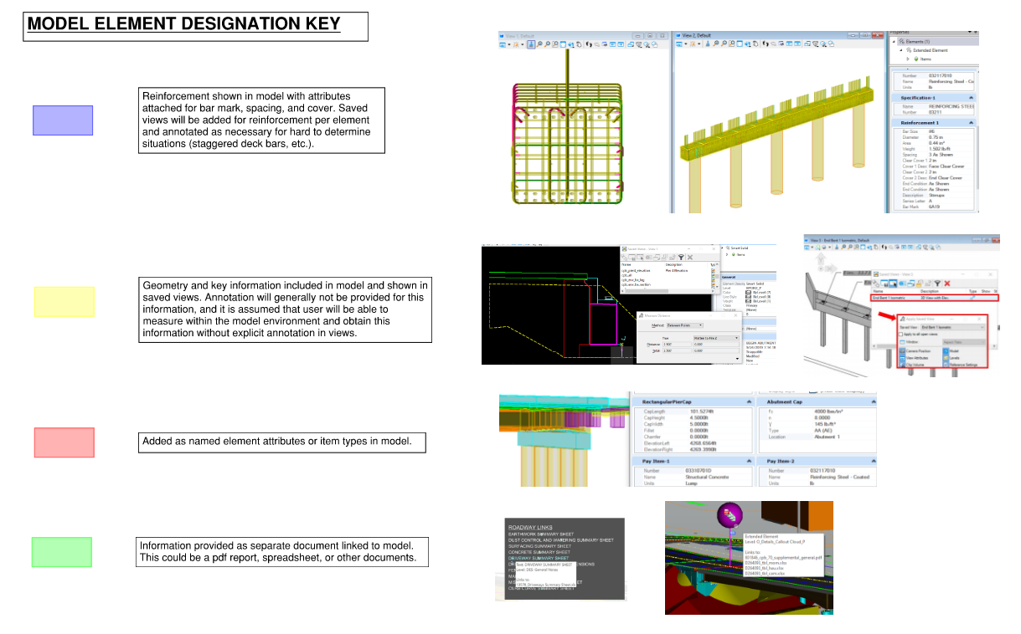
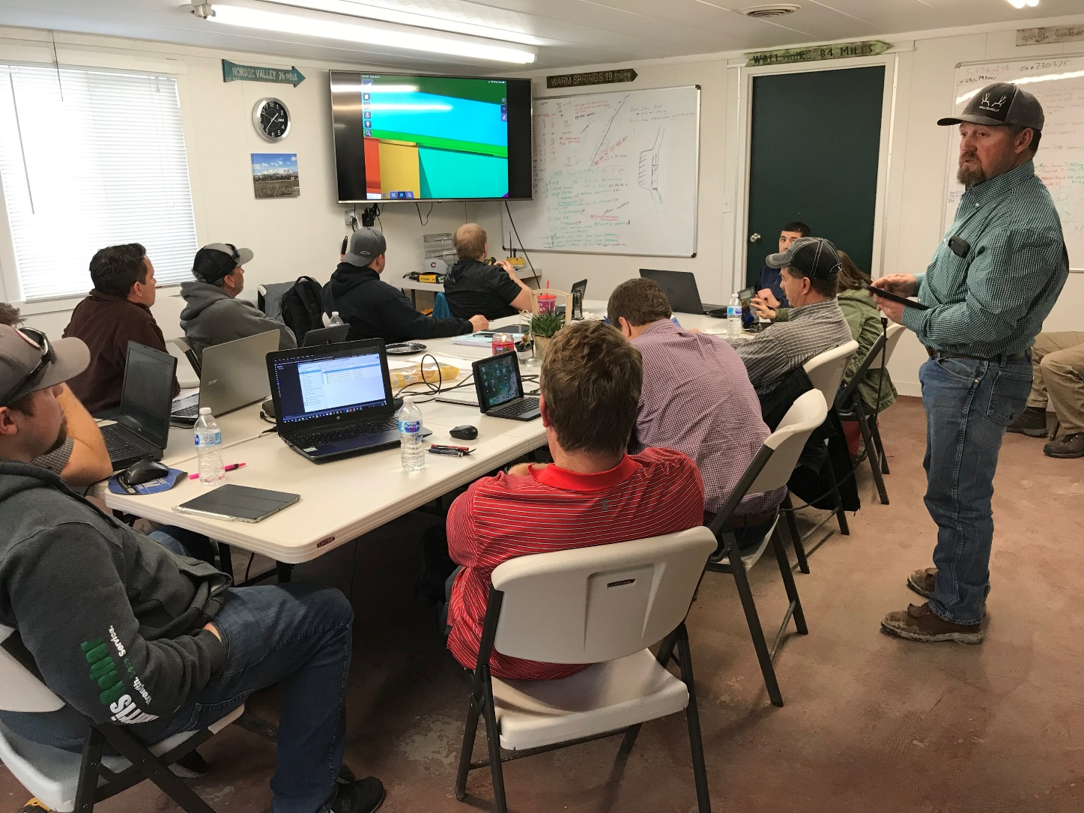
Guidance and Training
Crosswalk
  Where to find the information in model files
  Sample 2D plan set
Training Video
  Short demonstration and instruction
  Tool or task-specific

Slide 28
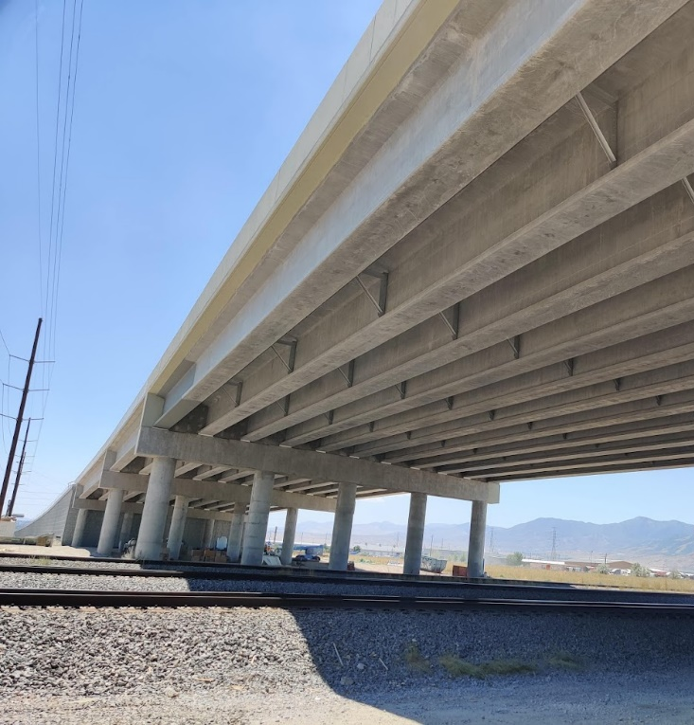
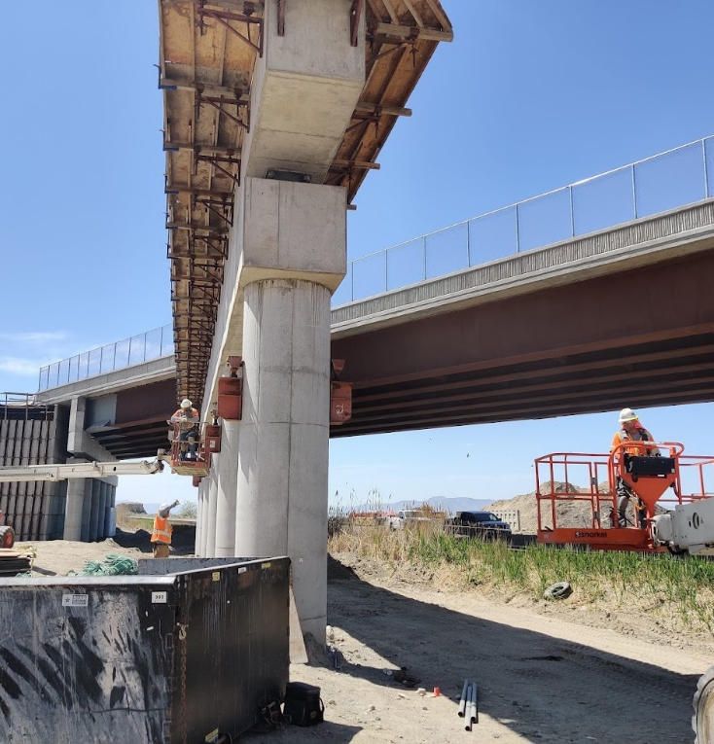
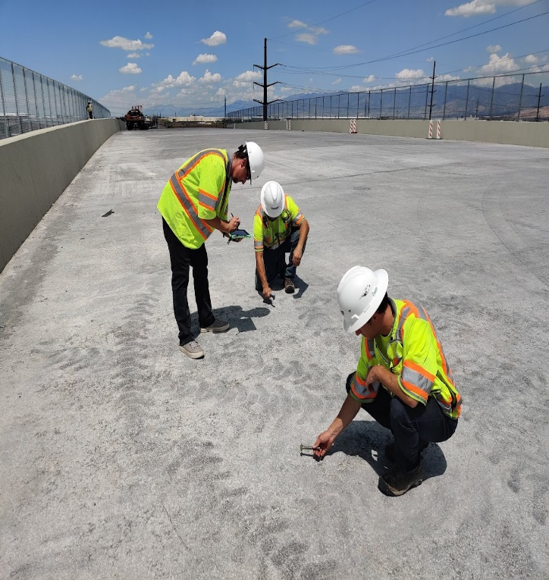



Construction
Utilize .dgn model file and published model.
Convert file to other modeling software.

Slide 29
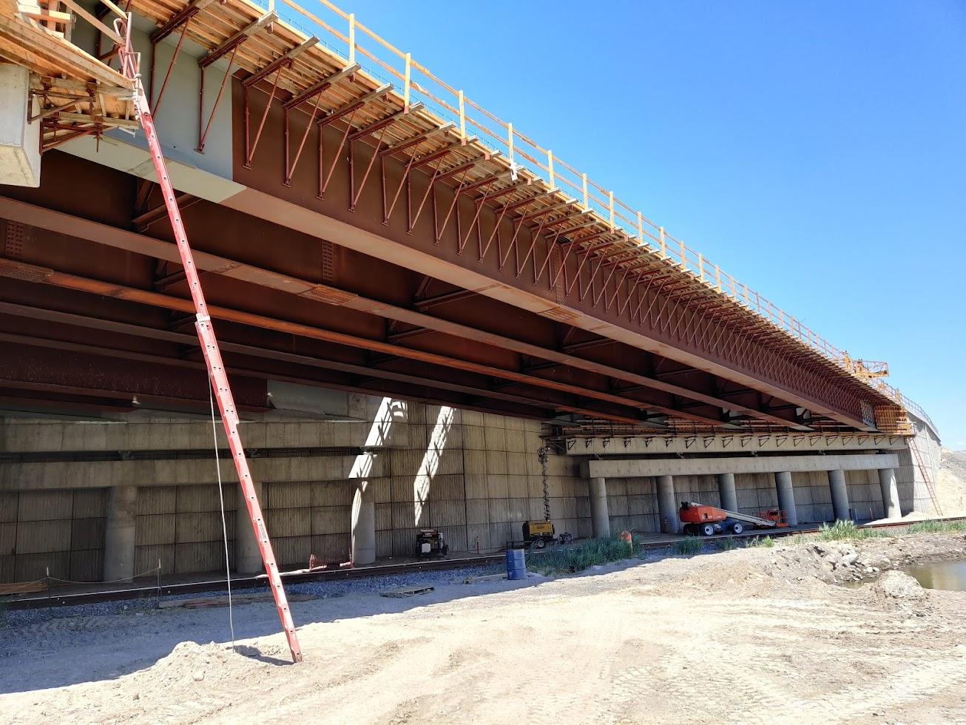
Lots or reluctancy to utilize models. Still want 2D plans.
Pull survey directly from model.
Contractor utilizes collaborative software to track and record issues.
High learning curve, Need constant training
Having everything in one package has shown to be beneficial.
Found issues in field by having all structures models compiled.
Simply can update the model and send new files to crews
Measurements in a model are still difficult. Need better saved views
Don’t be pessimistic.

Slide 30
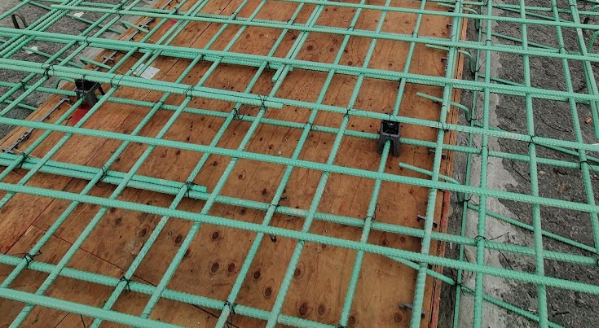

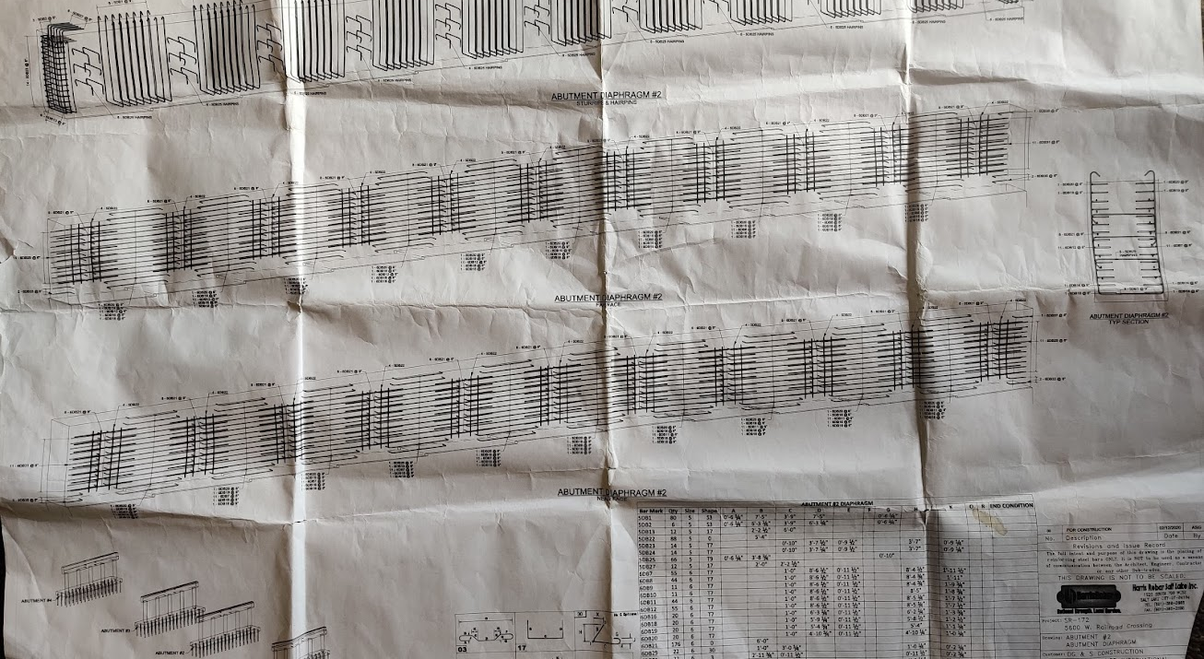
Reinforcement for Construction
Model files are converted to .ifc files.
Fabricator utilizes .ifc in proprietary software.
Fabricator still creates 2D plans for field crews.

Slide 31
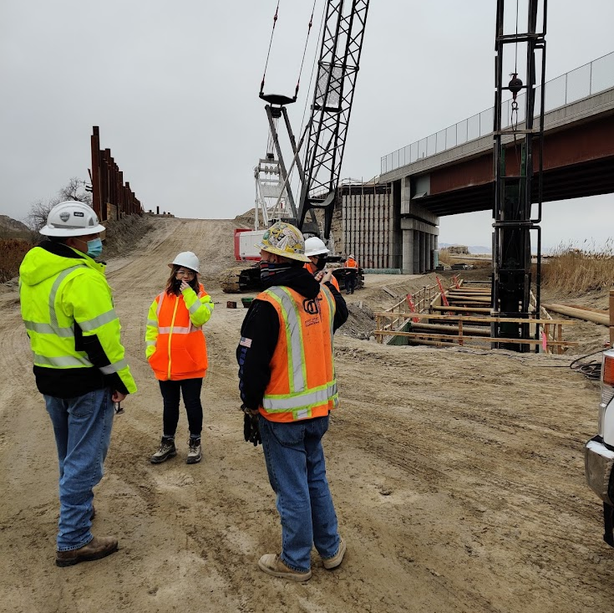
Inspectors and Field Engineers
Utilizes similar workflow to reviewers and contractors.
Part of collaborative software to share items instantly between contractor, field crew and designers.

Slide 32

Thank You
Questions?

