Slide 1
Safety Assessment For Every Roadway (SAFER)

Slide 2
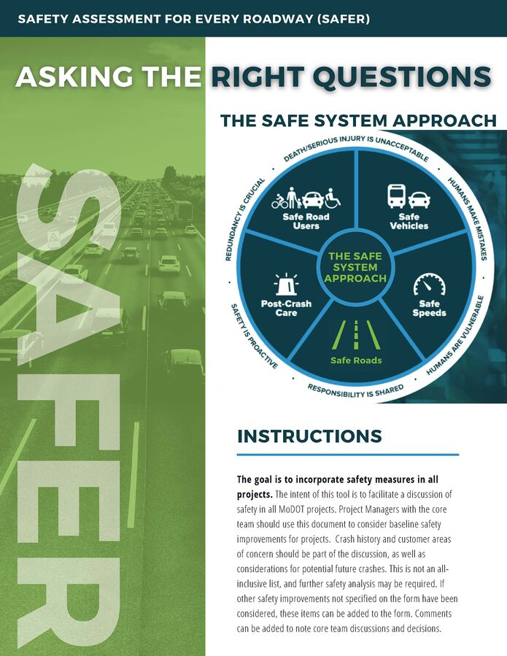
Notes:
Give a high-level overview of the document – what was our goal
Give a high-level overview of the issues that we were seeing
Segway into talking about the Safe Systems Approach

Slide 3
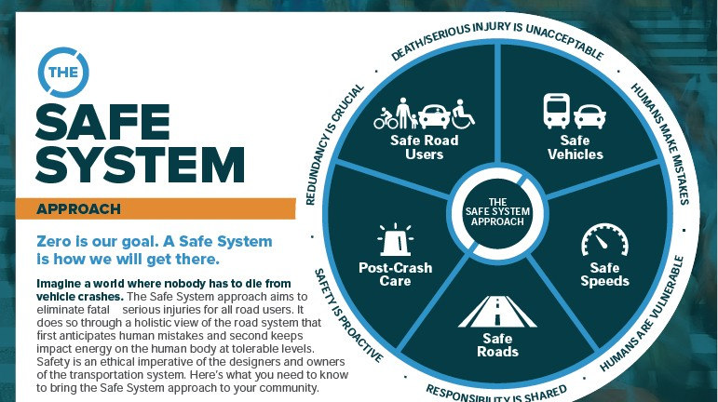

Slide 4
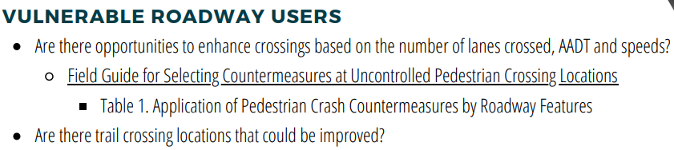
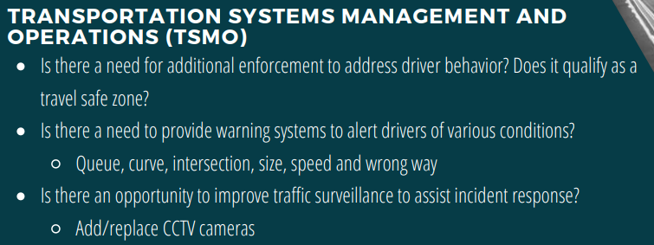
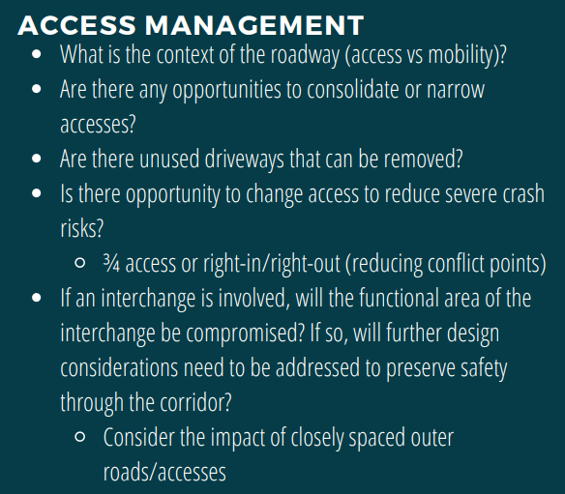
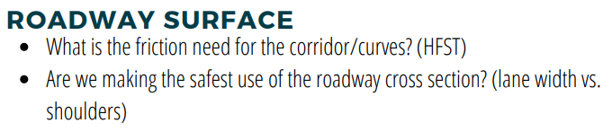
Notes:
List out all the categories
This is a living document and will be updated as needed
It is available publicly
This is not a check list
There have been some made, but that is at a district level
How incorporated in the project process this is also varies

Slide 5
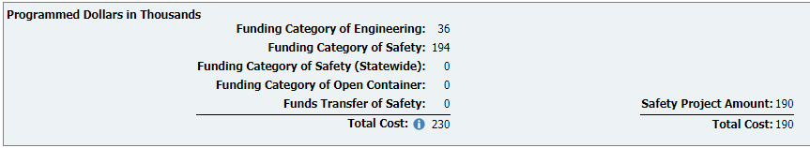
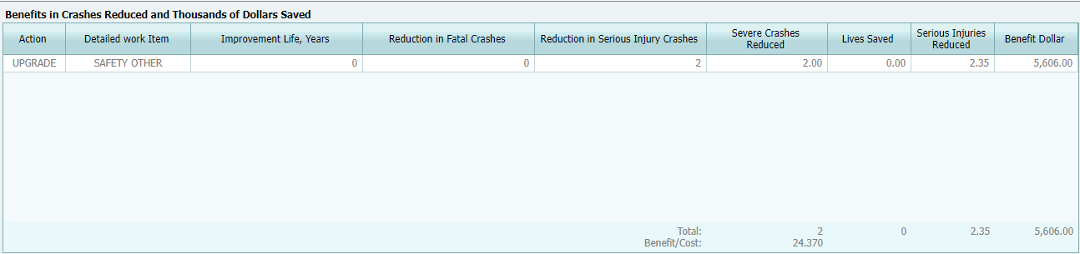
Notes:
How this works in practice for our staff
The variations from district to district
The latest steps we have taken to further this – quantifying benefits segway

Slide 6
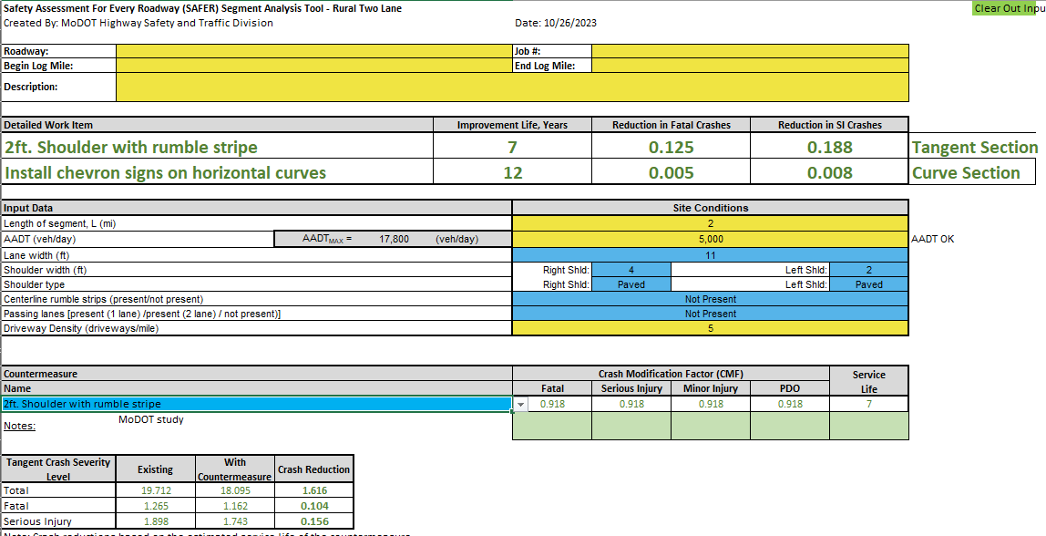
STIP Safety Estimator Tools
Notes:
Go over the tools that we had created to help with quantifying benefits
Segway into outcomes that we have seen in the STIP

Slide 7
STIP Outcomes
50% of STIP projects include safety
$648 million in safety investment
The overall B/C is 4.2
342 projects were repair/replace which is about $113 million
$240 million of that are “safety” funds
Notes:
Show the percent of all projects in STIP that have safety
Show the overall B/C
Show the number of projects reporting 0s
Show the distinction from maintenance safety and added safety and the story we are trying to tell with this new data that we have

Slide 8
Thank You!
Katy Harlan
Phone: 573-526-4293
Email: katy.harlan@modot.mo.gov

