Slide 1
Evaluating Arkansas Weathering Steel Bridge Performance (TRC2103)
Transportation Research Conference (05-22-24)
Ernie Heymsfield (Pi) & gary prinz (co-pi)
Yessenia Gonzalez (Graduate research assistant),
University of Arkansas / dept. of civil engineering

Slide 2
Outline
Introduction
DOT Survey
Field Study
Life-Cycle Cost Analysis
Conclusions

Slide 3
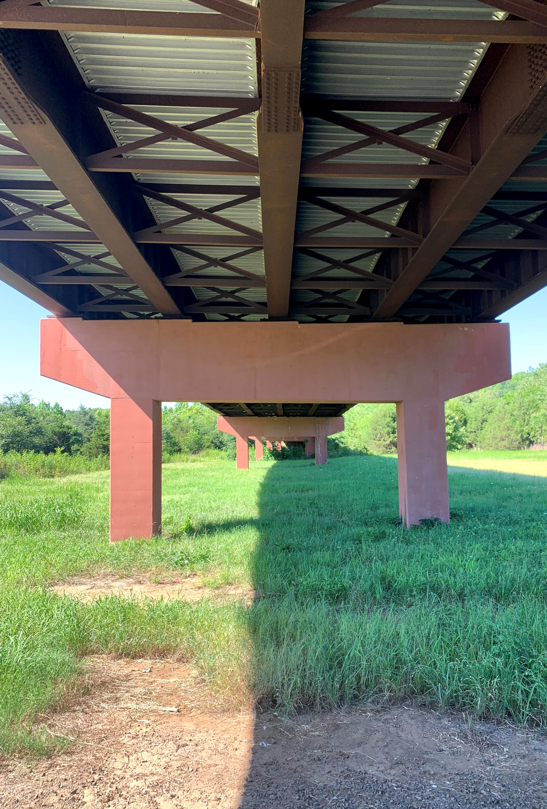
Introduction
    Uncoated Weathering Steel (UWS)
    Low carbon steel including nickel, copper, and chromium.
    Patina (protective oxide film)
    Thick oxide film protective coating
      Protects against moisture, oxygen, and contaminants
      5-7 years
      Proper environmental conditions
      Proper Patina: Fine-grained, dark brownish-red, tightly adhered
      Requires wet-dry cycling for proper patina formation

Slide 4
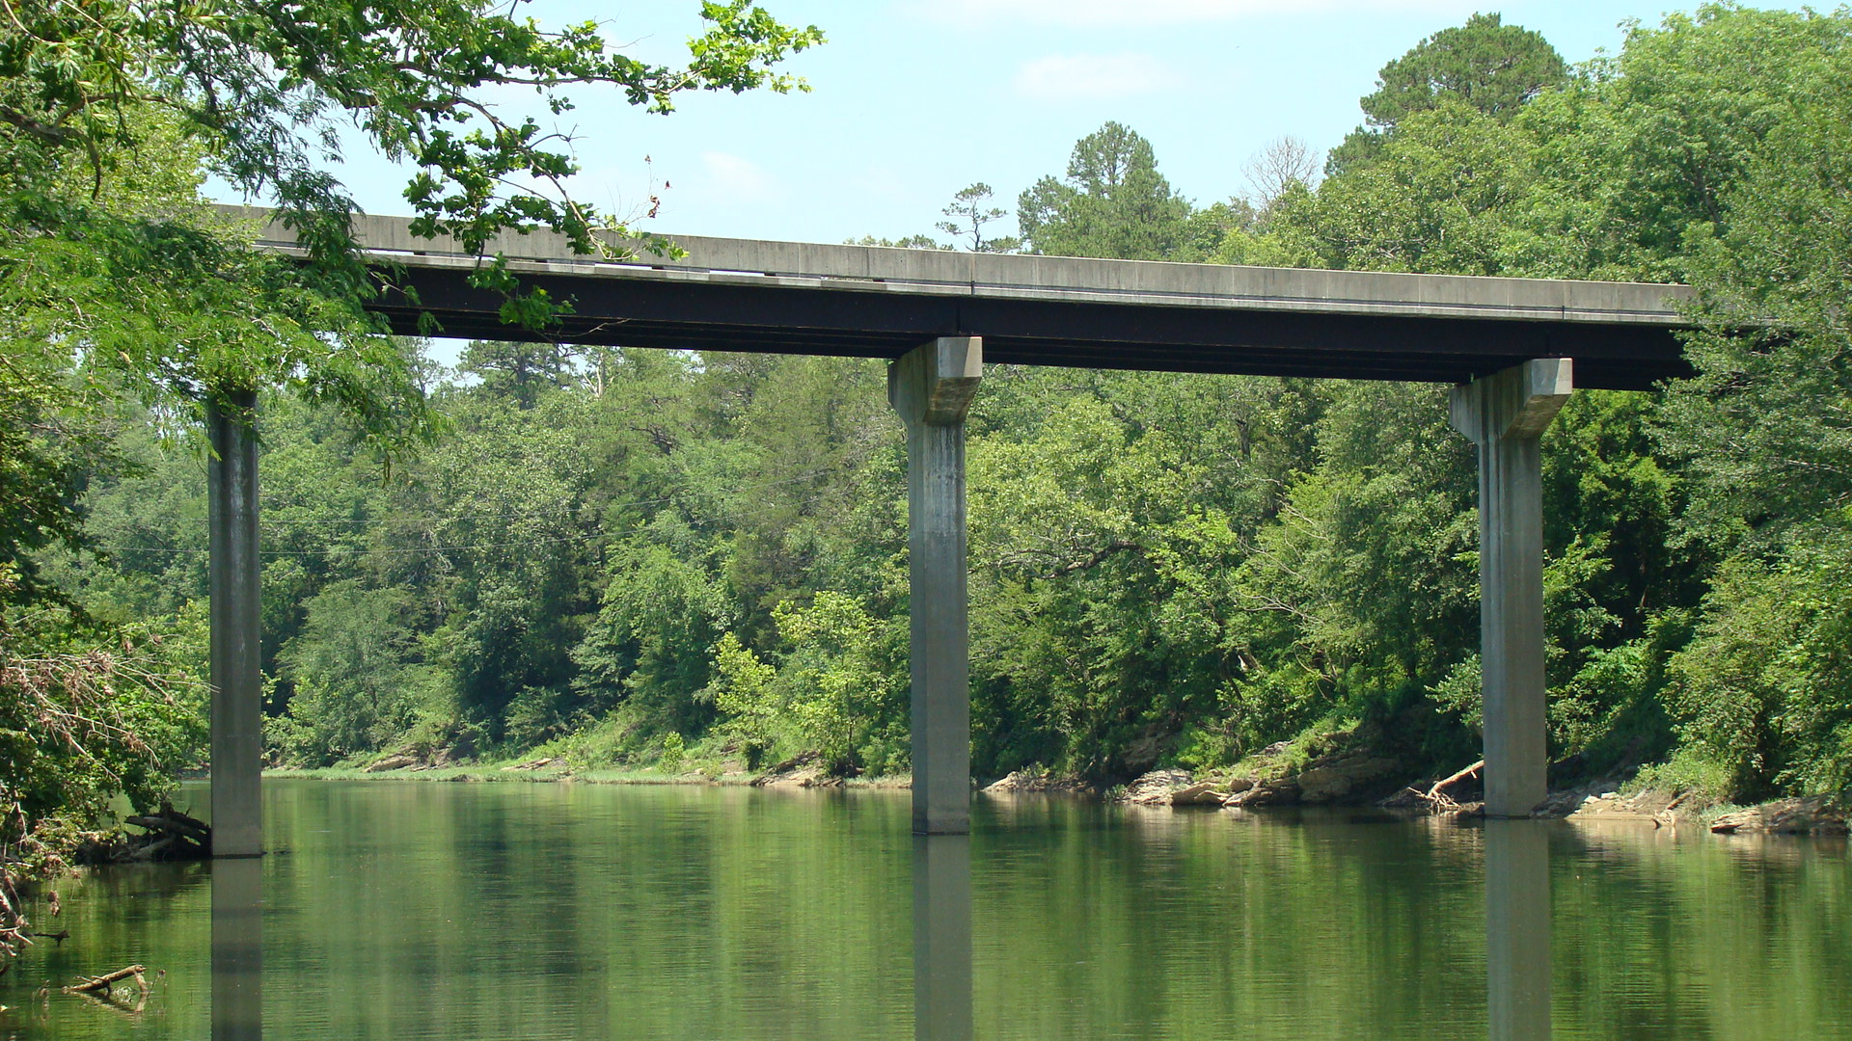
    Uncoated Weathering Steel (UWS)
    Benefits
    Negates the need for bridge painting
    Reduces bridge maintenance and rehabilitation
    Cost savings
BR06592 over Ouachita River

Slide 5
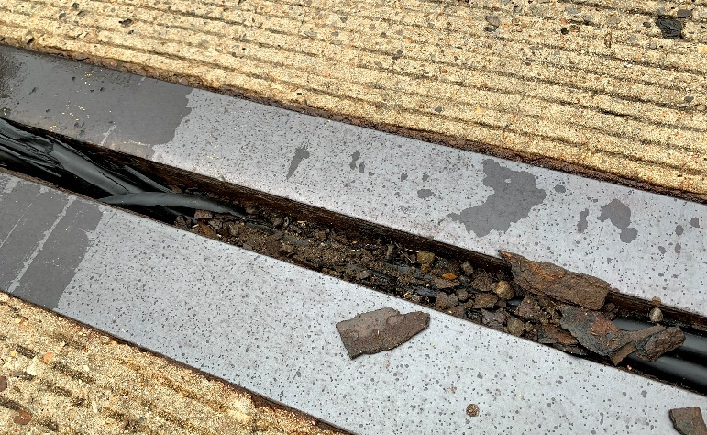
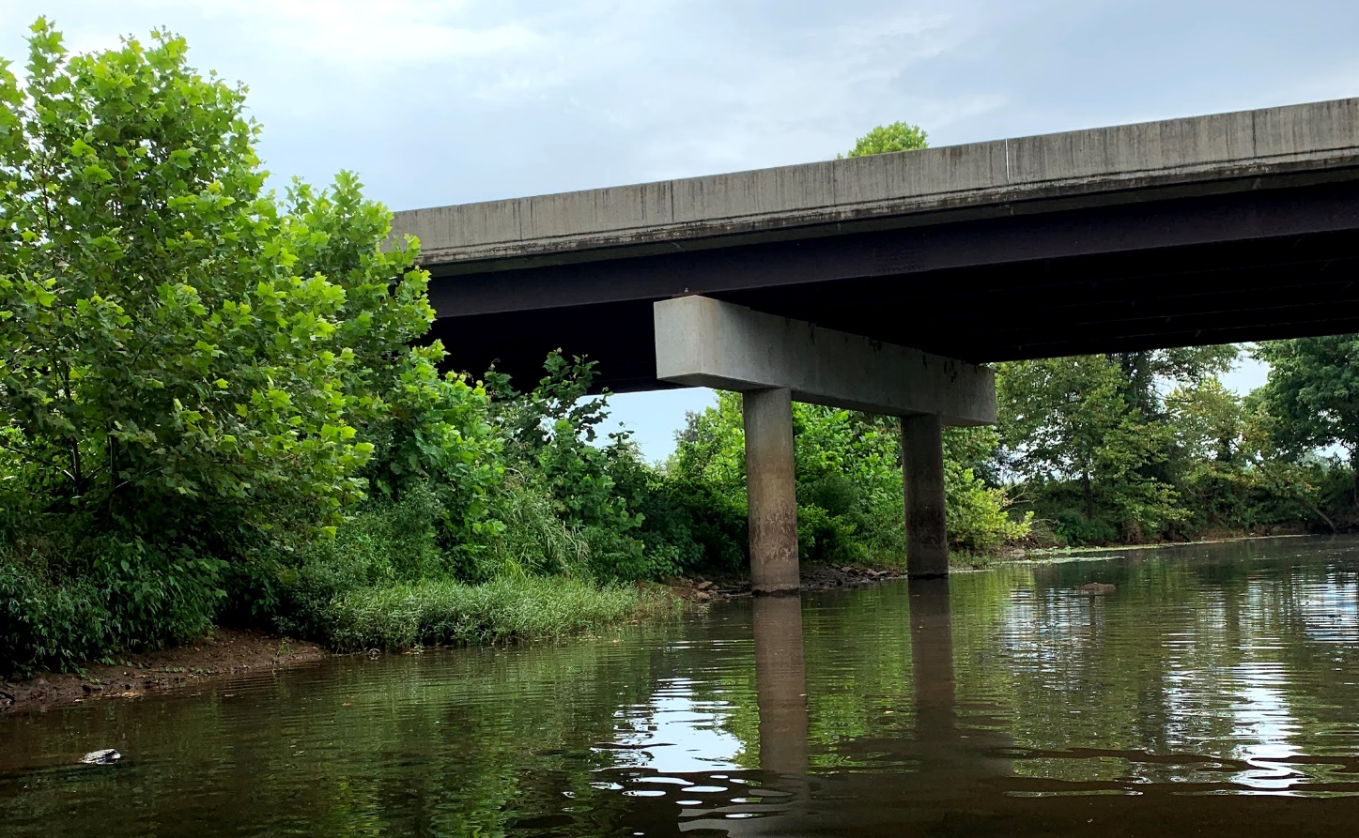
Primary Factors Influencing UWS Performance
Micro-environmental – (localized area and bridge design)
-Debris collection
-Water drainage at bridge expansion joints
-Using deicing chemicals
Macro-environmental – (local regional weather conditions)
-Humidity
-Temperature
-Precipitation
-Pollution
Debris formation
Bridge near vegetation

Slide 6
Oxide Film Condition States
National Bridge Inspection Standards (NBIS)
Categorize oxide film degradation as a function of texture and color
  Good (1)
  Fair (2)
  Poor (3)
  Severe (4)

Slide 7
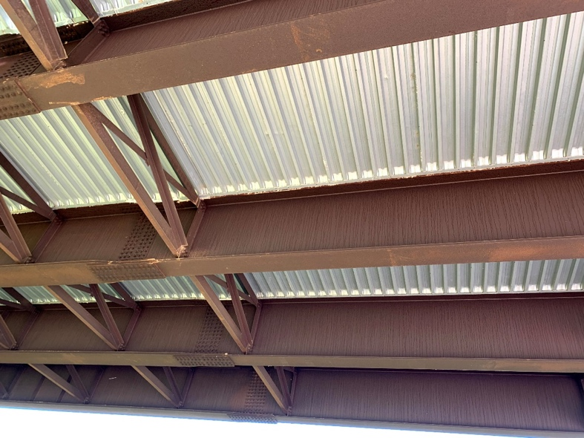
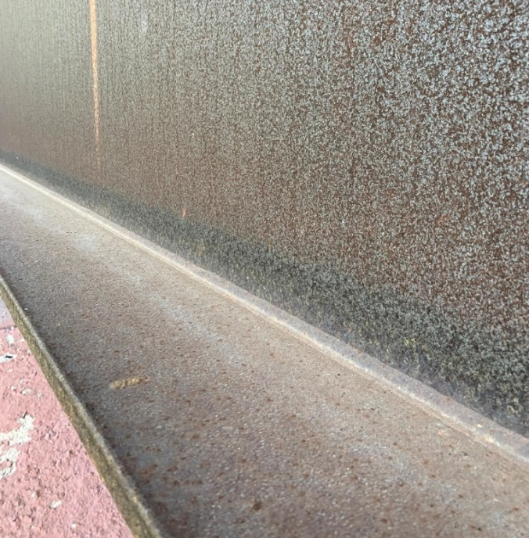
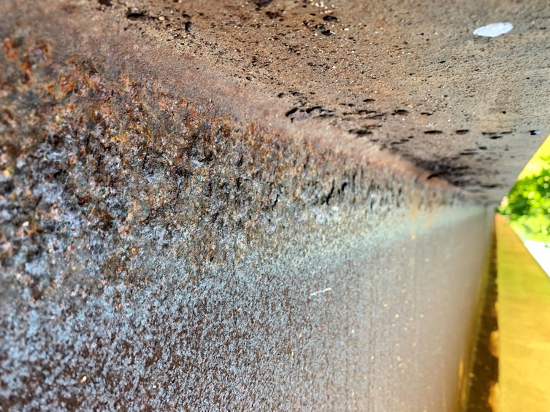
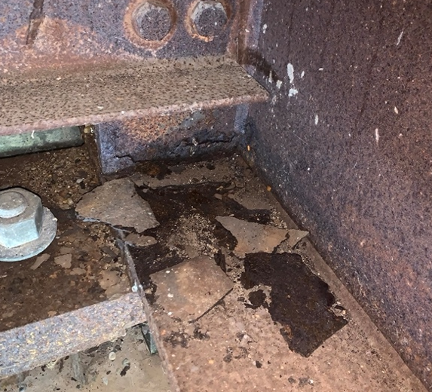
Condition States (1-4)
CS 1
CS 2
CS 3
CS 4

Slide 8
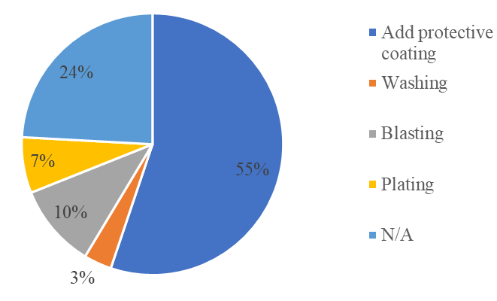
DOT Survey
Painting, drainage, blast cleaning, sacrificial layer
Summary of corrective measures implemented by DOTs (26 responses)

Slide 9
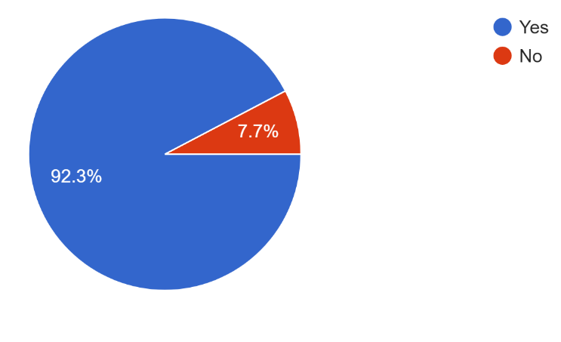
DOT Survey
Would you recommend using weathering steel in future bridge structures? (26 responses)

Slide 10
Oxide Film Degradation in Arkansas
    71 of ARDOT’s 859 UWS bridges have > 90% of the exposed girder area experiencing oxide file degradation

Slide 11
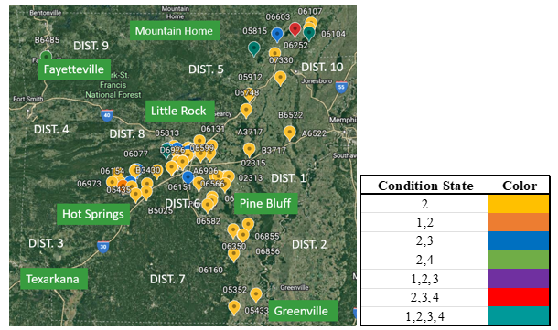
Bridge location: 90-100% degradation
DIST. 9

Slide 12
TABLE 1 Number of Bridges in Each Time Period as a Function of Degradation

Slide 13
Number of Bridges in Each ARDOT District as a Function of Degradation

Slide 14
Bridge Ranking for Remediation
20 bridges within Arkansas were prioritized for remediation
A weighted factors approach was incorporated by considering different weighted factors (7 trial approaches) applied to the oxide film degradation percentage

Slide 15
Bridge Prioritization
(Bridge Ranking Weighted Factors)
Wt Factor = f (measure of severity)
RANKING = WEIGHT(i) * % of Bridge Experiencing CS(i)
Low score
Cost to remediate

Slide 16
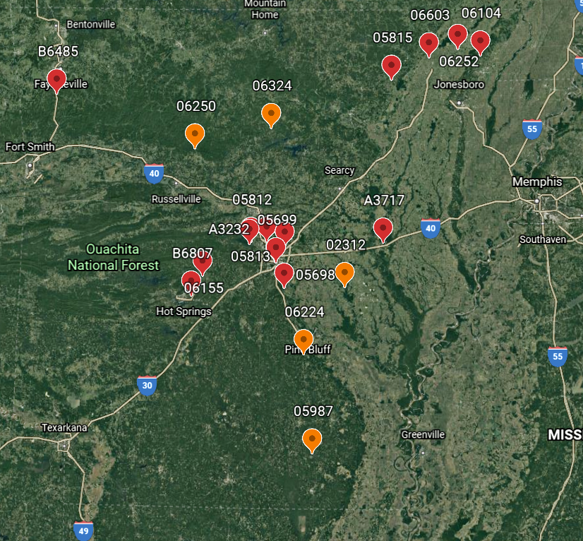
Mountain Home
DIST. 9
Fayetteville
DIST. 5
DIST. 10
DIST. 4
DIST. 8
DIST. 1
Hot Springs
Pine Bluff
DIST. 6
DIST. 3
DIST. 2
DIST. 7
Texarkana
Greenville
Top 20 Bridge Ranking for Remediation in First 5 Trials

Slide 17
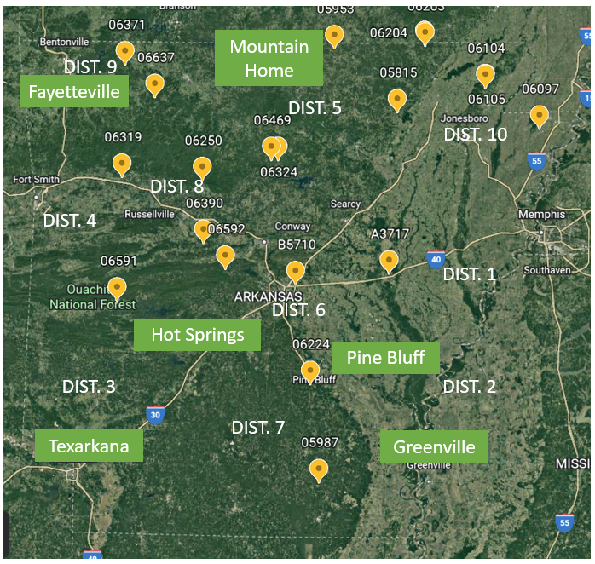
Top 20 Bridge Ranking for Remediation in Trials 6 & 7

Slide 18
Bridge Field Inspections
March 22 – March 25, 2022
  6 bridges
June 13 – June 16, 2022
  11 bridges
June 21, 2022
  2 bridges
June 30, 2022
  2 bridges
March 27– 28, 2023 (UWS encased in concrete)
  4 bridges
  TOTAL = 25 bridges

Slide 19
Bridge Inspection Sites
6 BRIDGES
11 BRIDGES
2 BRIDGES
2 BRIDGES
4 BRIDGES

Slide 20
Bridge Inspection Details (2022)
6 BRIDGES
6 Districts
2, 5, 6, 8, 9,
10
11 BRIDGES
21 BRIDGES
18 multi-simple
2 BRIDGES
2 BRIDGES

Slide 21
Bridge Inspection Details (2023) UWS Encased in Conc.
4 BRIDGES

Slide 22
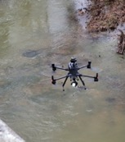
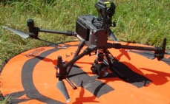
Bridge Inspection Using UAS
DJI Matrice 300 RTK
Camera with 30x zoom lens
Gimbal Connector Spotlight
2 Controllers
30 minutes of flying time
FAA Part 107 License
Visual line-of-site
Check traffic and weather conditions
Obstacle avoidance
BENEFITS
Access to locations
No special equipment
No lane closure
Figure 1: UA on homebase
Figure 2: UA Inflight

Slide 23
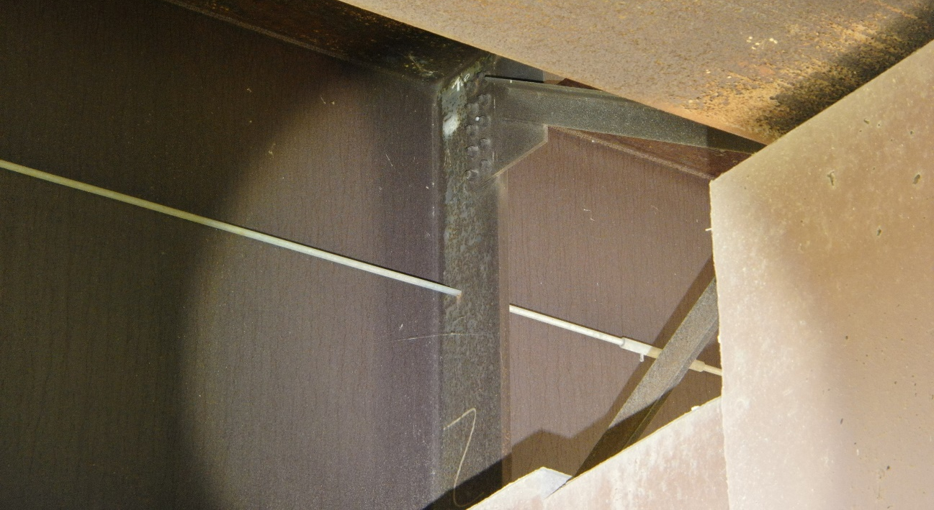
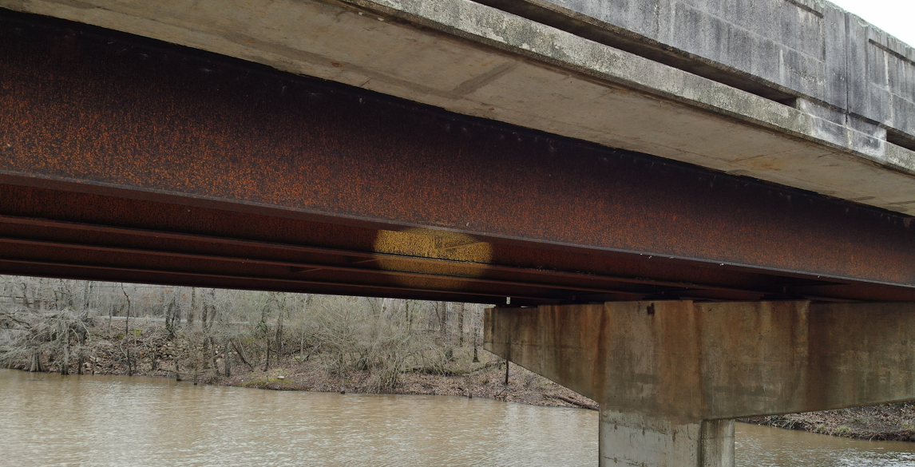
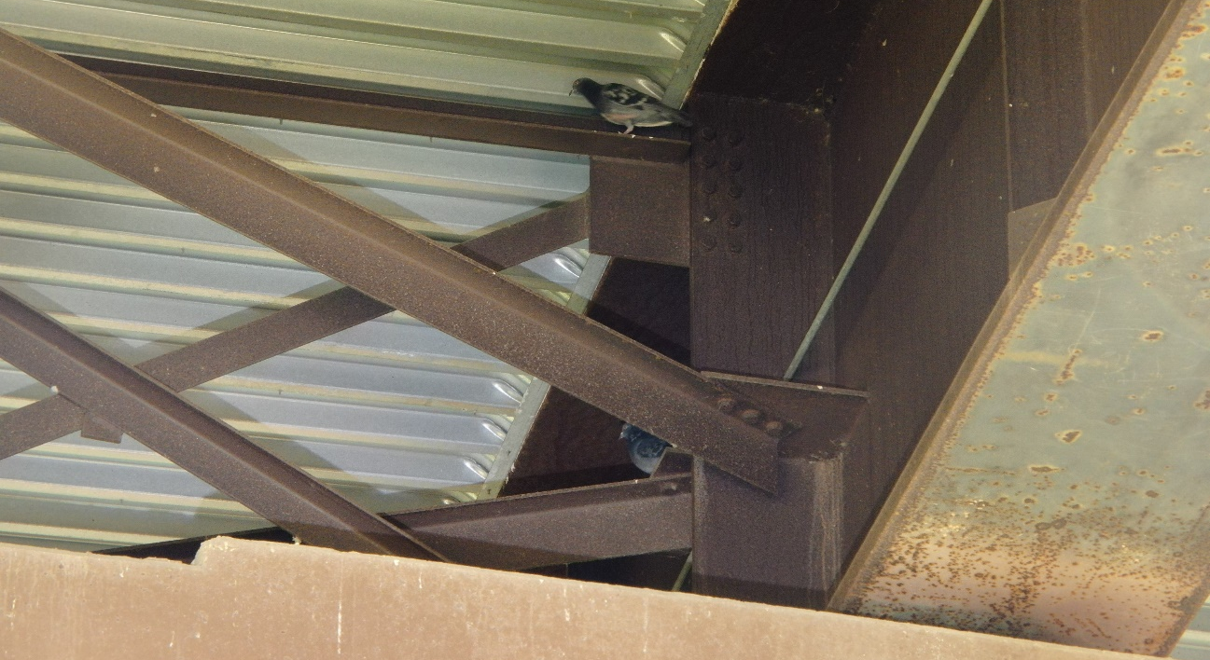
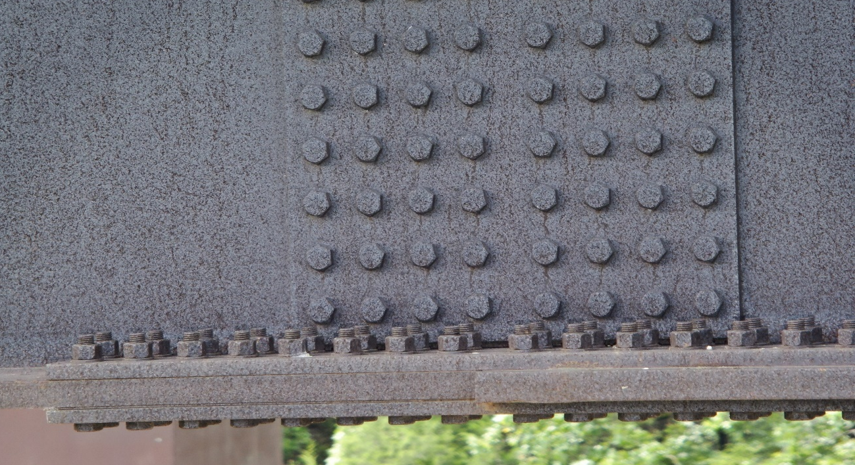
UAV Pictures
Figure 1: Spotlight
Figure 2: At Level
Figure 3: Spotlight 2
Figure 4: Field Splice

Slide 24
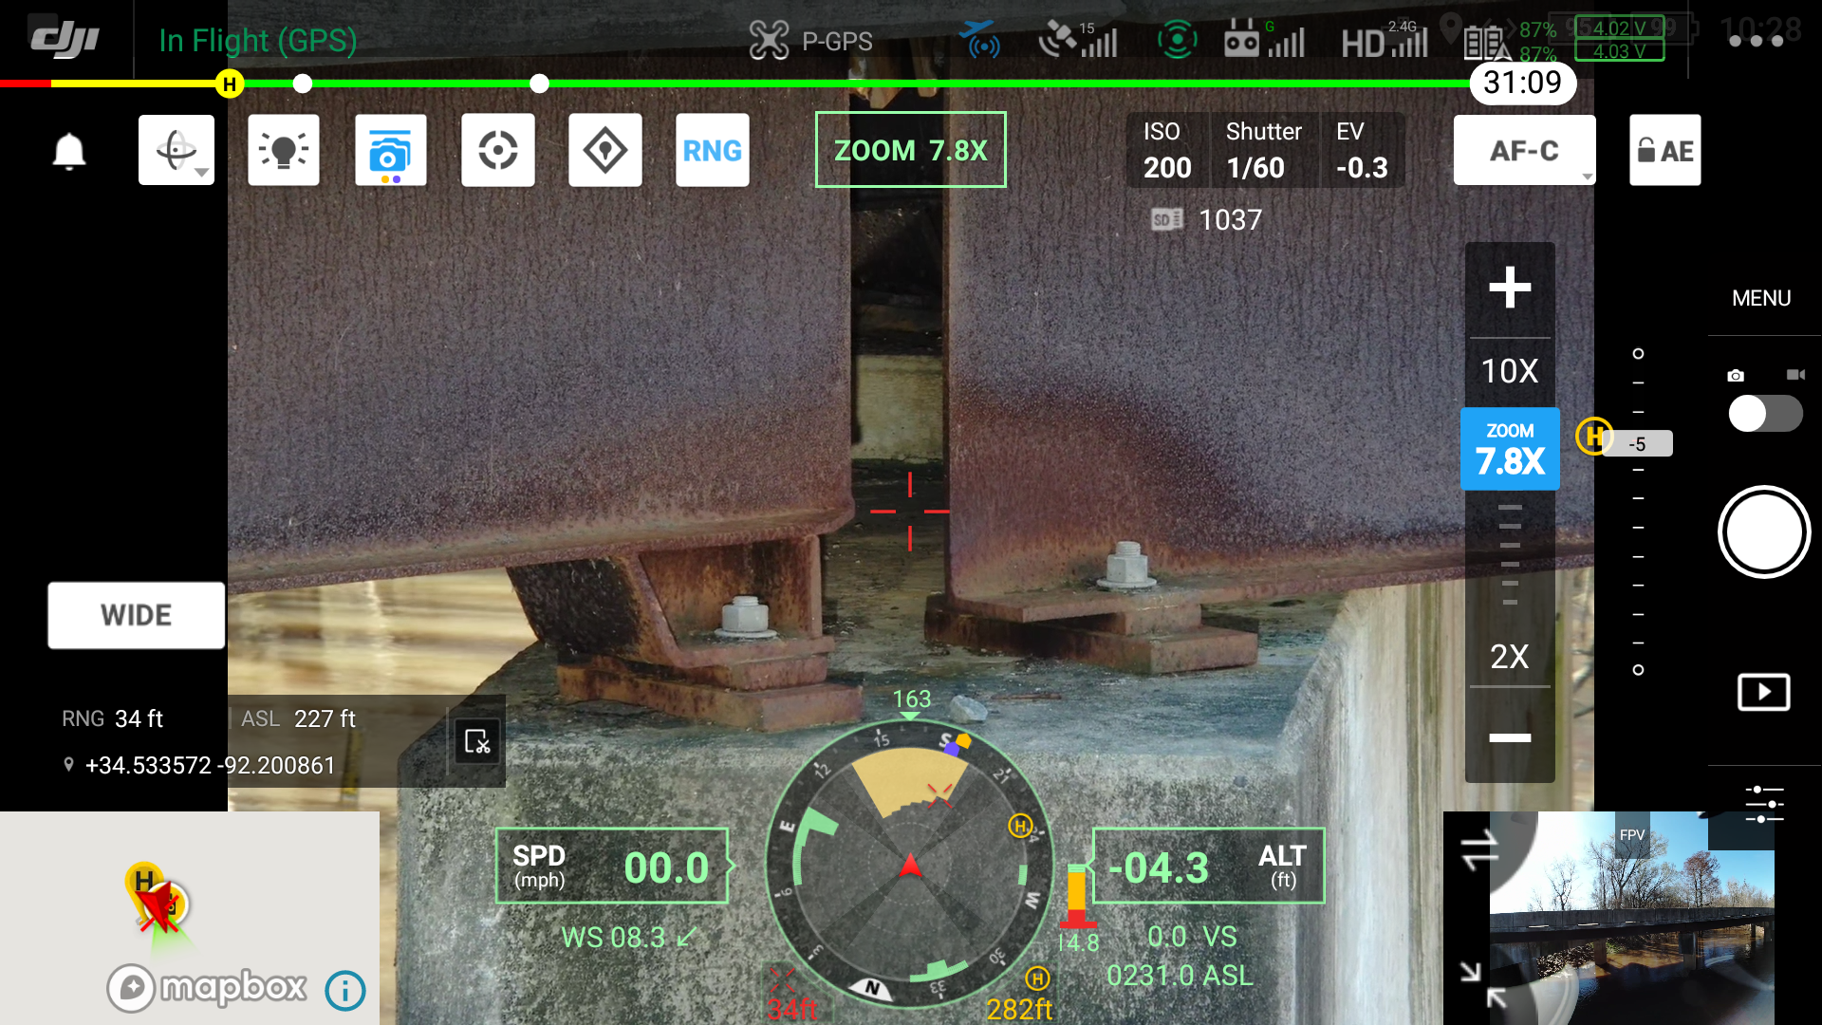
UA Screen Shots
Figure 1: UAV Screenshot

Slide 25


Expansion Joint
COMPRESSION SEAL JOINT
(BRIDGE 5812)
MISSING COMPRESSION
SEAL JOINT

Slide 26
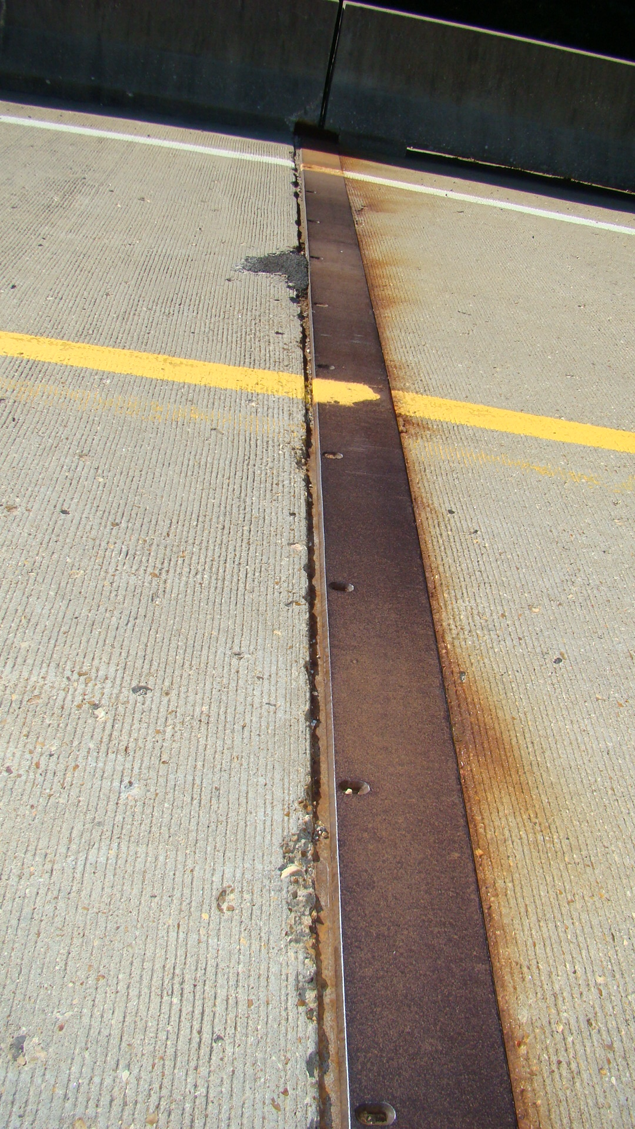
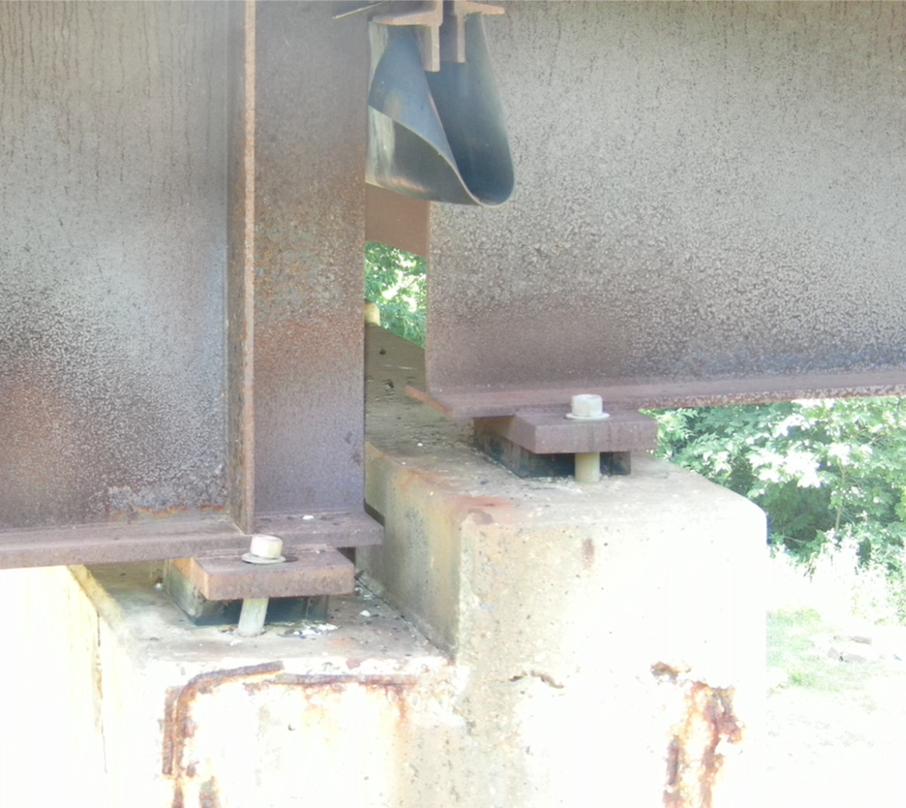
Expansion Joint (Br 6371, Kings River)

Slide 27
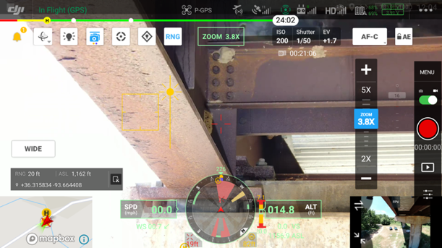
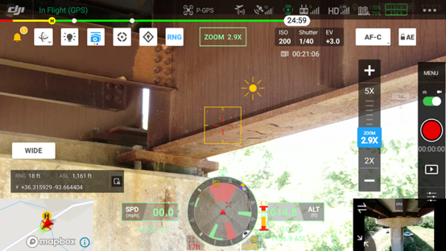
Beneath Expansion Joint (Br 6371, Kings River)
Girder 4
Girder 1

Slide 28
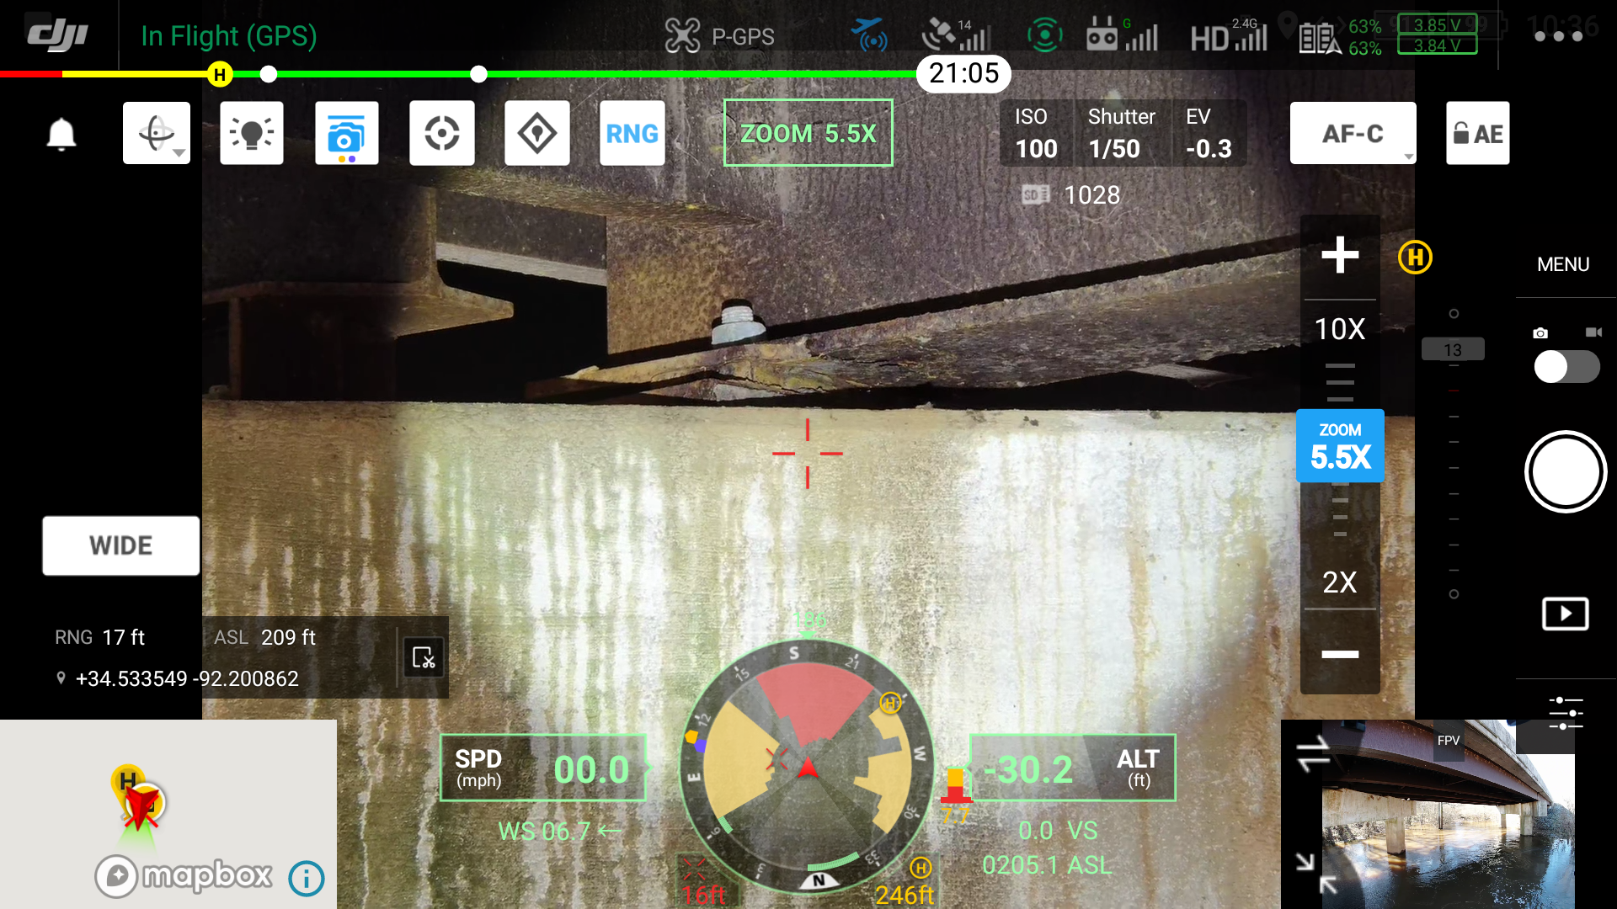
Bridge Supports Interior Girder (Bridge 6609)

Slide 29
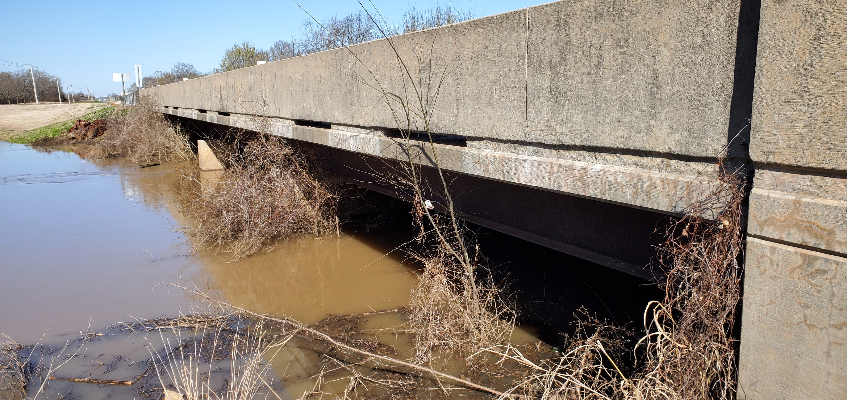
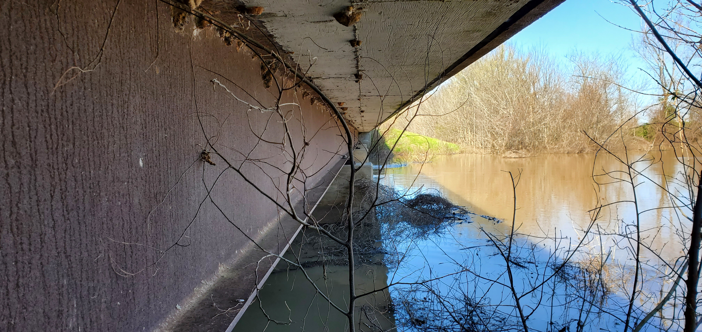
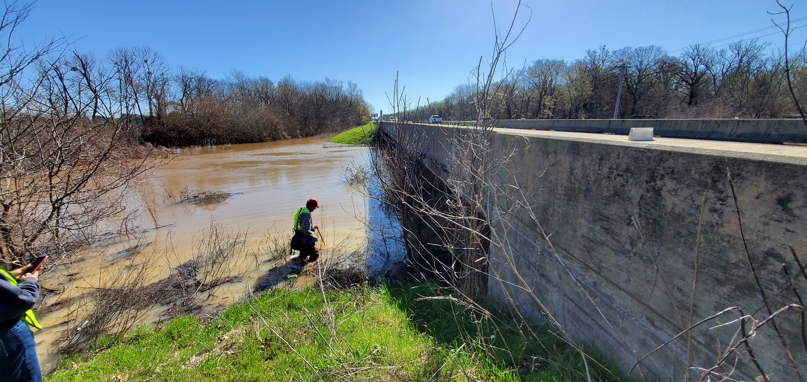
VEGETATION
Big Ditch Canal (#2312, Brummitt)

Slide 30
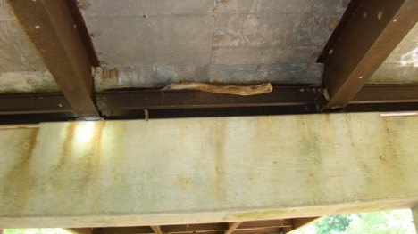
High Water (Bridge 6204)
Trapped
tree branch

Slide 31
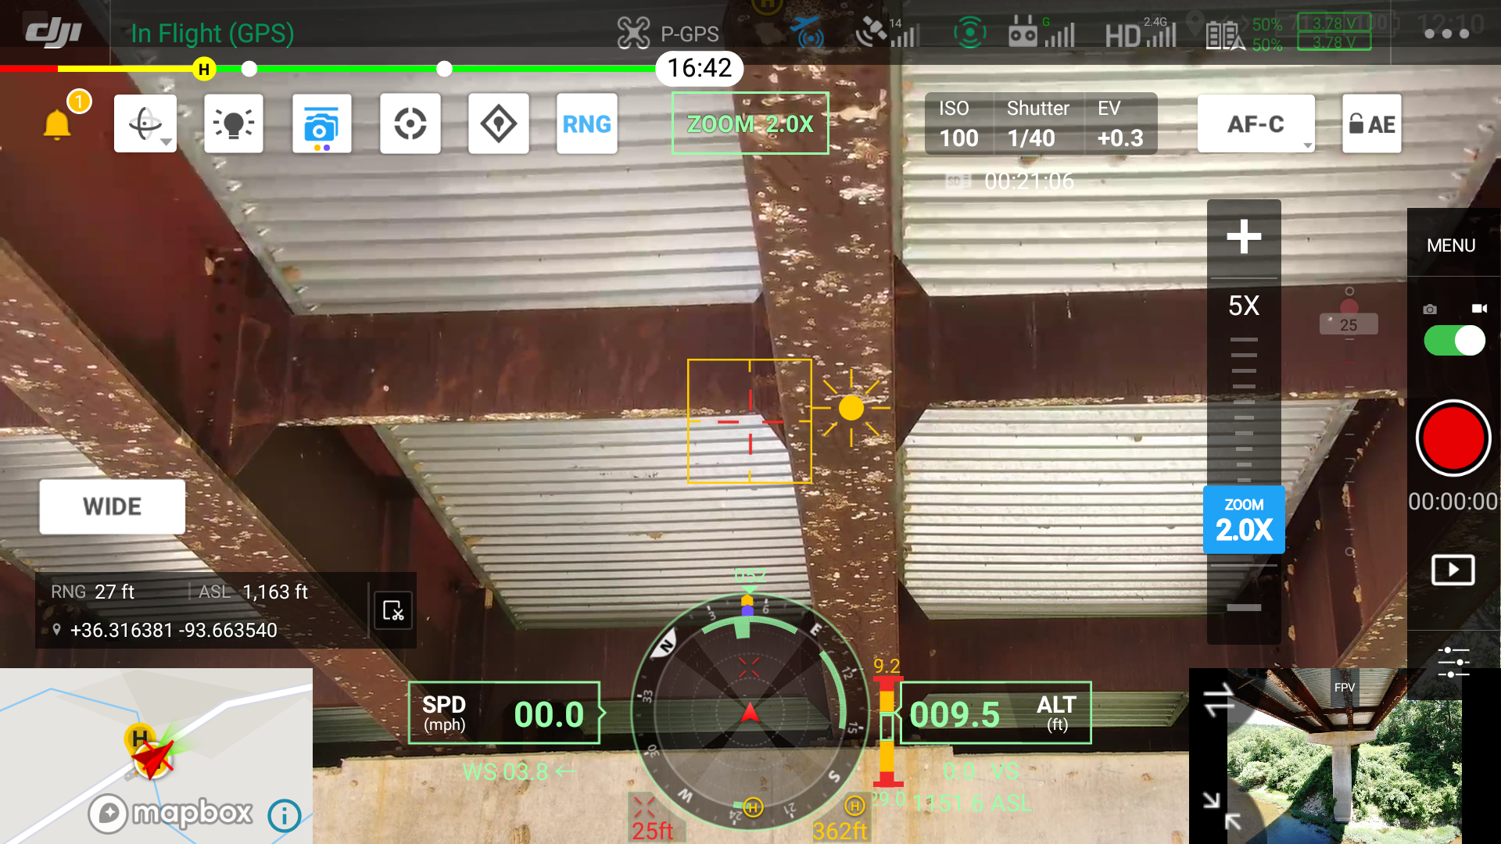
Insect Frass (Br. 6371, Kings River)

Slide 32
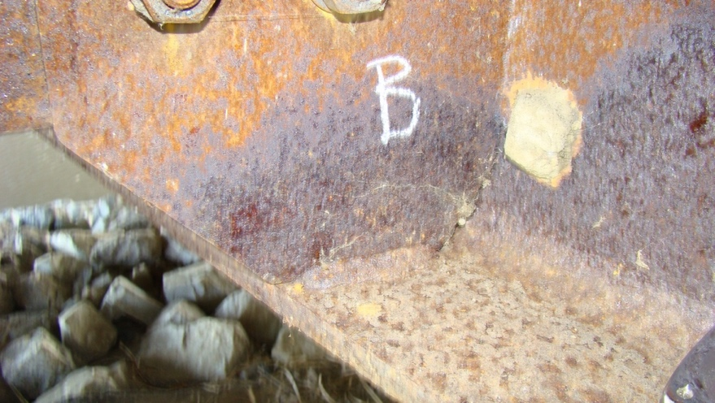
Corrosion at Diaphragm Connection (Bridge 07335)

Slide 33
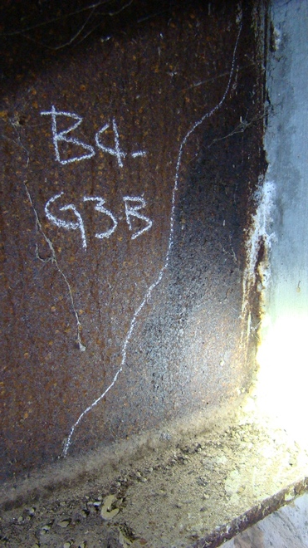
Corrosion at Integral Abutment (Bridge 07335)
efflorescence

Slide 34
Economic Analysis
Life Cycle Cost –
One Span Bridge
Unit Costs
(NCHRP 314)

Slide 35
Economic Analysis
Life Cycle Cost –
One Span Bridge
Unit Costs
(NCHRP 314)

Slide 36
Economic Analysis
Life Cycle Cost – One Span Bridge
Year | Painted A709 Gr. 50 |  | Bare A709 Gr. 50W |  | Maintenance Painted A709 Gr. 50W |  | Bare A709 Gr. 50W w/ Annual Washing
 | Escalated Cost ($) | Present Worth ($) | Escalated Cost ($) | Present Worth ($) | Escalated Cost ($) | Present Worth ($) | Escalated Cost ($) | Present Worth ($)
0 | - | 105,962 | - | 39,804 | - | 39,804 | - | 39,804
15 | 122,902 | 29,421 | - | - | 20,559 | 4,922 | - | -
30 | 177,738 | 10,185 | - | - | 29,732 | 1,704 | - | -
45 | 257,042 | 3,526 | - | - | 42,998 | 590 | - | -
60 | - | - | - | - | - | - | - | -
Annual Cost ($) |  |  |  |  |  |  |  | 1,801
Life-Cycle Cost ($)ª |  | 149,094 |  | 39,804 |  | 47,020 |  | 63,029
Cost Index |  | 3.75 |  | 1 |  | 1.18 |  | 1.58
2.49% inflation
10% interest

Slide 37
Conclusions
  Condition State is a function of compression strip seal condition, vegetation, and humidity (water crossing)
  Deicing application is minimal and therefore not a major contributor to UWS corrosion
  Rating between districts is consistent
  Bridge Functionality
    UWS bridges are continuing to work as intended
    Some bridges are experiencing CS 4 however with minimal section loss
  Remediation should include:
    Repair compression strip seals
    Cleaning poor (CS 3) and severe (CS 4) areas prioritizing bridges based on their ranking

Slide 38
Accomplishments
Final Report and Implementation Report submitted
Poster at TRB Annual Meeting
2 Journal Articles (ASCE Journal of Performance of Constructed Facilities)

Slide 39
Acknowledgements
TRC 2103 Project Managers: Kimberly Romano & Gloria Hagins
TRC 2103 Subcommittee:
  Rick Ellis (chair),
  Tammy Herman
  Jeff Jones,
  Andy Nanneman,
  Andy Tackett,
  Dennis Vire, and
  Yongsheng Zhao

Slide 40

Questions?

