Slide 1
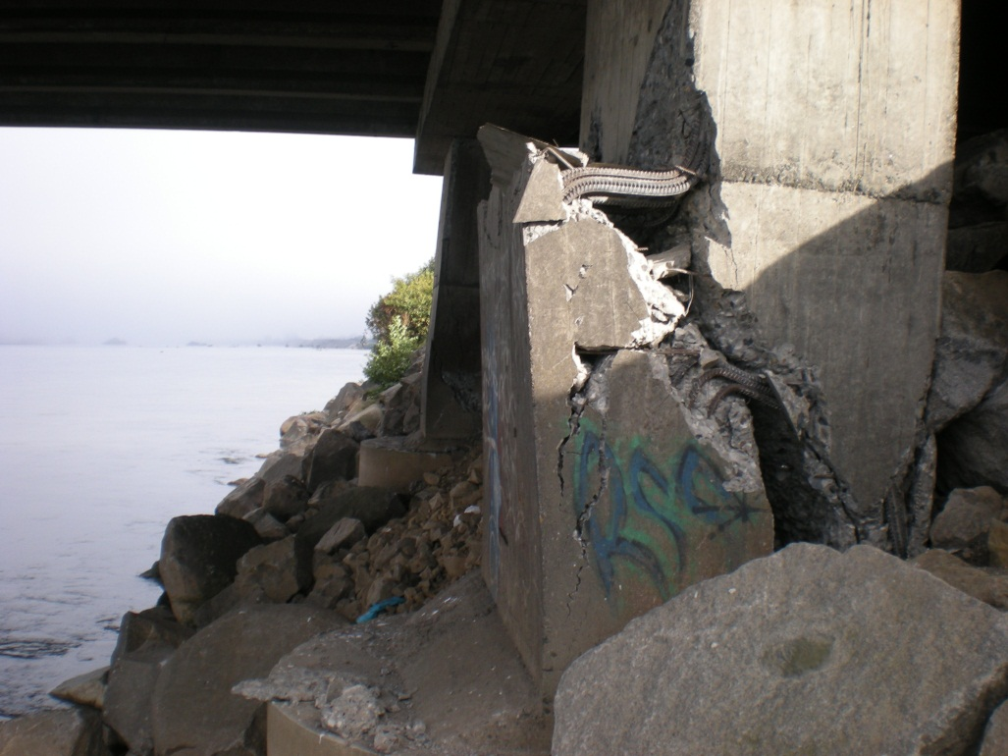
Earthquake-Induced Soil Liquefaction and Transportation Structures
  Dr. Dave Baska
  May 23, 2024

Slide 2

But first …

Slide 3
But first …
…ground motion
updates

Slide 4
Updates from 2002 to 2018 USGS National Seismic Hazard Model (NSHM)
Earthquake catalog
Ground Motion Models
  NGA-East
  NGA-West2
Multi-period response spectrum (22 periods)
  V_{S30} (Site Class) included in computations
  USGS web tool for data

Slide 5
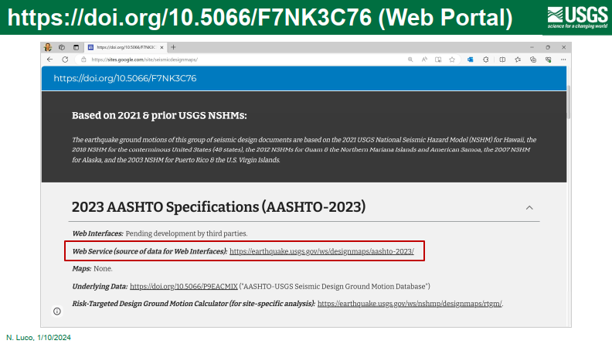
Site Class (ASCE 7-16)

Slide 6
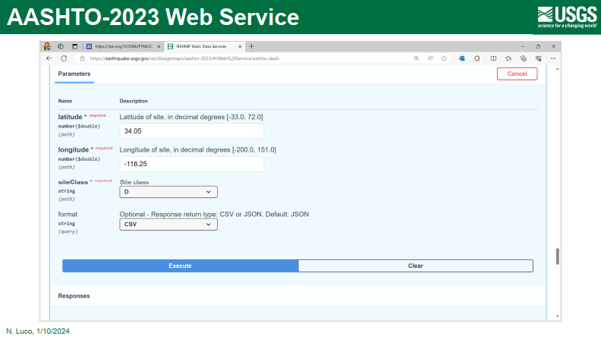

Slide 7
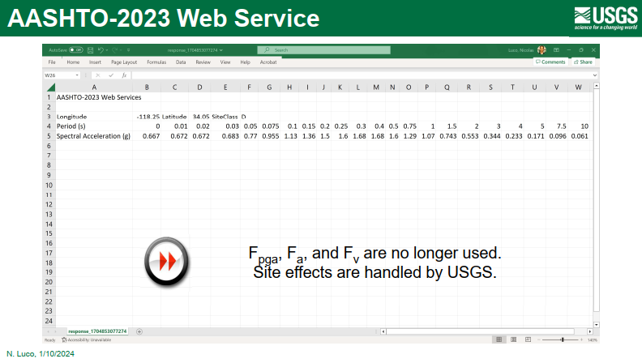

Slide 8
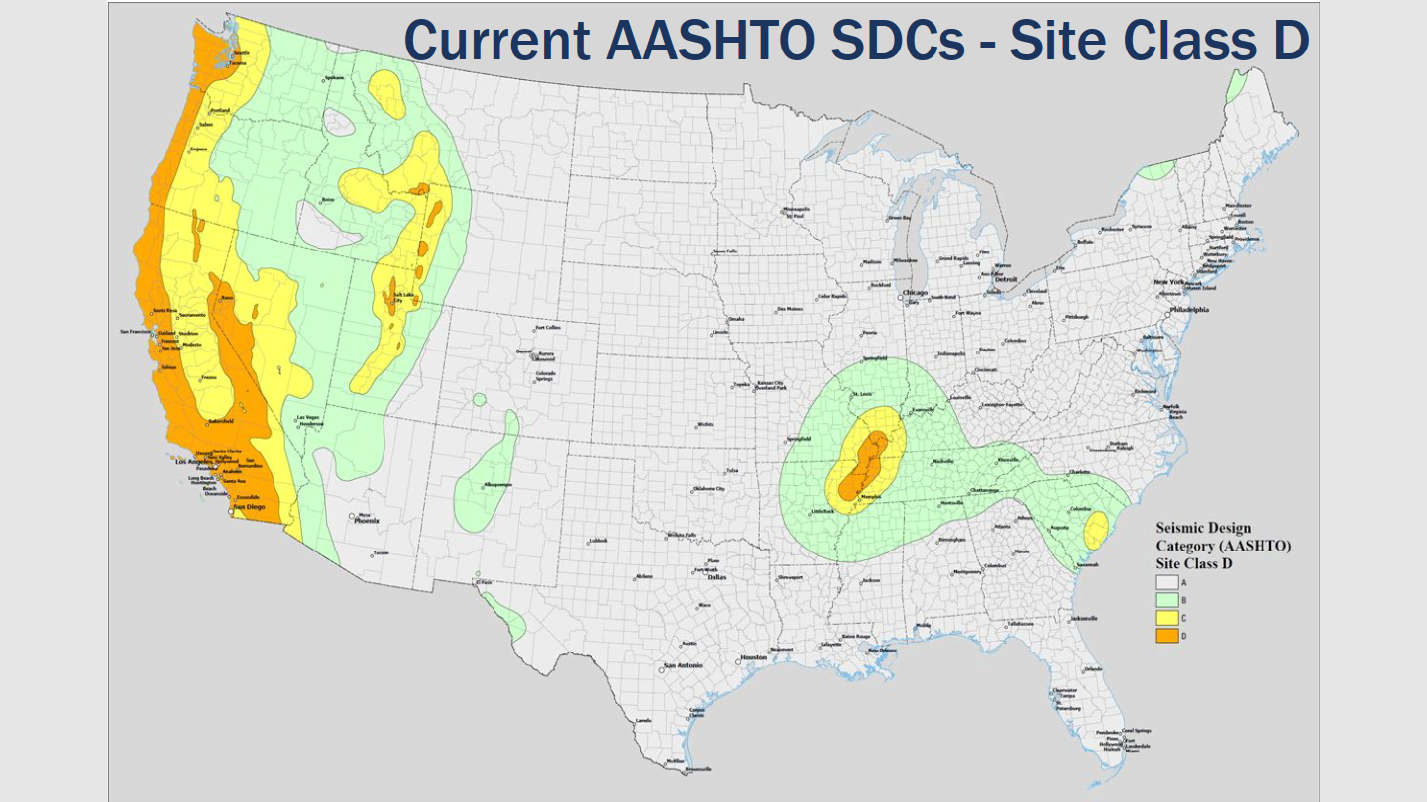
Site Class (ASCE 7-16)

Slide 9
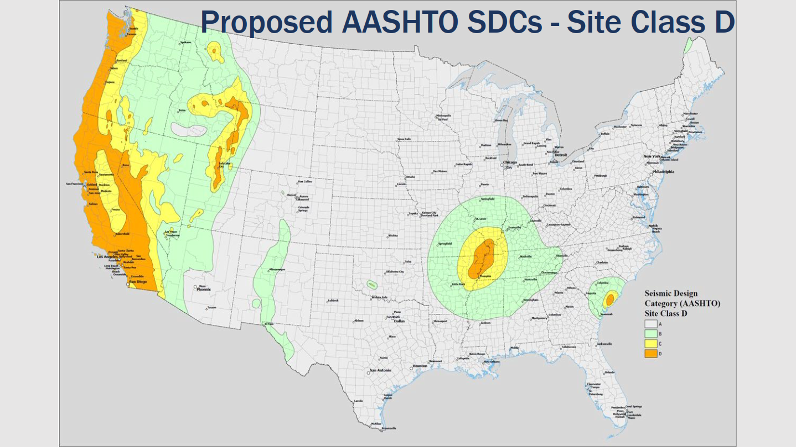
Site Class (ASCE 7-16)

Slide 10
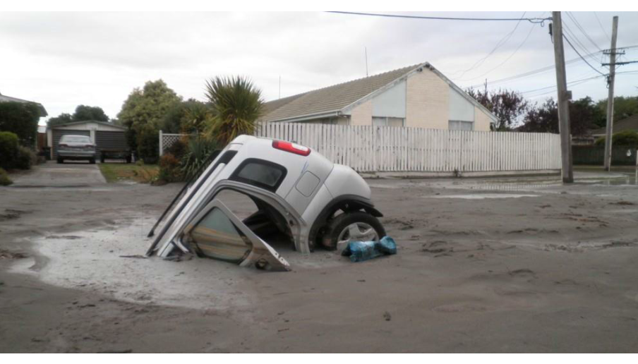
Outline – Earthquake-Induced Soil Liquefaction
Lateral spread and flow failure loads
Downdrag loads
Mitigation

Slide 11
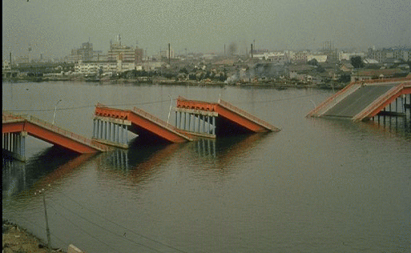
Outline – Earthquake-Induced Soil Liquefaction
Lateral spread and flow failure loads
Downdrag loads
Mitigation

Slide 12
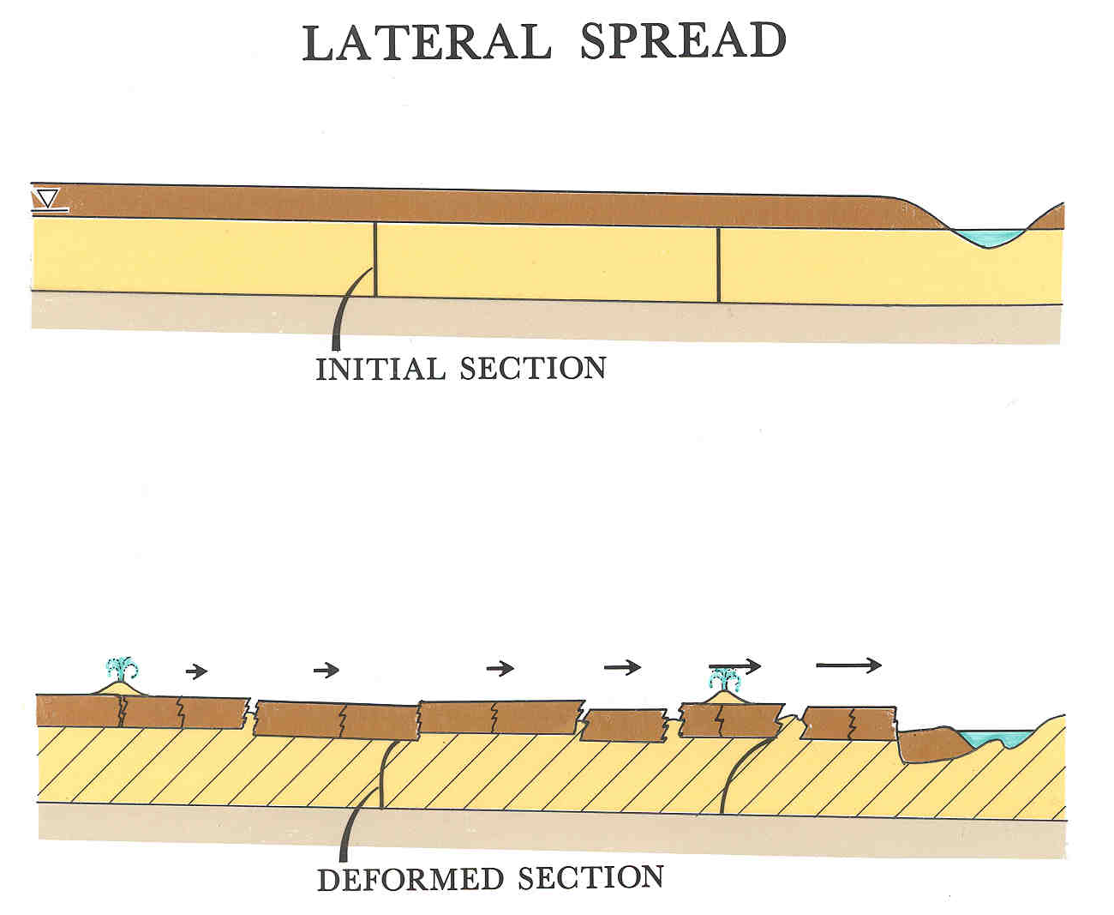
Nonliquefied crust
Before earthquake
After earthquake

Slide 13
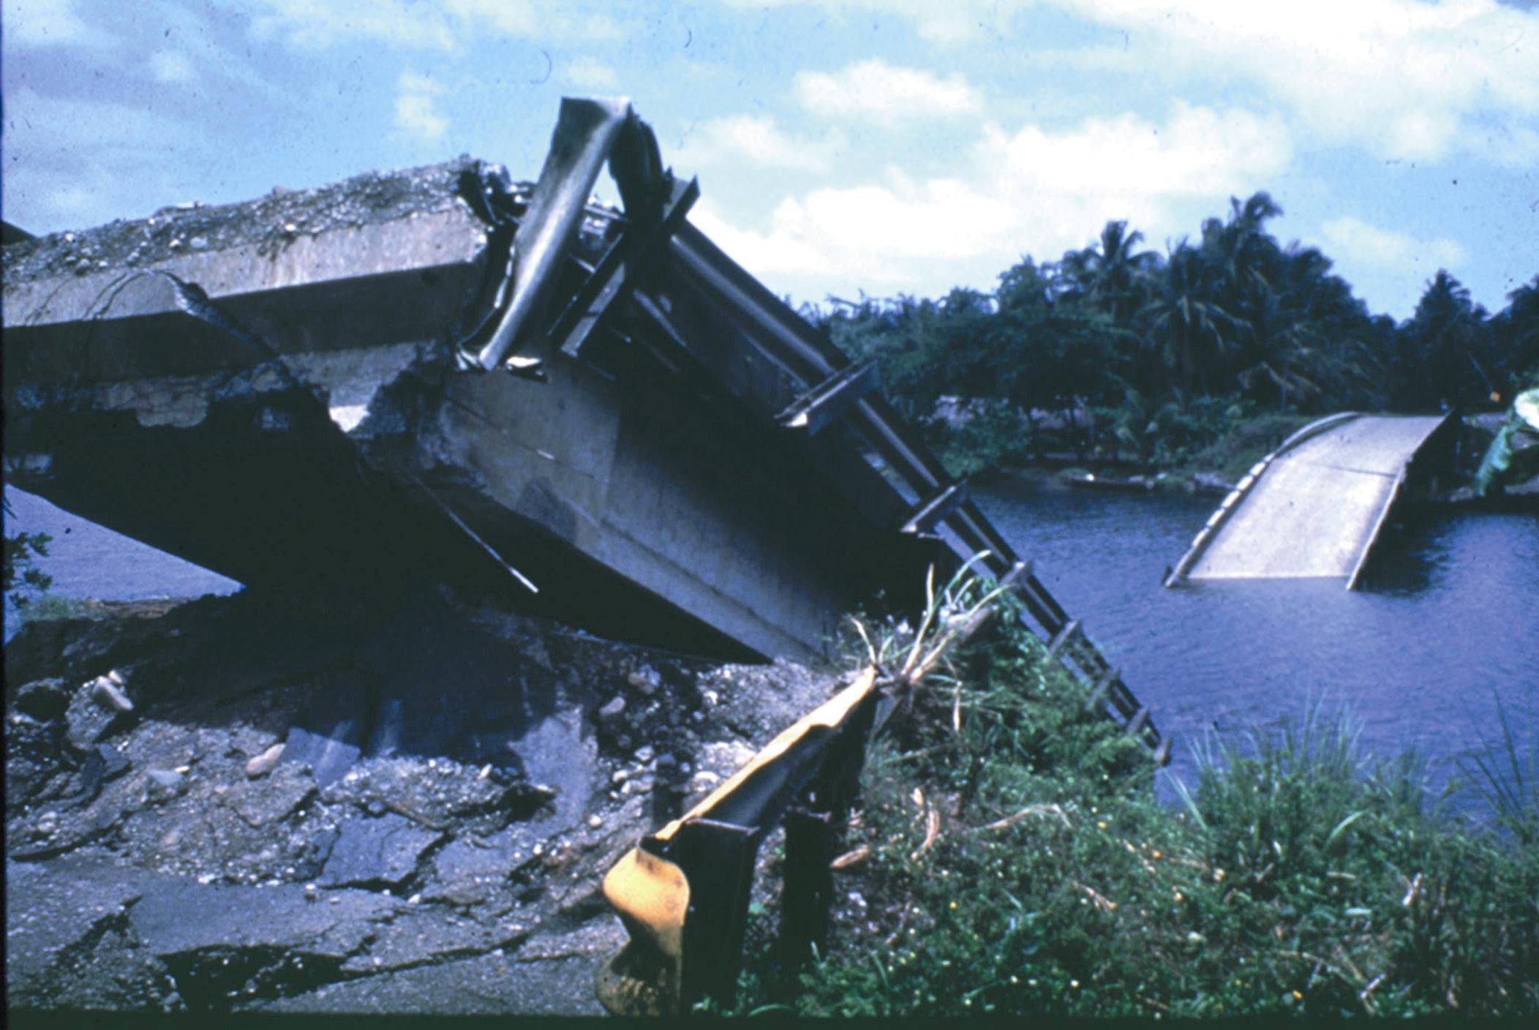
Collapsed bridge over Rio Viscaya following 1991 Limon Province, Costa Rica, earthquake; collapse was caused by 3 m of lateral spread displacement toward river channel

Slide 14
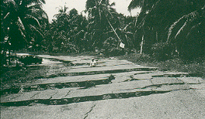
Extensional fissures in roadway at head of lateral sperad that caused collapse of the Rio Viscaya bridge (behind camera)

Slide 15
Three Approaches to Computing Soil Lateral Load
Displacement based
Force based
Dynamic stress-deformation

Slide 16
Three Approaches to Computing Soil Lateral Load
Displacement based
Force based
Dynamic stress-deformation

Slide 17
Displacement Based Approach
Most common approach in the U.S.
Equivalent nonlinear static analysis
  Caltrans 2012 (Arduino, et al. 2017)
  Free field soil displacements (LPILE)
Two cases:
  Restrained (abutments)
  Unrestrained (interior piers)

Slide 18
Displacement Based Approach
Unrestrained
Restrained

Slide 19
Unrestrained Case
Movement of large soil mass is unimpeded by foundation
Key design elements
  Crust displacement
  Corresponding foundation loads and displacements

Slide 20
Restrained Case
Movement of approach embankment is limited by foundation
Key design elements
  Load-displacement behavior of pile group
  Slide mass displacement as a function of pile group resistance
  Compatibility between slide mass and foundation resistance displacements

Slide 21
Three Approaches to Computing Soil Lateral Load
Displacement based
Force based
Dynamic stress-deformation

Slide 22
Force Based Approach
Specified in Japanese codes
  Based on case histories (1995 Kobe earthquake)
Pressures computed as follows:
  Liquefied soil: 30% of total vertical stress
  Nonliquefied crust: passive earth pressure
  Applied to width of foundation group

Slide 23
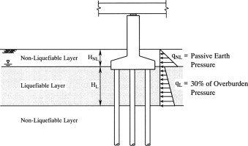
Force Based Approach

Slide 24
Three Approaches to Computing Soil Lateral Load
Displacement based
Force based
Dynamic stress-deformation

Slide 25
Dynamic Stress-Deformation Approach
Numerical modeling (e.g., FLAC)
Not used for “routine” design
Typically requires pre-approval and peer review

Slide 26
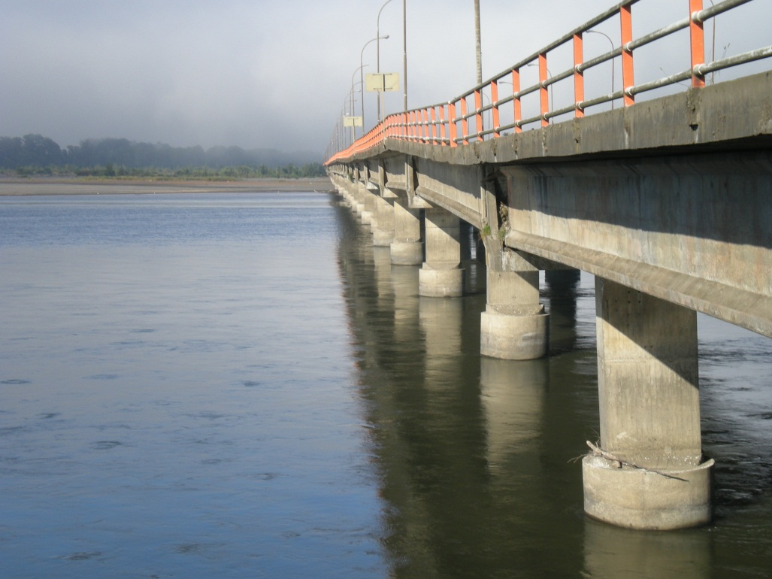
Outline – Earthquake-Induced Soil Liquefaction
Lateral spread and flow failure loads
Downdrag loads
Mitigation

Slide 27
Two Approaches to Computing Downdrag Loads
AASHTO LRFD Bridge Design Specifications (extreme limit state)
  Nonliquefied side friction above liquefied zone
  Side friction as low as residual strength in liquefied soils
Neutral plane theory (typically requires pre-approval)
  Force and settlement equilibria

Slide 28
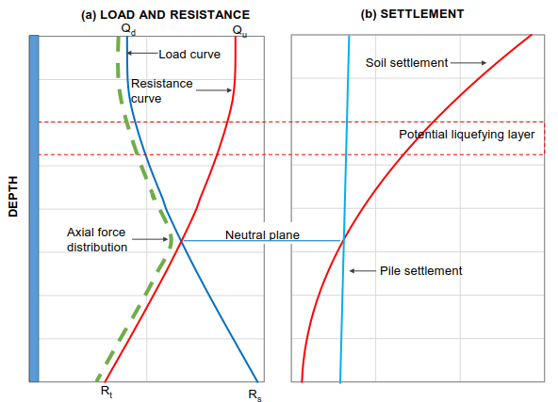
Neutral Plane

Slide 29
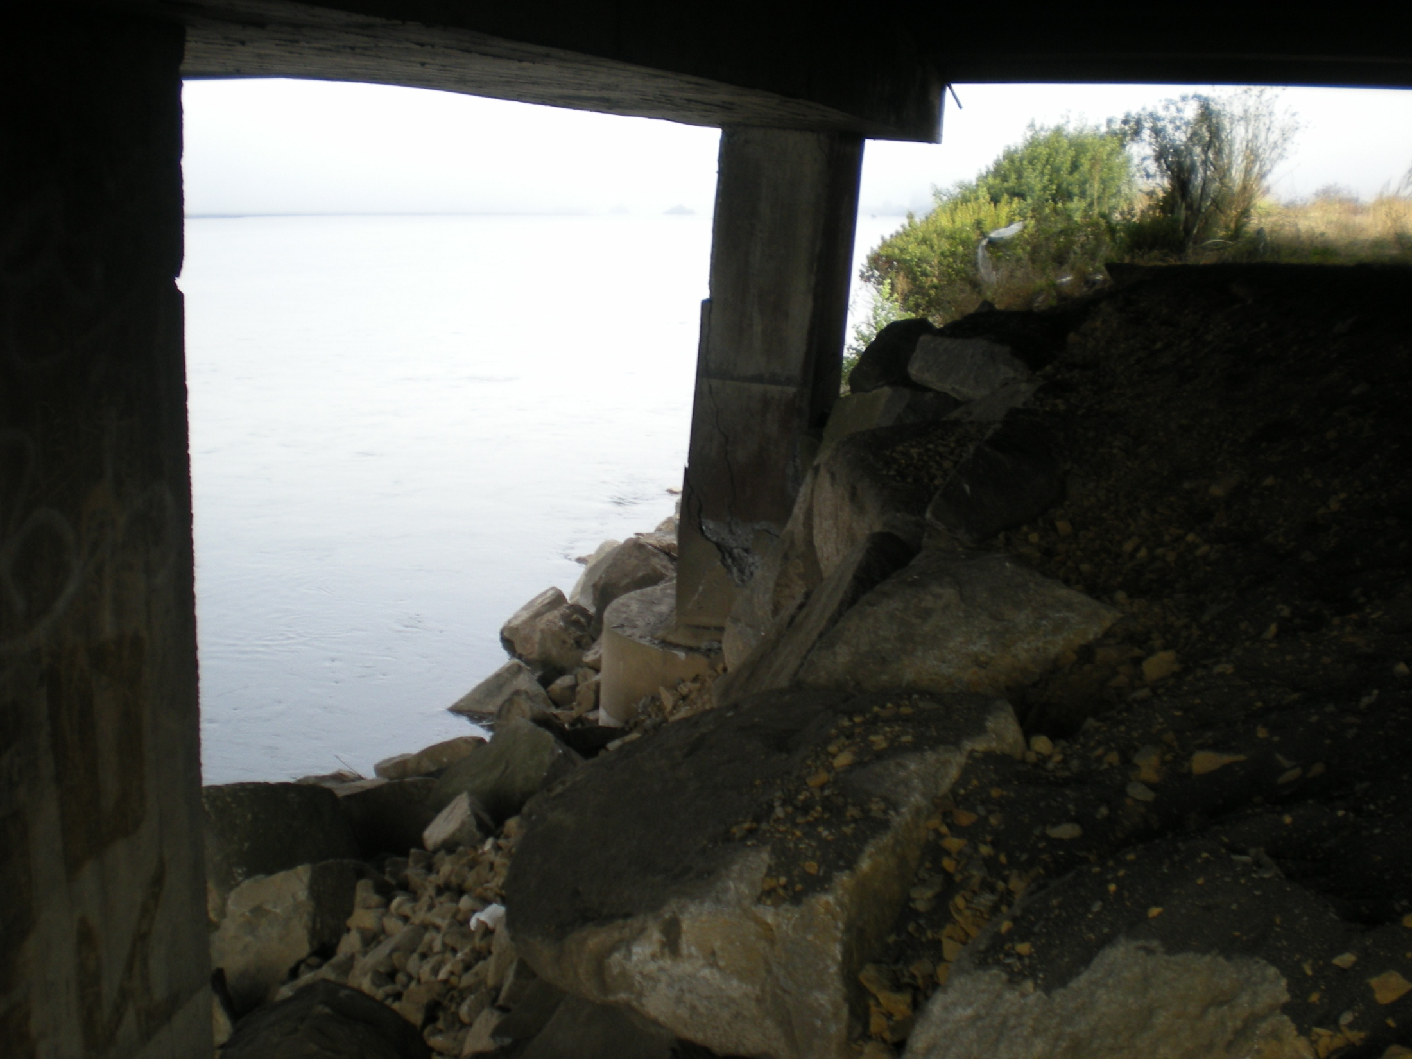
Outline – Earthquake-Induced Soil Liquefaction
Lateral spread and flow failure loads
Downdrag loads
Mitigation

Slide 30
Three Approaches to Mitigating the Liquefaction Hazard
Design structure to accommodate loads
  Economical if shallow depth (< 20 feet) of liquefaction and minimal crust thickness
Design substructure to resist the loads
  e.g., “structural pinning”
Improve the ground to eliminate the hazard

Slide 31
Summary
Design ground motion values have increased
Liquefaction reduces soil strength and results in displacements at the ground surface and at depth
Methods are available to quantify the soil loads and mitigate the effects

Slide 32
Thanks to …
ARDOT
Professor Steve Kramer (UW)
Professor Les Youd (BYU)
Dr. Nico Luco (USGS)
WSDOT

Slide 33
