Slide 1
Technical Council on
ROW Engineering
Accomplishments and Goals

Slide 2
Welcome
What’s with the Technical Council on ROW Engineering?
ROW Engineering Training
Ongoing Research
Goals
Recap

Slide 3

What’s with the Technical Council
on ROW Engineering?
Let’s dig in…

Slide 4
Technical Council on
ROW Engineering Recognizes
Neither ROW, nor Engineering
Term given to tasks related to ROW during the Plans Development process
Group designation for DOT team assigned to perform these tasks
Specialized skillset, takes years to become proficient

Slide 5



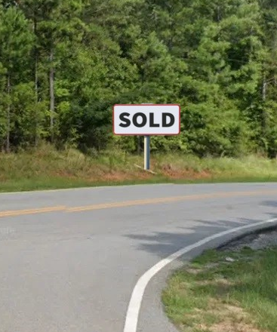
The DOT’s “Big Four”
Contributors to Project Delivery
Survey
Design
Utility Coordination
Real Estate
Each team relies on manuals/standards for guidance
Work can be in silos

Slide 6

What about ROW Engineering?
Staff is well versed in the “Big Four”
Can view plans from all perspectives
Bridges the gaps between siloed
DOT sections
Will ensure all ROW needs are met
for all disciplines
The Technical Council (TC) on ROW Engineering exists to support ROW Engineering teams / tasks

Slide 7
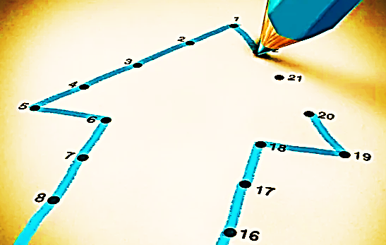
Connecting the Dots…
TC calls revealed two BIG issues and one continuing theme
Lack of Succession Planning at DOTs
No formal guidelines for ROW Engineering
50 States / 50+ Ways to address ROW

Slide 8
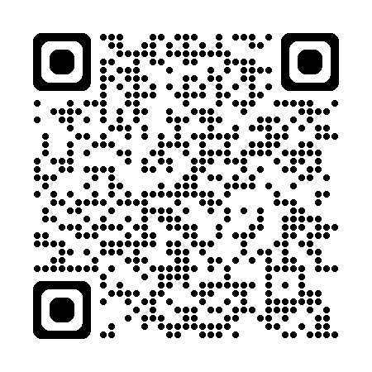
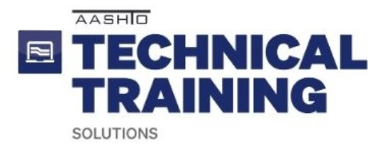
ROW Engineering Training
aka Succession Planning

Slide 9

ROW Engineering Essentials
Training was needed, we nailed it
Succession planning
Unique skillset for ROW Engineering
50 States / 50+ Ways
A course was born!

Slide 10

ROW Engineering Essentials
Highlights
40,000ft introduction to
ROW Engineering
Generic training, springboards to
State DOT-specific training
Presents essential ROW Engineering tasks including research and plan review
7 modules, with knowledge checks

Slide 11

ROW Engineering Essentials
Takeaways
Basic understanding of ROW Engineering
Improvement in DOT project development process
3.5 PDHs
ANYONE who uses ROW plans will learn something new!

Slide 12

Ongoing Research

Slide 13

Why Research?
No formal processes for ROW Engineering
50 States / 50+ Ways
Presents a practical path forward
for ROW Engineering teams
and practices

Slide 14
NCHRP 10-136
ROW and Utility Risk Factor Identification and Management
Identify ROW, ROW Engineering, and Utility risk factors
Propose strategies to manage risks
Develop methods to minimize recurring risks
Status: Research Team selected, research begins in July

Slide 15

NCHRP 10-136

Slide 16
NCHRP 10-138
Strategies for Earlier, More Effective ROW Engineering Involvement in Project Delivery
Review current DOT practices for ROW Engineering activities
Correlate start times with frequency of ROW on the Critical Path
Develop implementation strategies for DOTs
Status: Research Team selected, research begins in July

Slide 17
NCHRP 10-138
DESIGN
REAL ESTATE
BUILD
Project development process ON PAPER

Slide 18
NCHRP 10-138
DESIGN
BUILD
Project development process IN REALITY
Where is ROW Engineering?

Slide 19
NCHRP 10-138
DESIGN
REAL ESTATE
BUILD
ROW ENGINEERING
Now THIS is more like it!

Slide 20
NCHRP 10-140
Guide for ROW Management with a Utility Awareness
Identify Barriers in ROW Management/Utility Coordination
Develop strategies to improve management and coordination programs
State level focus, not project specific
Status: Research Team selected, research begins in July

Slide 21
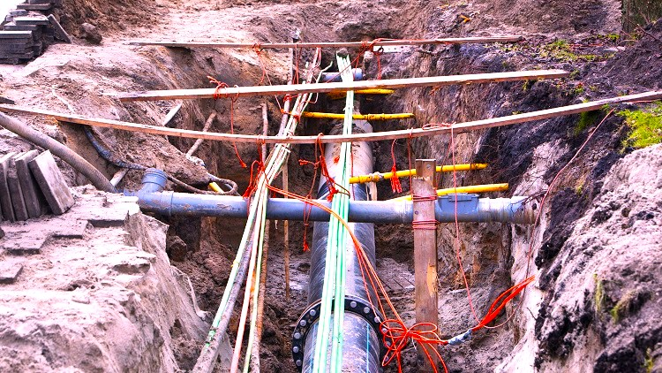
NCHRP 10-140

Slide 22
NCHRP 20-134
Guide for Confirming Ownership of the ROW and Adjacent Parcels
Identify current DOT methods to confirm ownership of the ROW and parcels adjacent to the ROW
Create a tiered system of ROW research practices based on project purpose, need and scope.
Status: Project selected for funding, panel selection in summer

Slide 23
Coming Soon
Upcoming Research Need Statements
Best Practices for Confirming Existing Utilities and their Associated Easements
Clarifying the difference between Prior Rights and Prescriptive Rights
Defining ROW Engineering
Status: Research Need Statements in progress

Slide 24

Goals: Research into Action
What to do with all those findings?
Ongoing research program
  New topics build on prior efforts
Develop AASHTO Deliverable
  Identify ROW Engineering-related gaps in the current Green Book
  Create new ROW Engineering content for the 9th edition

Slide 25

TC on ROW Engineering
  Assists ROW Engineering staff
  Not ROW, Not Engineering
ROW Engineering Essentials
  Intro level training
  Springboard to DOT specific methods
ROW Engineering Research
  Projects will build on each other
  Results will lead to ROW Engineering content in the Green Book
Recap

Slide 26


For More Information
Genevieve Haller
Project Manager, ROW Engineering
Delaware DOT
Genevieve.Haller@delaware.gov

