Slide 1

Investigating Concrete Deck Cracking in Continuous Steel Bridges
(TRC 1903)
May 23, 2024
Ernie Heymsfield (PI), Cameron Murray (coPI),
Abdul Salah (Grad Research Assistant; May, 2020), & Fernando Ortiz (Grad Research Assistant; Dec, 2019),
Shuyah Ouoba (PhD student)
University of Arkansas / Dept. of Civil Engineering

Slide 2

OUTLINE
Project Objective & Tasks
Study Areas / Analysis Approach
Background
  Bridge deck cracking examples
  Pouring method (sequence pour vs. continuous pour)
  Concrete Material Behavior
Bridge Instrumentation
Numerical Analysis
Conclusions

Slide 3
PROJECT OBJECTIVE / TASKS
PROJECT OBJECTIVE:
  Minimize bridge deck cracking at continuous steel girder bridges constructed using a continuous bridge deck pour.
    Ensure safety
    Minimize bridge maintenance
PROJECT TASKS:
  DOT Surveys
  Bridge Site Visits
  Bridge Instrumentation
  Numerical Analysis (ABAQUS)

Slide 4
PROJECT STUDY AREAS
TRC1903
STUDY AREAS
CONSTRUCTION
METHOD
MATERIAL
BEHAVIOR
pouring sequence,
deck construction time,
pour lengths, construction
loads
concrete strength = f(time)

Slide 5
ANALYSIS APPROACH
CONCRETE TENSILE STRESS >
CONCRETE TENSILE STRENGTH
CONCRETE
CRACKING

Slide 6
BACKGROUND

Slide 7
Bridge Maintenance Problems
#1 bridge maintenance problem – concrete bridge deck deterioration
Water ingress corrosion damage

Slide 8
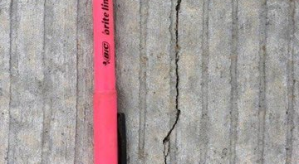
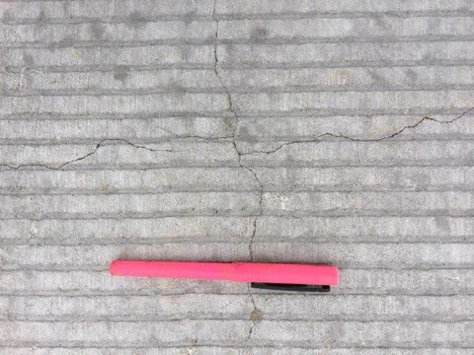
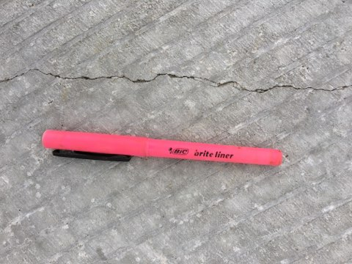
CADRON CREEK BRIDGE, Van Buren County
Conc. Deck Cracking
3 span continuous plate girder, cont. deck pour
1/8” tine, 1/2” -3/4” spacing
Remediation: pavement grinding & retining
Mike Hays, Bridge Resident Engineer

Slide 9
BACKGROUND
CONCRETE BRIDGE DECK CASTING SEQUENCE
  SEQUENCED POUR
  CONTINUOUS POUR

Slide 10
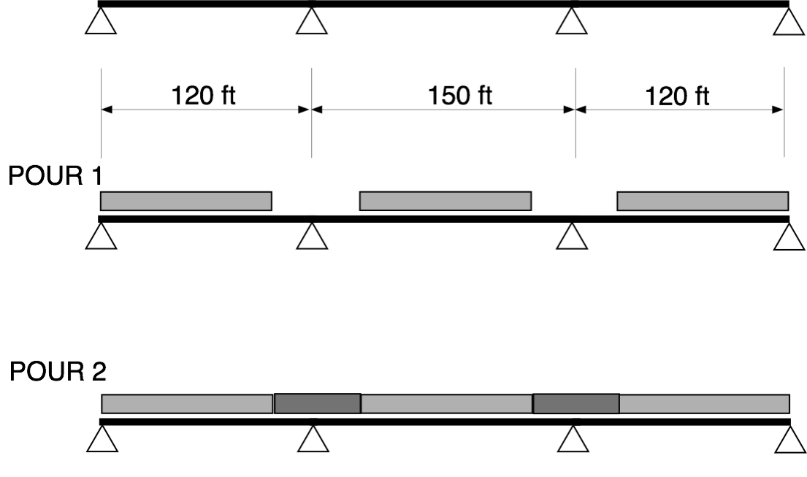
SEQUENCED POUR

Slide 11
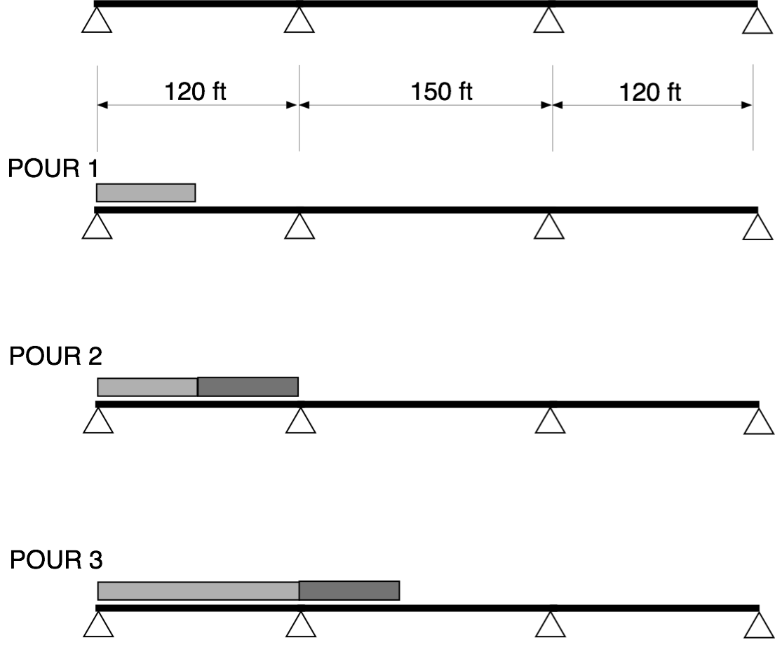
CONTINUOUS POUR

Slide 12
EARLY AGE CONCRETE MATERIAL BEHAVIOR
(Eurocodes – European Standards)

Slide 13
CONCRETE SHRINKAGE
Thermal Shrinkage
  Temperature change
  Early age
Endogenous Shrinkage
  Pore water consumption
  Negligible in normal concrete
Drying Shrinkage
  Hygrometric equilibrium with the ambient humidity
  Long term component
  Important for normal concrete
TOTAL SHRINKAGE

Slide 14
CEMENT HYDRATION HEAT CURVE
Ref: Iowa State Univ, Natl. Conc Pvmnt Tech Cntr

Slide 15
ELASTIC MODULUS f(creep, time) f’c = 4ksi, Thermal Load applied at 1 day
Ref: EUROCODE COMMITTEE for STANDARDIZATION

Slide 16
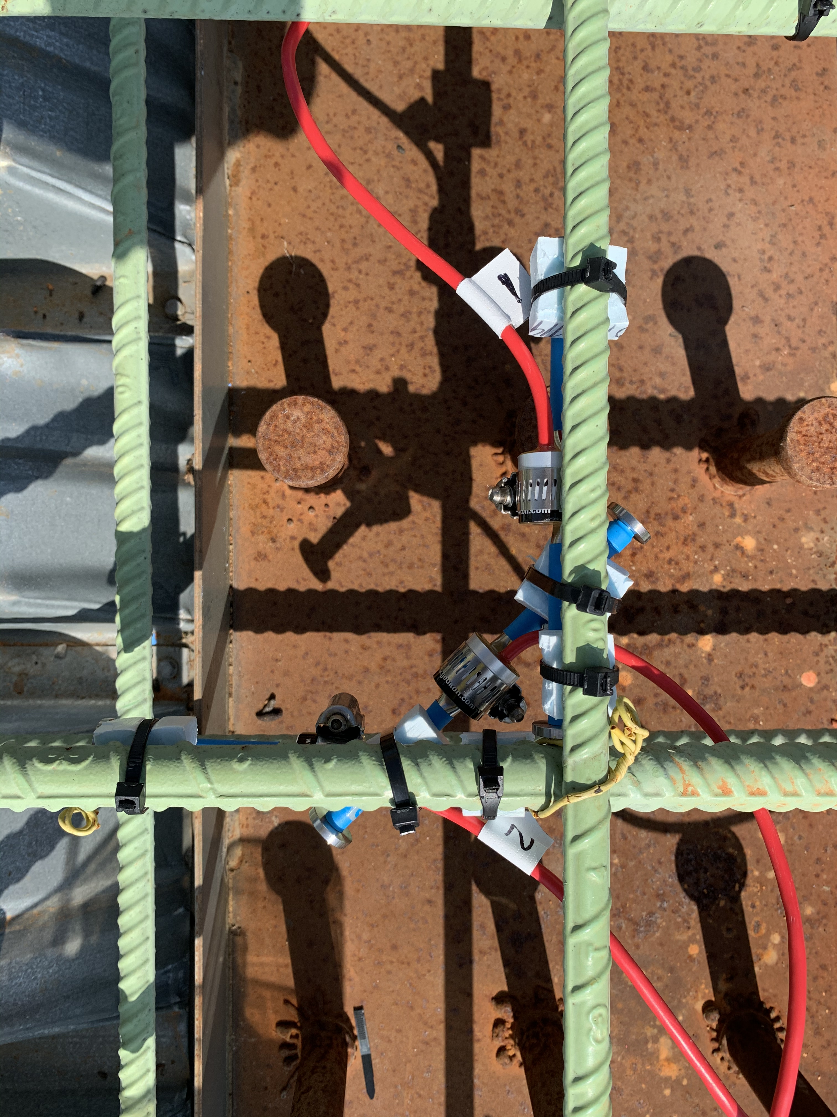
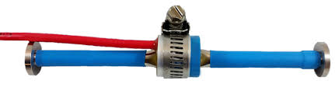
TRC 1903 Field Study
3 Bridge Instrumentation Sites
  DeQueen (August 2019) *Continuous Pour*
  Bella Vista (June 2020) *Two Stage Pour*
  Marked Tree (August 2021) *Continuous Pour*
32 Vibrating wire strain gauges @ each bridge site (strain & temperature measurements)
Geokon.com

Slide 17
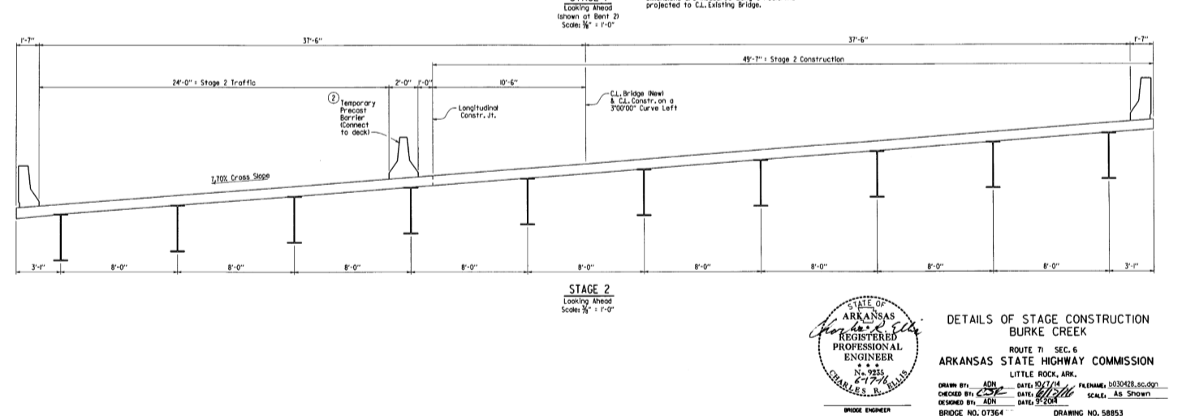
TRC 1903: Field Visit 1
Near DeQueen, Arkansas
Bridge poured 8/22/2019
3 SPAN (60’-70’-60’)
49’-7” Stage 2
1’-7”
1’-7”
31’-6”
31’-6”
Traffic
8’
8’
8’
8’
8’
8’
8’
8’
8’
N

Slide 18
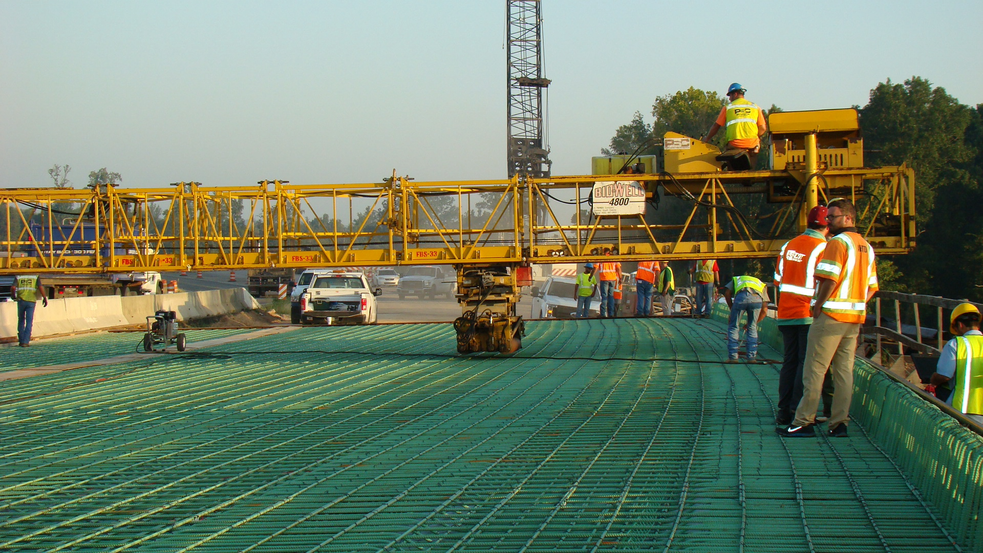
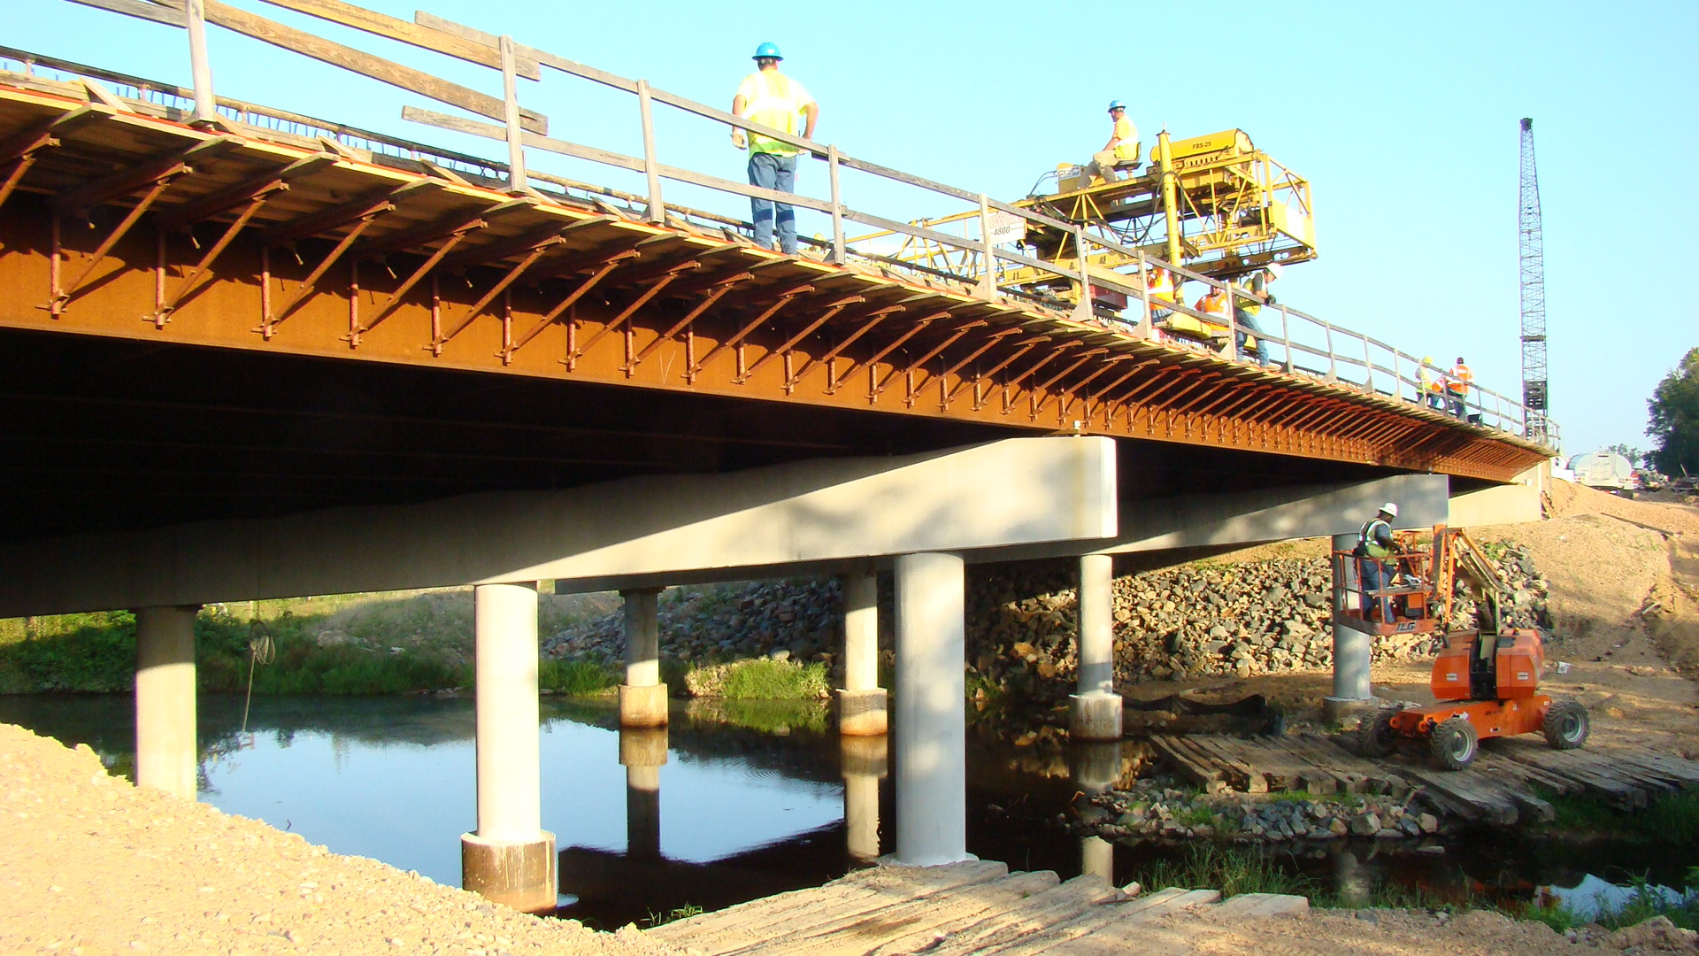
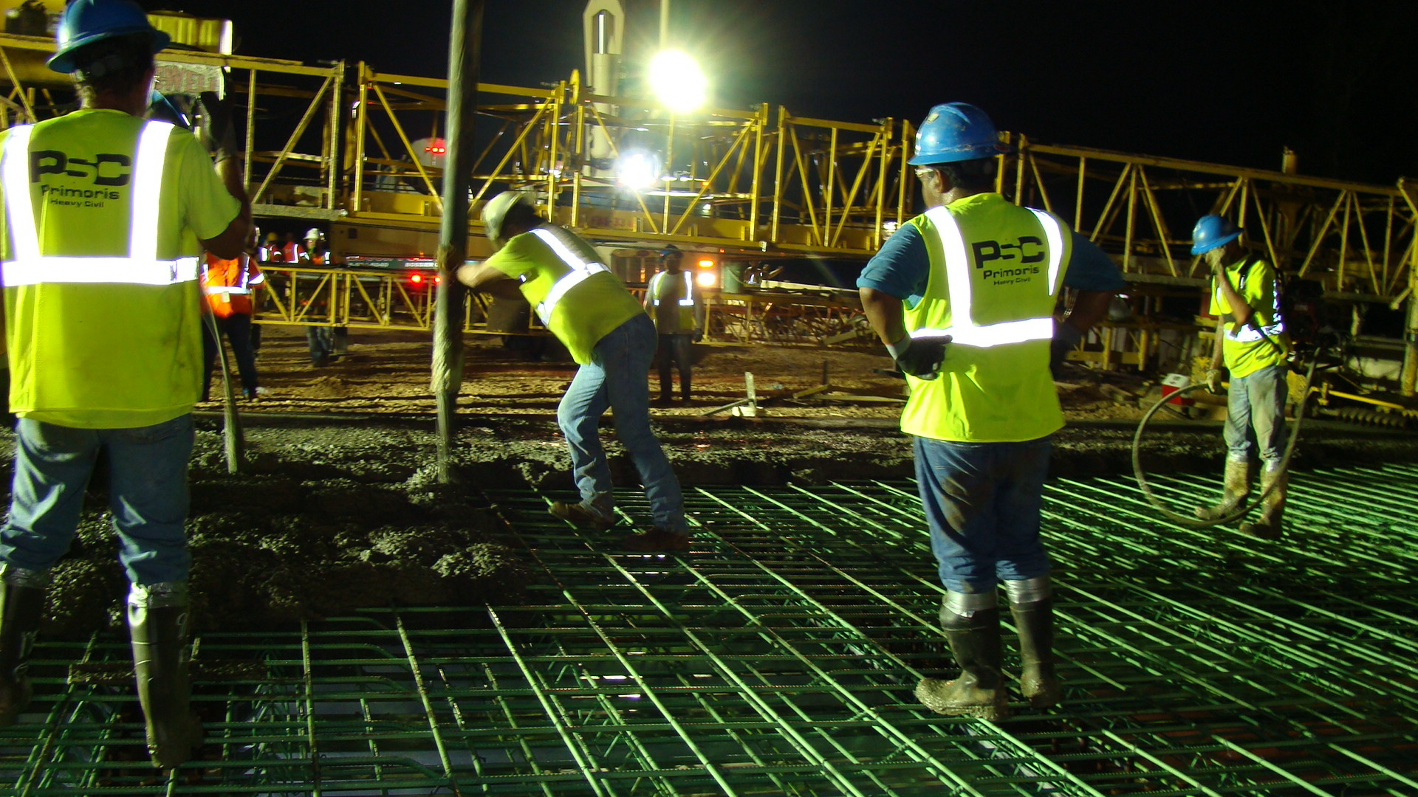

Slide 19
TRC 1903: Field Visit 1
Peak temp. leads to expansion of deck –peak in VWSG
Trend of shrinkage over time

Slide 20
TRC 1903: Field Visit 1
Potential for Cracking
Notes:
Estimated stress versus strength over first 7 days
Strength gain estimated based on measured compressive strengths provided by ARDOT and relationships in Eurocode for strength gain of concrete. MOE and tensile strength estimated by ACI equations

Slide 21
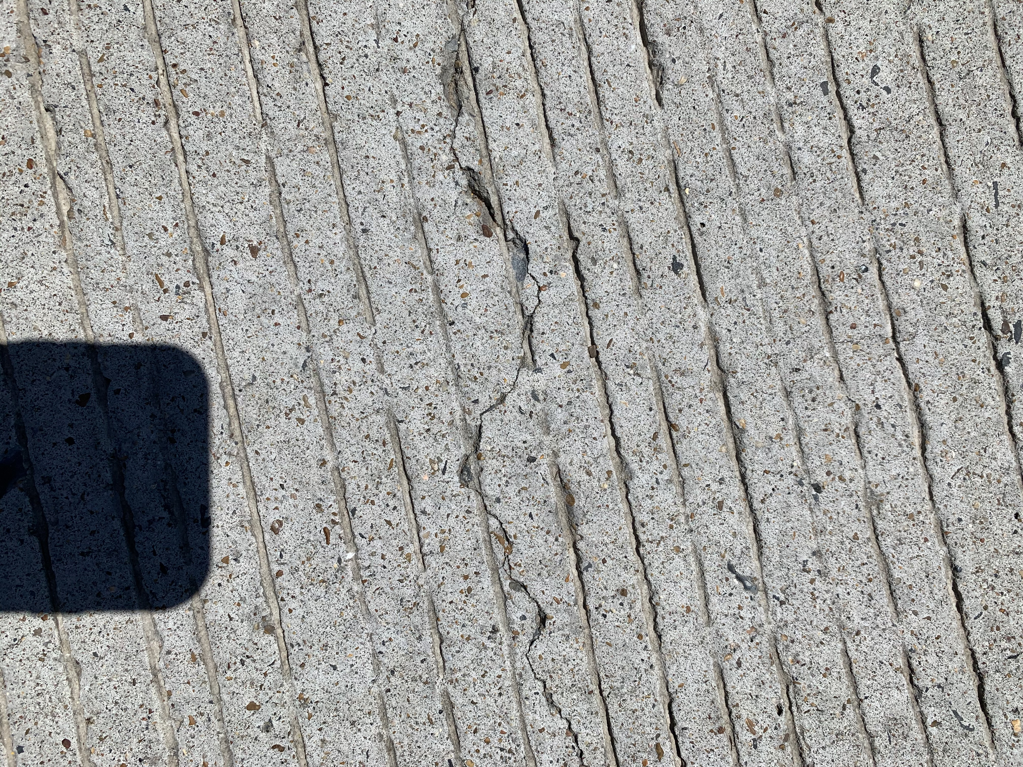
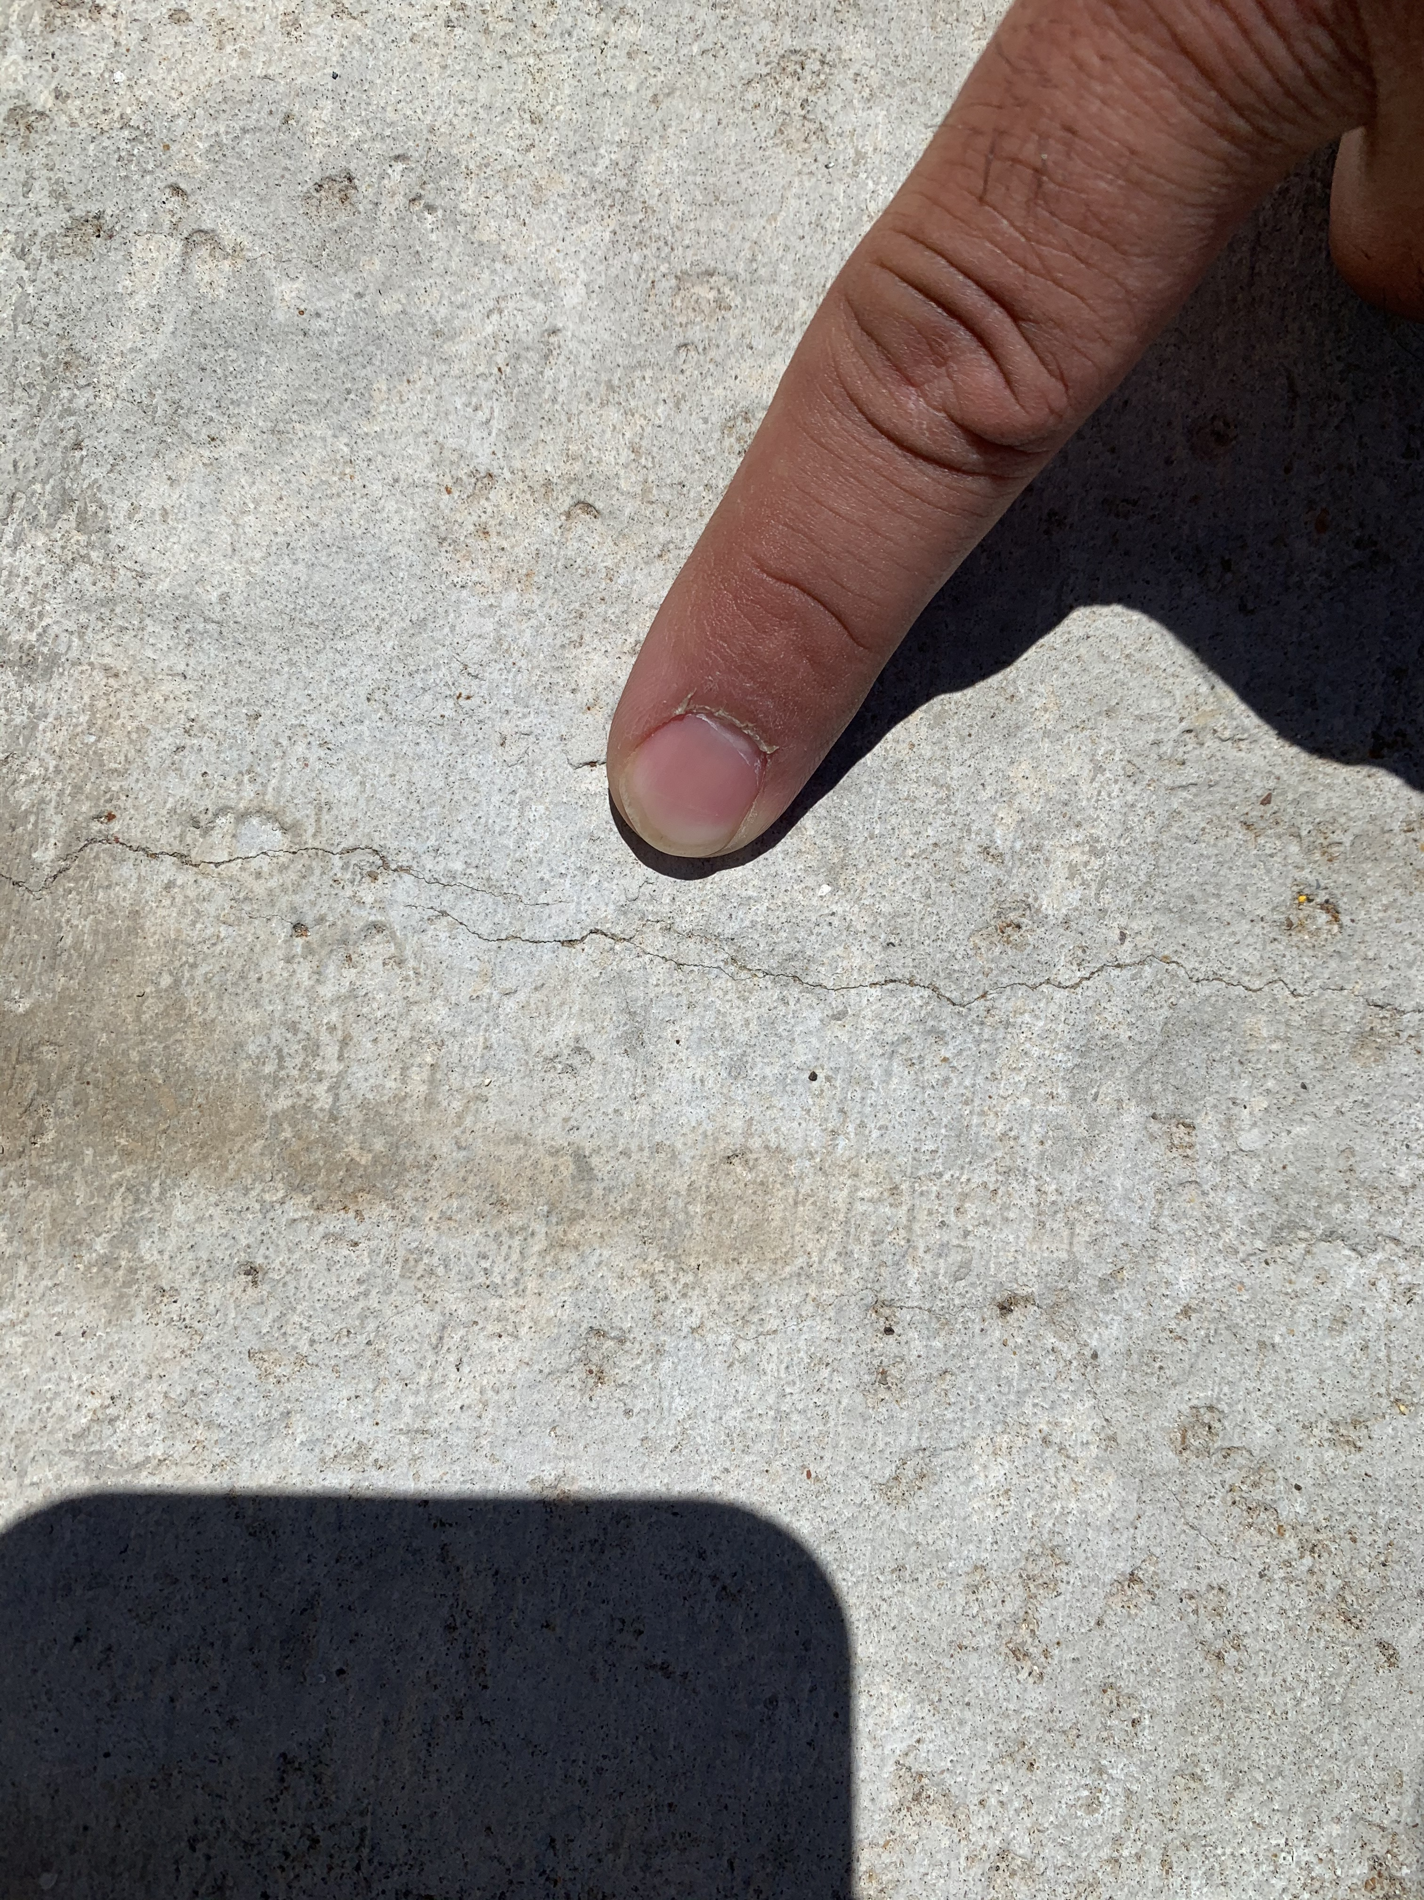
TRC 1903: Field Visit 1
Notes:
Transverse cracking at 8-10’ spacing on end spans and 3-5’ spacing on center span
Longitudinal cracks near beams

Slide 22
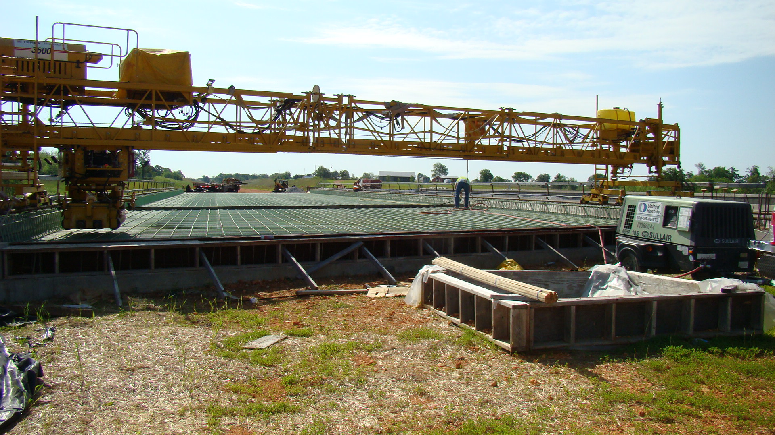
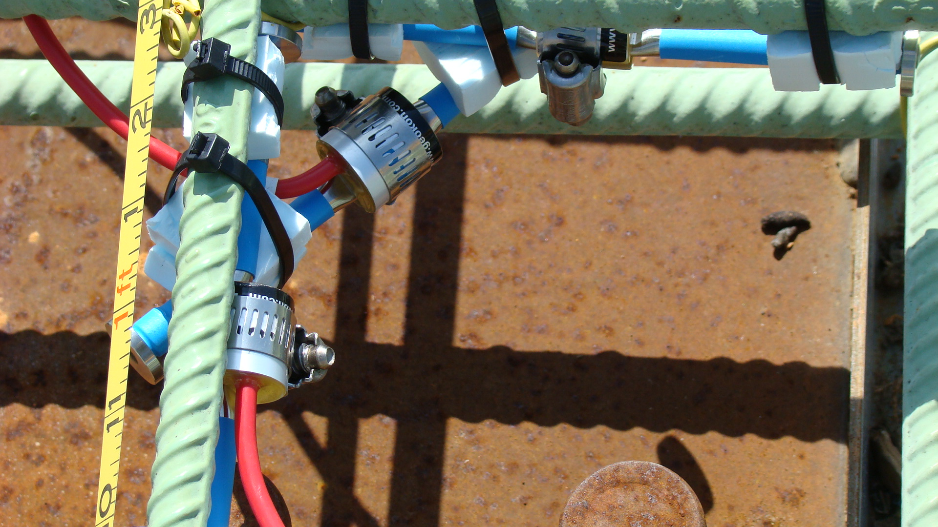
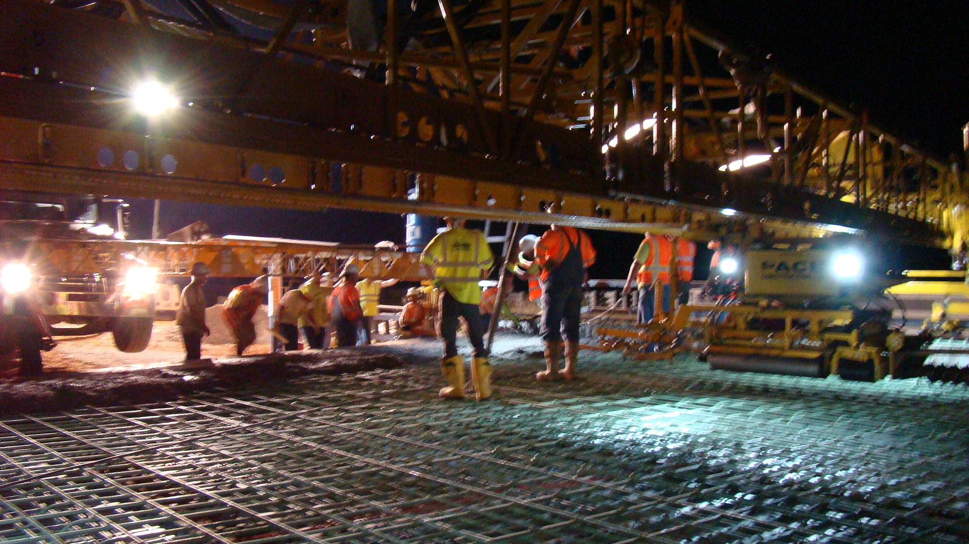
TRC 1903: Field Visit 2
BELLA VISTA BYPASS

Slide 23
Field Visit 2 (I49 Bella Vista Bypass)
Near Bella Vista, Arkansas (549)
3 Span Continuous W (62’ – 80’ – 62’ = 204’)
W36x135 (pos regions); W36x182 (neg regions)
Bridge poured 6/12/20 (1) and 6/16/20 (2)
Example Measurements
(Sensor 10, 13, 17 longitudinal)
Notes:
10 rosettes along centerline
2 gauges in 6x12 cylinders to measure free shrinkage
Example measurement from similar location as in first bridge

Slide 24
TRC 1903: Field Visit 2
Notes:
Time starts at 4+ days because this was second pour
Data reduced the exact same way as other example sensor
Same strength and stress data shown, shrinkage controlled much better for this bridge.
Temperatures were lower in concrete (125 compared to 140) environmental conditions were better (may versus august temps)
Contractor covered bridge deck for at least the first 14 days (I think)

Slide 25
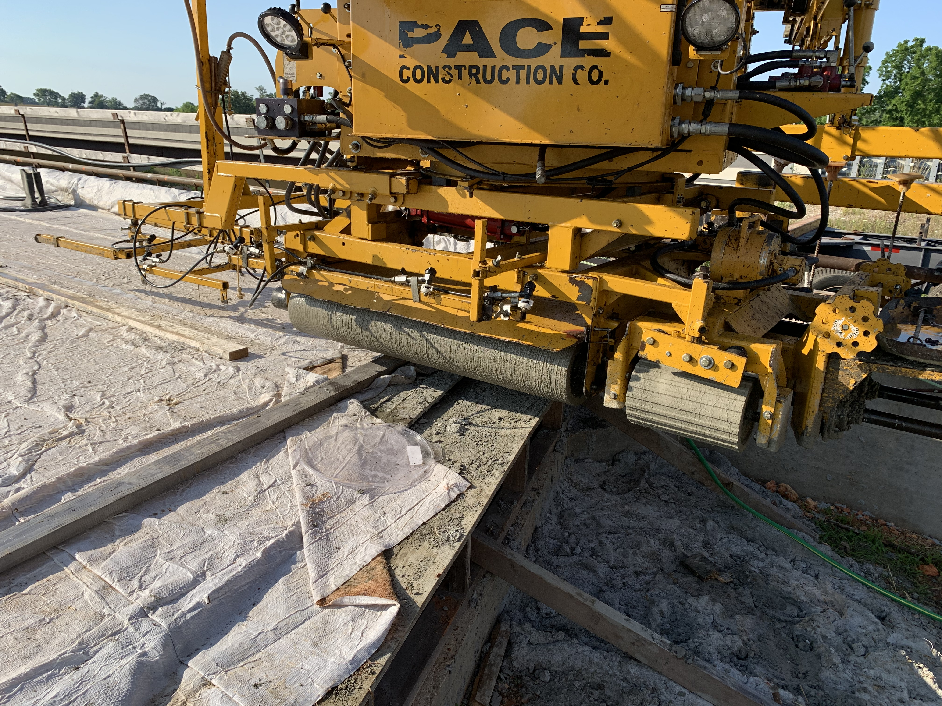
TRC 1903: Field Visit 2
Burlap/plastic tarps
Continuous moisture
No cracking observed
Notes:
Time starts at 4+ days because this was second pour
Data reduced the exact same way as other example sensor
Same strength and stress data shown, shrinkage controlled much better for this bridge.
Temperatures were lower in concrete (125 compared to 140) environmental conditions were better (may versus august temps)
Contractor covered bridge deck for at least the first 14 days (I think)

Slide 26
NUMERICAL ANALYSIS
Construction Methods and Effects of Thermal Shrinkage
Time evolution of the concrete stress
  Fresh concrete weight poured in subsequent sections
  Composite girder section properties (f(concrete age))
Time evolution of the concrete tensile strength

Slide 27
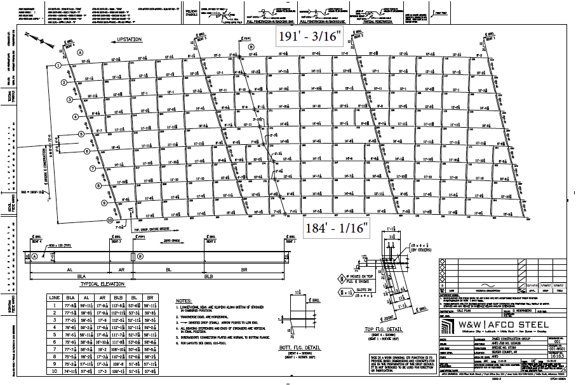
FRAMING PLAN
(2 STAGE CONSTRUCTION)
N
W36 x 135
191’ – 3/16”
184’ – 1/16”
MC18 x 42.7

Slide 28
De Queen Bridge NUMERICAL MODEL
(using ABAQUS)
N
W36 x 135
roller
support
pin
support
pin
support
roller
support
MC18 x 42.7
60 ft
70 ft
60 ft
7 ¾” slab

Slide 29
SLAB
WEIGHT
LOADING

Slide 30
THERMAL SHRINKAGE

Slide 31
TOP of SLAB STRESS (27 days)
-0.1 ksi
LOCATION

Slide 32
TOP of SLAB STRESS (6 days)

Slide 33
RECOMMENDATIONS- DESIGN
Continuous vs. Sequenced (thermal shrinkage)
Reduce minimum cementitious content from 611 lb/yd³ to as low as 517 lb/yd³ (TRC 1602)
Calculate an approximated bridge deck thermal shrinkage stress
Observation: Actual deck strength will = 4 ksi @ 7 days

Slide 34
RECOMMENDATIONS- CURING
Independent of structure type
Consider fresh concrete fogging
Moist cure and protect from moisture loss (7-14 days)
  Use concrete curing blankets for at least 7 days after placement.
  Disallow lithium-based curing compounds

Slide 35
CONCLUSIONS
Deck Cracking occurs when tensile stress exceeds concrete tensile strength
  slab dead loads (minimal effect)
  thermal shrinkage
2 Continuous Deck Pour Bridge were instrumented (DeQueen & Marked Tree)
1 Sequence Deck Pour (Bella Vista I49)
Recommendations to ARDOT
  Curing: cover concrete & retard concrete cooling

Slide 36
Timeline
July 2018 – June 2022
July 2022: Final Report submitted for review
February 21, 2024: Training Workshop for Capillary Pressure Sensor Testing to Identify Curing Regimen in Freshly Placed Bridge Decks (TRC1902) and Investigating Concrete Deck Cracking in Continuous Steel Bridges (TRC1903)
March 2024: Final Report Approved

Slide 37
ACKNOWLEDGEMENTS
Arkansas Department of Transportation
Project Manager: Will Caster and Kim Romano
TRC 1903 Subcommittee:
David Henning (Subcommittee Chair), Ryan Blackenship, Stewart Linz, Jim Pool, and Andy Tackett

Slide 38

GO HOGS GO!
University of ARKANSAS
RAZORBACKS
ernie@uark.edu

