Slide 1

Evaluation of Impacts Due to a Bridge Closure
A Case Study of the Mississippi River Bridges in Arkansas
Arkansas Department of Transportation
Transportation Research Committee Conference
Hot Springs, Arkansas
May 2024
Presented by
Sarah Hernandez, Ph.D., P.E.
Department of Civil Engineering

Slide 2
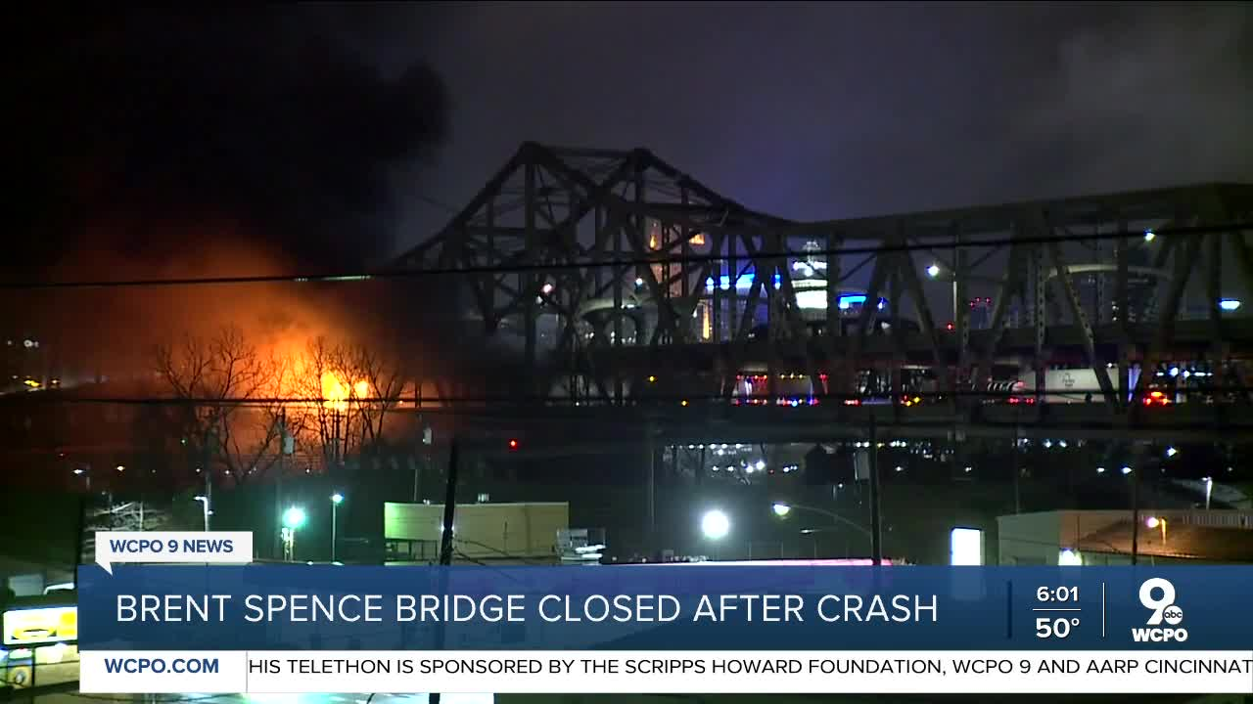
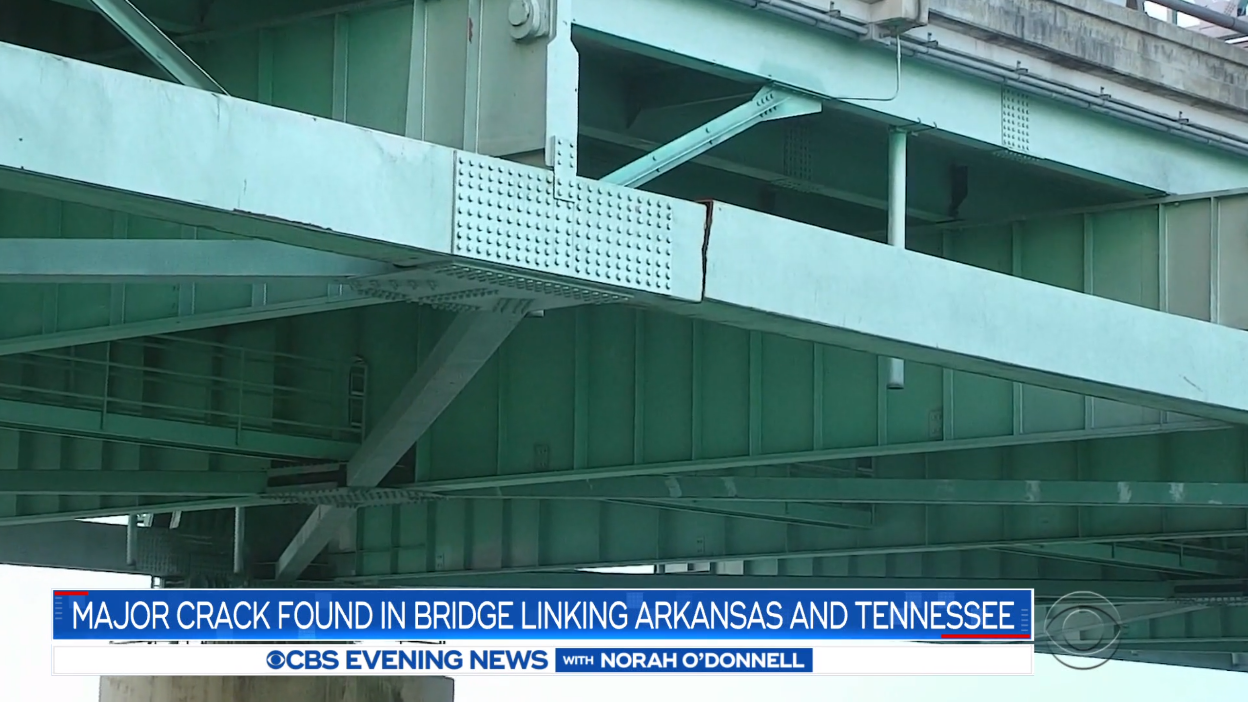
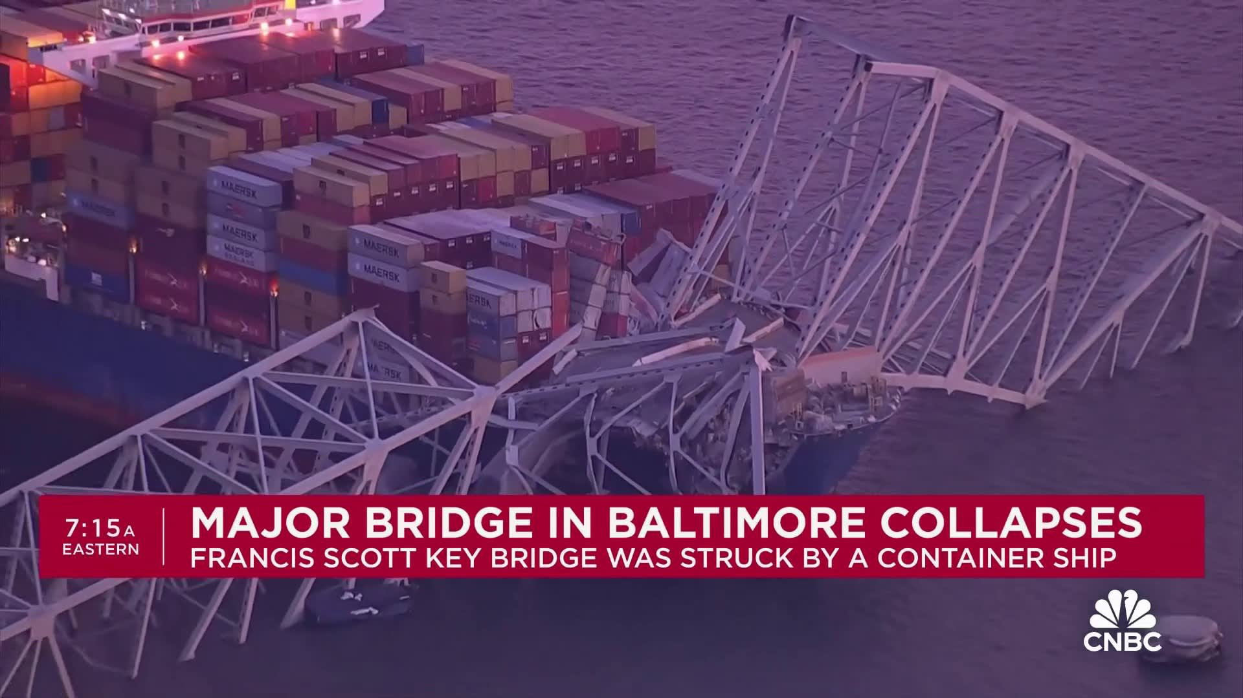
Major bridge closures across the U.S.
Case 1: Brent Spence Bridge
(I-75/71 over Ohio River)
Case 2: Hernando de Soto Bridge
(I-40 over Mississippi River)
Case 3: Francis Scott Key Bridge
(I-695 over Patapsco River)
150,000 (20% HV)
November 2020 42 days
Severe fire caused by the collision
41,000 (30% HV)
May 2021 Roadway- 83 days Waterway- 3 days
Large crack in metal beam
40,000 (28% HV)
March 2024
A cargo ship crashed into the bridge

Slide 3
Impacts of bridge closures are unique
Unexpected road closures can cause significant impacts on the traveling public and freight carriers in terms of travel delays, safety, and mobility.
Bridge closures present unique and significant disruptions due to lengthier detours typically around waterways and other geological features.

Slide 4
Need to expand to multi-modal, scenario analysis
Current Methods | Proposed Methods
Examine the impacts of each transport mode separately | Perform a comprehensive multi-modal analysis, include both roadway and waterway
Cost estimates are based on delays due to detours | Considers delay costs from detours as well as the monetized impacts of secondary safety effects
Look back analysis only | Scenario planning for closures Excel-based Tool

Slide 5
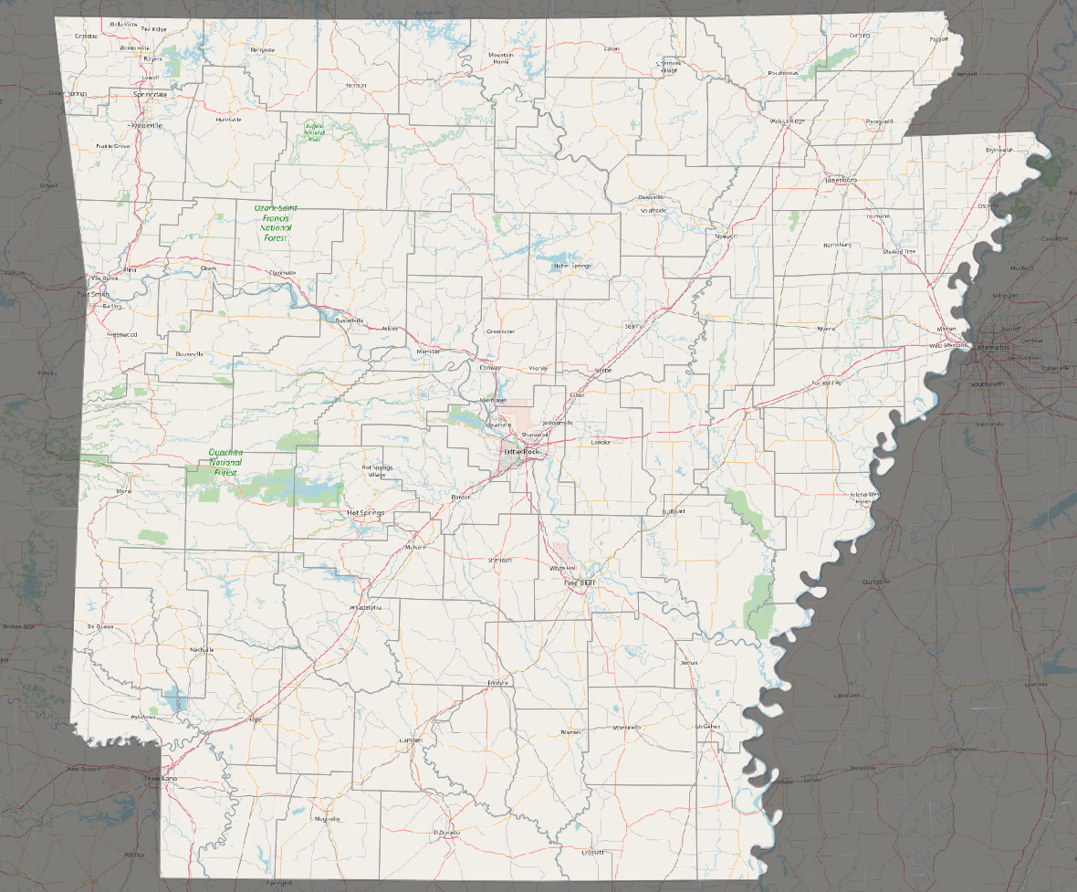

Arkansas bridges over the Mississippi River
Bridge Name | Annual Average Daily Traffic (vehicles per day) | Truck Percentage | Approx. Driving Distance to Next Bridge
Interstate 40 Hernando de Soto Bridge | 41,000 | 29% (12,000) | 10 miles to Memphis and Arkansas Bridge (I-55)
Interstate 55 Memphis and Arkansas Bridge | 46,000 | 35% (16,000) | 10 miles to Hernando de Soto Bridge (I-40)
US Highway 49 Helena Bridge | 4,400 | 20% (880) | 100 miles to Memphis and Arkansas Bridge (I-55)
US Highway 82/278 Greenville Bridge | 7,200 | 24% (1,728) | 200 miles to Helena Bridge (US 49)
(a). US Highway 49, Helena Bridge
(b). US Highway 82/278, Greenville Bridge

Slide 6
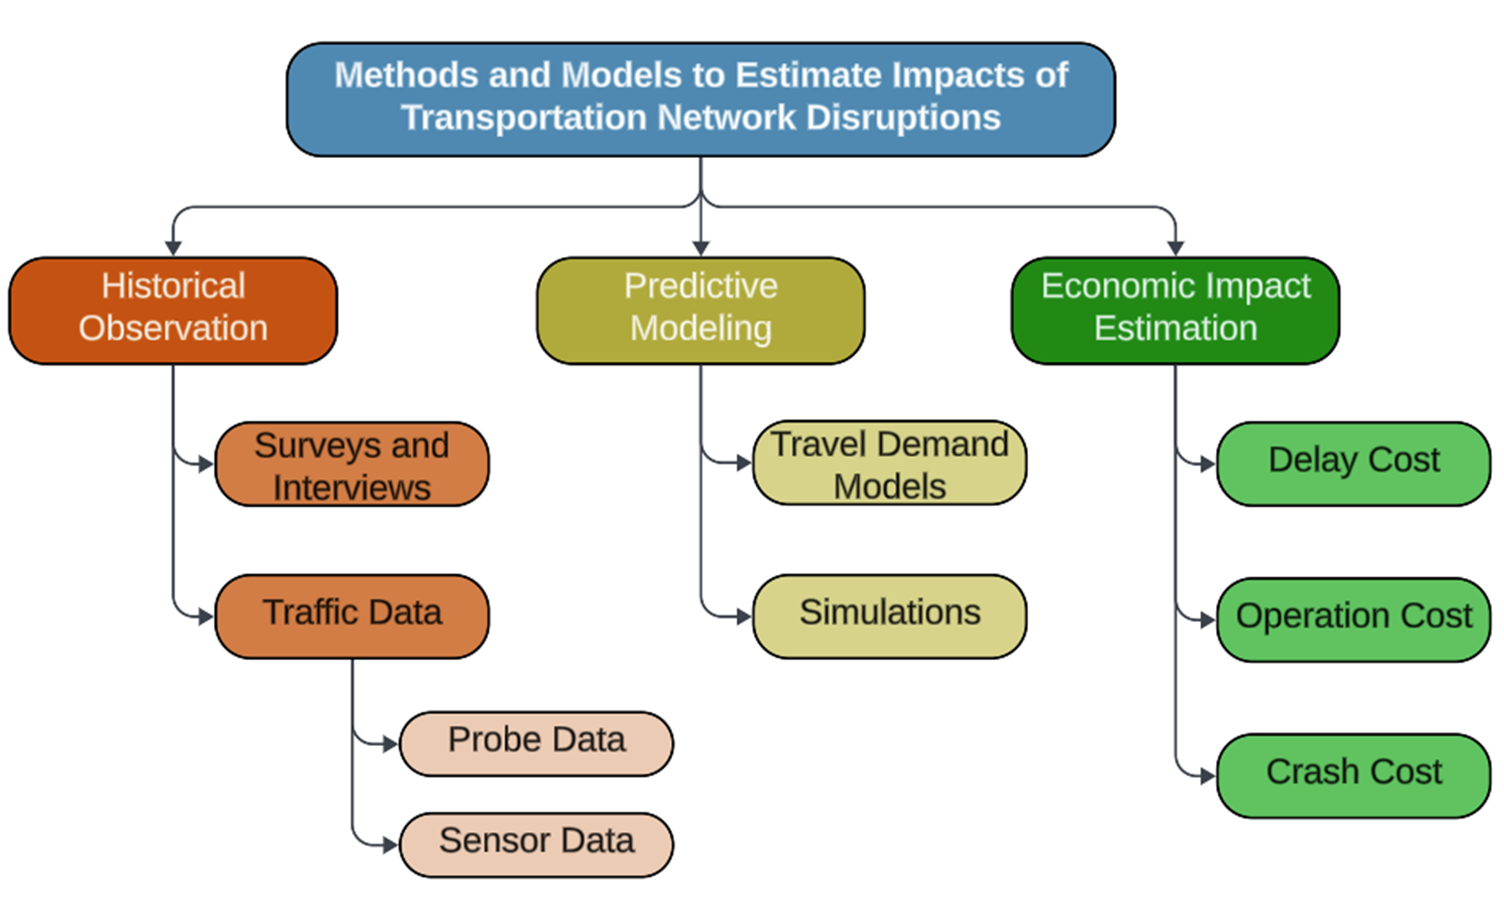
Existing methods and models

Slide 7
State-of-the-practice in scenario-based disruption analysis
Travel Demand Models (TDM) are commonly used for roadways
Simulation models (one-dimensional, discrete) are popular for waterways
Use of performance measure outputs (VHT, VMT) from TDMs in combination with user cost factors is widely used.
The main methods identified for use in this study include:
  Travel Demand Model (TDM) scenario analysis coupled with roadway user cost factors to estimate the impacts of closures on roadway users. (e.g. Vehicle Operating Costs and Lost Wages, etc.)
  Historical observation of waterway traffic flows coupled with waterway user cost factors.

Slide 8
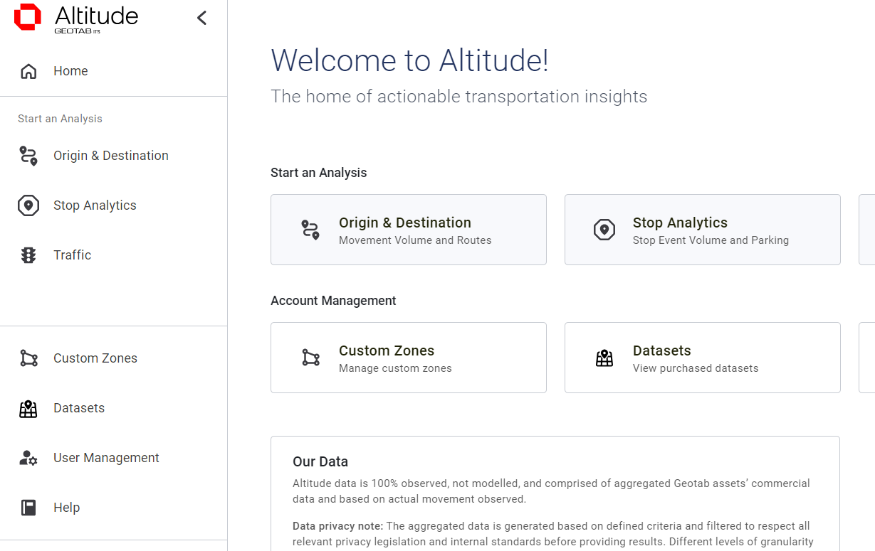
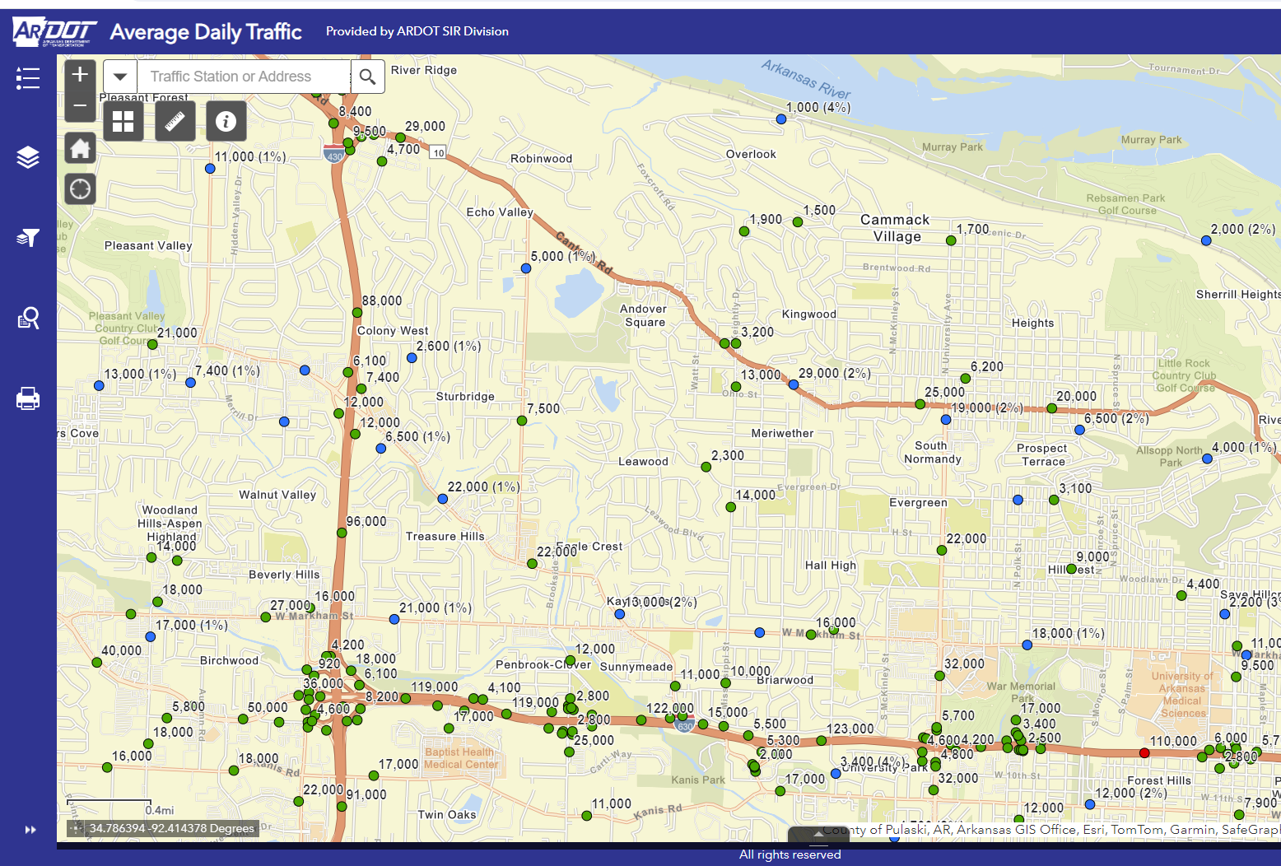
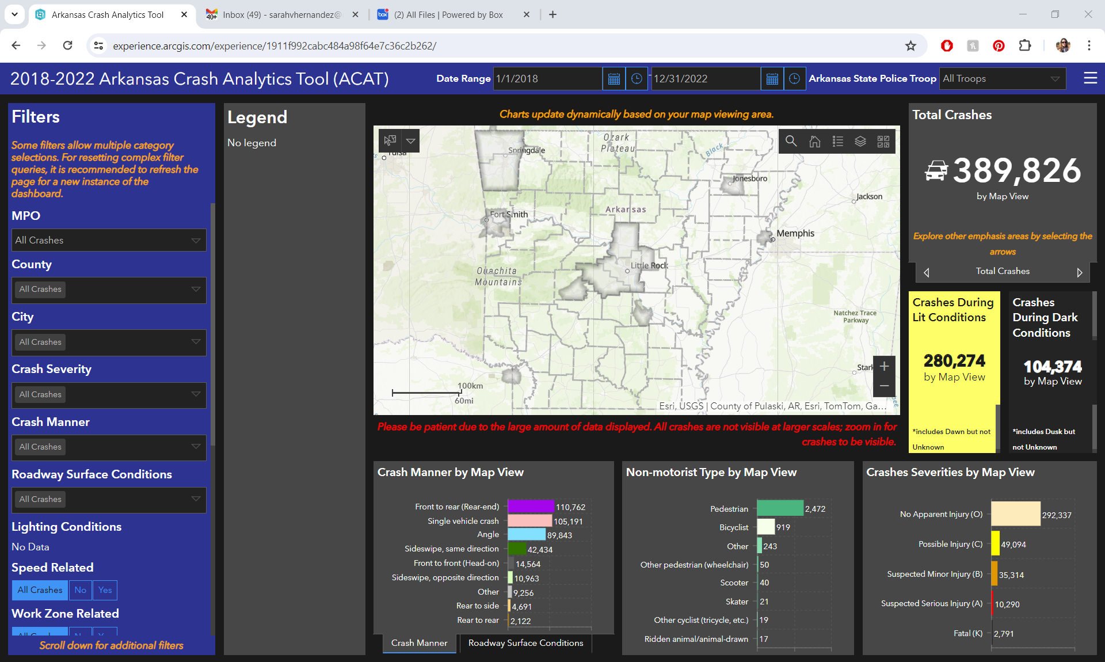
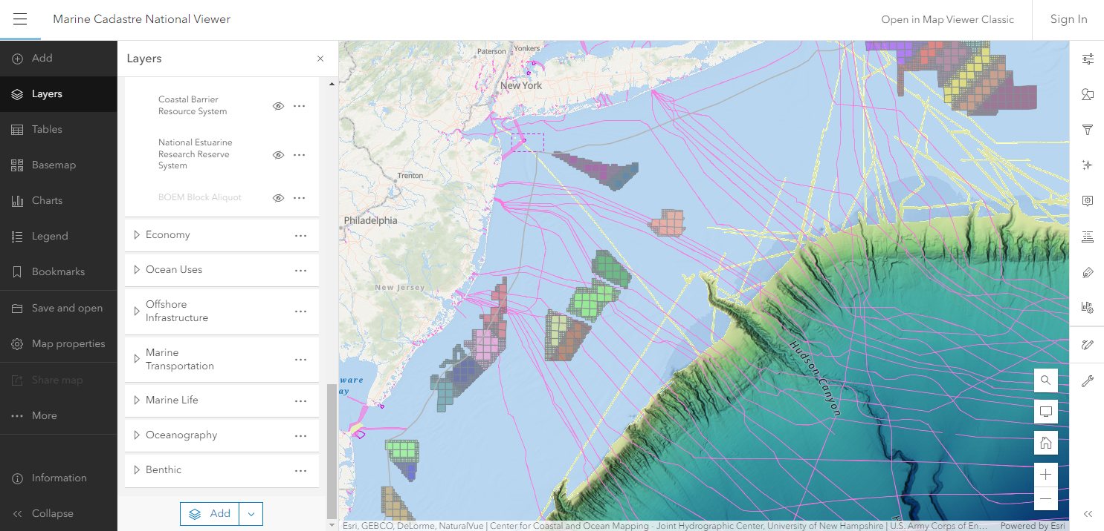
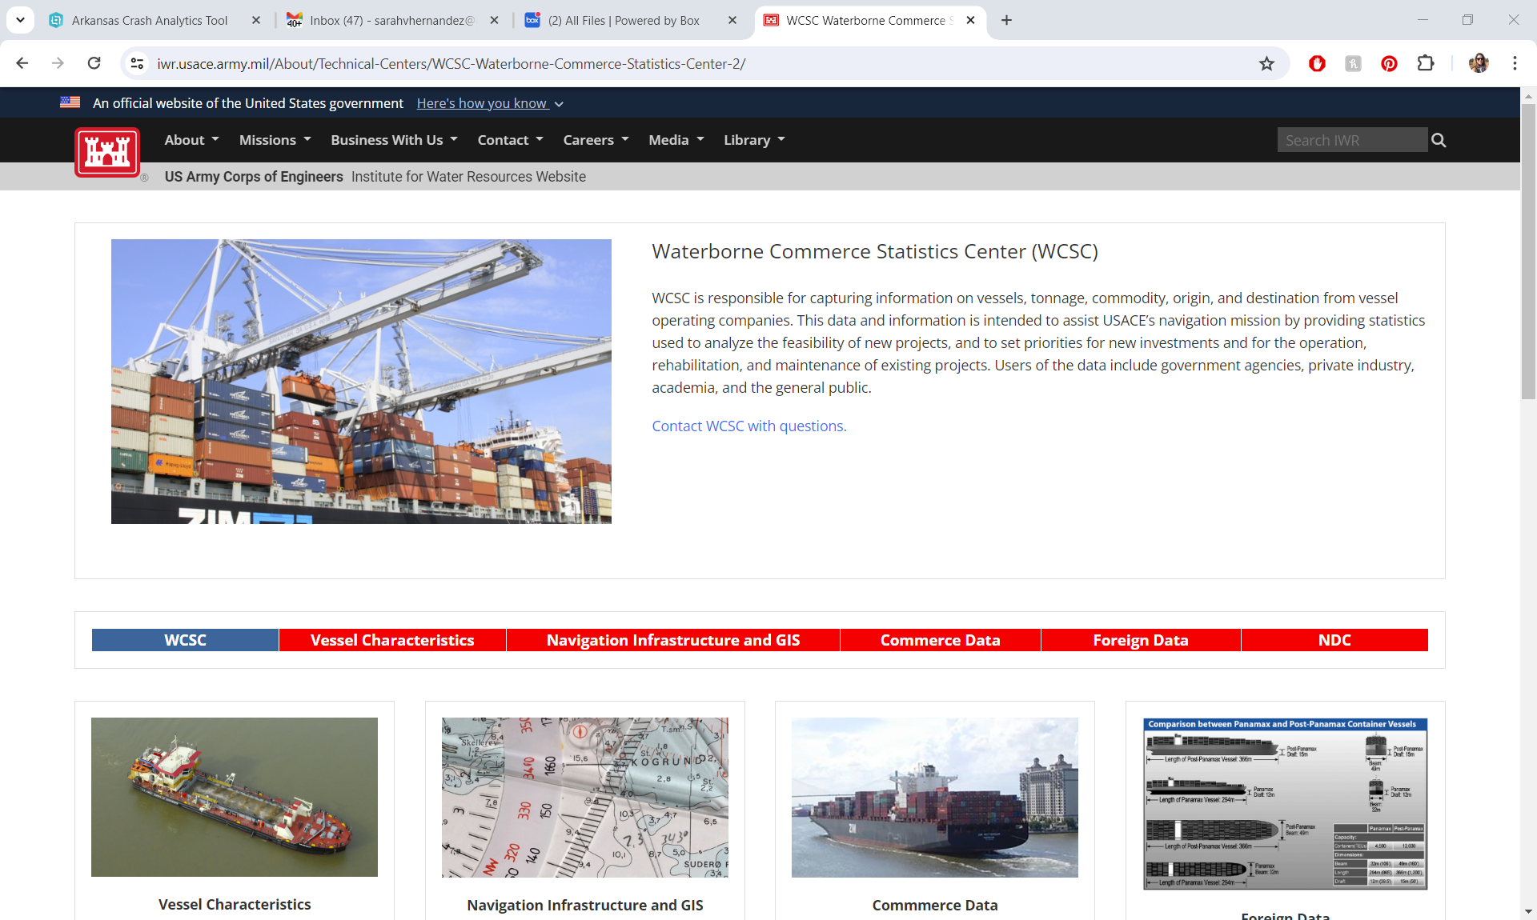
Data sources for multi-modal analysis
Roadway
Probe Data
Streetlight & Geotab
Sensor Data
Classification count
Crash Data
ARDOT ACAT
Waterway
Vessel Movement Data
AIS (marinecadastre.org)
Waterway Commodity Data
USACE WCSC

Slide 9
Analysis Time Periods
April 15-30
Pre-Closure
Aug. 1- 6
Partial Closure
May 11-July 1
Full Closure
October 30
Post Closure
2021
Jan
Feb
Mar
April
May
June
July
Aug
Sept
Oct
Nov
Dec
Stable Traffic Flow Period
Jan 15-30
April 15-30
July 15-30
Oct 15-30
2022
Jan
Feb
Mar
April
May
June
July
Aug
Sept
Oct
Nov
Dec

Slide 10
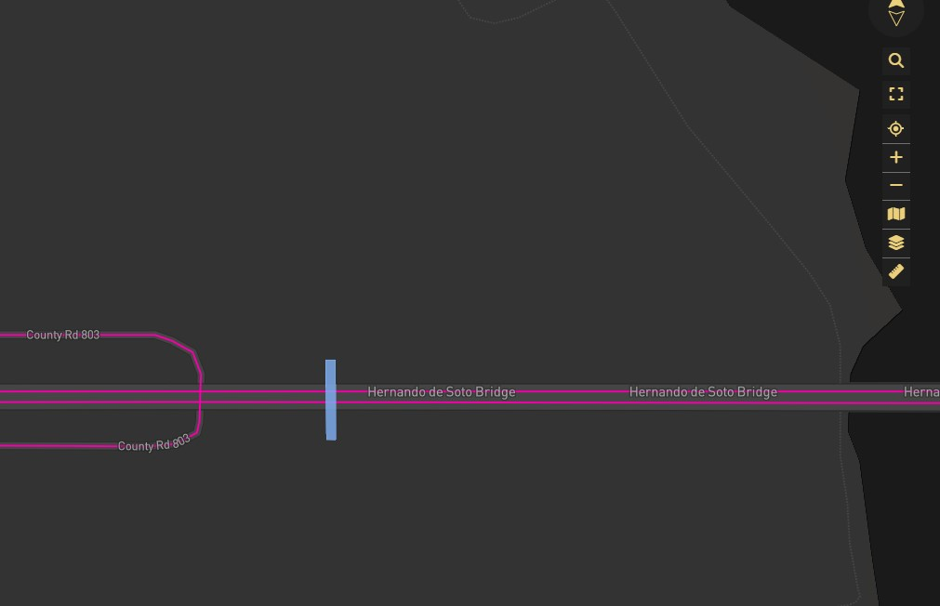

Passenger Vehicle OD: StreetLight Data
StreetLight Data, Inc. pioneered the use of ‘Big Data’ analytics to shed light on how people, goods, and services move, empowering smarter, data-driven transportation decisions.
Current subscription maintained by ARDOT
Streetlight classifies a stationary trip as 5 minutes or more.
Origin-Destination by Census block for vehicles passing a ‘screenline’ across the bridge
Co Rd. 803
Hernando De Soto Bridge
Screenline

Slide 11
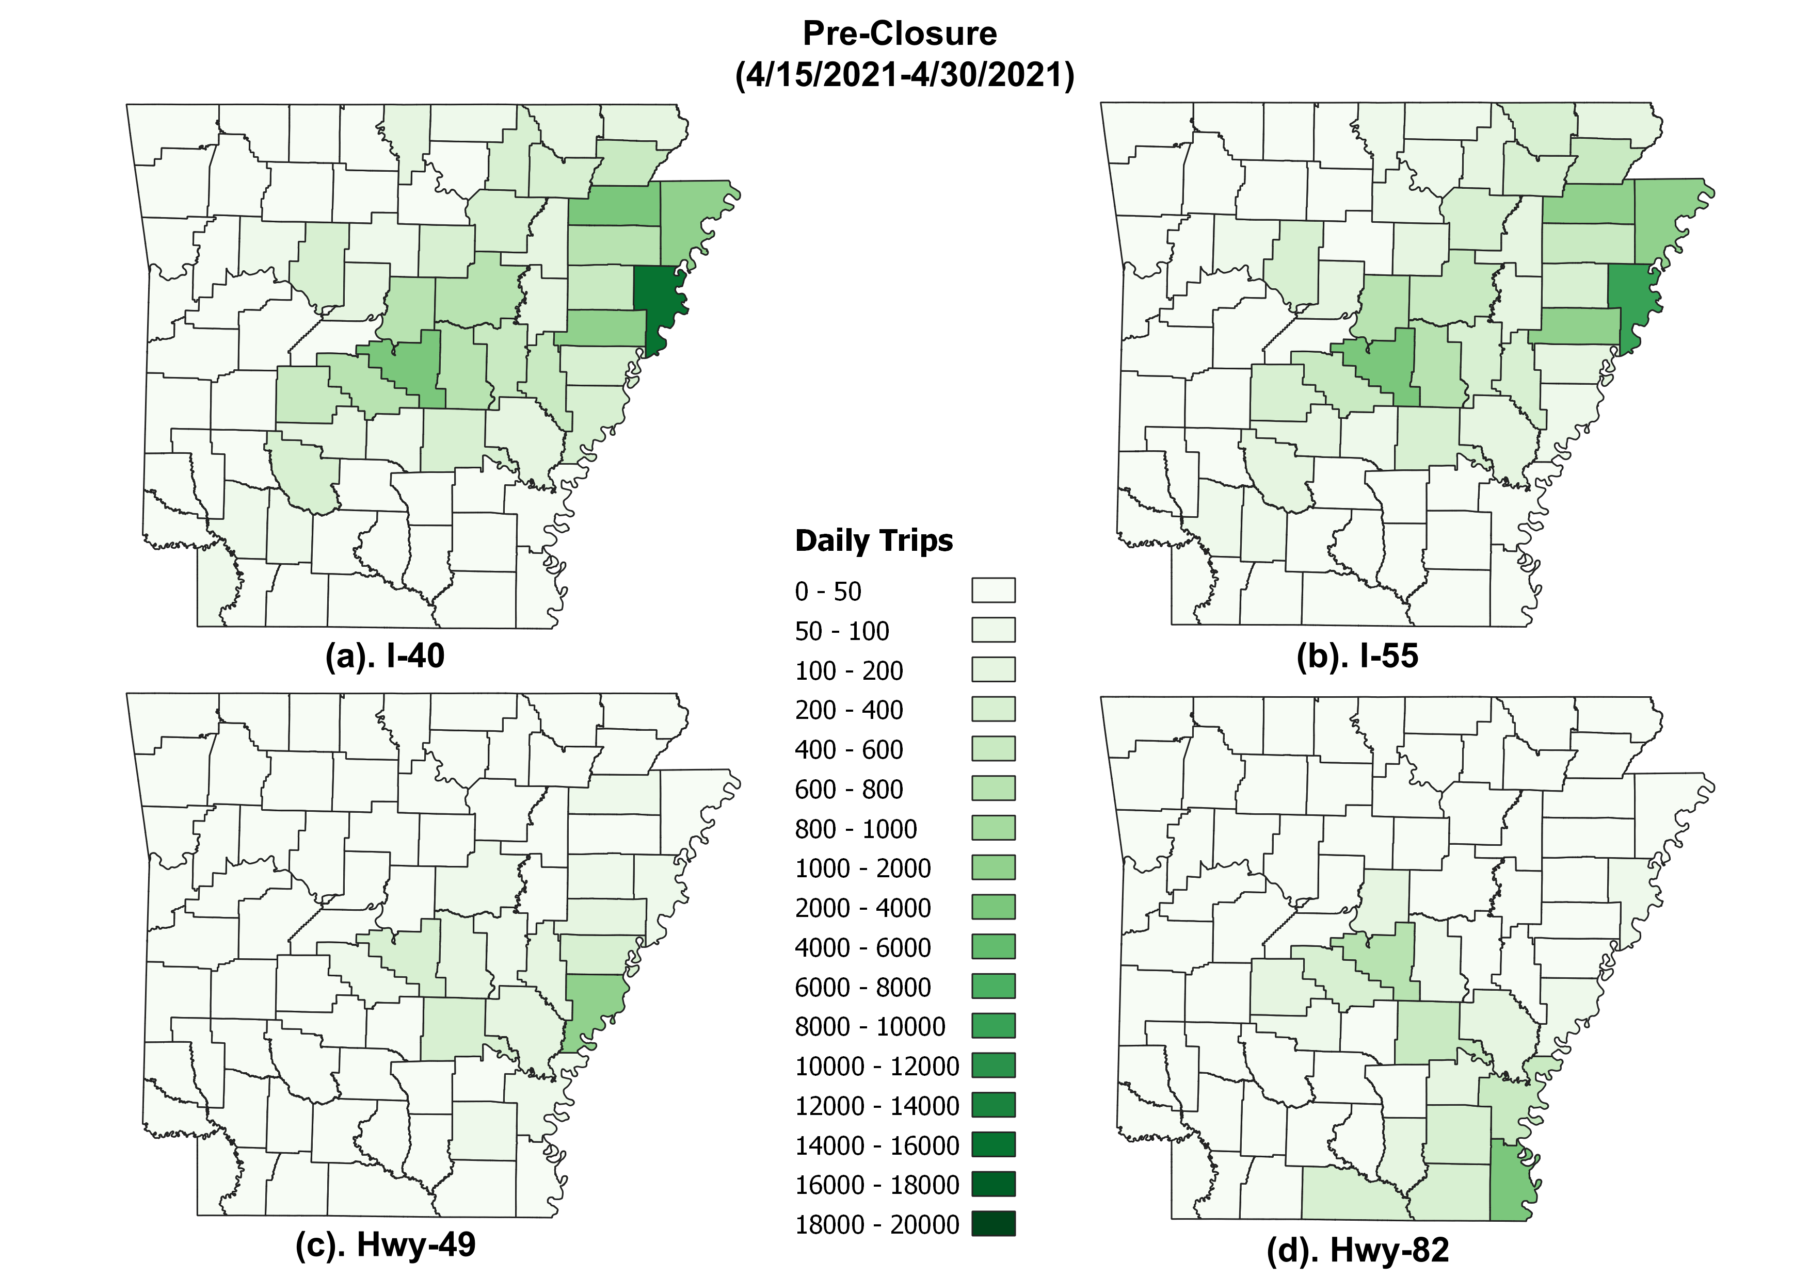
Pre-Closure Origins: April 2021

Slide 12
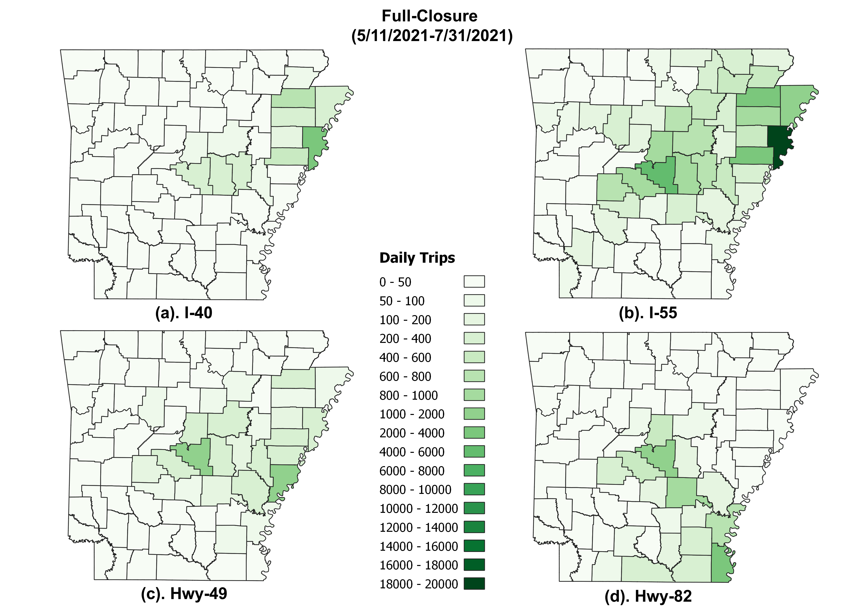
Full Closure Origins: May-July 2021

Slide 13
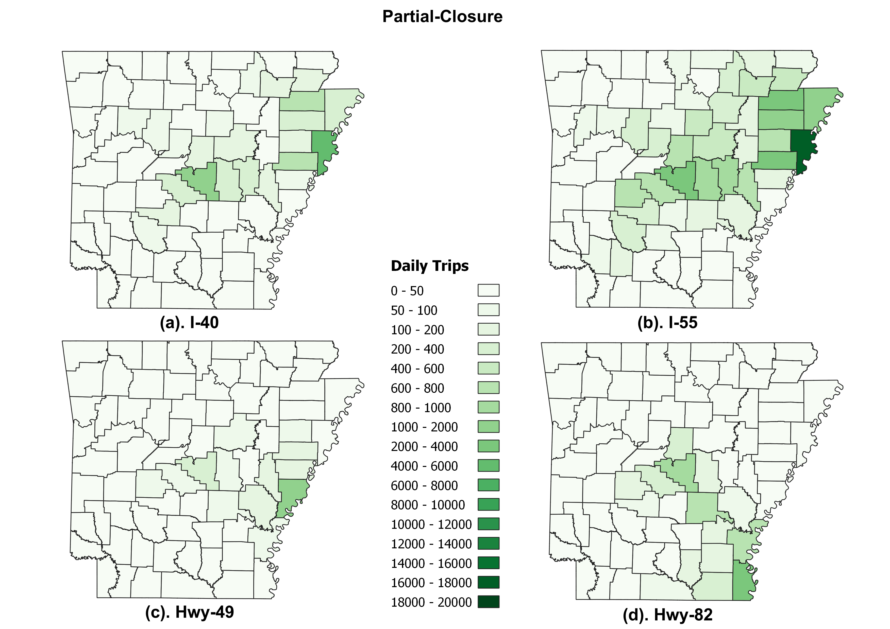
Partial Closure Origins: July 31-Aug 6 2021

Slide 14
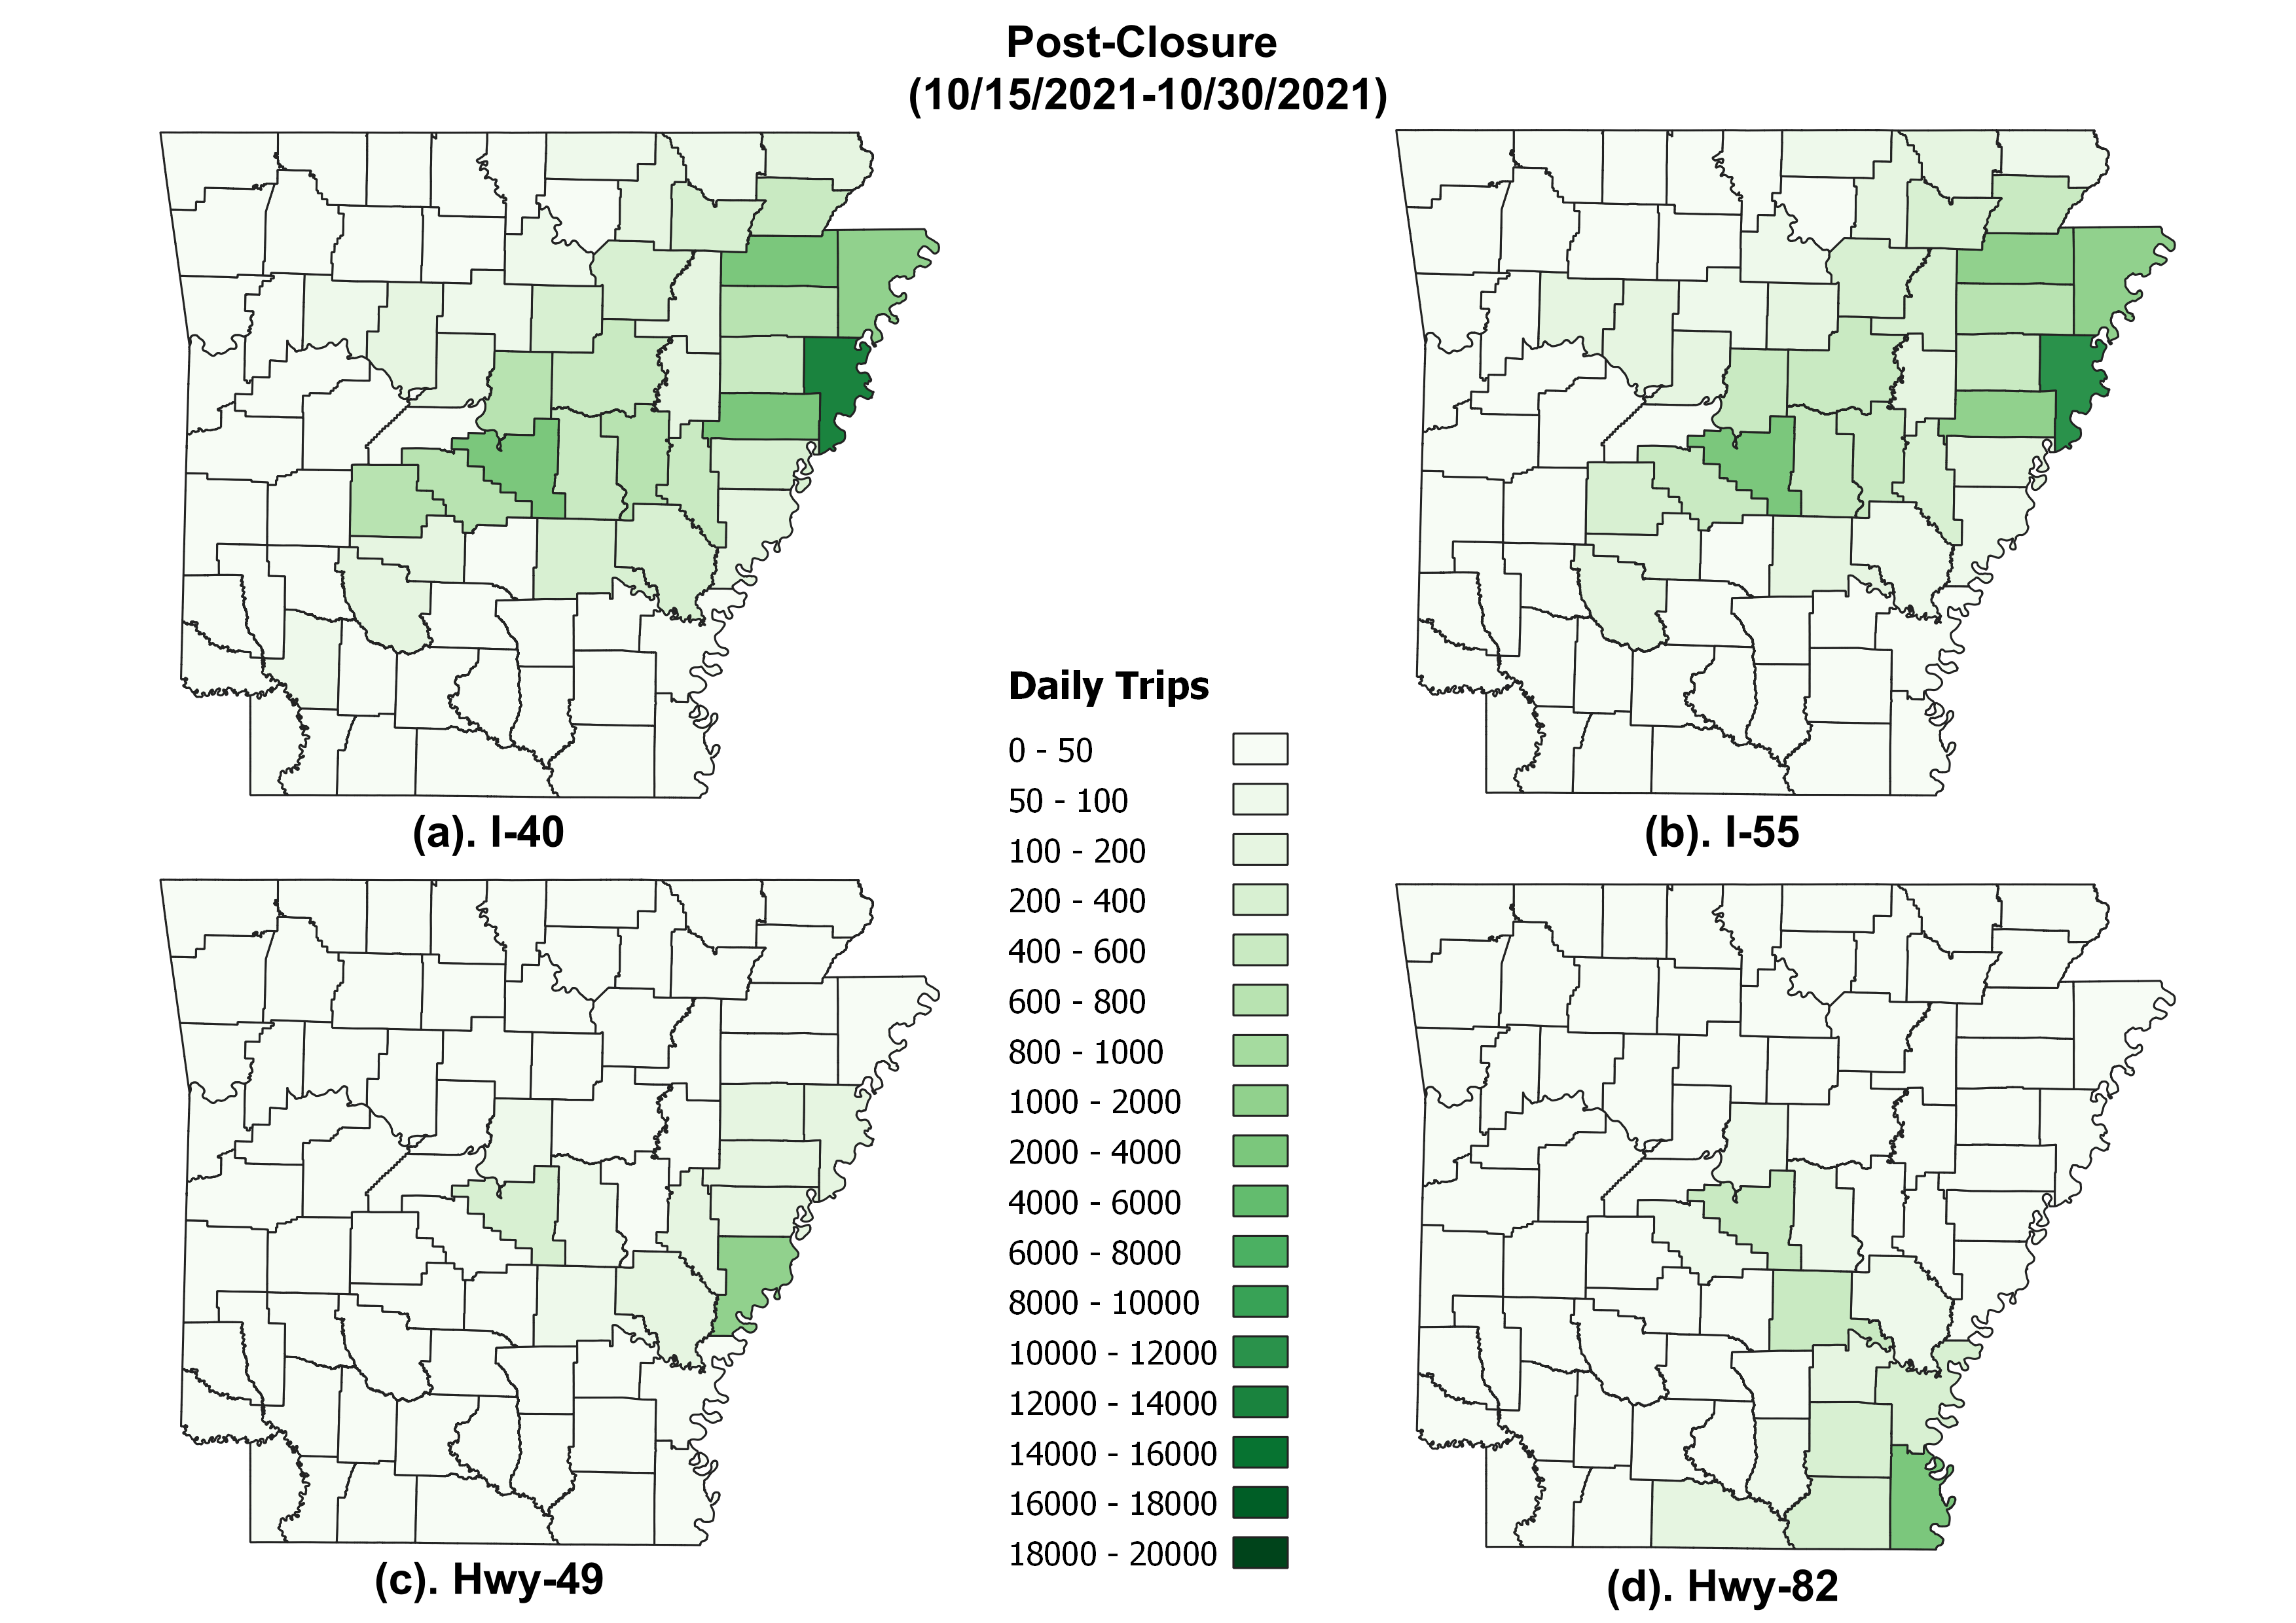
Post Closure Origins: October 2021

Slide 15
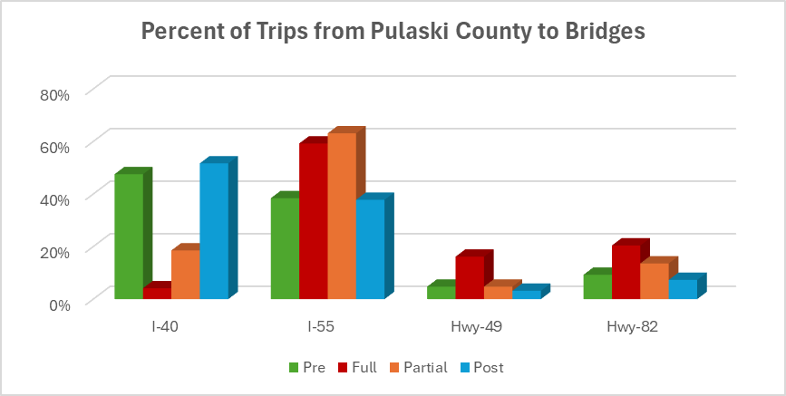
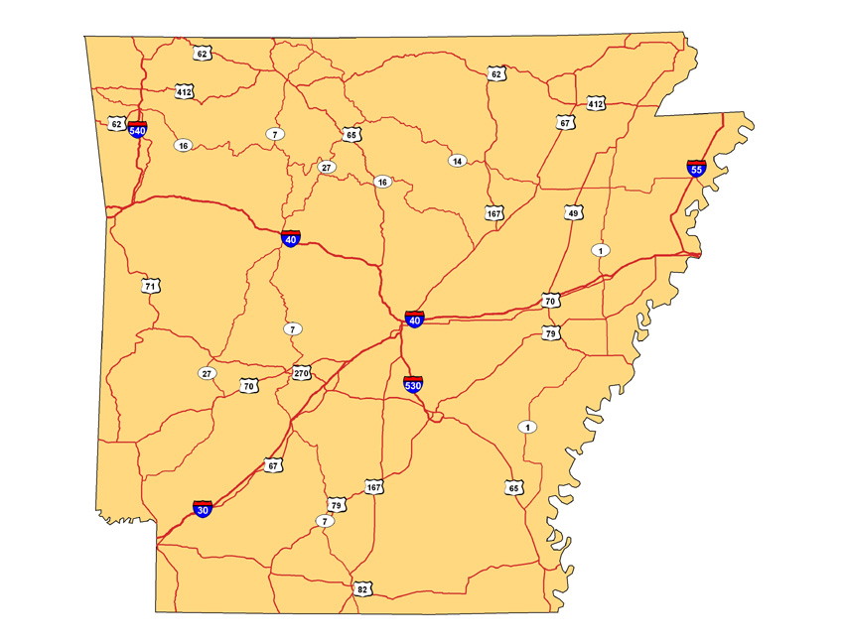
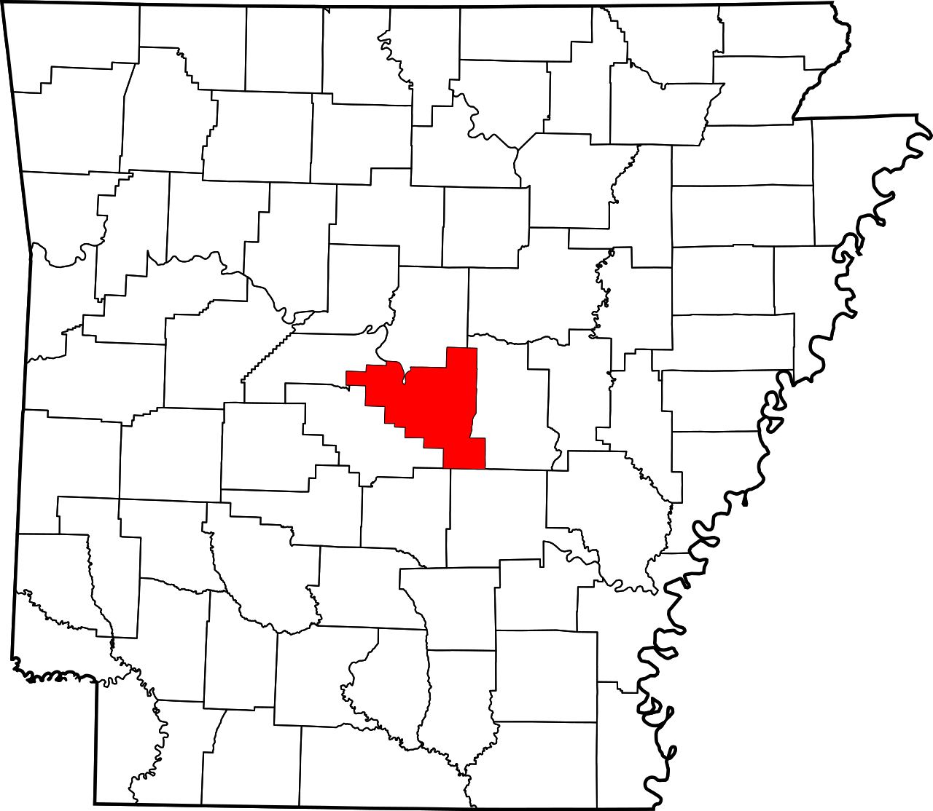

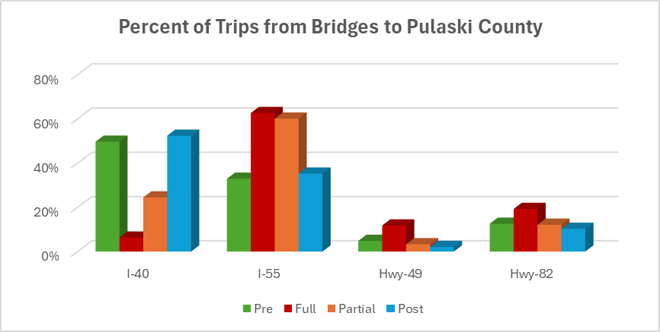
Distribution of passenger trips from Little Rock to Bridges
I-40
I-55
Hwy-49
Hwy-82

Slide 16
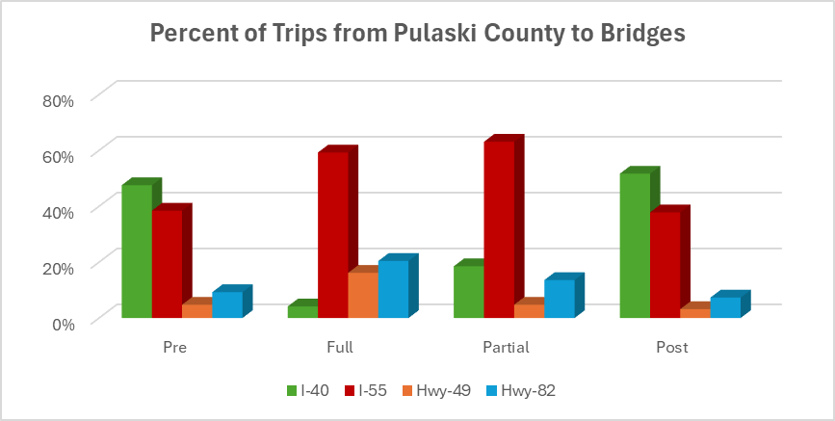

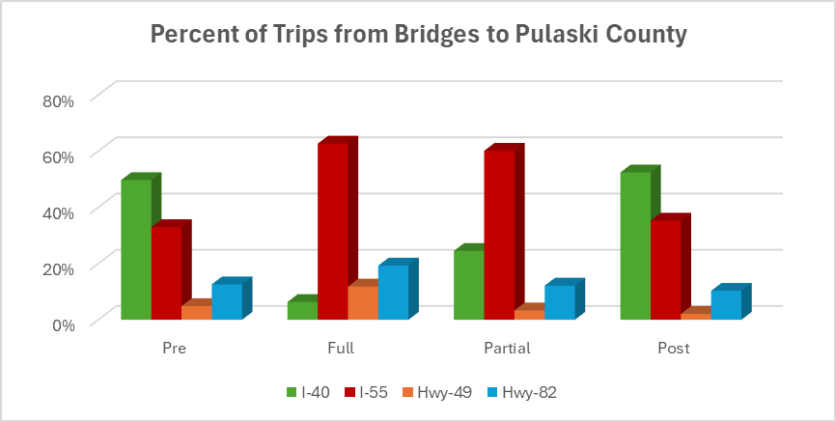


Distribution of passenger trips from Little Rock to Bridges
I-40
I-55
Hwy-49
Hwy-82

Slide 17
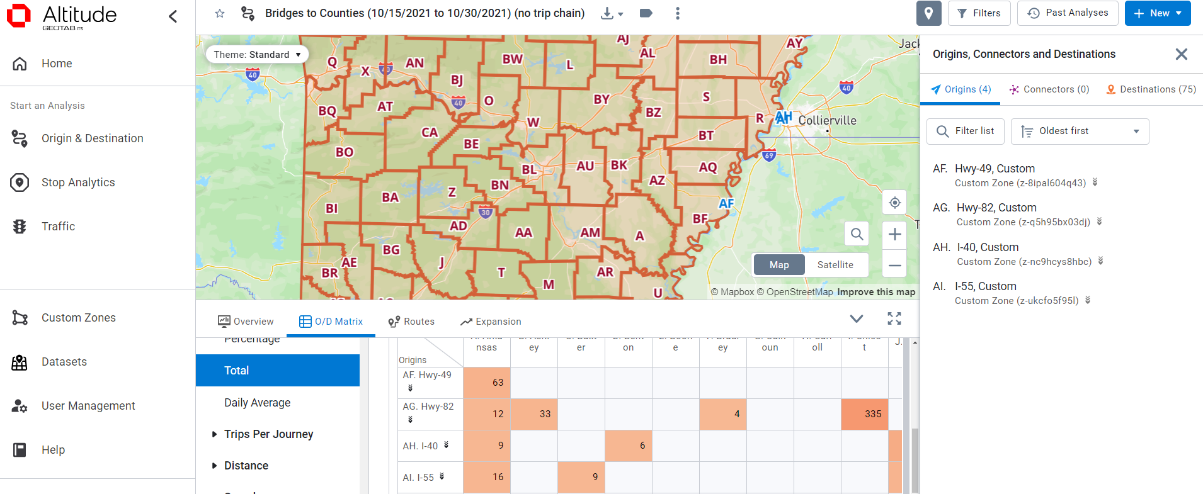

Truck OD: Geotab
Geotab specializes in telematics solutions for fleet management and vehicle tracking.
Geotab collects data from vehicles equipped with their devices.
Geotab classifies a ‘journey’ when a vehicle starts moving until it stops with ignition turned off
(or idles for 3 min 20 sec)

Slide 18
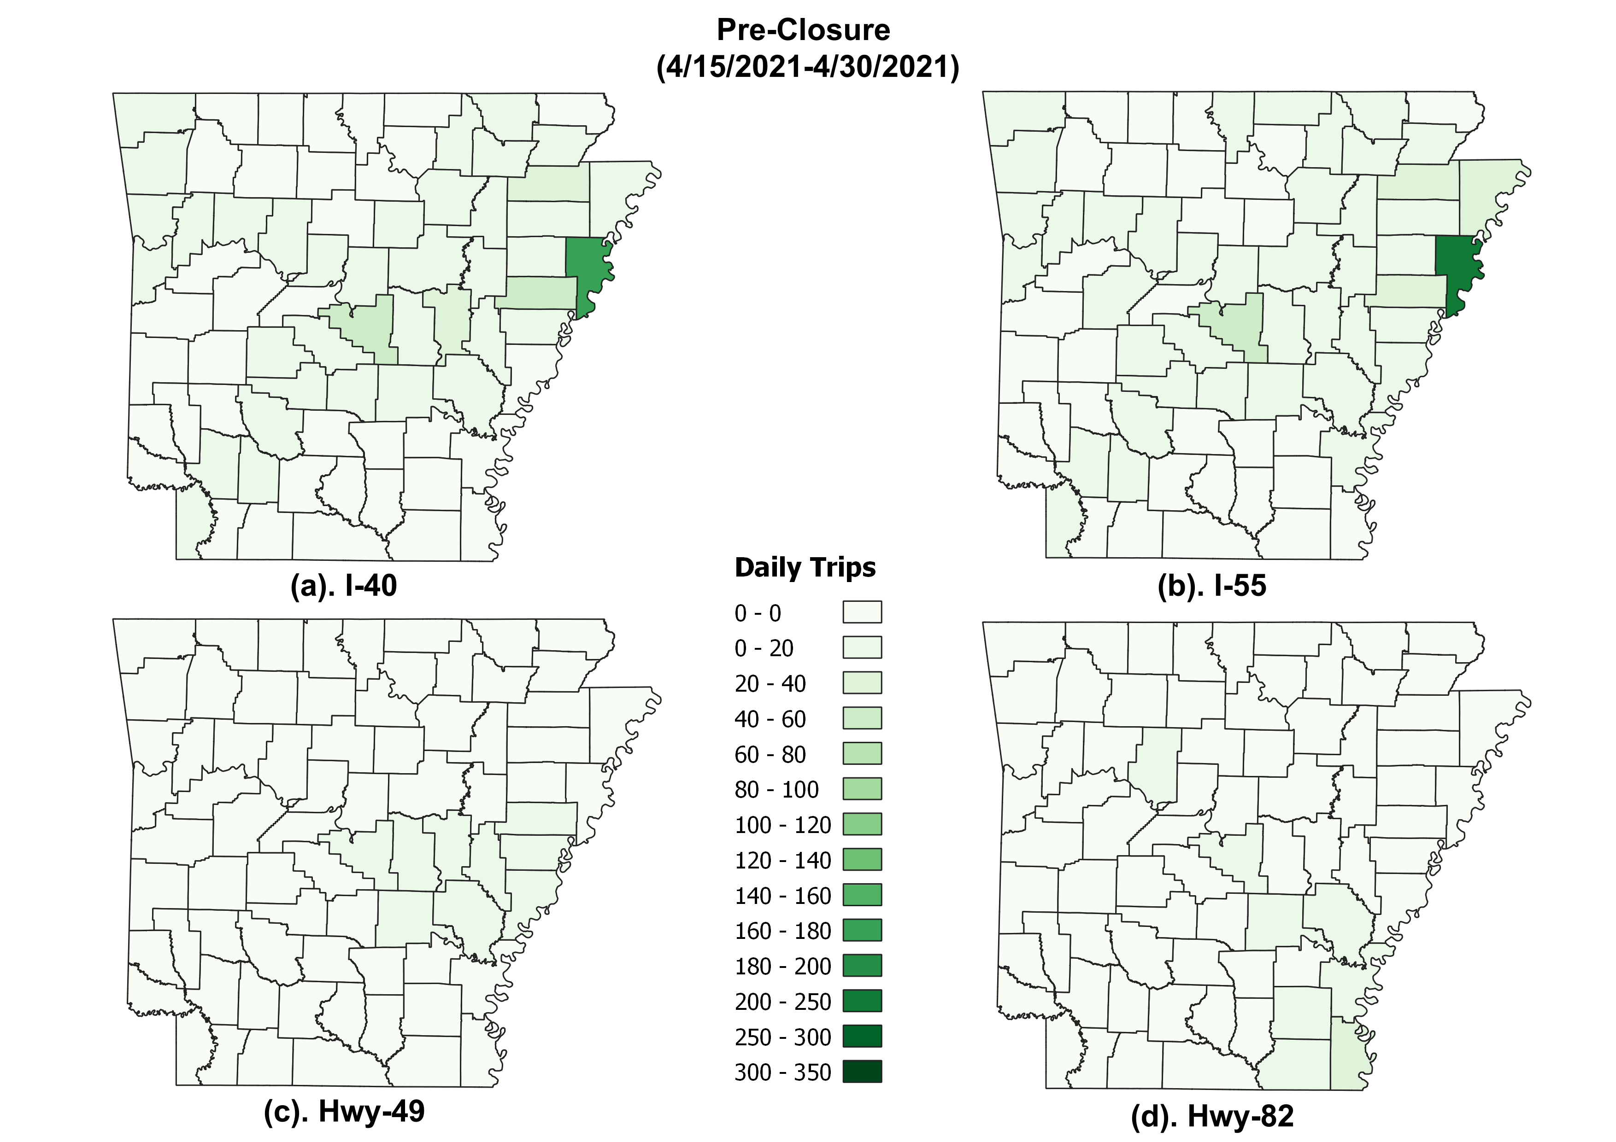
Pre-Closure Origins: April 2021

Slide 19
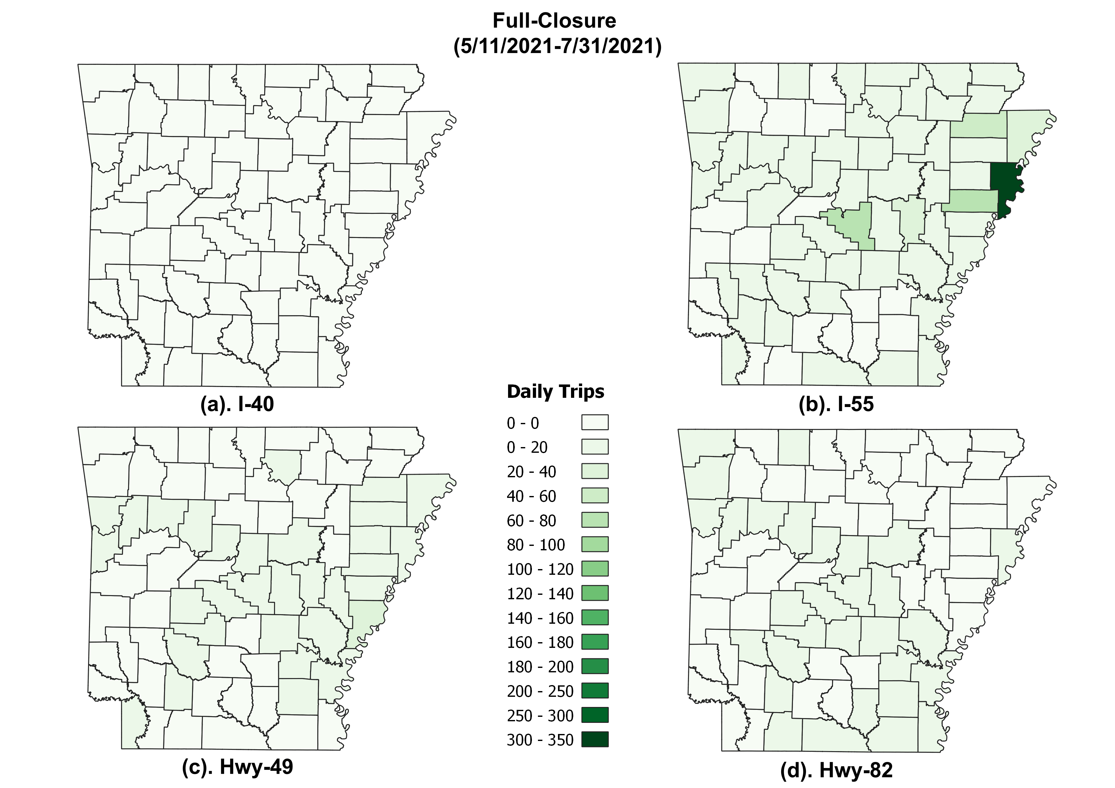
Full Closure Origins: May-July 2021

Slide 20
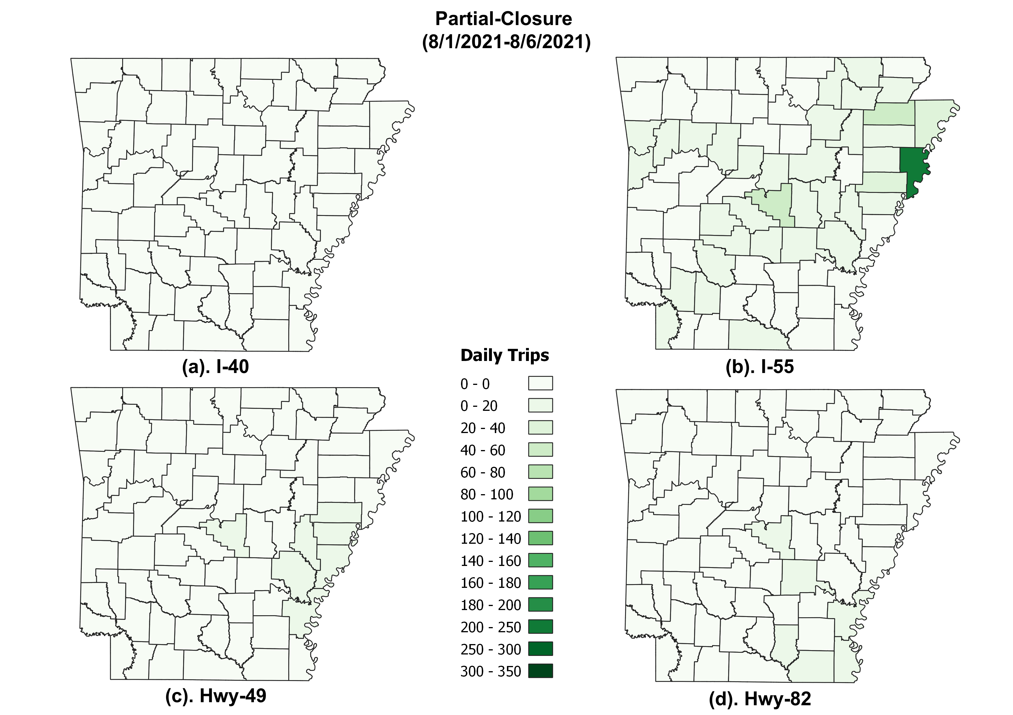
Partial Closure Origins: July 31-Aug 6 2021

Slide 21
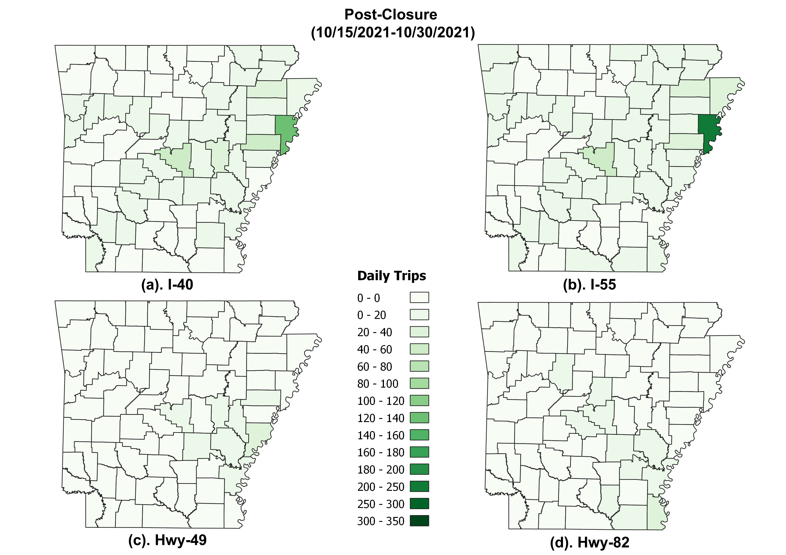
Post Closure Origins: October 2021

Slide 22
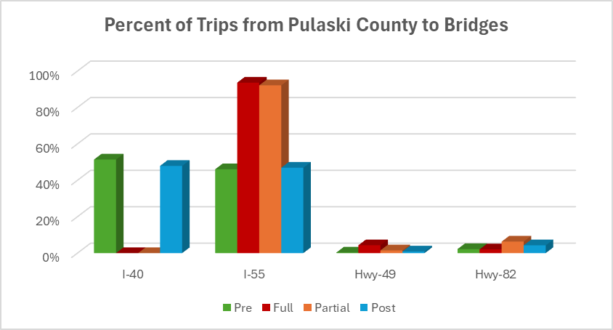
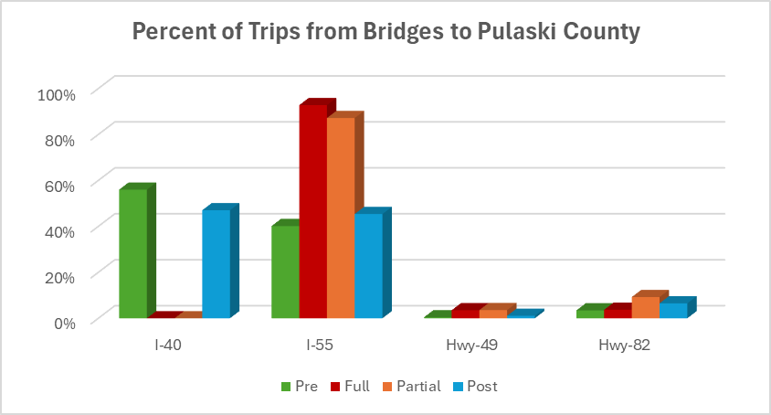
Distribution of truck trips from Little Rock to Bridges
I-40
I-55
Hwy-49
Hwy-82

Slide 23
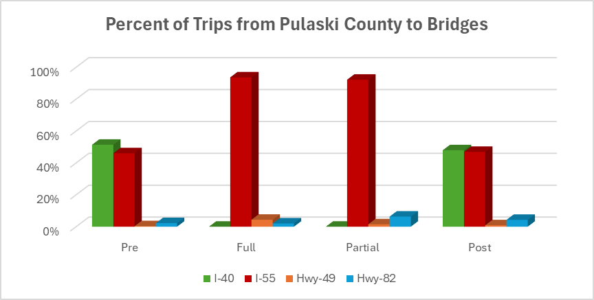
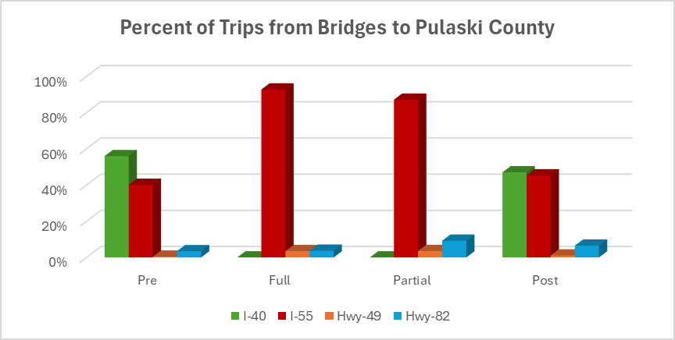
Distribution of truck trips from Little Rock to Bridges
I-40
I-55
Hwy-49
Hwy-82

Slide 24
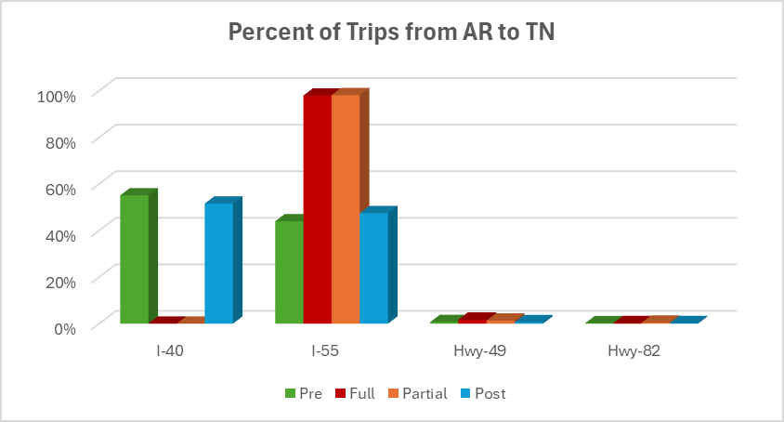
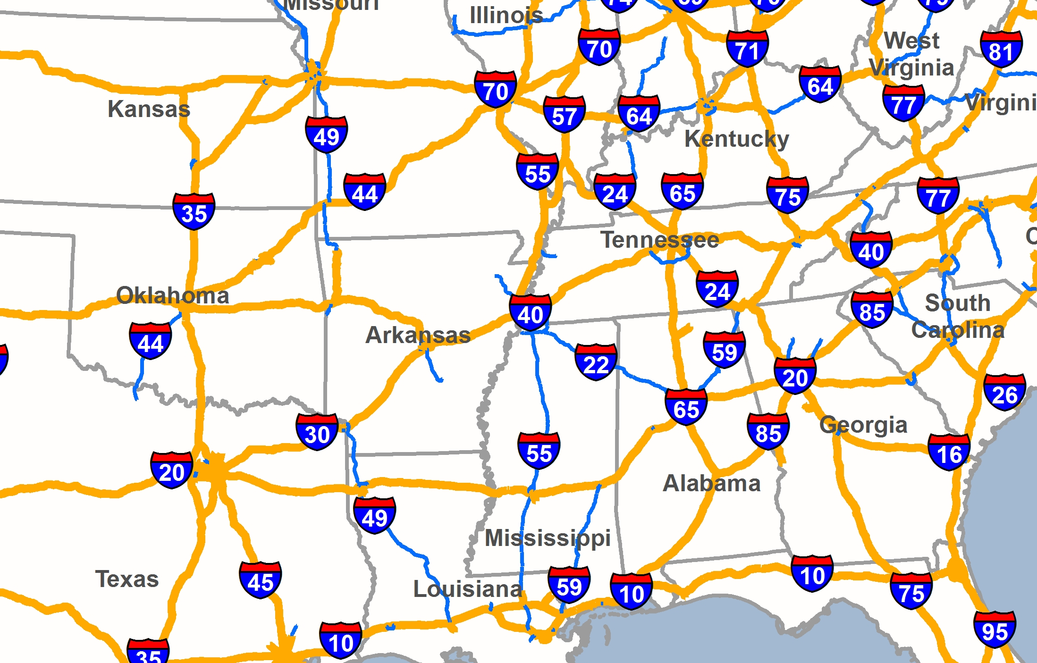

Truck ‘trips’ from bridge to neighboring states

Slide 25
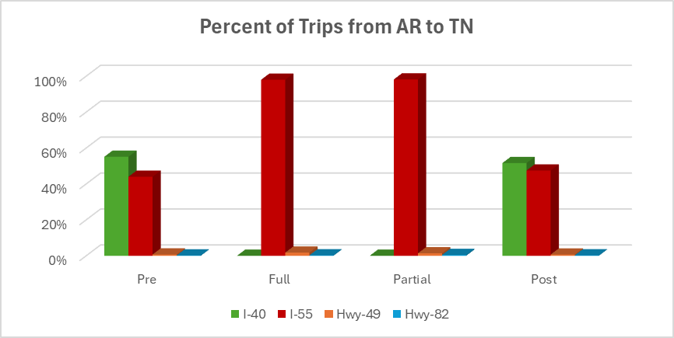
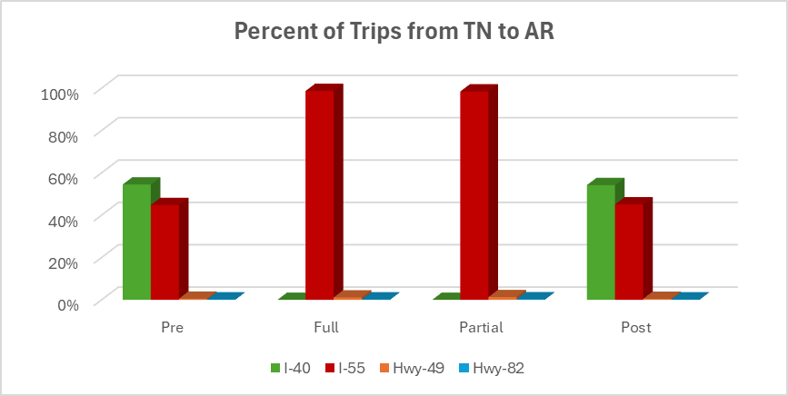
Truck ‘trips’ from bridge to neighboring states

Slide 26
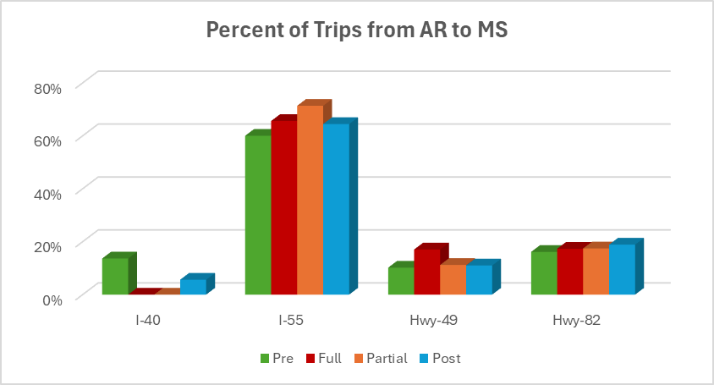
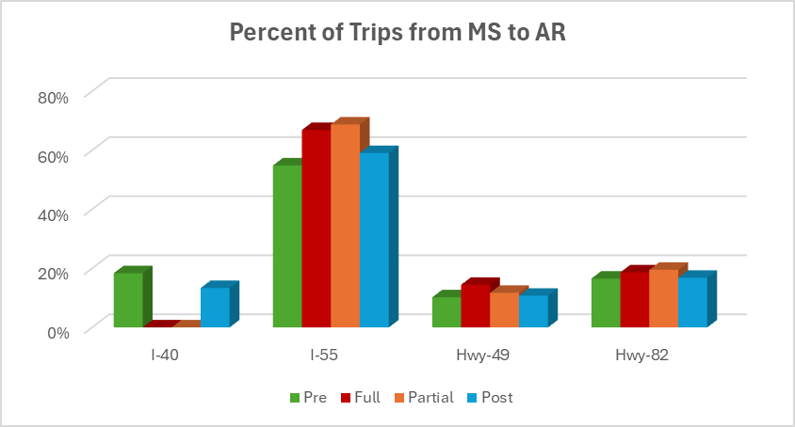
Truck ‘trips’ from bridge to neighboring states

Slide 27
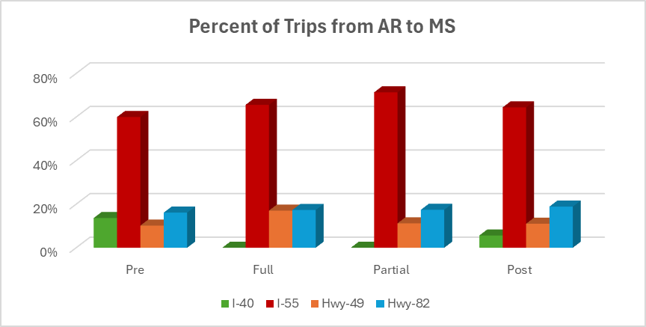
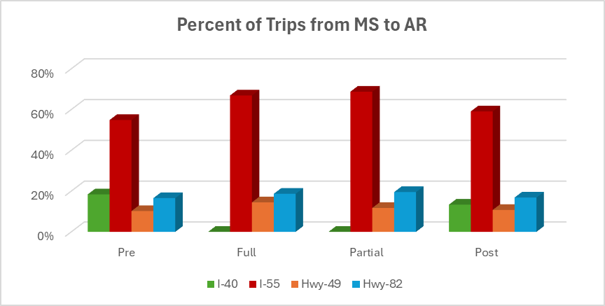
Truck ‘trips’ from bridge to neighboring states

Slide 28
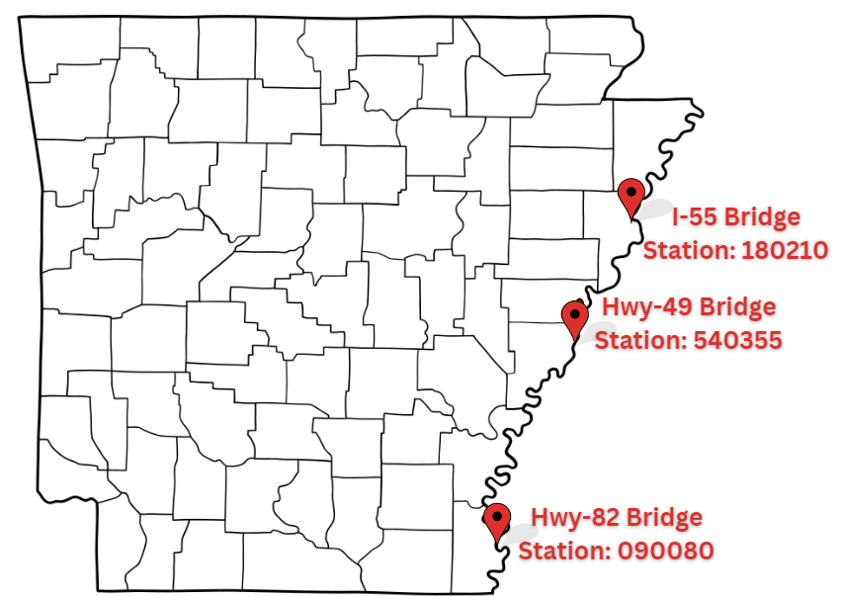
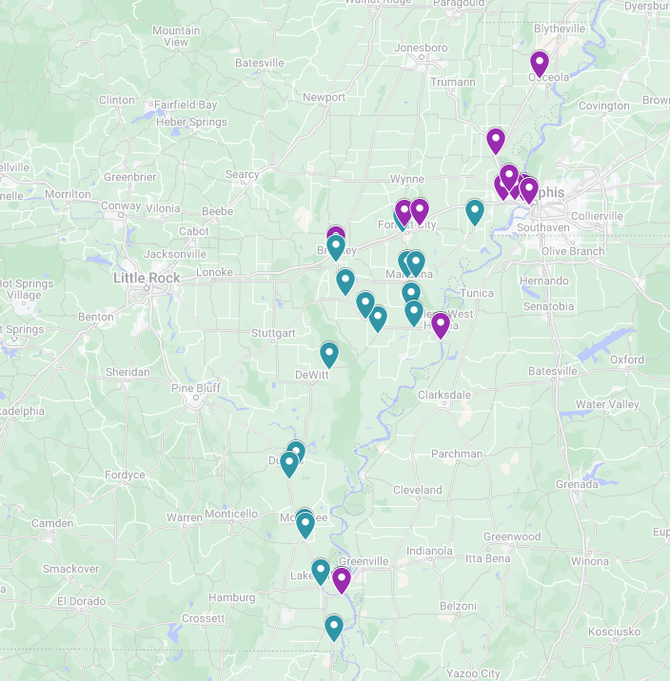
Traffic Volumes by Bridge: ARDOT Count Stations
3 stations-one for each bridge during the I-40 bridge closure
  May 25- Aug 5, 2021
29 classification count stations
  Annual volumes- AADT

Slide 29
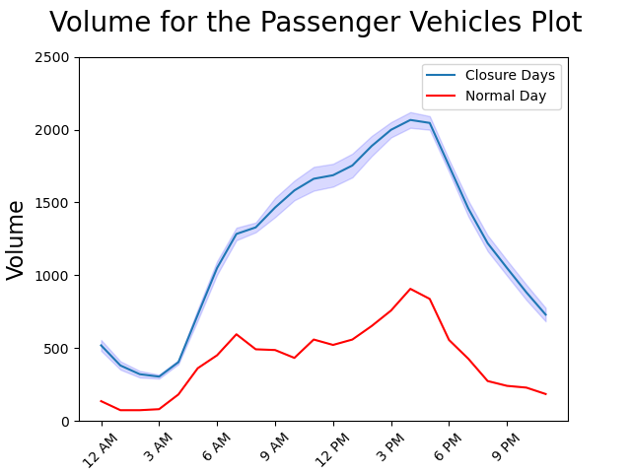
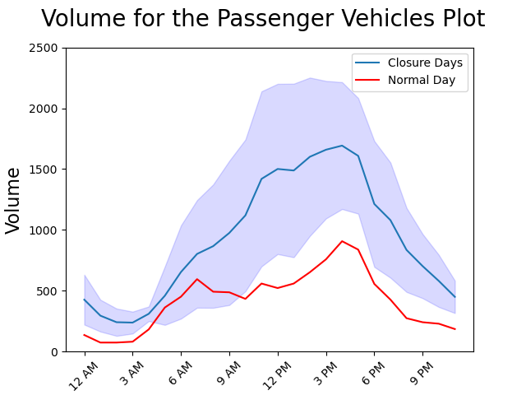
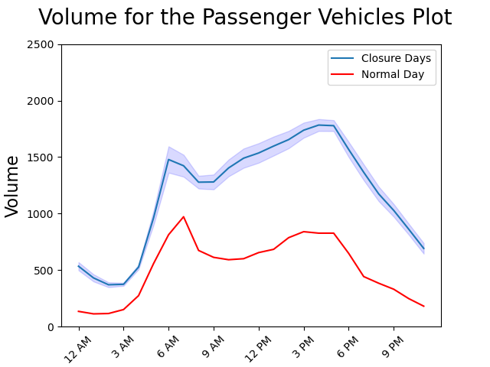
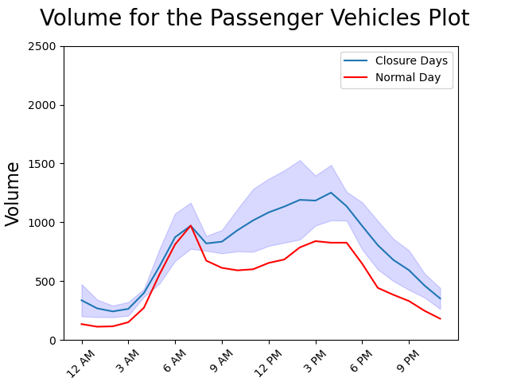
Passenger Traffic Volumes: I-55 Bridge
Full-Closure
Partial-Closure
Northbound
Southbound

Slide 30
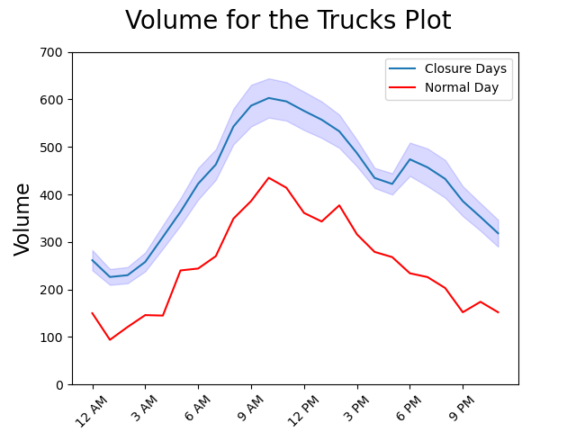
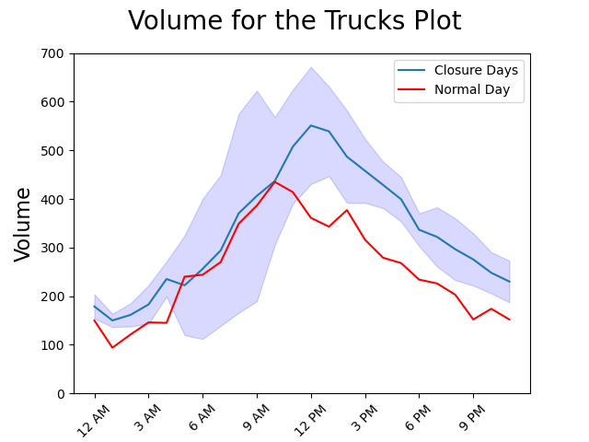
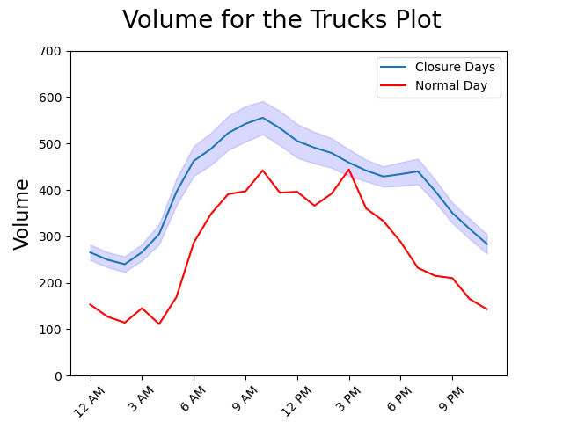
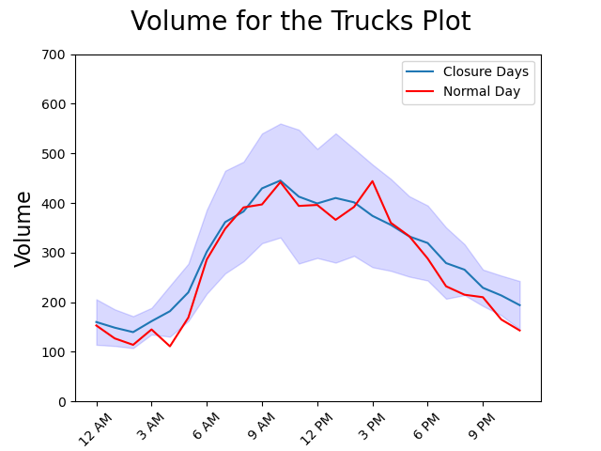
Truck Traffic Volumes: I-55 Bridge
Full-Closure
Partial-Closure
Northbound
Southbound

Slide 31
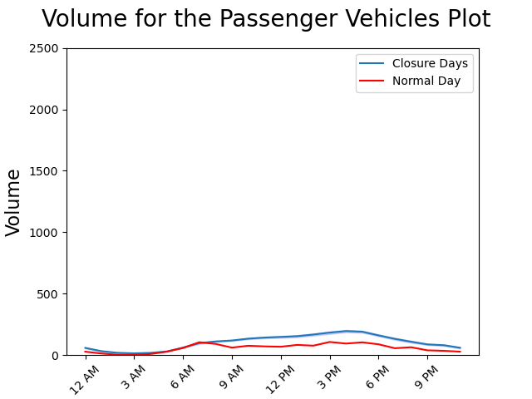
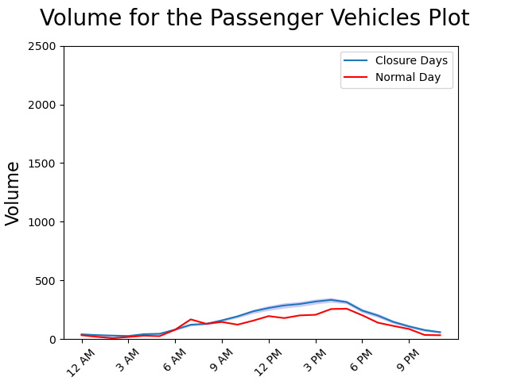


Passenger Traffic Volumes: Full Closure
I-55 Bridge
Hwy-49 Bridge
Hwy-82 Bridge
Northbound
/
Westbound
Southbound
/
Eastbound

Slide 32



Passenger Traffic Volumes: Partial Closure
I-55 Bridge
Hwy-49 Bridge
Hwy-82 Bridge
Northbound
/
Eastbound
Southbound
/
Westbound

Slide 33




Truck Traffic Volumes: Full Closure
I-55 Bridge
Hwy-49 Bridge
Hwy-82 Bridge
Northbound
/
Eastbound
Southbound
/
Westbound

Slide 34




Truck Traffic Patterns: Partial Closure
I-55 Bridge
Hwy-49 Bridge
Hwy-82 Bridge
Northbound
/
Eastbound
Southbound
/
Westbound

Slide 35

Waterway disruptions: Vessel Movements
AIS: maritime navigation safety system that collected by the U.S. Coast Guard.
Real-time and historical vessel movements, positions, and characteristics.

Slide 36

Multi-Modal Scenario Analysis

Slide 37

Closure Plan Tool Development
Develop a model as an Excel-based tool for “what if” analyses, called Closure Plan
Select a bridge and corresponding closure scenario and
Select appropriate operational and planning solutions
Outputs:
  Difference in distance between detour and original route (mile), D
  Extra travel time on detour (minutes), Td
  Number of full closure days (days), DFC, and/or time periods (peak hours), DHR
  Number of days of partial closure (days), DPC
  Work zone length (miles), WL
  Work zone speed limit (mph), WZS
  Work zone speed limit reduction (mph), WZSR

Slide 38
Thanks!
Any questions?
Sarah Hernandez
Phone: 479-575-4182
Email: sarahvh@uark.edu

