Slide 1
Safe Streets & Roads for Fayetteville, Arkansas
Accelerating Change Toward Vision Zero
Transportation Research Committee
22nd May, 2024

Slide 2
Timeline Leading to Application and Award
$350B Bipartisan Infrastructure Bill Enacted November 2021 - $5B for SSFA ‘22-’26
Round 2 Dec ‘23 Fayetteville - $25M Implementation
August 2023 NWA Community SS4A Applications Submitted (Bentonville, Fayetteville, Rogers)
Round 1 Oct ‘23 Hot Springs - $280K Planning
2022 $800M SS4A awarded
474 Planning Grants 37 Implementation Grants (Average 1.6M)
June 2023, NWA Comprehensive Safety Action Plan (CSAP) Finalized
Safety Action Plan created in just 7 months by Northwest Arkansas Regional Planning Commission (NWARPC) (MPO) and consultant Toole
Just in time to apply in August 2023
Notes:
Safety Action Plan by NWARPC – tight time frame big thanks to making it happen quickly

Slide 3
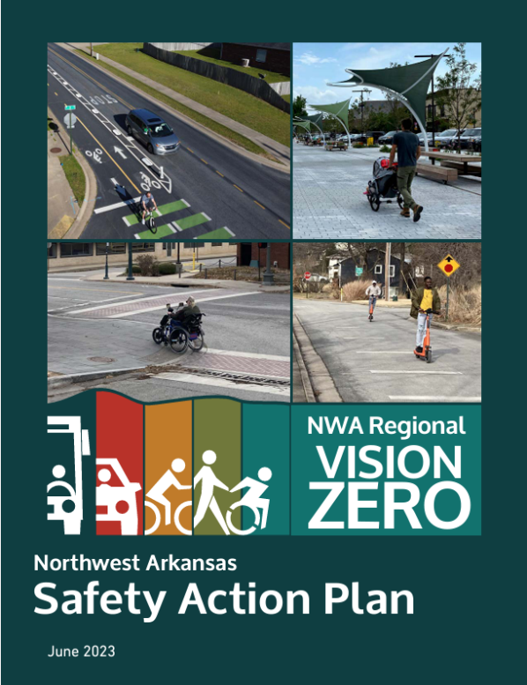
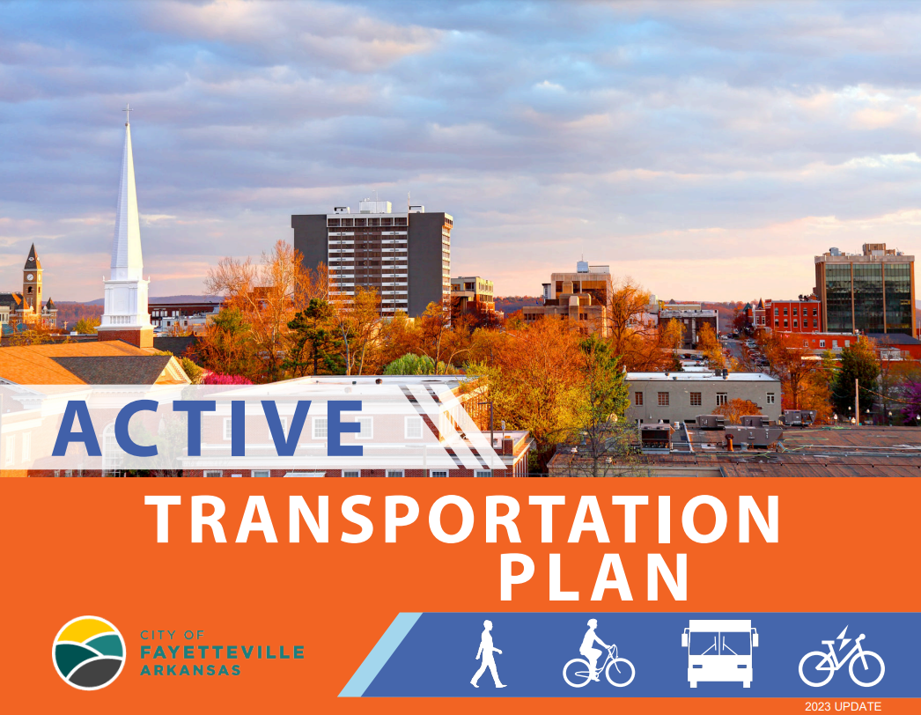
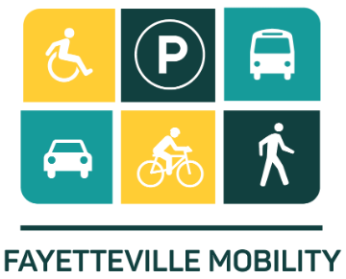
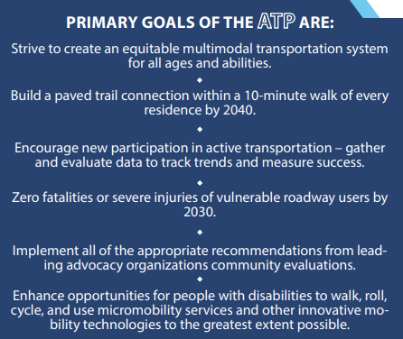


Comprehensive
Master Plans
Notes:
Power of Planning – Funding starts with a plan

Slide 4
Fayetteville 2018 Mobility Plan
Goals and Objectives
A transportation network that is safe for all users
A transportation network that emphasizes multi-modal mobility
A transportation system that promotes and supports economic growth and sustainability
A transportation network that is equitable
SS4A Grant Priorities from
U.S. DOT
Promote safety to prevent death and serious injuries on public roadways
Low-cost, high-impact safety strategies over a wide geographic area
Incorporate evidence-based projects and strategies and adopt innovative technologies and strategies;
Engagement with a variety of public and private stakeholders
Align with the DOT Strategic Goals safety; climate change, sustainability, equity, workforce development, job quality, and wealth creation
Notes:
Aligning City Goals with DOT SS4A Goals

Slide 5
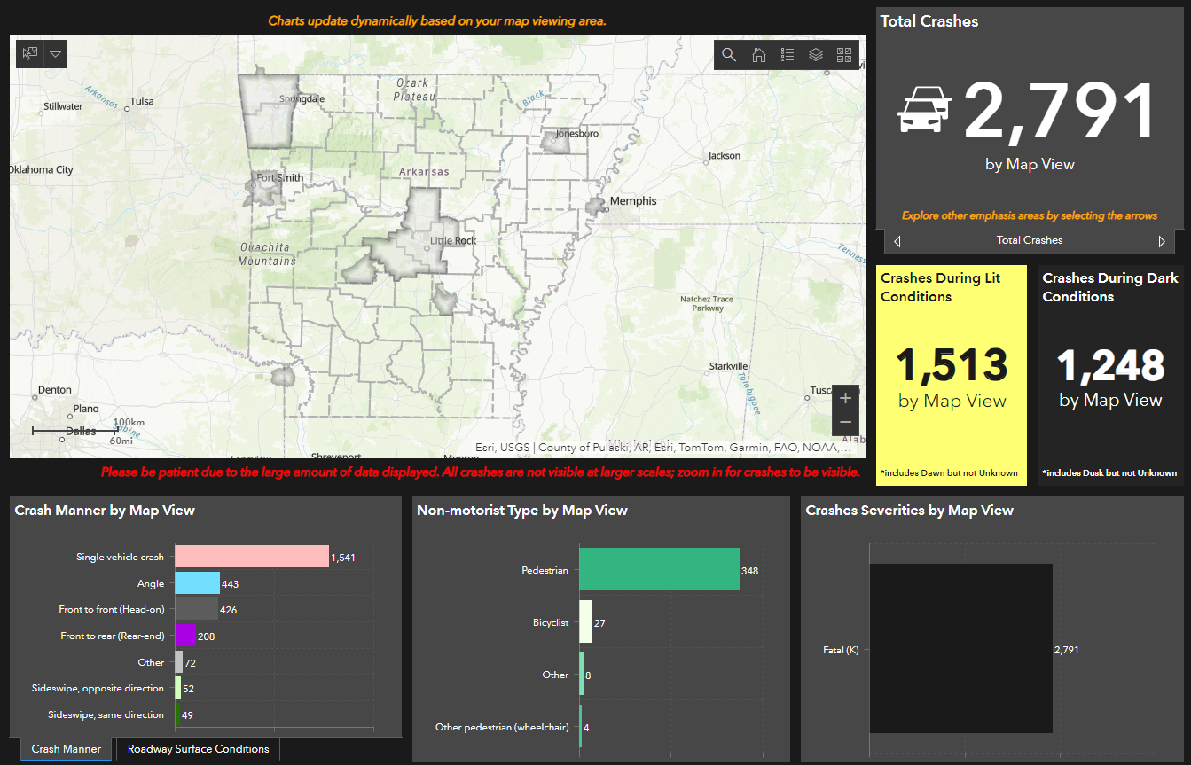
2018 to 2022 Arkansas Crash Analytics Tool (ACAT)
Total Fatalities
Fatalities
Fatalities
Notes:
Problem statement – Death and serious injury is unacceptable

Slide 6
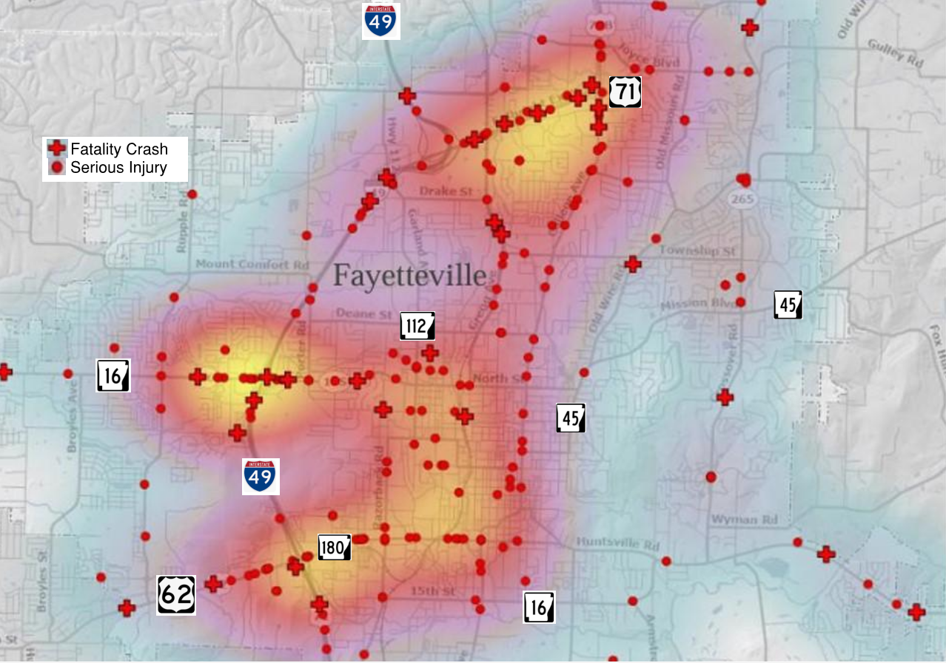
Fayetteville 2017-2021
41 Fatalities
Notes:
Most crashes occurring on state highways that have more volume but there are also design safety considerations. The improvements at Wedington will help prevent future fatalities and serious injuries

Slide 7
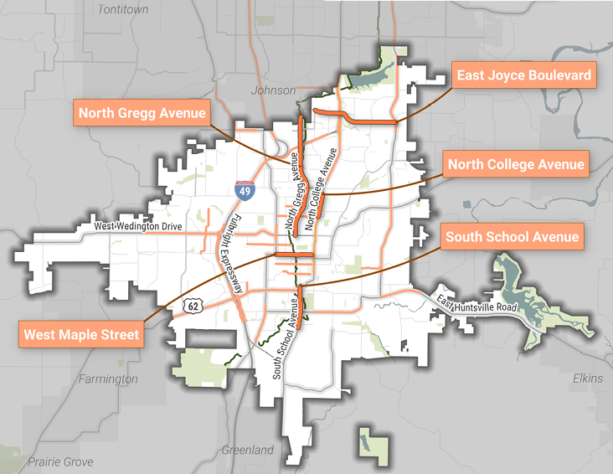
Fayetteville High Injury Network
Notes:
We focused on city streets in high injury network – not state highways to simplify process

Slide 8
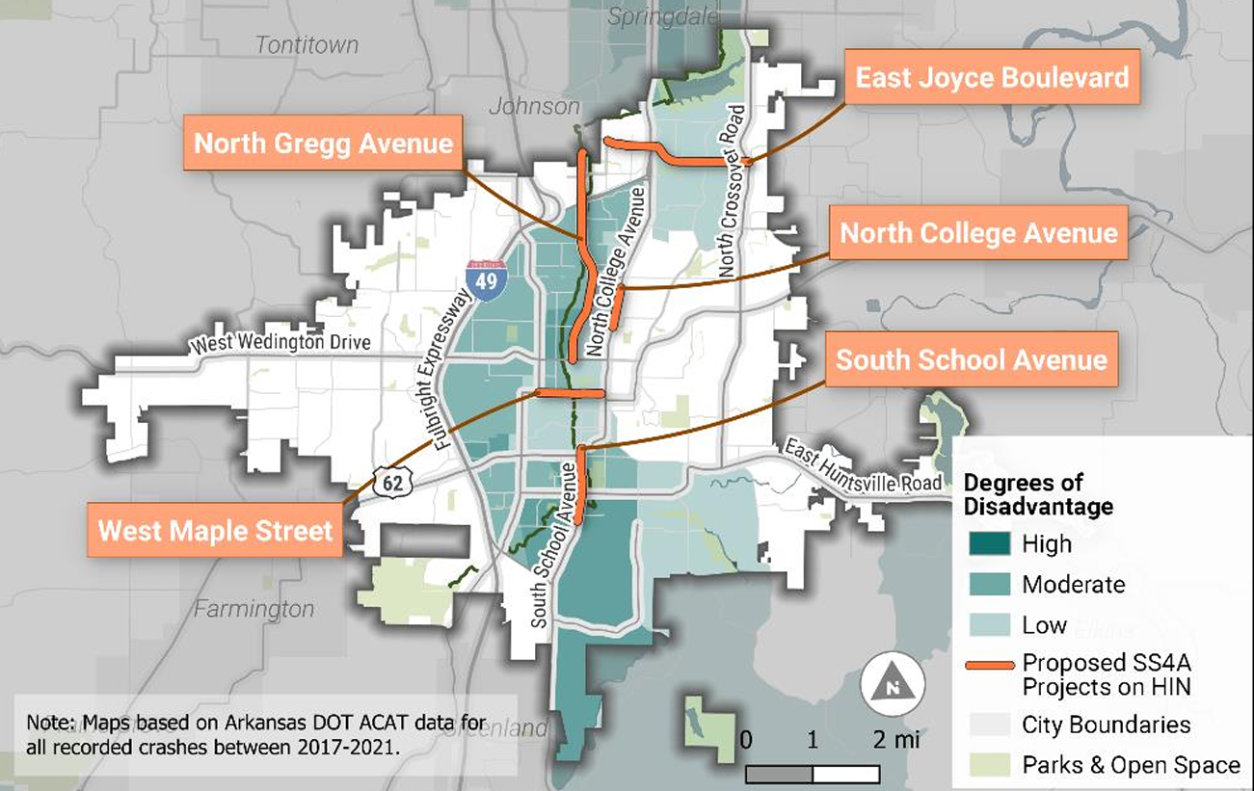
Fayetteville High Injury Network
Notes:
Focus on HIN streets that are also in the equity areas of need – this is important for Federal funding.

Slide 9
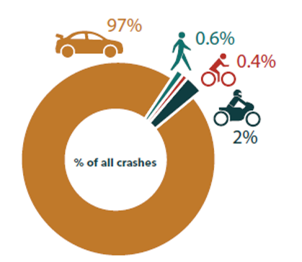
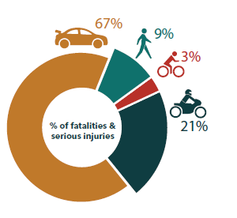

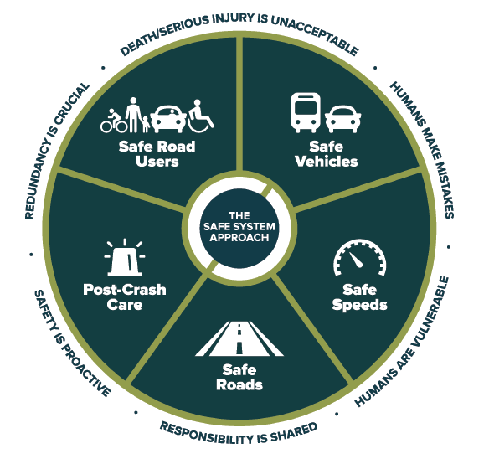
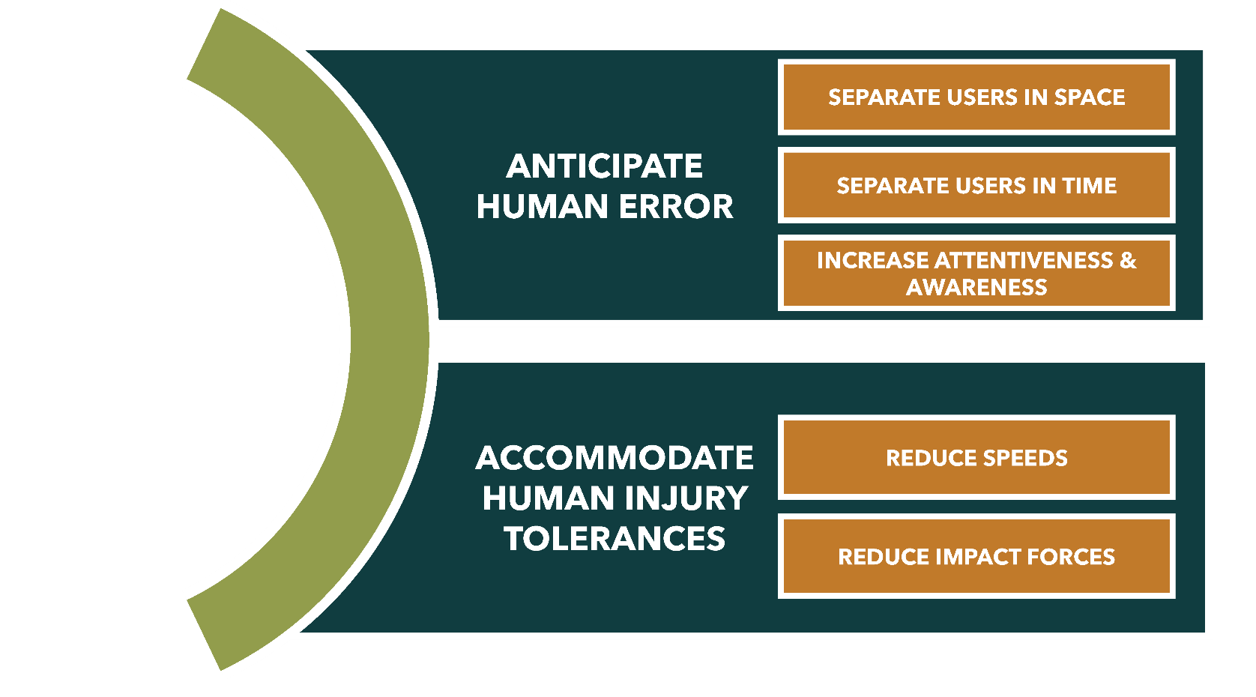
Pedestrian, bike and motorcycles are involved in 3% of crashes but represent in 33% of all fatalities & serious injuries in NWA

Slide 10
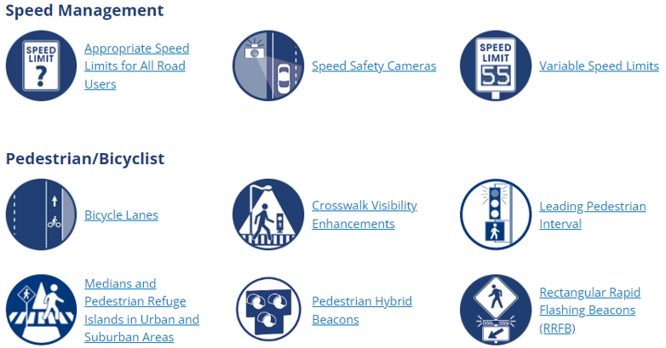
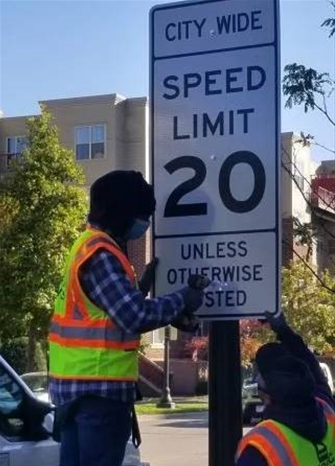


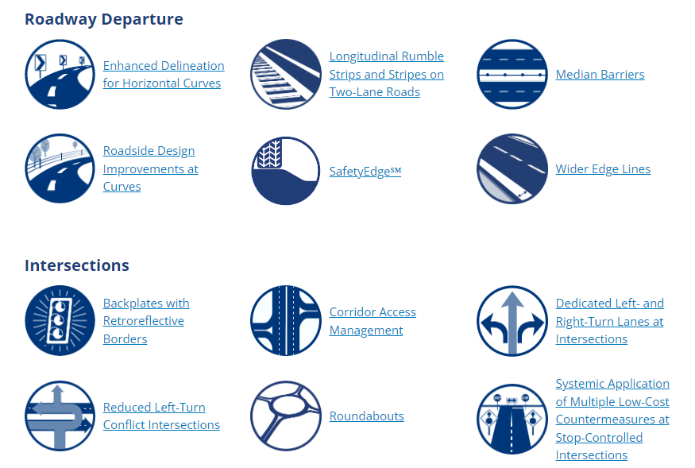
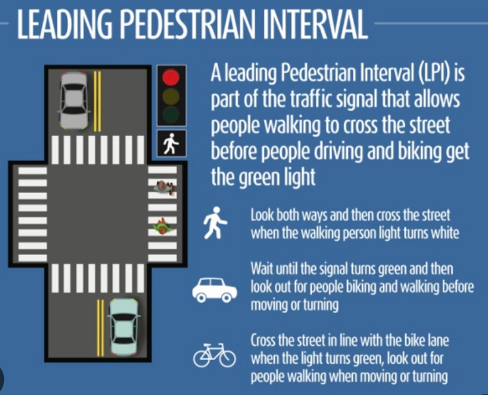
Proven Safety Countermeasures
Proven Safety Countermeasures

Slide 11
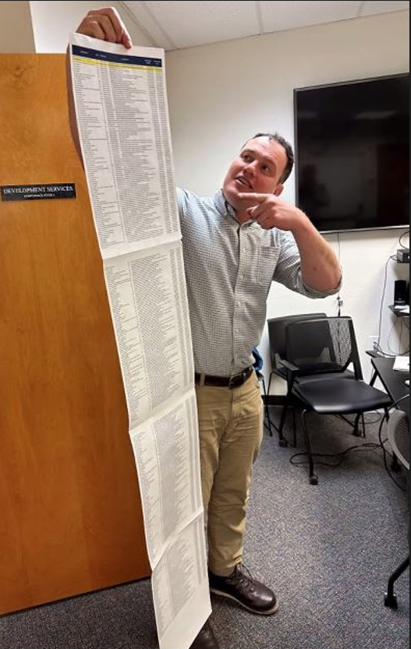
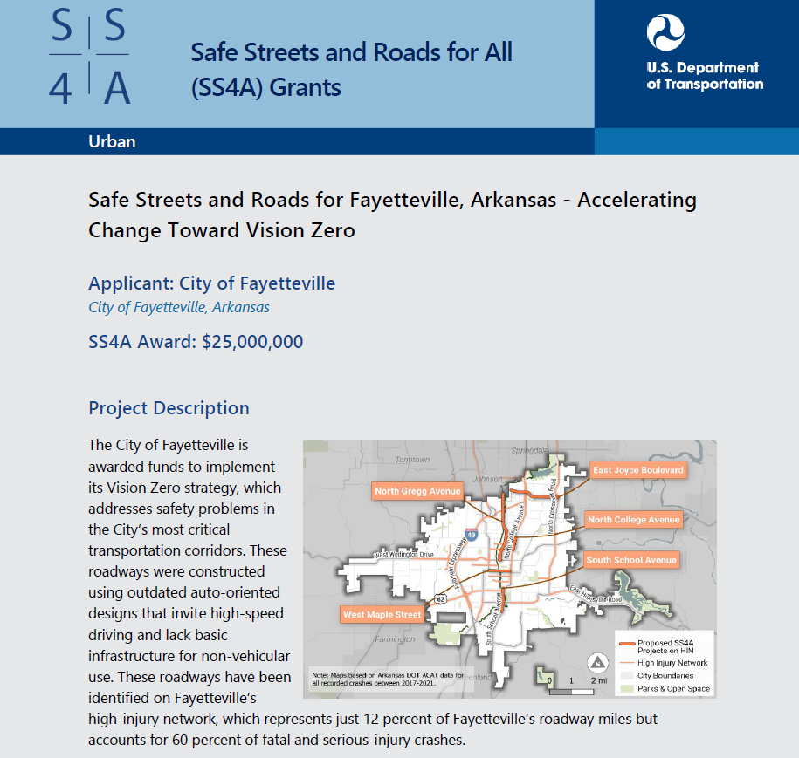

Slide 12
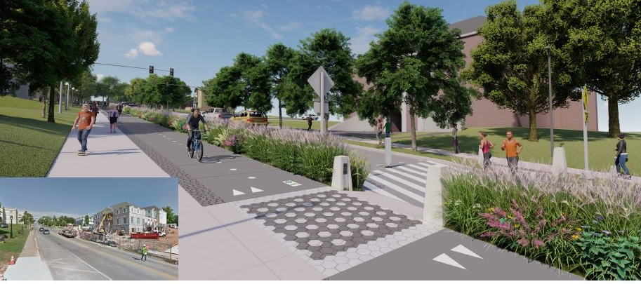
Maple Street
Razorback Greenway to Garland

Slide 13
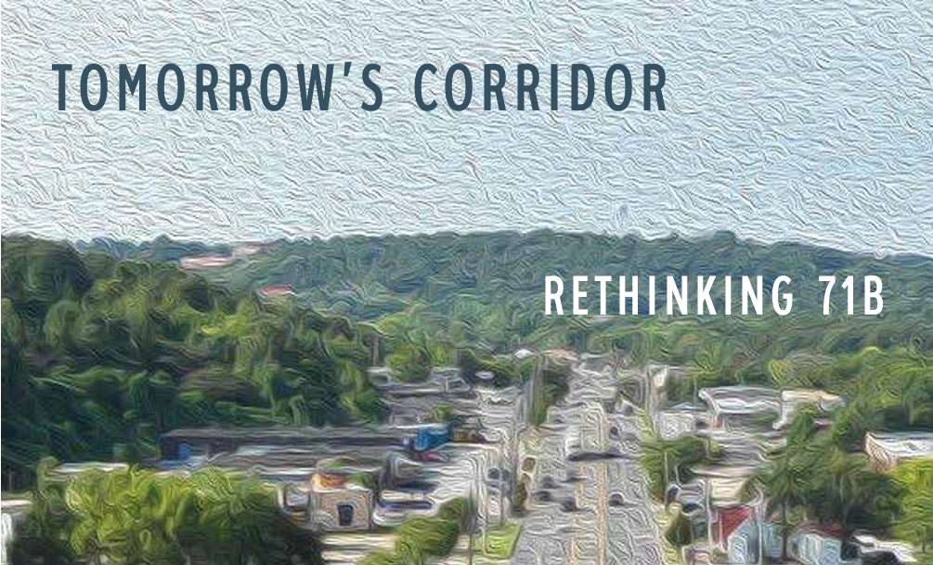
71B Corridor

Slide 14
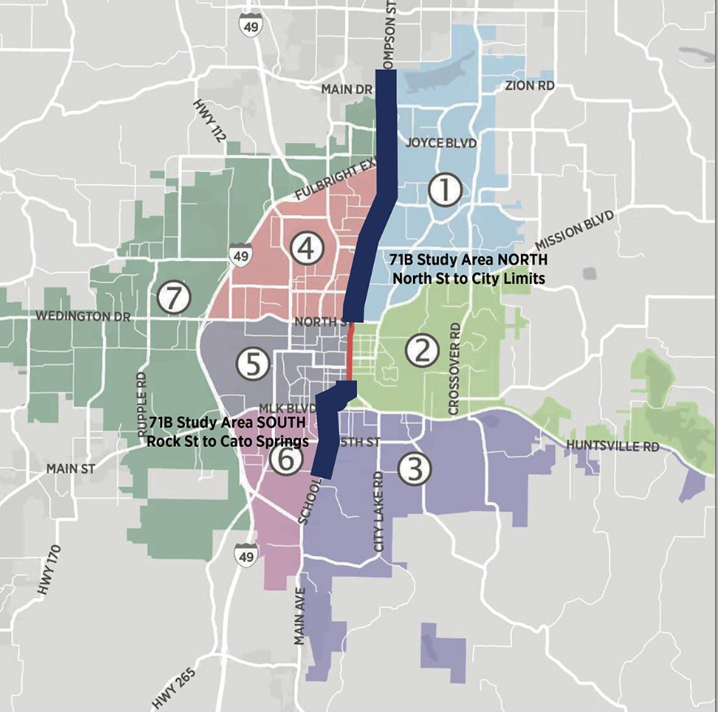
71B Corridor

Slide 15
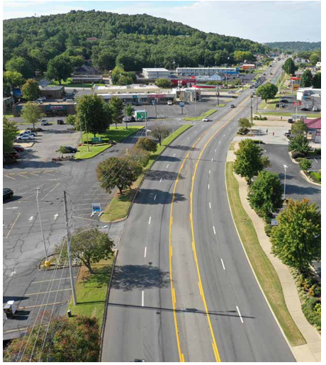
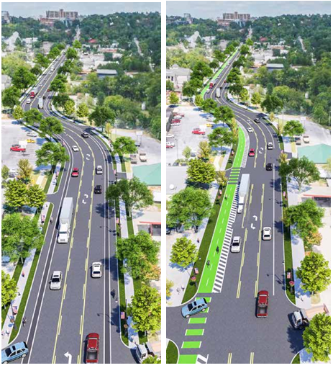
South School Avenue
MLK Jr. Blvd. to 15th Street
Existing Conditions
Proposed Road Diet

Slide 16
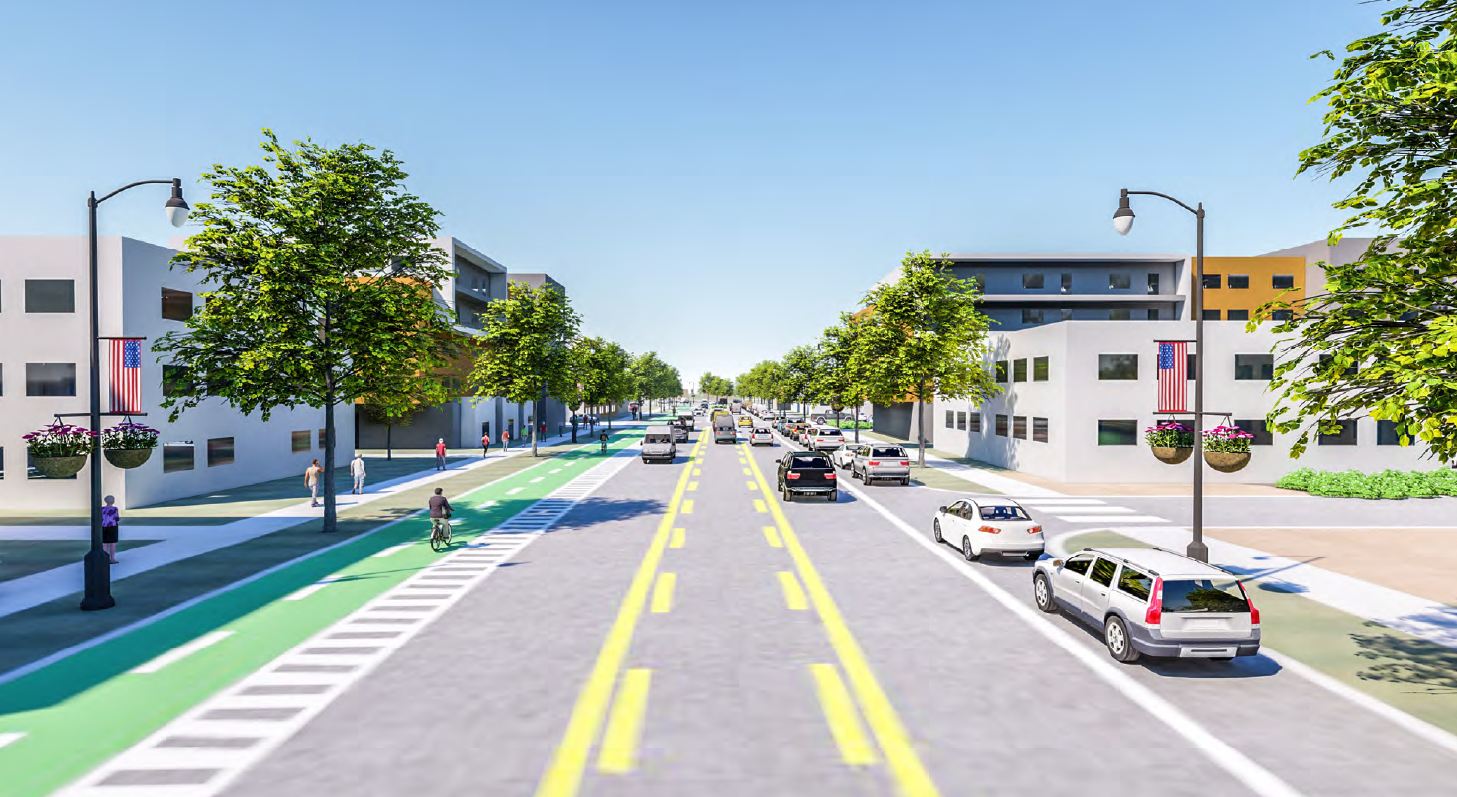
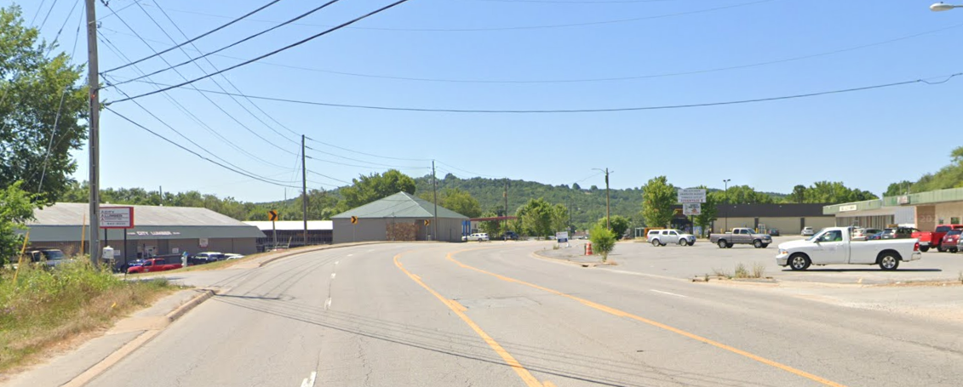
South School Avenue
MLK Jr. Blvd. to 15th Street
Proposed Improvements
Existing Conditions

Slide 17
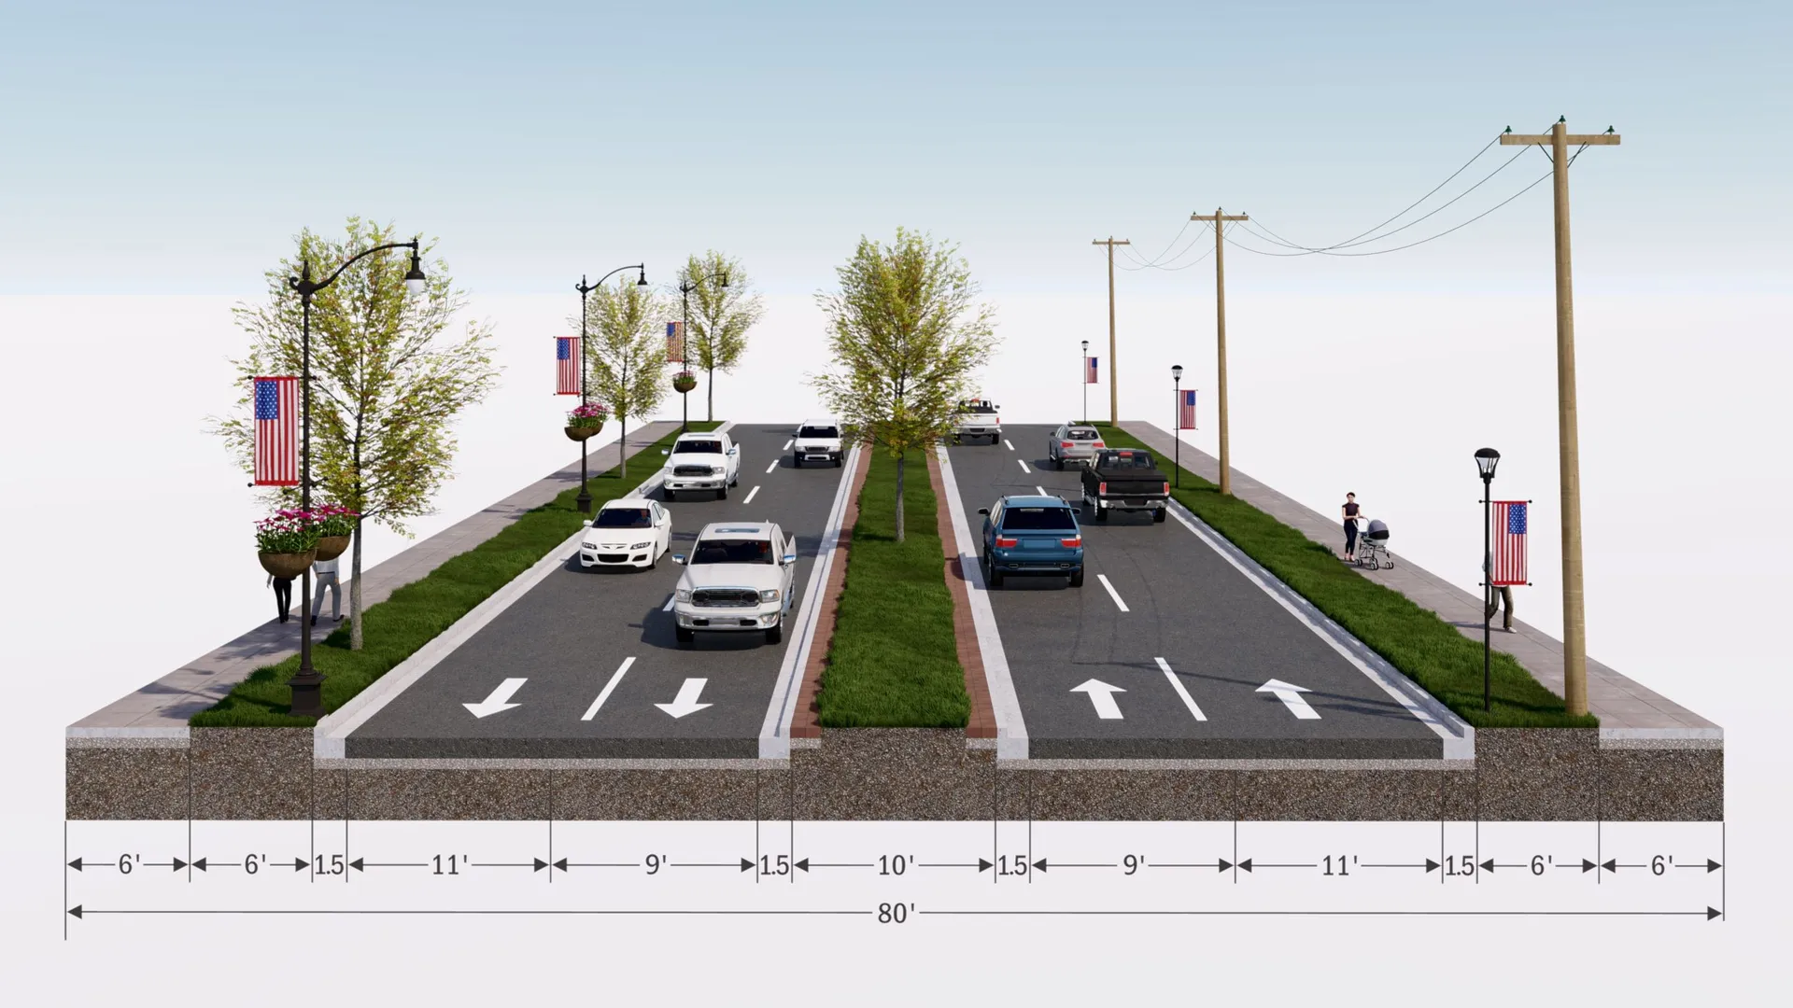
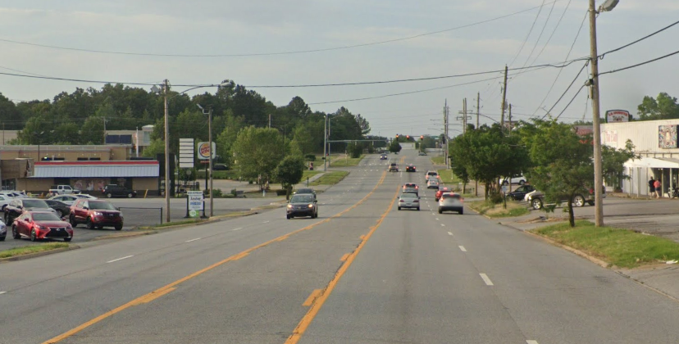
College Avenue
Sycamore to Township
College Avenue
Proposed Improvements
Existing Conditions

Slide 18
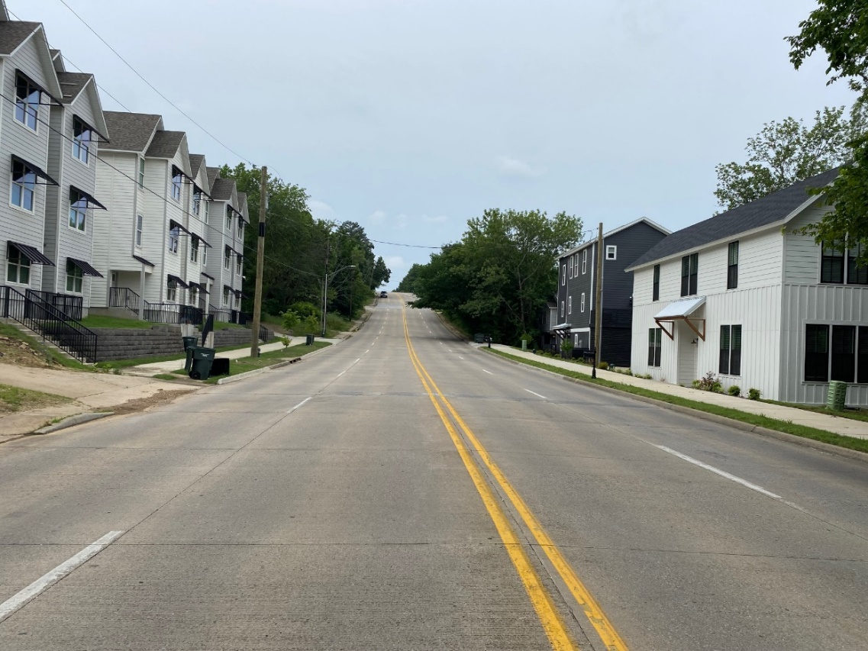
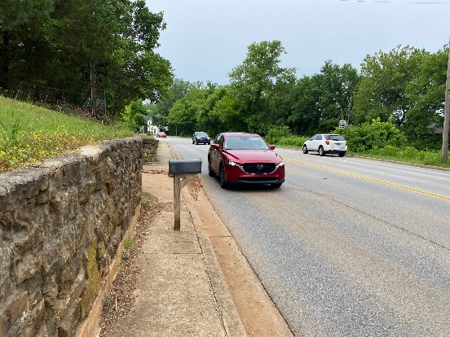
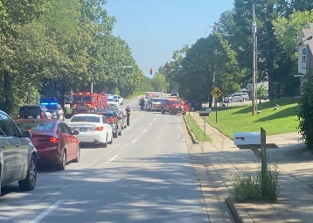
Existing Conditions
N. Gregg Ave.
North St. to Drake St.
Notes:
Considering a road diet to reduce to 3 lanes with parallel parking - Redevelopment need for parking

Slide 19
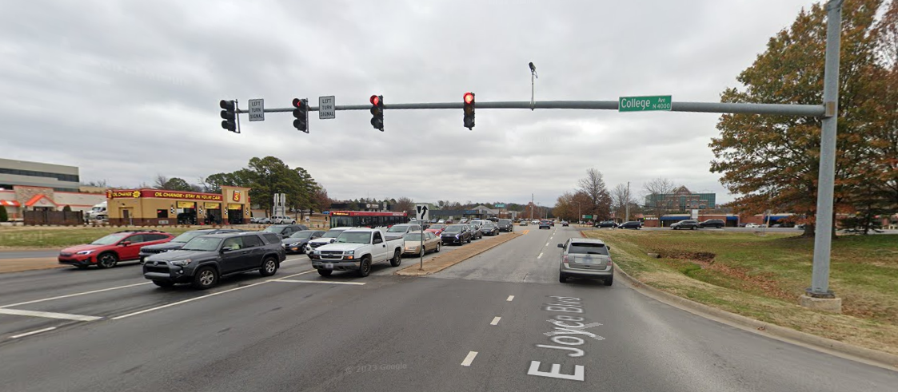
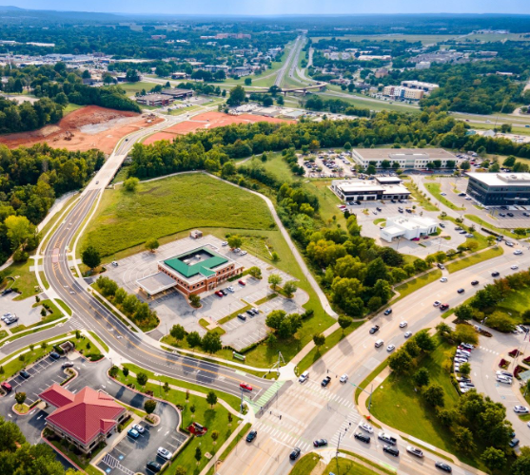
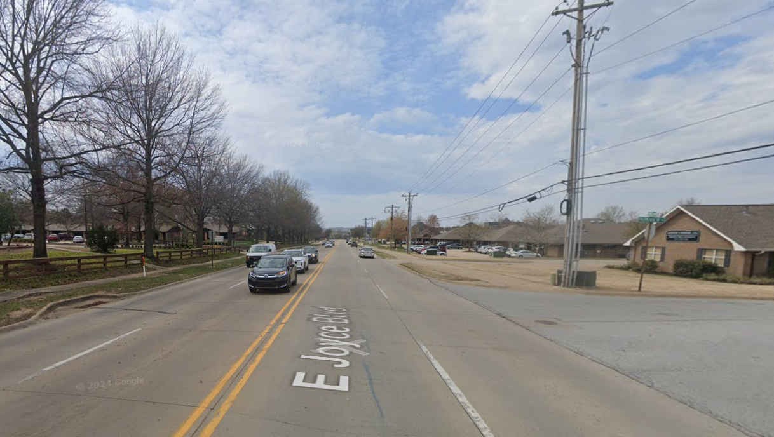
E. Joyce Blvd.
College Ave. to Crossover Rd. (Hwy 265)
Notes:
4-lane cross section

Slide 20
Funding Overview
Total cost: $33.5 million
Federal Funds: $25 million (75%)
Local Match: $8.5 million (25%)
City of Fayetteville $7.25 million
University of Arkansas $1.25 million

Slide 21
Project Summary Budget
Project | Area | Total Budget | Federal Funds | Local Matching Funds
N College Ave | Sycamore St to Township St | $12 million | $9 million | $3 million
S School Ave | MLK to 15th Street | $5 million | 3.75 million | $1.25 million
Maple St | Gregg Ave to Garland Ave | $10 million | $7.5 million | $2.5 million (City and UA)
Joyce Blvd | Hwy 71 to Crossover Rd | $3.5 million | $2.5 million | $1 million
Gregg Ave | North St to Drake St | $2.5 million | $1.875 million | $625,000
Education & Awareness | Community-wide | $500,000 | $375,000 | $125,000
Project Summary Budget

Slide 22
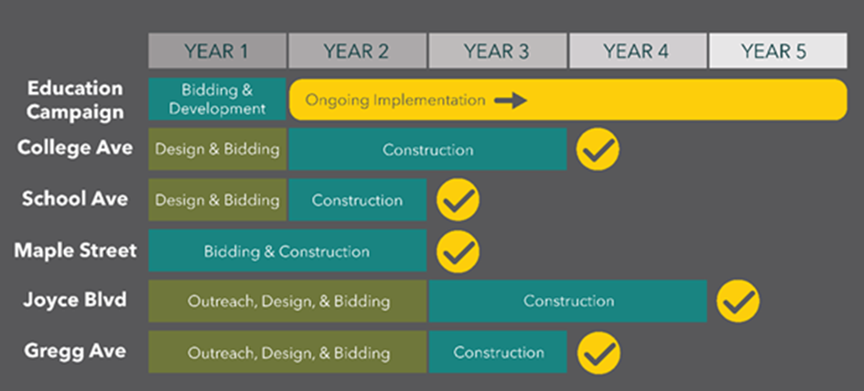
Project Schedule

Slide 23
Grant Preparation - Lessons Learned
Go for the maximum award amount – include multiple projects
Focus on the Notice Of Funding Opportunities (NOFO) Stay in the guidelines
Planning is powerful – Safety Action Plan & complementary comprehensive transportation master plans
Align application with the SS4A program goals
Have a grant writing team that includes passionate local advocates in addition to experienced grant writing professionals
Notes:
Like and open book test – NOFO We failed repetitively at RAISE – small project

Slide 24
Thank you!
Public Works Department Engineering Division , CITY OF FAYETTEVILLE

Slide 25
