Slide 1

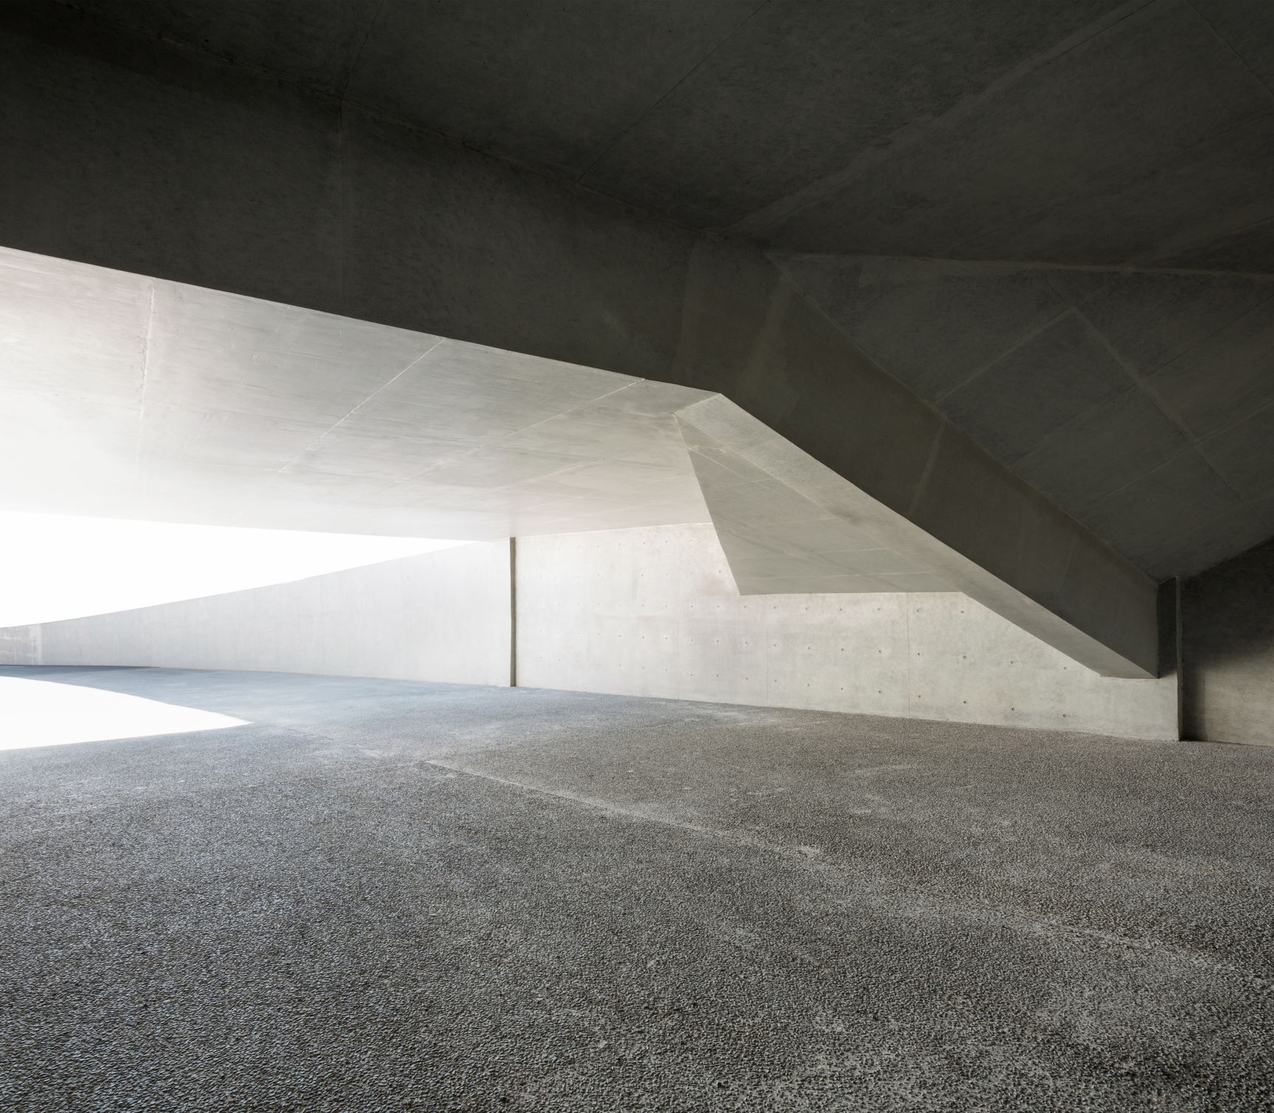
TRC 2203
Low Shrinkage Concrete Mixtures for Arkansas
Shuyah Ouoba
Cameron D. Murray, Ph. D., P. E.
Casey Jones, Ph. D, P. E.
Micah Hale, Ph. D., P. E.

Slide 2
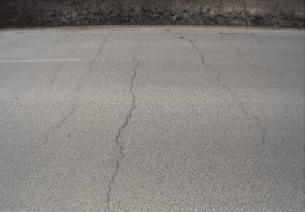
Background and Objectives
  Low resistance to freezing and thawing;
  Risk of reinforcement corrosion;
  Reduced service life.
Transverse cracking of concrete bridge deck (Vaitkus et al 2012)
  Objectives:
    Influence of Coarse Aggregates on the drying shrinkage in S(AE) concrete mixtures.
    Develop a low-shrinkage mixture adapted to materials found in Arkansas.
Department of Civil Engineering

Slide 3
Outline
Task 1
  Literature Review
Task 2
  Evaluation of Recent Bridge Decks
Task 3
  Standard mix and testing
  Development of Low Shrinkage mixtures
Task 4
  Development of Mixture Specifications for Local Aggregates
Task 5
  Development of Recommendations for Low-Shrinkage Concrete
Department of Civil Engineering

Slide 4

Task 1: Literature Review

Slide 5
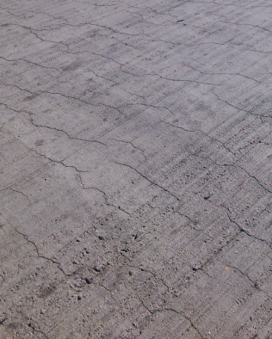
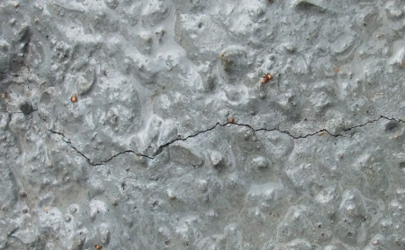
Shrinkage
Shrinkage: Volume reduction in concrete, due to loss of water and the chemical reactions taking place during the hydration process.
Autogenous Shrinkage
Plastic Shrinkage
Drying Shrinkage
Thermal Shrinkage
Carbonation Shrinkage
Autogenous Shrinkage cracks (Concrete Society 2024)
Plastic Shrinkage cracks (Sayahi 2019)
Thermal Shrinkage cracks (De Filippo 2014)
Department of Civil Engineering
Notes:
Autogenous shrinkage: Caused by the self-desiccation of concrete as water is consumed during the hydration process.
Plastic Shrinkage: resulting from water evaporation from the surface of freshly placed concrete
Drying shrinkage: Volume change resulting from loss of water after the concrete dries when exposed to the atmosphere;
Carbonation Shrinkage: occurring relatively later in the life of the concrete, when the concrete is left exposed to to air containing some dioxide of carbon

Slide 6
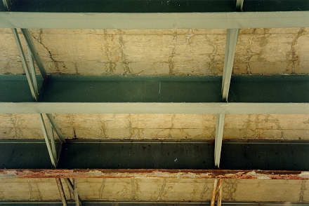

Shrinkage
Autogenous shrinkage
Thermal shrinkage
Drying shrinkage
Bottom view: Transverse Cracking on concrete bridge deck (ODOT 2008)
Department of Civil Engineering

Slide 7
Shrinkage: Causes
Design
Environmental
D
E
Restraints
Joints
Types of structure
Concrete Strength
Ambient Temperature
Concrete Temperature
Construction
Materials
C
M
Cement content
Water content
Admixtures
Aggregates
Curing Method
Curing Duration
Department of Civil Engineering
Aggregate bin – Gravel #57
Notes:
As Performance based requirements allowing flexibility for aggregate types can be more economical, maintain the required concrete properties and decrease the risk of shrinkage and therefore cracking in bridge decks

Slide 8

Task 2: Evaluation of Recent Bridge Decks

Slide 9
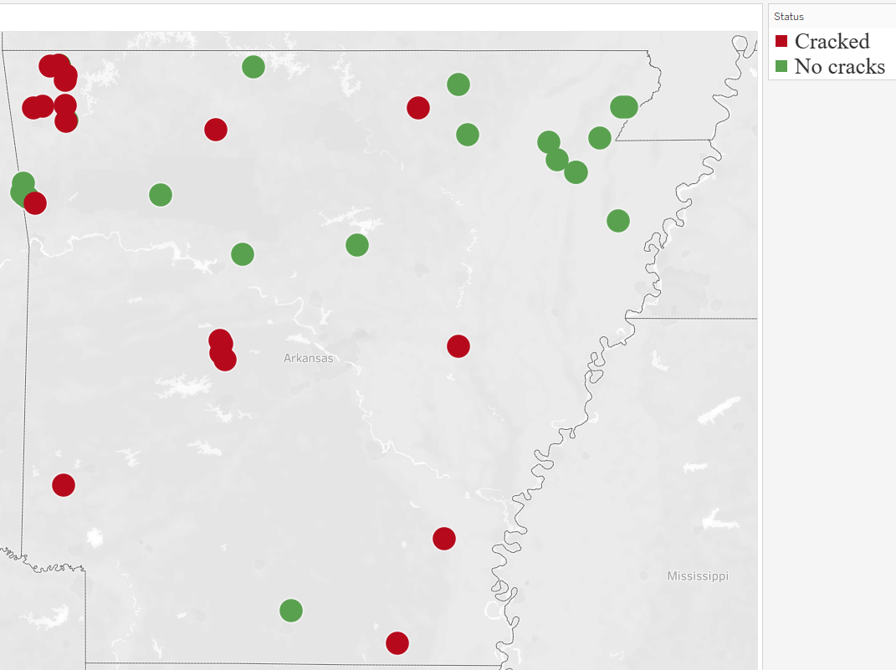
Evaluation of recent bridge decks
Location of surveyed bridges
Department of Civil Engineering
Notes:
There seems to be no spatial trend explaining the cracking of the bridges surveyed, as the bridges are distributed all over the map.

Slide 10
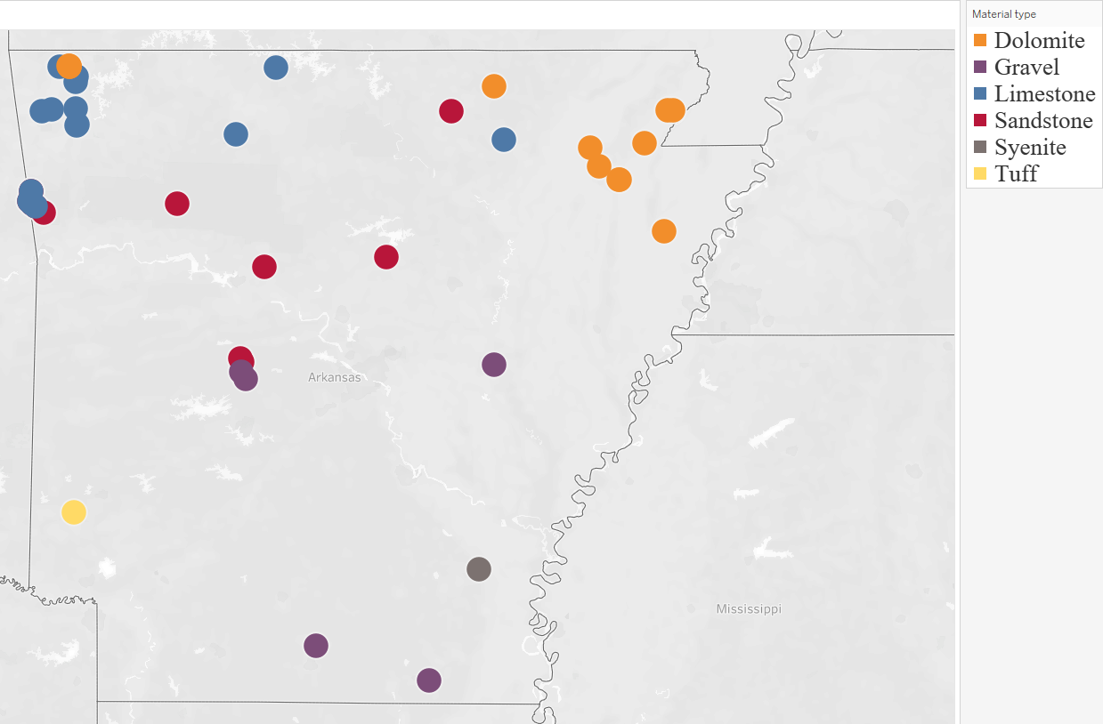
Evaluation of recent bridge decks
Rock Species | Usage
Dolomite | 13
Limestone | 13
Sandstone | 10
Gravel | 7
Syenite | 2
Tuff | 1
Distribution of aggregates used
Department of Civil Engineering
Notes:
Finally, we looked at the mineralogy of coarse aggregate used in the construction of the surveyed bridges.
The distribution shown on this map is in fact related to availability of the material, since local materials are preferred to reduce their transportation costs.

Slide 11
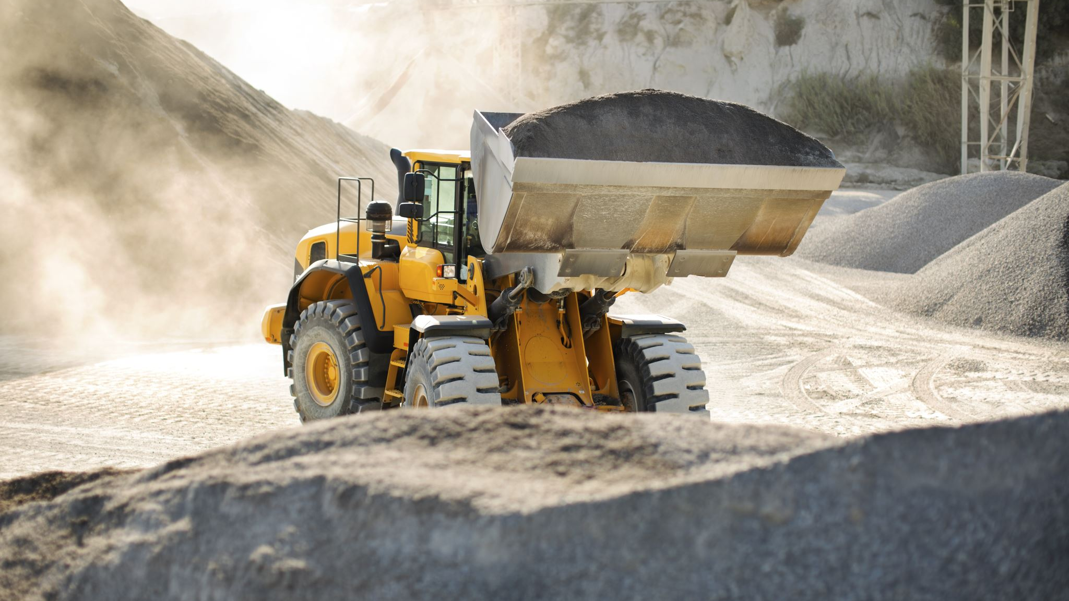
Task 3: Development of Low – Shrinkage Concrete Mixes

Slide 12
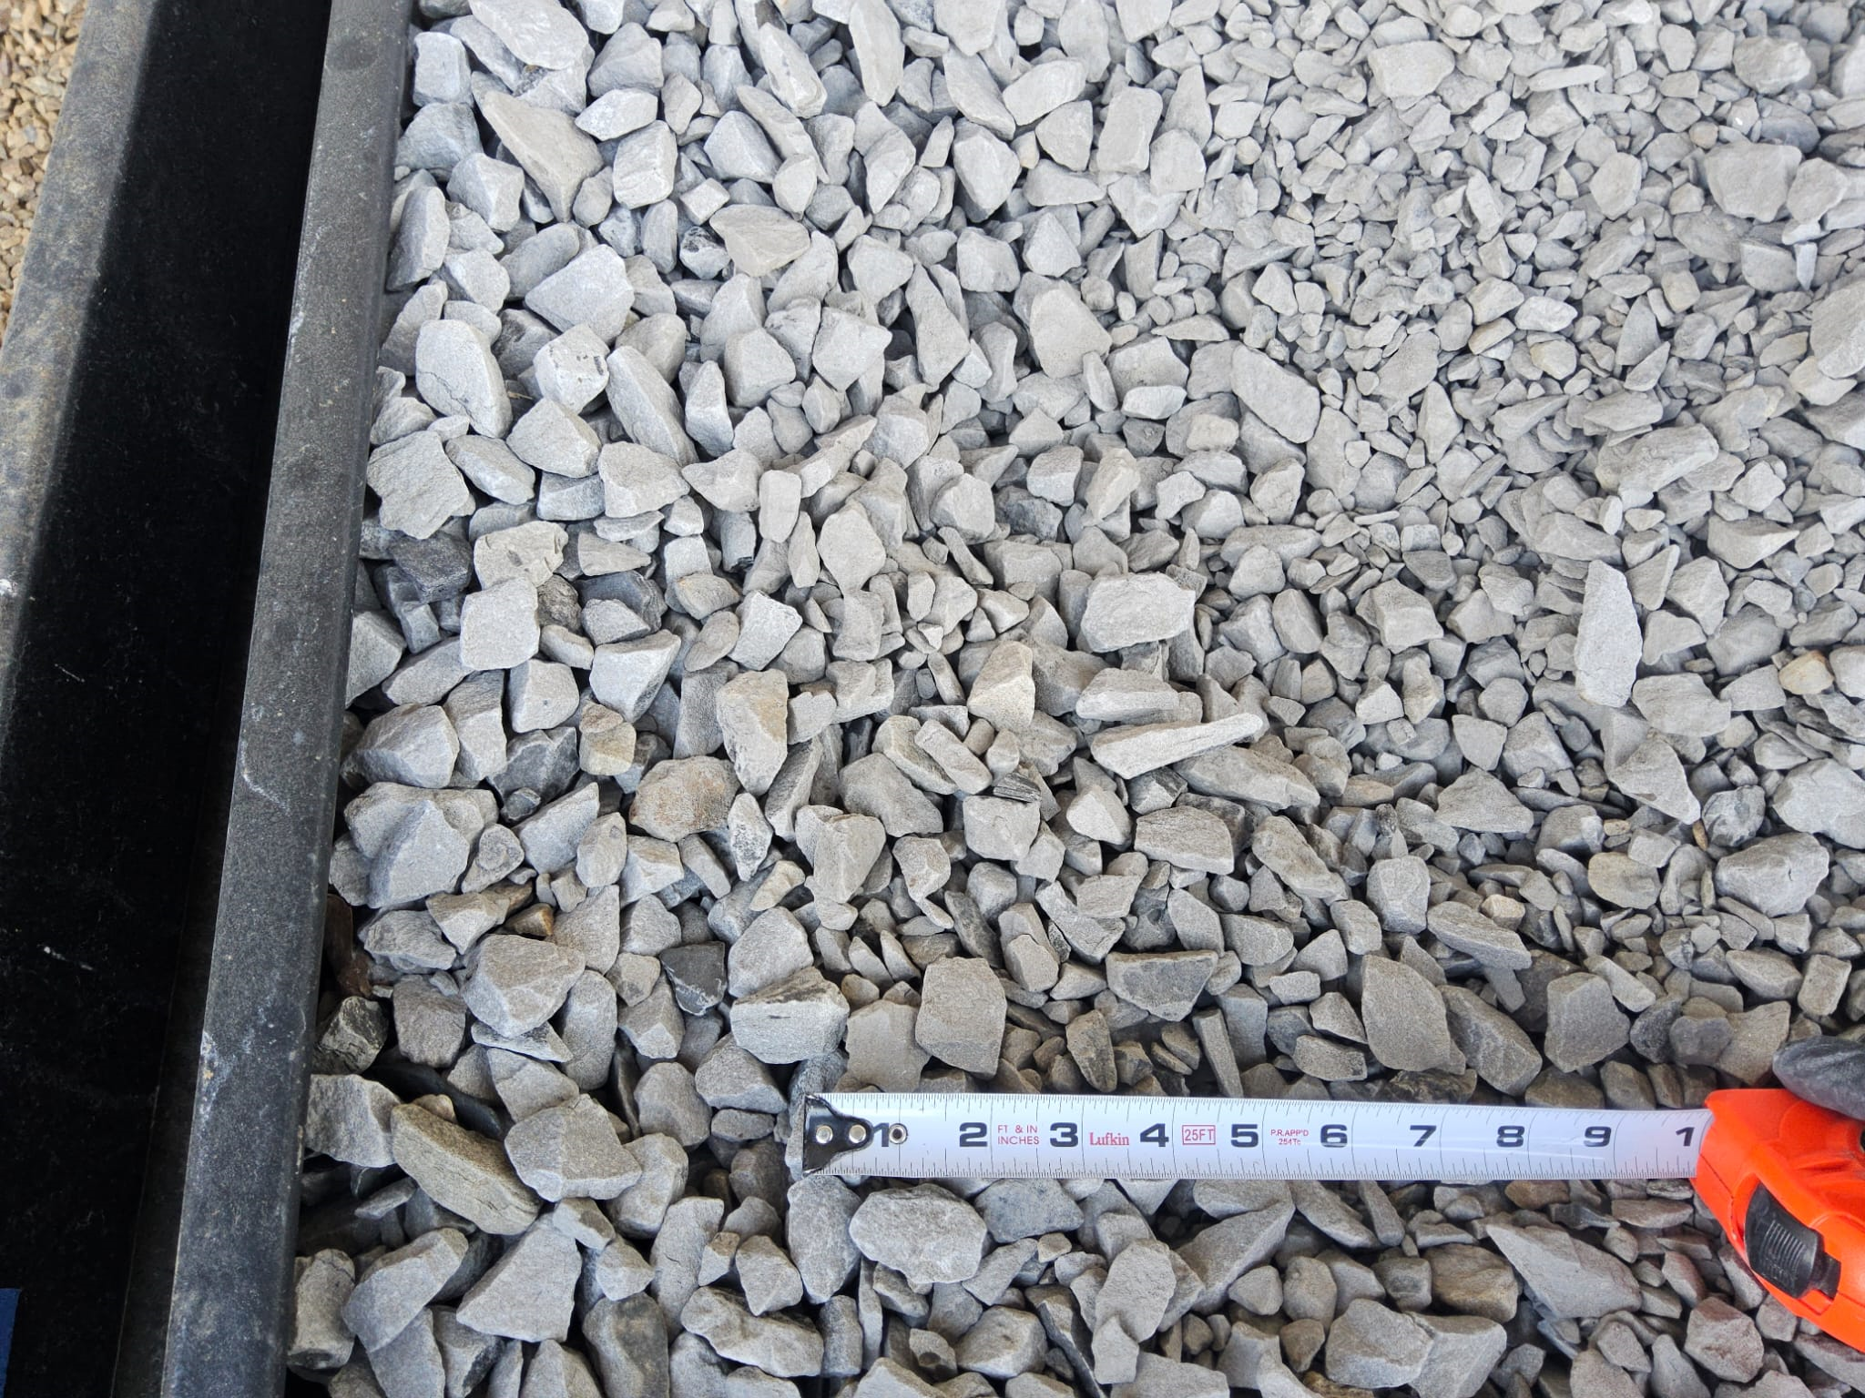
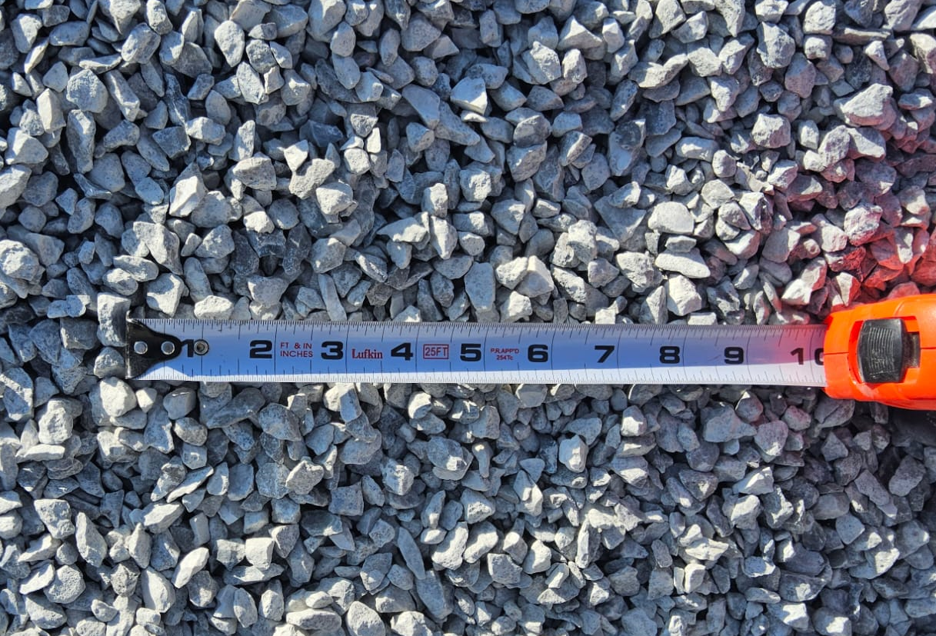
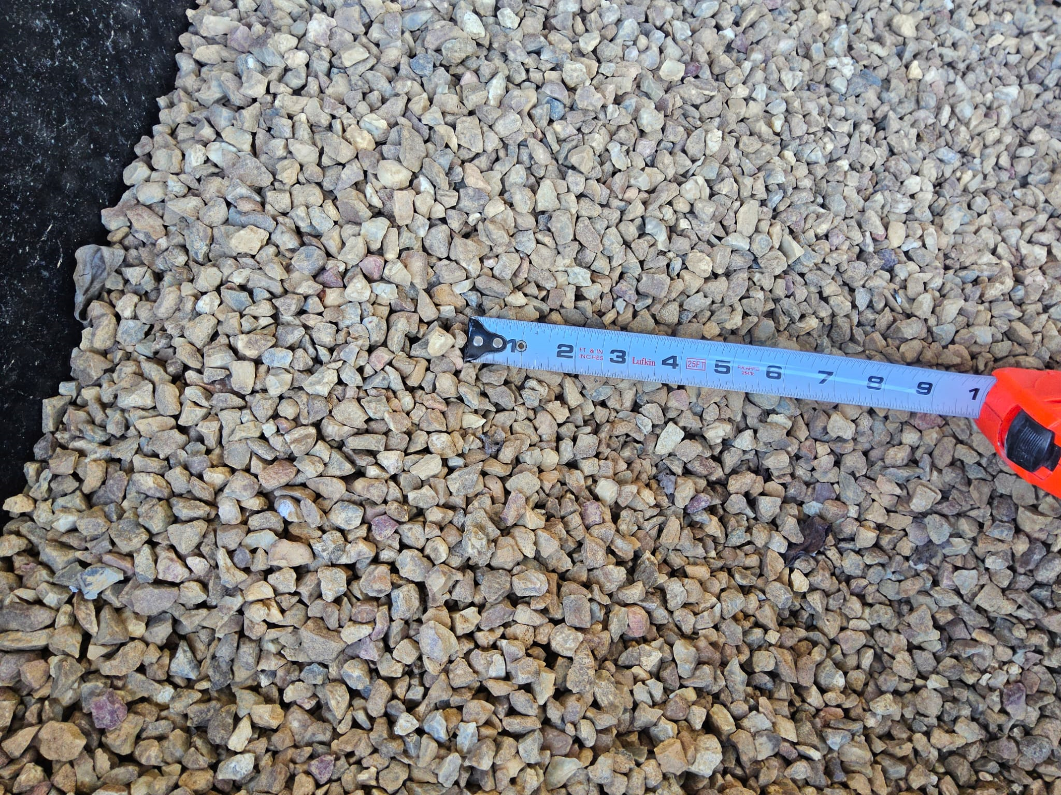
I. Design Approach
Coarse Aggregates:
Four Species
Limestone | Dolomite | Sandstone | Gravel
OR
#8
Two Gradations
AND
# 57
Chip class 2
Department of Civil Engineering

Slide 13

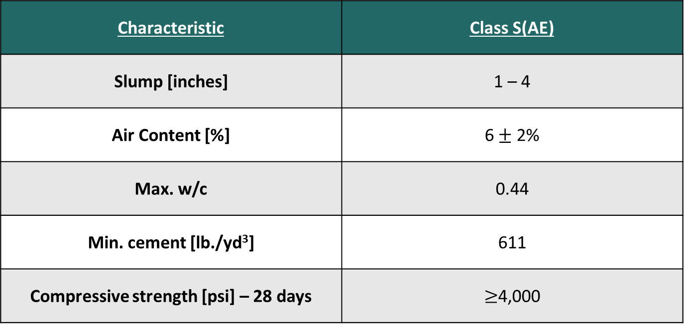
I. Design Approach
Design Approach
Characteristic | Class S(AE)
Slump [inches] | 1 – 4
Air Content [%] | 6$±$ 2%
Max. w/c | 0.44
Min. cement [lb./yd³] | 611
Compressive strength [psi] – 28 days | $≥$4,000
AHTD 2024
Department of Civil Engineering
Notes:
Concerning our design approach properly said, it is based on the requirements of the ARDOT Specifications for Air Entrained concrete, which specifies a slump of 1-4 inches, an air content of 6 + or – 2% and a compressive strength of at least 4000 psi at 28 days, among other things.

Slide 14
I. Design Approach
Standard S(AE)
Cement = 611 lb/yd³
Cement Reduced by 5.9%
Cement=575 lb/yd³
#57 + #8 Coarse Aggregates = 1850 lb/yd³
Cement Reduced by 15.4%
Cement=517 lb/yd³
#57 Coarse Aggregates = 1800 lb/yd³
#57 + #8 Coarse Aggregates = 1850 lb/yd³
Fly Ash substitution
Cementitious=517 lb/yd³ (20-30% Fly Ash)
#57 + #8 Coarse Aggregates = 1850 lb/yd³
Design Approach
6.5 bags of cement
5.5 bags of cement
6 bags of cement
5.5 bags of cementitious
Department of Civil Engineering

Slide 15
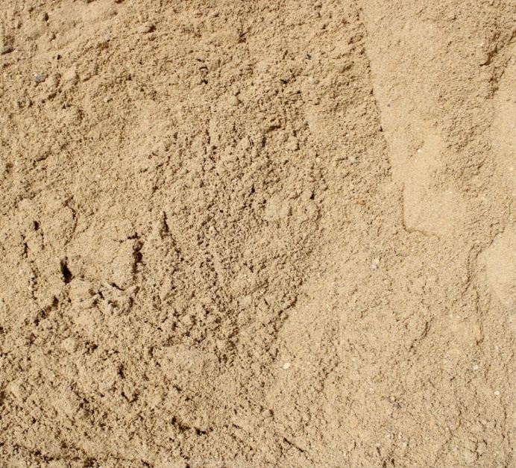
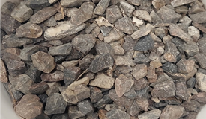
II. Methods
1. Optimization Method – Tarantula Curve
Department of Civil Engineering
Notes:
Aggregate gradation method showing excessive or lacking sieve sizes in combined gradation;
Combined amount of all rock+sand retained on each sieve as a percentage of the total aggregate.
Can also predict the workability and ease of finishing from the chart.

Slide 16

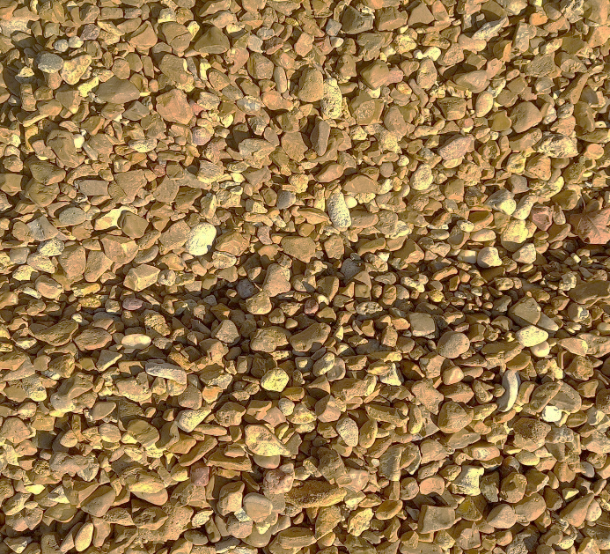
II. Methods
1. Optimization Method – Tarantula Curve
Standard S(AE) mix
Department of Civil Engineering

Slide 17

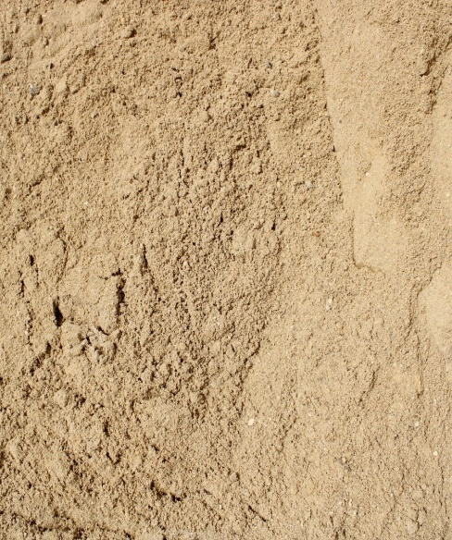
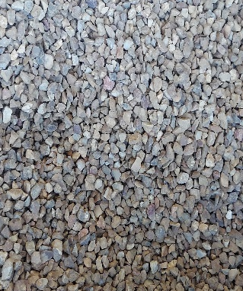
II. Methods
1. Optimization Method – Tarantula Curve
Optimized with 575 lb cement
Department of Civil Engineering

Slide 18

II. Methods
1. Optimization Method – Tarantula Curve
Optimized with 517 lb cement
Department of Civil Engineering

Slide 19
II. Methods
2. Shrinkage Testing – ASTM C157
Department of Civil Engineering
Notes:
We compare the change in length over original length to get a strain.

Slide 20
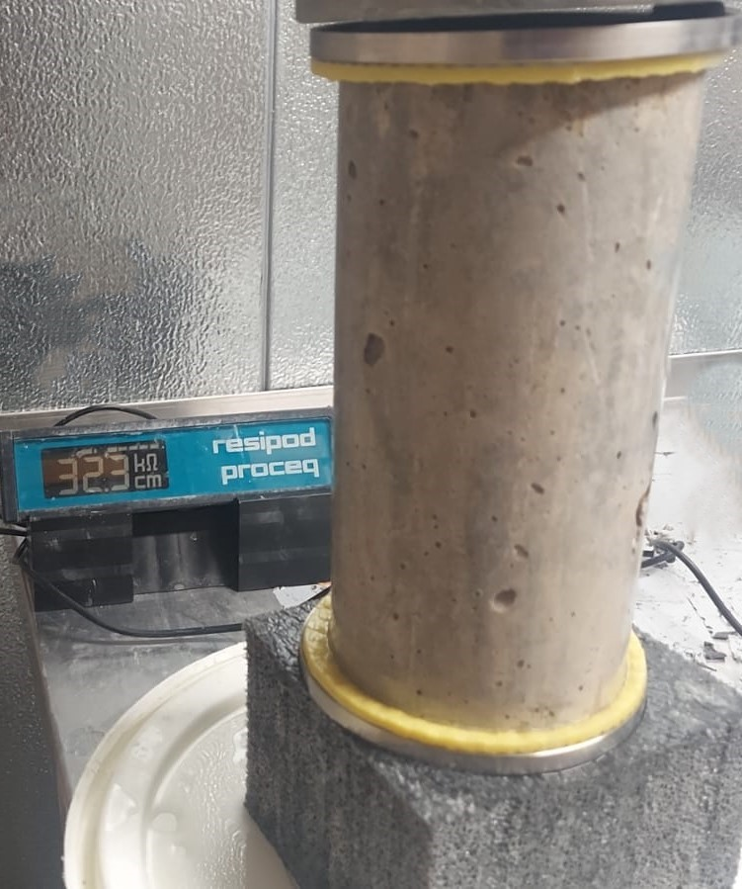

II. Methods
3. Electrical Bulk Resistivity – ASTM C1876
Source of Alternate current
Concrete sample
S
Electrode plate
Department of Civil Engineering
Notes:
This method assesses the ability of concrete to resist a chloride passage or flow of electrical current
Current is passed through the sample & measure the response voltage.
This test is a good indicator of the permeability of the concrete.

Slide 21
III. Results: Compressive Strengths
Standard S(AE)
Cement reduced by 5.9%
Cement reduced by 15.4%
Substitution with 20% F. A.
Substitution with 30% F. A.
Limestone
Sandstone
Dolomite
Gravel
Limestone
Sandstone
Dolomite
Gravel
Limestone
Sandstone
Dolomite
Gravel
Department of Civil Engineering
Notes:
Most mixes reached the design strength ${f′}_{c}=4,000 psi$ at 7 days;
By reducing the cement content by 15.4 % and optimizing the mix, the design strength requirement is still achieved

Slide 22
III. Results: Compressive Strengths
Standard S(AE)
Cement reduced by 5.9%
Cement reduced by 15.4%
Substitution with 20% F. A.
Substitution with 30% F. A.
Limestone
Dolomite
Gravel
Limestone
Dolomite
Gravel
Sandstone
Sandstone
Limestone
Sandstone
Dolomite
Gravel
Department of Civil Engineering
Notes:
Most mixes reached the design strength ${f′}_{c}=4,000 psi$ at 7 days;
By reducing the cement content by 15.4 % and optimizing the mix, the design strength requirement is still achieved

Slide 23
III. Results: Compressive Strengths
Standard S(AE)
Cement reduced by 5.9%
Cement reduced by 15.4%
Substitution with 20% F. A.
Substitution with 30% F. A.
Limestone
Sandstone
Gravel
Limestone
Sandstone
Dolomite
Gravel
Dolomite
Limestone
Sandstone
Dolomite
Gravel
Department of Civil Engineering
Notes:
Most mixes reached the design strength ${f′}_{c}=4,000 psi$ at 7 days;
By reducing the cement content by 15.4 % and optimizing the mix, the design strength requirement is still achieved

Slide 24
III. Results: Compressive Strengths
Standard S(AE)
Cement reduced by 5.9%
Cement reduced by 15.4%
Substitution with 20% F. A.
Substitution with 30% F. A.
Limestone
Sandstone
Dolomite
Gravel
Limestone
Sandstone
Dolomite
Gravel
Limestone
Sandstone
Dolomite
Gravel
Department of Civil Engineering
Notes:
Most mixes reached the design strength ${f′}_{c}=4,000 psi$ at 7 days;
By reducing the cement content by 15.4 % and optimizing the mix, the design strength requirement is still achieved

Slide 25
III. Results: Shrinkage
Aggregate Type: Limestone
Department of Civil Engineering

Slide 26
III. Results: Shrinkage
Aggregate Type: Sandstone
Department of Civil Engineering

Slide 27
III. Results: Shrinkage
Aggregate Type: Dolomite

Slide 28
III. Results: Shrinkage
Aggregate Type: Gravel

Slide 29
III. Results: Shrinkage
Aggregate Type: Trap Rock

Slide 30
III. Results: Shrinkage
Shrinkage andAggregate Type at 84 days
Notes:
We also compare the drying shrinkage values at 84 days, and considering the limestone shrinkage as our baseline, we see that sandstone is shrinking 83% more than limestone, followed by the gravel (40%), dolomite and finally trap rock.

Slide 31
III. Results: Electrical Bulk Resistivity
Standard S(AE)
Cement reduced by 5.9%
Cement reduced by 15.4%
Substitution with 20% F. A.
Substitution with 30% F. A.
Limestone
Sandstone
Dolomite
Gravel
Trap Rock
Electrical Bulk Resistivity at 90 Days
Notes:
Bulk Resistivity increases over time here only the results at 90 days are shown, and Higher resistivity means better resistance to fluid penetration.
There is a threshold of 50 Ω.m, meaning that any resistivity below that puts the concrete at a high risk of corrosion, and above that value, the concrete is in the moderate to low risk of corrosion zone, which is preferable. In our case, after 3 months, all our concrete was in the moderate to low risk of corrosion zone.

Slide 32
III. Results: Electrical Bulk Resistivity
Bulk Resistivity and Combined Aggregates Absorption
Department of Civil Engineering

Slide 33

Conclusions
Optimizing the mixture gradation reducing the cement content
Design Specifications
Combined Aggregates Absorption
Electrical Bulk Resistivity
Drying Shrinkage
Aggregate Types
Bridge Deck Curing to Decrease Shrinkage
Department of Civil Engineering
Notes:
It has been found that decreasing the cement content in concrete by 5.9% and 15.4% while optimizing the mixture gradation does not affect the properties of the concrete and still meets the design specifications.
Initial findings suggest that there is a connection between the electrical resistivity and the water absorption of the combined aggregates.

Slide 34
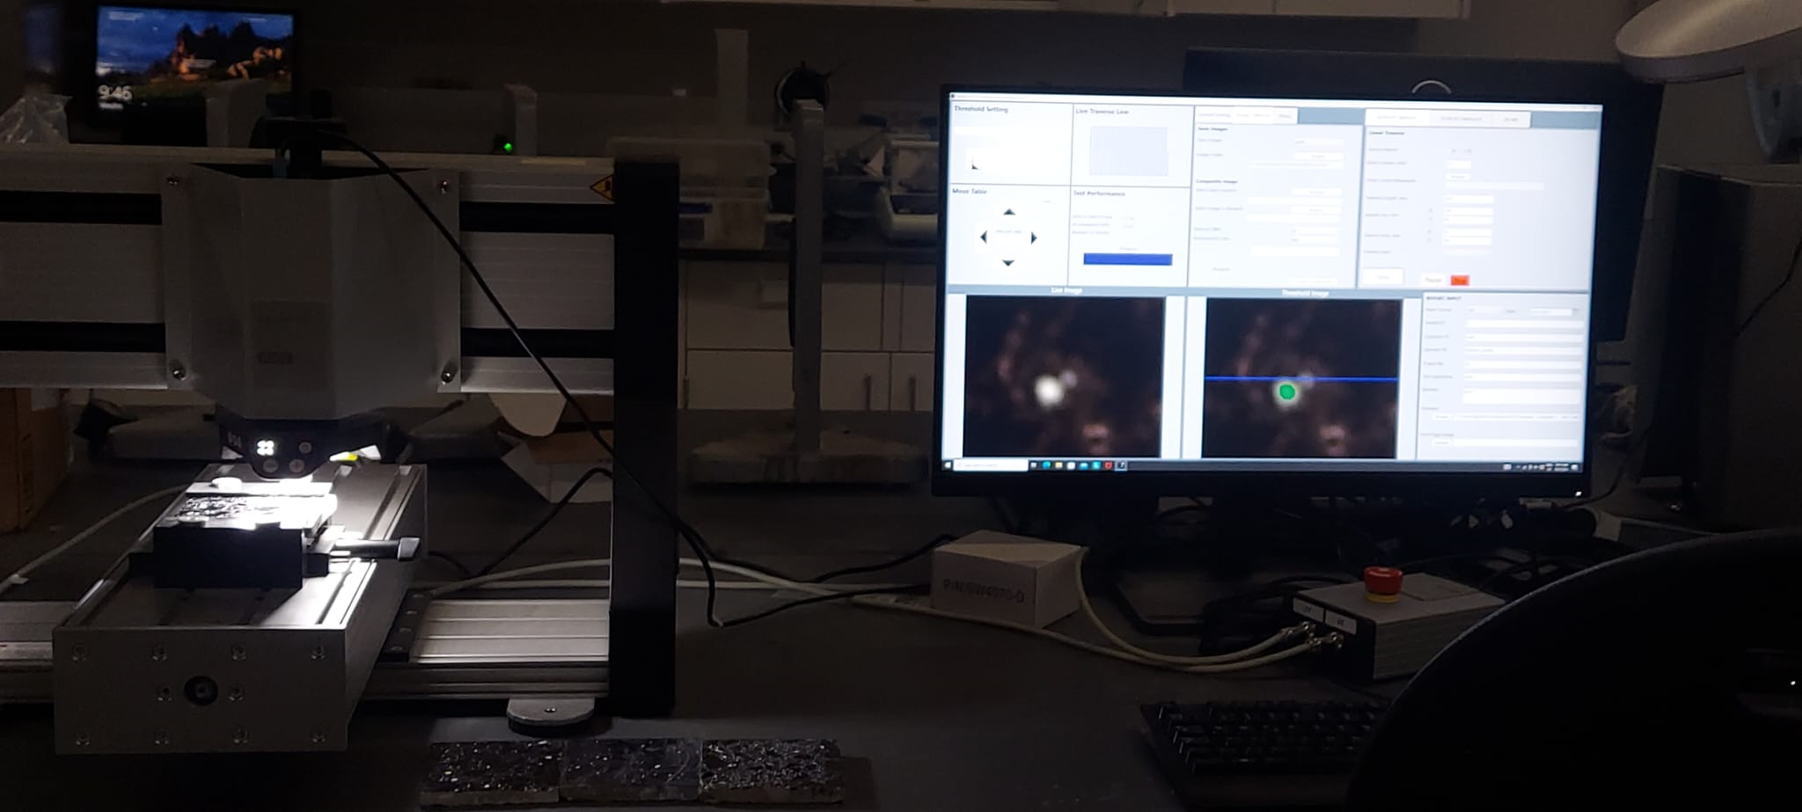
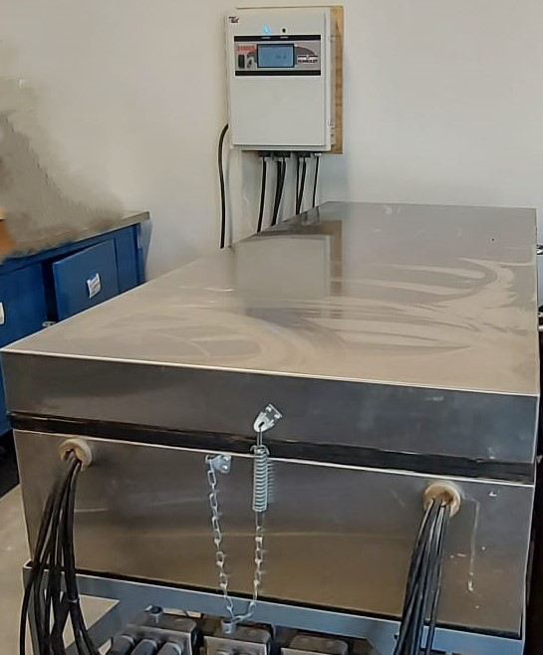
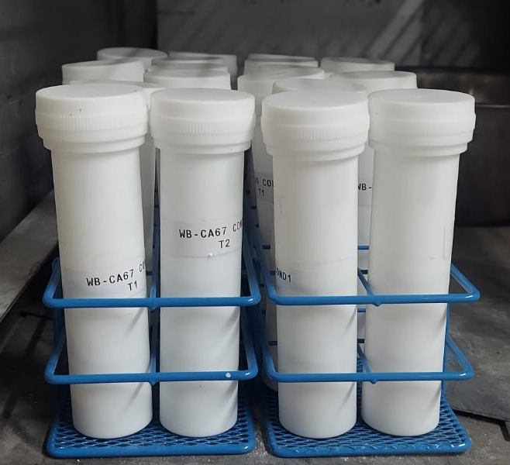
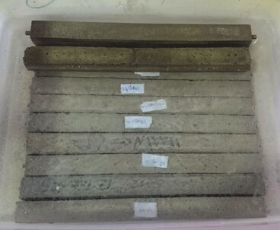

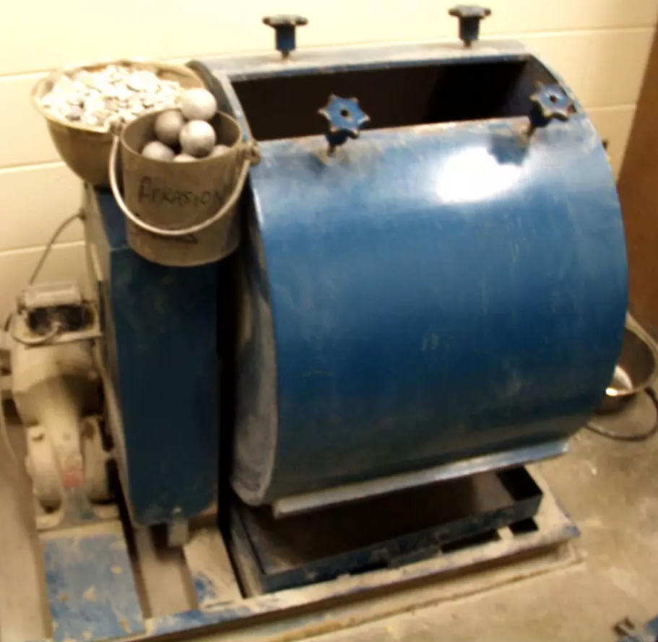
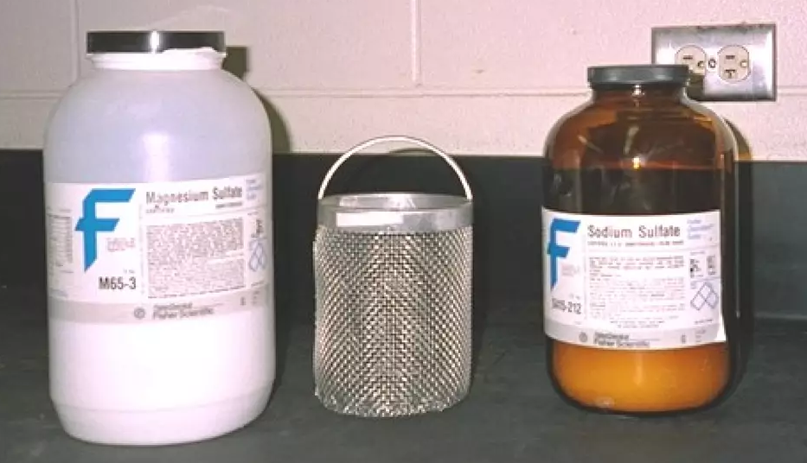
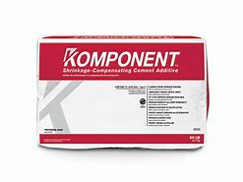
Future Work
Concrete Durability
Low-Shrinkage concrete mixes
Aggregates
Low-Shrinkage Concrete and Design Specifications
Department of Civil Engineering

Slide 35





Acknowledgments
Department of Civil Engineering

Slide 36

Questions?
Shuyah Ouoba
souoba@uark.edu
Dr. Cameron Murray (P.I.)
cdmurray@uark.edu

